Slide 1
Secondary Sort
Problem: Sorting on values
E.g. Reverse graph edge directions & output in node order
  Input: adjacency list of graph (3 nodes and 4 edges)
    (3, [1, 2]) (1, [3])
    (1, [2, 3]) ➔ (2, [1, 3])
    (3, [1])
Note, the node_ids in the output values are also sorted.
But Hadoop only sorts on keys!
Solution: Secondary sort
Map
  In: (3, [1, 2]), (1, [2, 3]).
  Intermediate: (1, [3]), (2, [3]), (2, [1]), (3, [1]). (reverse edge direction)
  Out: (<1, 3>, [3]), (<2, 3>, [3]), (<2, 1>, [1]), (<3, 1>, [1]).
  Copy node_ids from value to key.
1
2
1
2
➔
3
3
© 2010, Le Zhao
Notes:
What a hack! Would be better if sort can access value as well as keys.

Slide 2
Secondary Sort
Secondary Sort (ctd.)
Shuffle on Key.field1, and Sort on whole Key (both fields)
  In: (<1, 3>, [3]), (<2, 3>, [3]), (<2, 1>, [1]), (<3, 1>, [1])
  Out: (<1, 3>, [3]), (<2, 1>, [1]), (<2, 3>, [3]), (<3, 1>, [1])
Grouping comparator
  Merge according to part of the key
  Out: (<1, 3>, [3]), (<2, 1>, [1, 3]), (<3, 1>, [1])
  this will be the reducer’s input
Reduce
  Merge & output: (1, [3]), (2, [1, 3]), (3, [1])
© 2010, Le Zhao

Slide 3
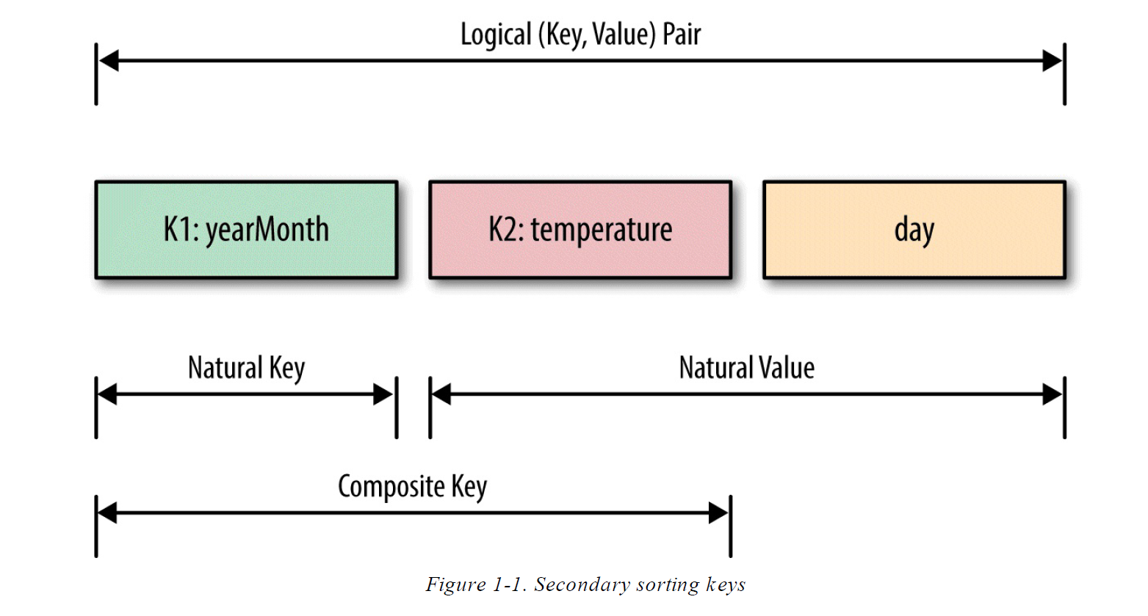
Example
© 2010, Jamie Callan

Slide 4
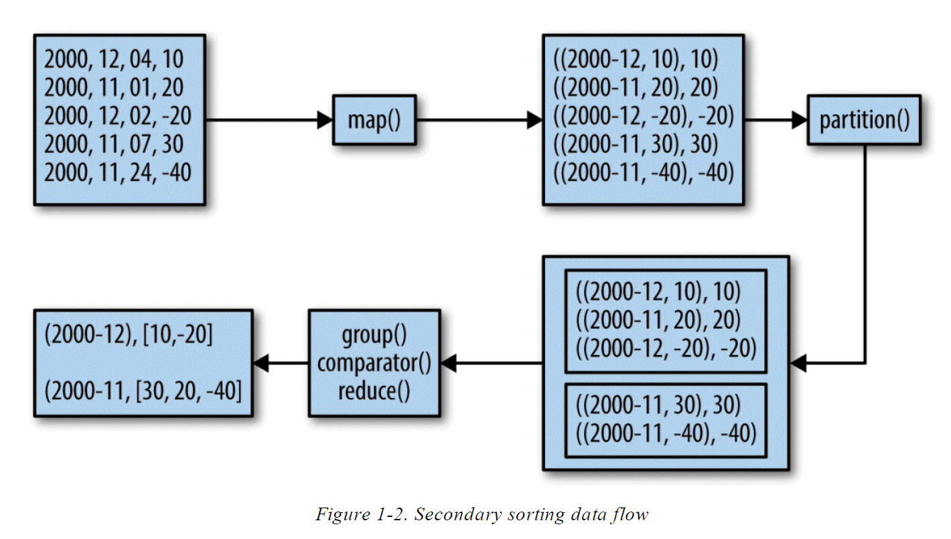
Example Data Flow
© 2010, Jamie Callan

