Slide 1
Build A
Secure And Scalable
Single Sign-On Gateway

Slide 2


Who Am I?
Xeodou
* Work For Wiredcraft
* Full Stack Developer
* JSConf China Organiser
* Hard-Core Open-source Fan

Slide 3

Why A Gateway?
Is it a Box ?

Slide 4
Gateway
* A Service
* User Validation
* Block hacks
* Proxy request
* Combine the response
* Easy manage microservices

Slide 5
What Do We Expect?
* Session management
* Proxy
* Rate-limiting
* Request protection
* Heart rating
* CORS
* …

Slide 6
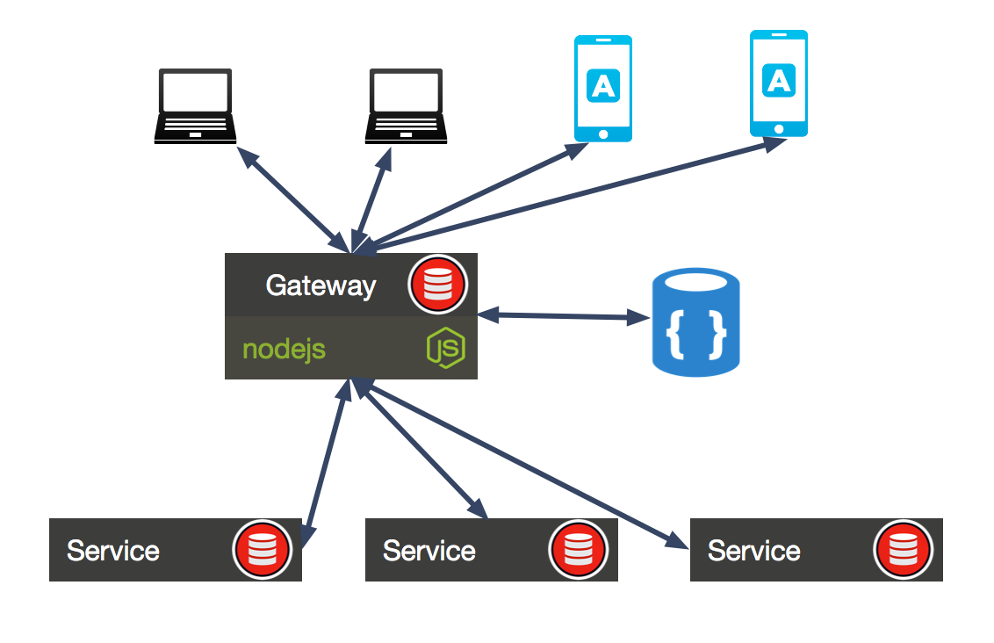

Slide 7
Security
* HTTP request and response
* Session management

Slide 8
Req & Res
* HTTPS everywhere
* Helmet module protect http headers
* Whitelist for request headers
* Backlist for response headers
* CORS

Slide 9
Session
* Expireable session
* Send cookie only over HTTPS
* Cookie only readable in browser
* Limit cookie domain name
* Block bad-user with IP and user identity

Slide 10
Scalable
* Proxy origin request stream
* Configuration with env variables
* Always has a default value
* Manager proxy rules with files

Slide 11
Q&A
Twitter: @xeodou
Github: @xeodou

