Slide 1
LangChain in LLM
Huimin Xu & Jiawei Xu

Slide 2
Content
LangChian (case 1)
Application: Question and Answer (case 2)
Evaluation (case 3)
Agent (case 4)
Google Colab: https://colab.research.google.com/drive/1Kqo9m6tL5gIXGNFzYpXct6V0cjfwpbug?usp=sharing

Slide 3
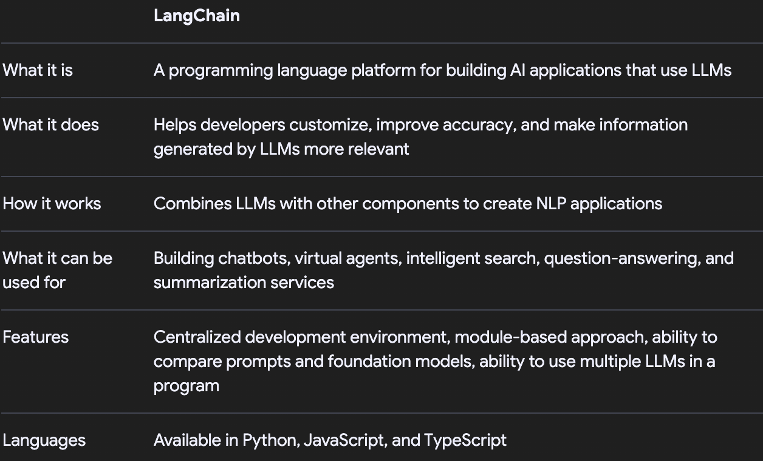
LangChain

Slide 4
Models: Integrates various language and vector models.
Prompts: Provides instructions to the model.
Indexes: Enables data retrieval functions.
Chains: Combines components for end-to-end applications.

Slide 5
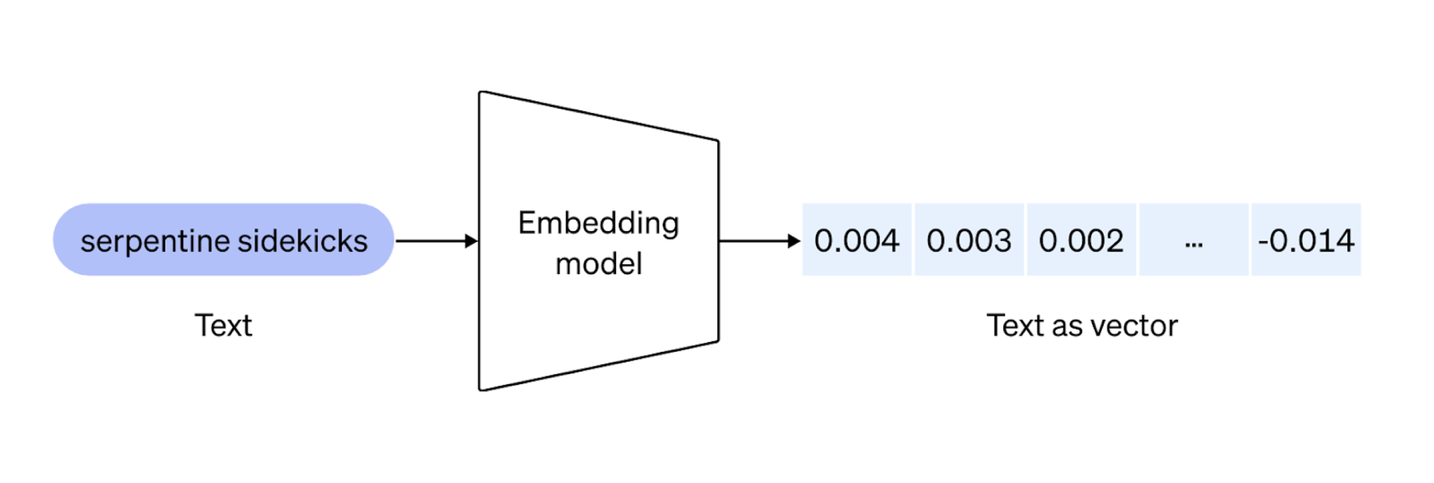
Question and Answer
Embedding Models

Slide 6
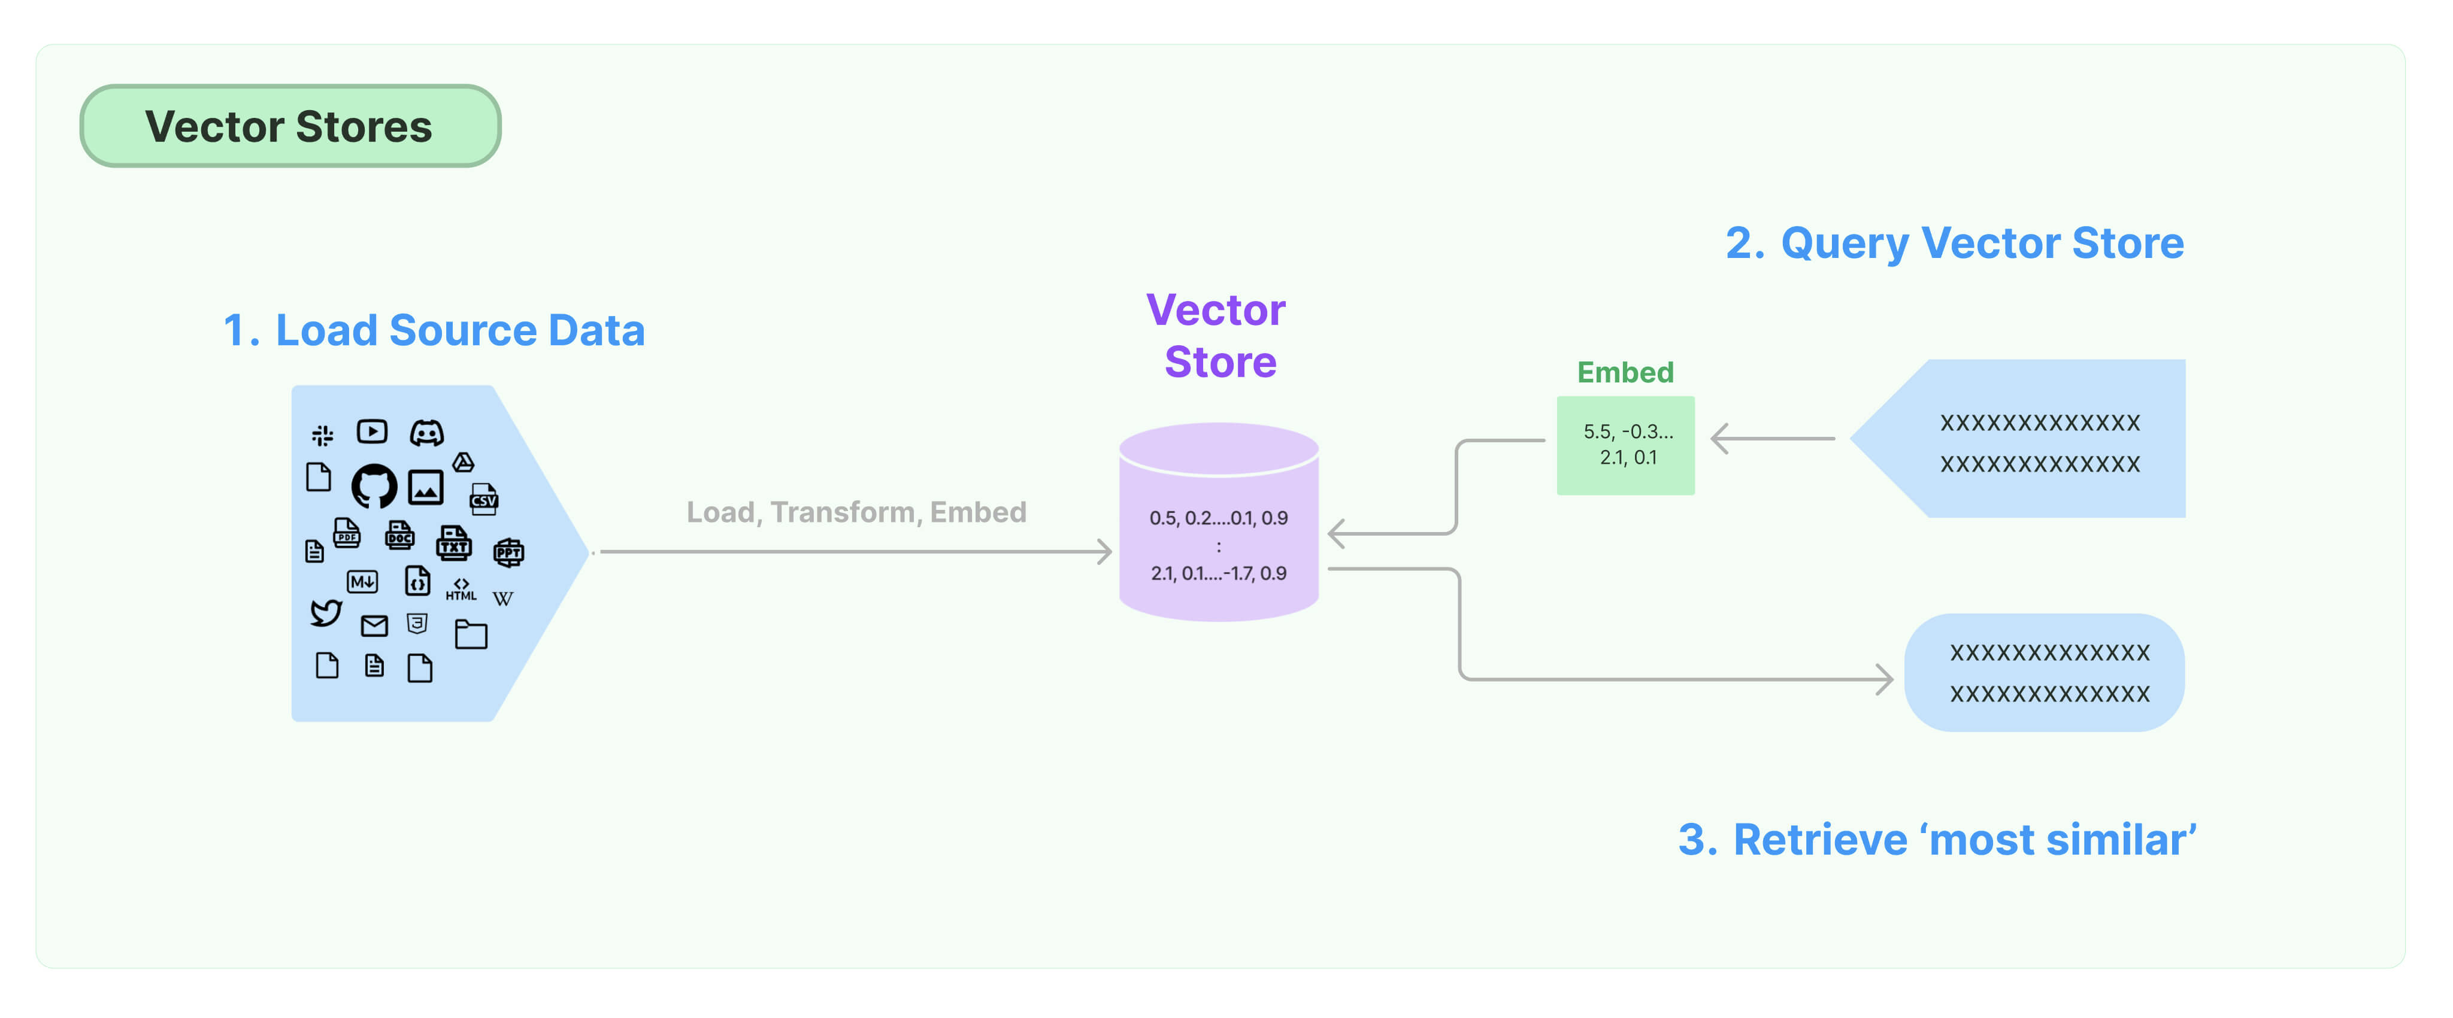
Vector stores

Slide 7
Evaluation
Building applications with language models involves many moving parts. One of the most critical components is ensuring that the outcomes produced by your models are reliable and useful across a broad array of inputs, and that they work well with your application's other software components.

Slide 8
Agent
The core idea of agents is to use a language model to choose a sequence of actions to take. In chains, a sequence of actions is hardcoded (in code). In agents, a language model is used as a reasoning engine to determine which actions to take and in which order.
Tools are functions that an agent can invoke.
Giving the agent access to the right tools; Describing the tools in a way that is most helpful to the agent

Slide 9
Resources
https://learn.deeplearning.ai/courses/langchain/lesson/1/introduction
https://python.langchain.com/v0.1/docs/get_started/introduction

