Slide 1
BATHCING FILES WITH ArcPY
By: Jian Xu

Slide 2
Purpose:
People encounter a lot of tedious repetitive tasks when using ArcMap. Often, there is no efficient tool to do this directly, thus avoiding unnecessary duplication of work. This project shows some batch processing functions (e.g. clip, mosiac ...) and a simple case about how to generate the contour line with my customized tools.

Slide 3
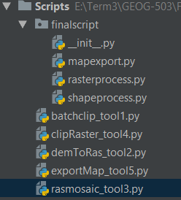
Standard Structure Of The Main Function
Batch Clip tool
MyBatchClip function in shapeprocess module
Convert DEM data to Raster tool
DEMtoRas function in rasterrpocess moudle
Mosaic different rasters tool
RasMosaic function in rasterrpocess moudle
Clip the raster tool
ClipRaster function in rasterrpocess moudle
Export Map tool
ExportMap function in mapexprot moudle

Slide 4
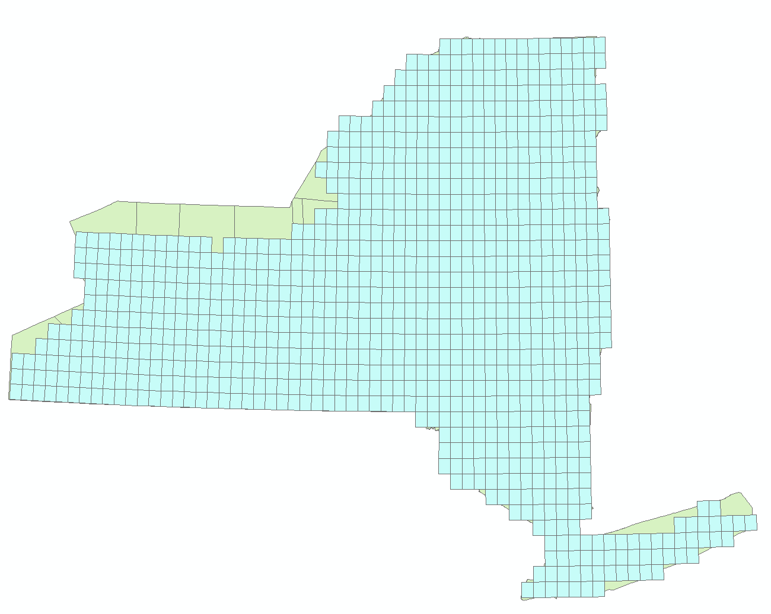
Test Data
The New York State Shapefile(Counties)
The DEM data in Broome County and surrounding area.

Slide 5
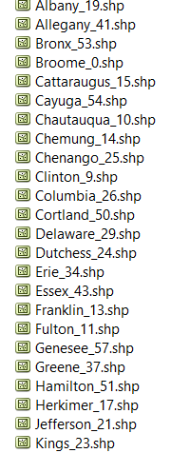
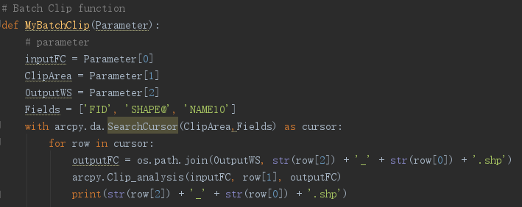
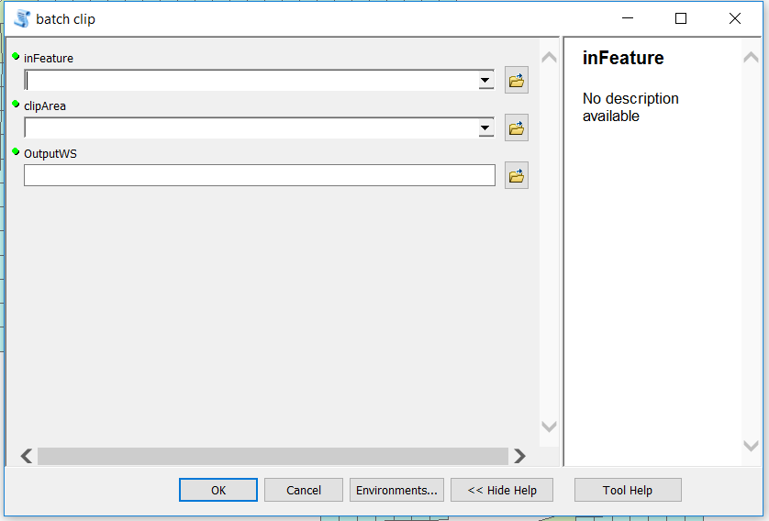
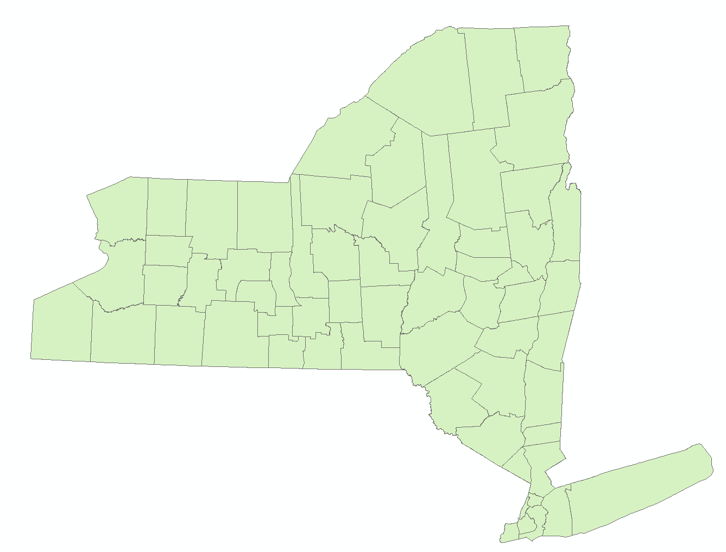
Batch Clip Tool
This tool can generate every single feature layer in the input feature.
E.g. NY state.

Slide 6
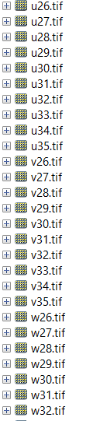
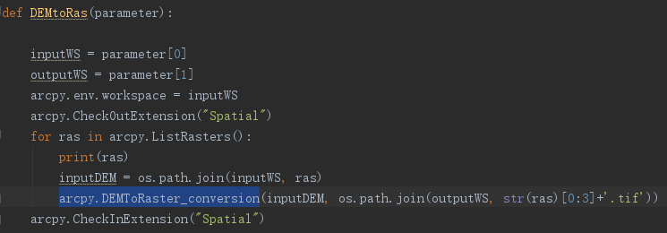
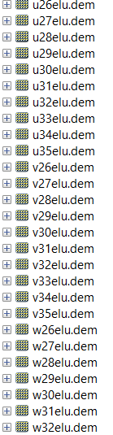
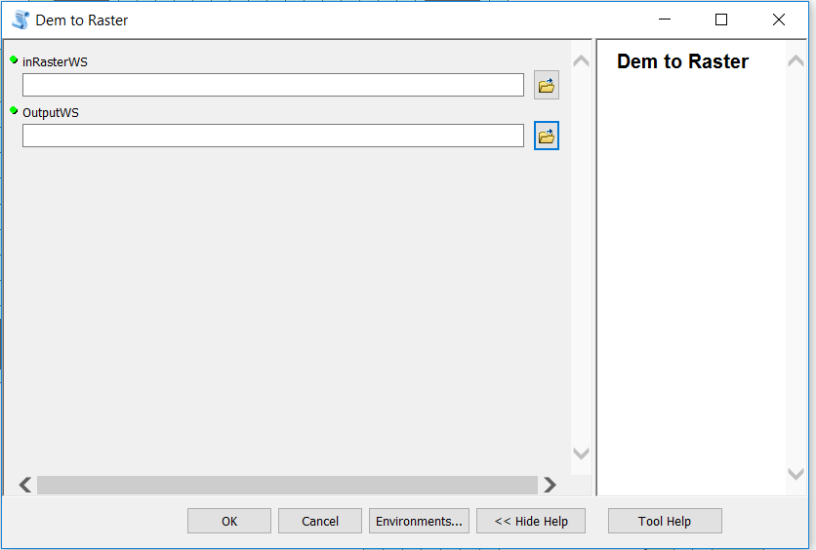
Dem to Raster
Using the “arcpy.DEMToRaster_coversion”

Slide 7
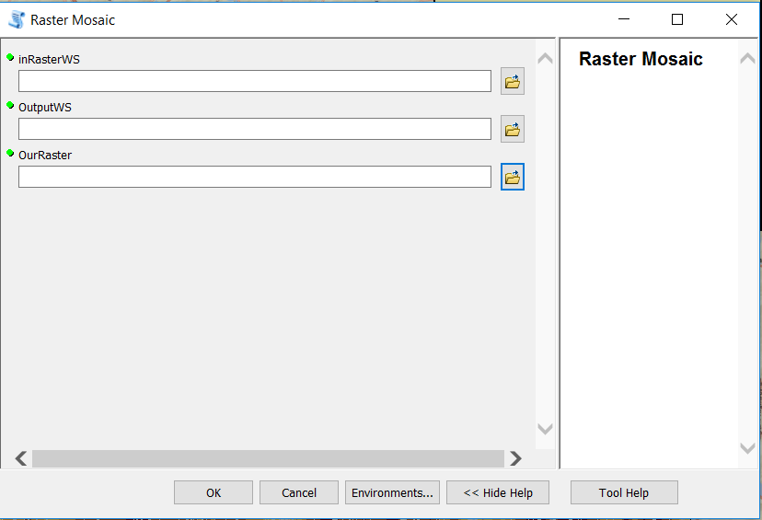
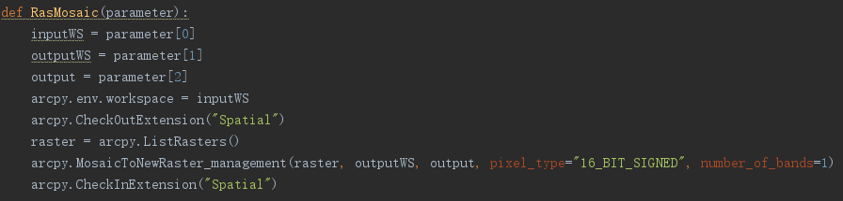
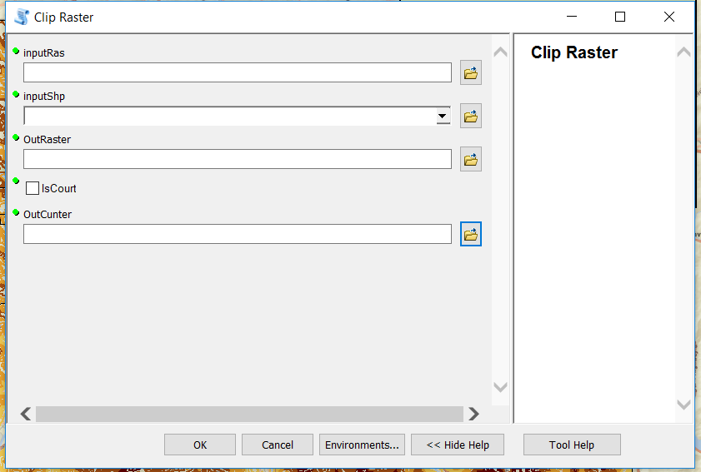
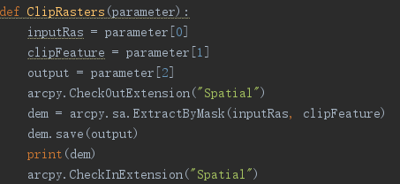
Extract By Mask And Generate The Contour Line
Spatial analysis tool
Extract by mask
Contour
More development…

Slide 8
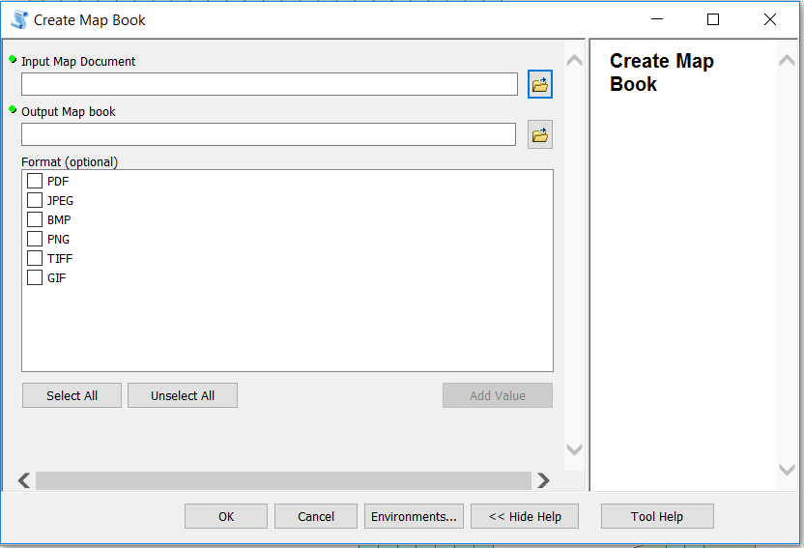
Create The Map
The output map can be customized by the format you want

Slide 9
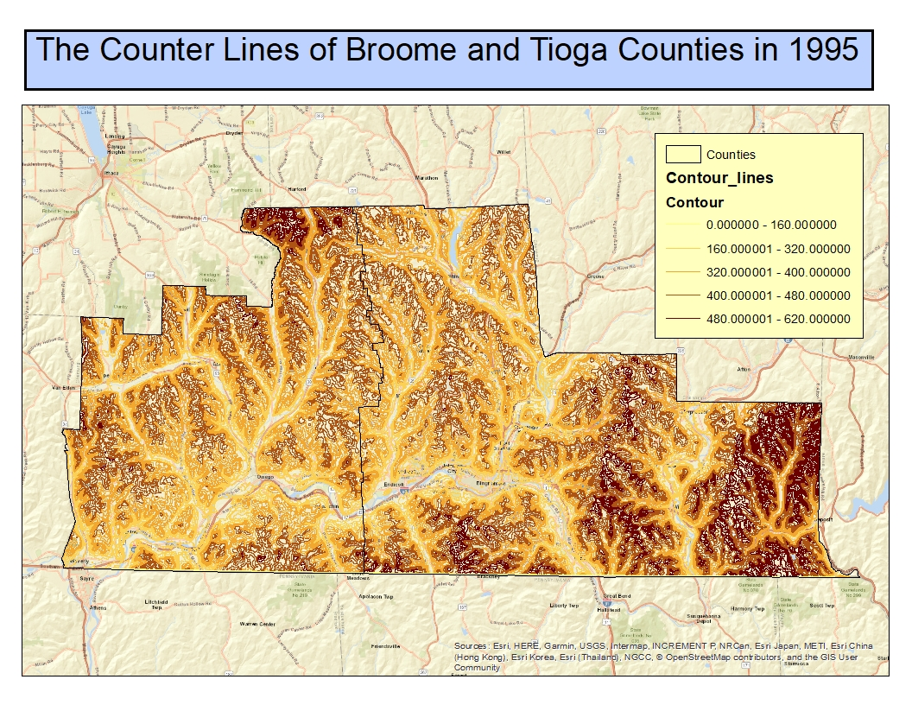
The result
We can have access to the distribution of the contour line in the Broome and Tioga Counties from the Map.
The altitude of east part in this area is much higher than the rest part of this two cities.

