Slide 1
Density-Matrix Renormalization Group for Quantum Spin Systems
Term Project for PHYS 580
Jin Xu
Graduate Student
Department of Physics, University of Alberta, Edmonton, T6G 2E1, Canada
Email: jin.xu@ualberta.ca

Slide 2
Quantum Spin Systems
Strongly correlated systems:
Motivations to study quantum spin systems:
1. localized electronic spins in the Mott-insulators (high-Tc cuprates)
2. exotic ground states (quantum spin liquid)
3. quantum information & quantum computation (entanglement)
4. quantum many-body physics (phase transitions)
Numerical methods:
1. exact diagonalization(ED): small systems
2. quantum Monte Carlo(QMC): large system without frustration, non-fermionic
3. density-matrix renormalization group(DMRG): one-dimensional systems

Slide 3
Density Matrices and DMRG Truncation
Block S
Block E
system
environment
New block S
New block E

Slide 4
Infinite System DMRG

Slide 5
Finite System DMRG

Slide 6
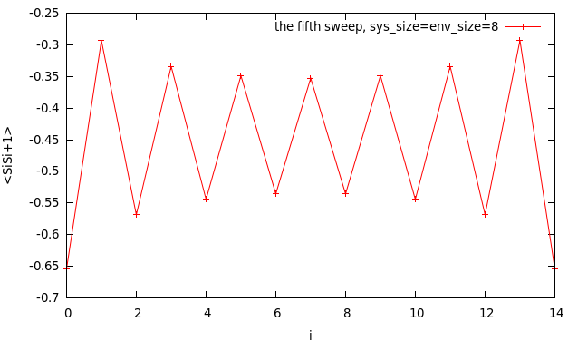
Results for L=16 (16 states to keep, 5 sweeps are finished, OBC)
The exact result for E/L from Bethe Ansatz | The converged result for E/L from DMRG
-0.4319357 | -0.4319835

Slide 7
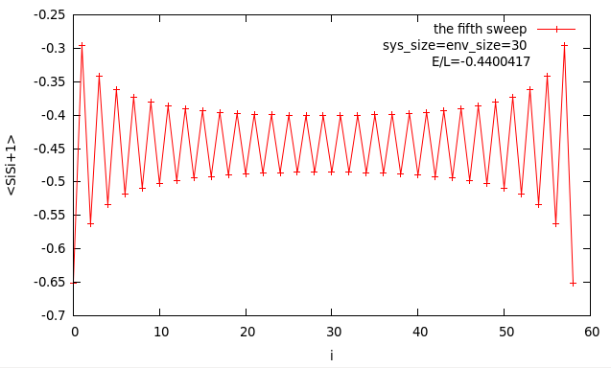
Results for L=60 (16 states to keep, 5 sweeps are finished, OBC)

Slide 8
More Applications of DMRG
1. Systems with periodic boundary conditions
2. T=0 dynamical properties of one-dimensional systems
3. Two-dimensional systems
4. Momentum-space DMRG
5. Transfer-matrix DMRG
6. Time-dependent DMRG
7. Applications to other areas: quantum chemistry, small grains, nuclear physics

Slide 9

Thank You for Listening!
Does it make sense?

