Slide 1

Gain Without Pain: Accurate WiFi-based Localization using Fingerprint Spatial Gradient
Chenshu Wu*, Jingao Xu*, Zheng Yang*,
Nicholas D. Lane^, Zuwei Yin*
*School of Software, Tsinghua University
^University College London and Bell Labs
9.13 in Maui, Hawaii
Notes:
[START]Thank you for the introduction, and Aloha everyone
Today I’m going to talk about our work
Gain without Pain: Accurate WiFi-based Localization using Fingerprint Spatial Gradient

Slide 2
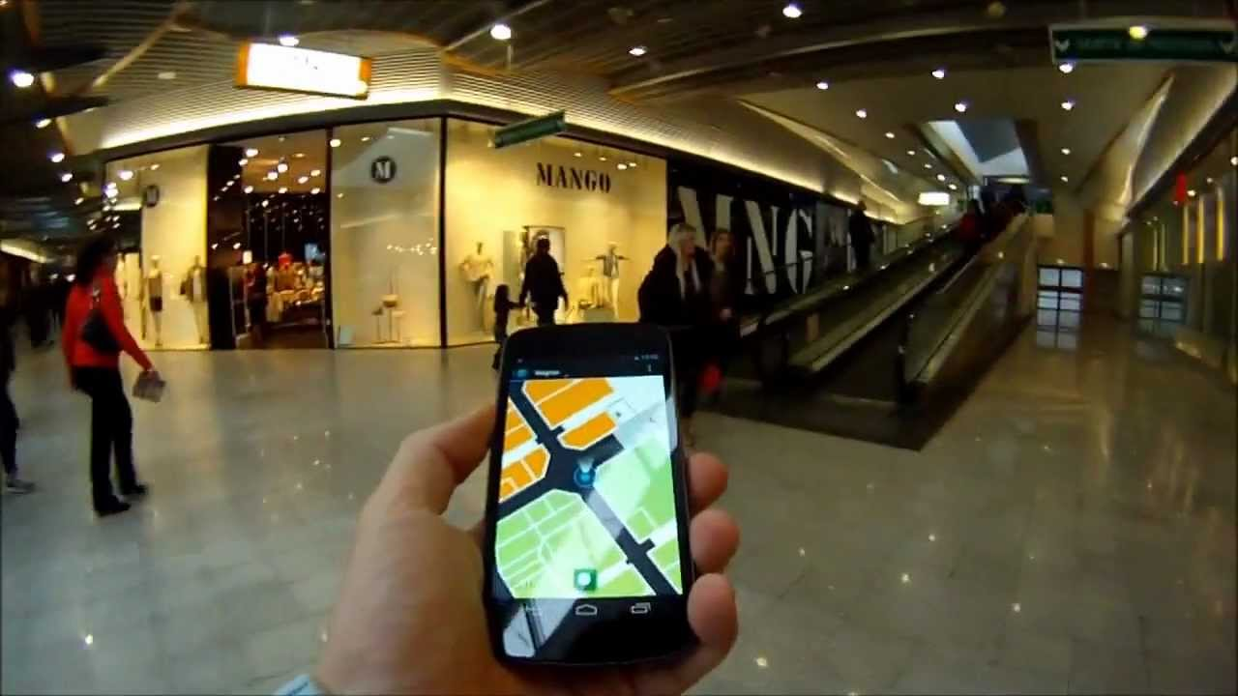
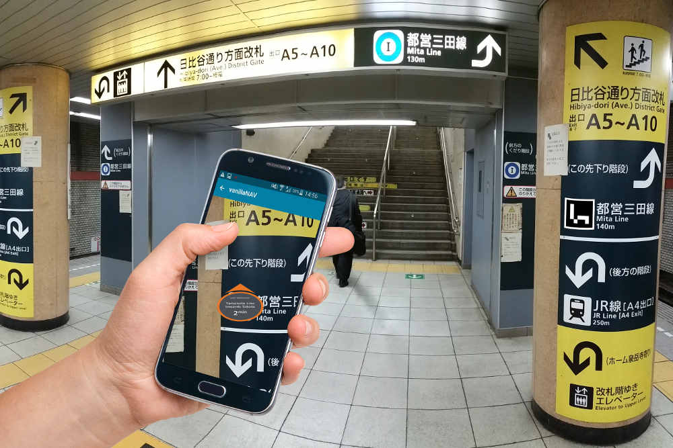
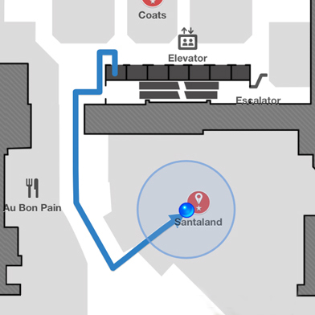
Motivation
Various location-based ubiquitous applications.
And locating with Wi-Fi is superior in
Ubiquitous: Almost everywhere installed infrastructure.
Low-cost: Off-the-shelf Wi-Fi devices.
Non-invasive: not required to wear/carry any special devices.
Indoor Location
Navigation
Mobile Tracking
Notes:
[START]The proliferation of various location-based ubiquitous applications fosters the demand for accurate localization services to be available everywhere, such as indoor location, indoor navigation and user’s mobile tracking.
Numerous techniques have been developed during the past decades based on WiFi, RFID, visual images and acoustic signals.
[CLICK]Among various approaches, WiFi fingerprint-based indoor localization has become one of the most attractive solutions due to WiFi devices are ubiquitous, cheap and does not require user to wear any devices.

Slide 3
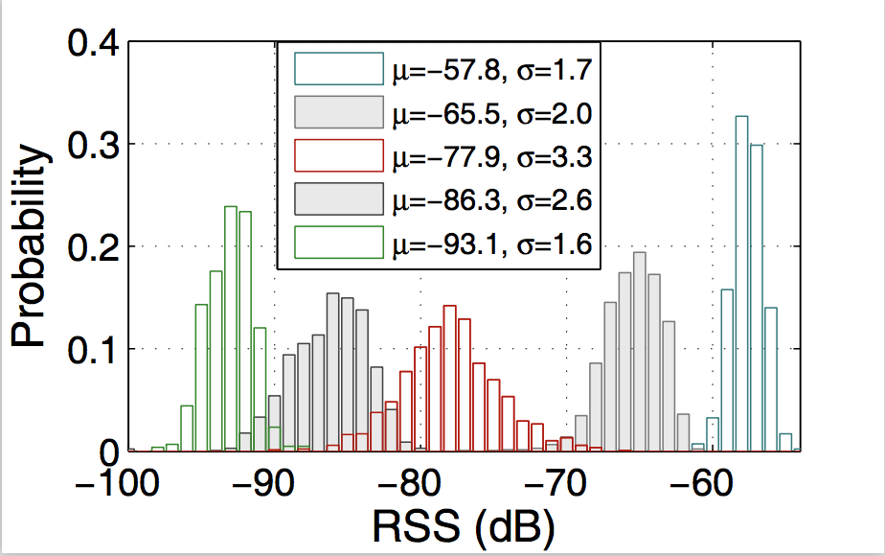
Major Problems
The RSS bias is large, usually >10db
No matter whether the AP is strong or not
Spatial ambiguity and Temporal instability
RSS bias over time
Notes:
[START] But the methods just use WiFi RSS fingerprint frequently yield large errors in practice.
One major root cause of the locations errors in RSS fingerprinting is the uncertainty of WiFi signals, just as shown in the left figure, we collect about 1500 RSS samples of different Aps and illustrate the RSS distributions of 5 Aps with diverse average RSS values, the RSS bias is very large whether the AP is strong or not.
[CLICK] Evidently, RSS variations may induce two aspects of severe influence: spatial ambiguity and Temporal instability.

Slide 4
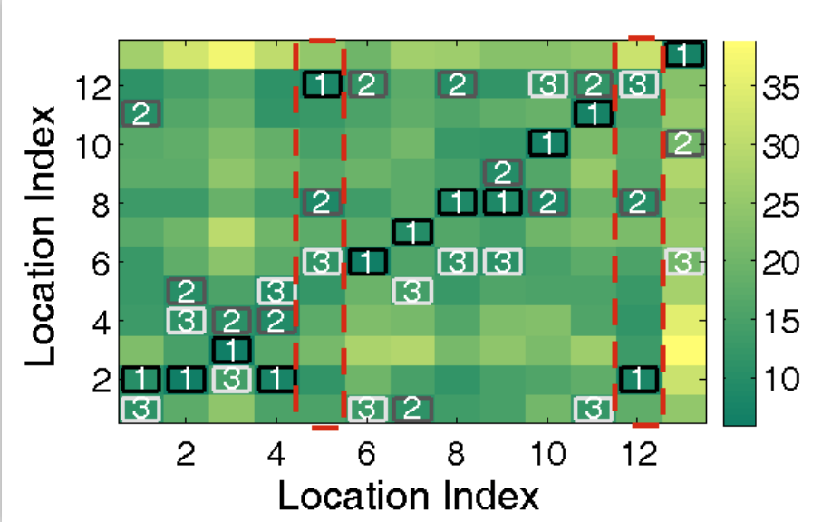
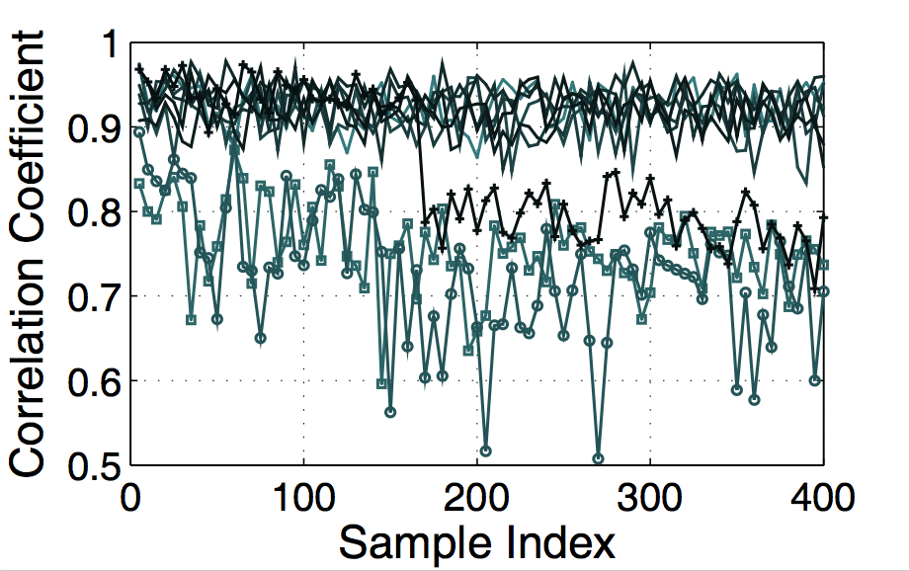
Major Problems
One fingerprint might be similar to those from two or more quite distant locations
Mismatch & Degrade the performance of original fingerprint database!
Fingerprint spatial ambiguity
Re-collected fingerprints from same location can’t match with initially fingerprint
Fingerprint temporal instability
Notes:
[CLICK] The spatial ambiguity means one fingerprint might be similar to those from two or more quite distant locations, rendering fingerprints over different locations become indistinguishable
[CLICK] Temporal instability means fingerprint of a location observed at one instant does not match the initially collected training fingerprints from the same location.
[CLICK]To conclude, both issues can lead to severe fingerprint mismatches and thus impair the localization accuracy and reside as two long-standing yet inevitable problems of conventional RSS fingerprints.

Slide 5
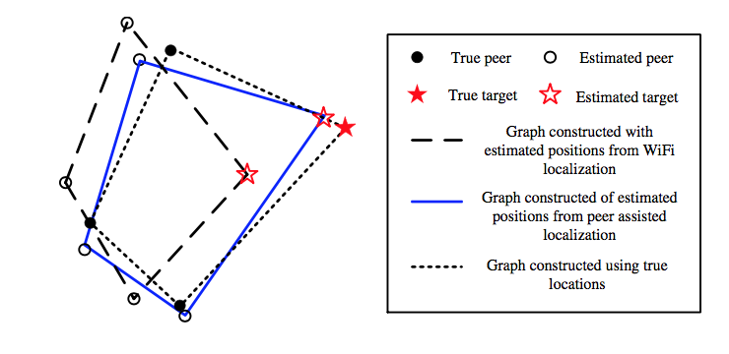
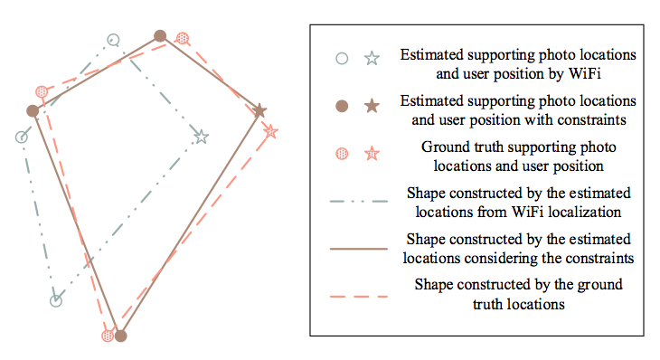
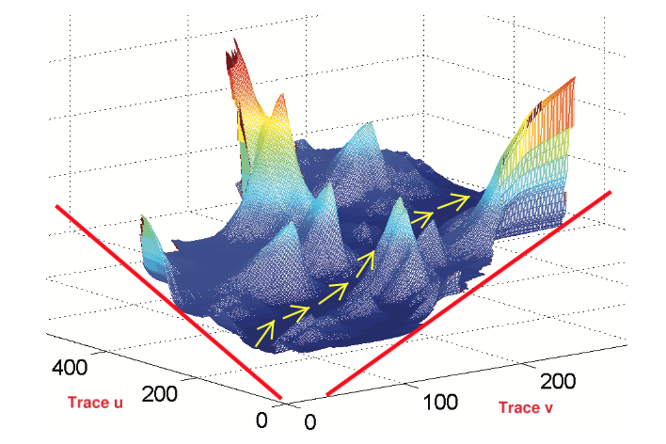
Existing Arts
Acoustic, Mobicom ’12
Argus, Ubicomp ’15
Followme, Mobicom ’15
While achieved better accuracy, these solutions degraded the delightful ubiquity and induce additional costs
Notes:
To solve the above two major problems, a bunch of works on indoor localization have been published in recent years, the key insight of these works can be divided into two parts.
The first part relay on additional sensors including visual images, acoustic signals and magnetic signals, these works achieve high level accuracy,
[CLICK]however they degraded the delightful ubiquity and induce additional system costs, for example, users need to heavily take pictures or cooperate with multiple peers for localization.

Slide 6
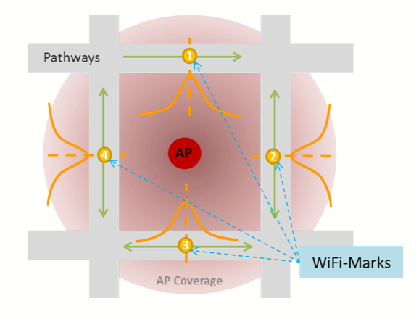
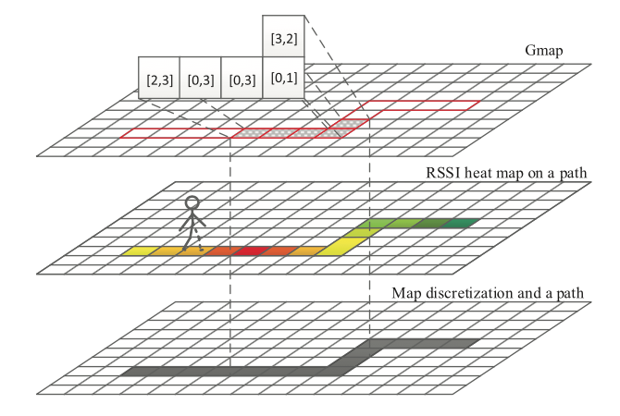
Existing Arts
Walkie-Markie, NSDI’13
GIFT, TIE ’16
Need a path and continuous fingerprints, can’t work when user is static!
Notes:
The second part consider the RSS changing trend when users are walking and collect continuous fingerprints, although these methods don’t need special hardware and achieve a more robust localization system,
[CLICK]however, they need a path and can’t work when user is static, moreover, the input of the system is continuous fingerprints which also induce system latency.

Slide 7

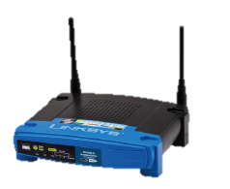
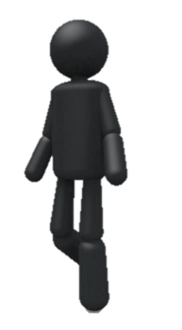
Problem Statement
Accurate localization using RSS fingerprint.
Overcomes spatial ambiguity & temporal instability using only Wi-Fi signals.
Without any additional system costs
Notes:
Unlike the existing arts, our goal is to overcome spatial ambiguity and temporal instability using only wi-fi signals and without any additional system costs.

Slide 8
Problem Statement
Additional information
Gain With Pain
High precision
Mitigate spatial ambiguity
Ease temporal instability
Induce system cost
Bring many restrictions
Special hardware
Gain Without Pain
A new form
Notes:
All in all,
[CLICK]the above methods are Gain with Pains,
[CLICK]which means although mitigate RSS fingerprint’s spatial ambiguity and temporal instability,
[CLICK]they induce system cost and bring many restrictions to users and sometimes need special hardware because they must use [CLICK]additional information.
[CLICK]But in our paper, we design a novel form based only on traditional RSS fingerprints and don’t need any extra information, which means our methods Gain without pains. We named the new form Fingerprint Spatial Gradient, which exploit the spatial feature of RSS fingerprints, in the following, I will describe the new form in detail.

Slide 9
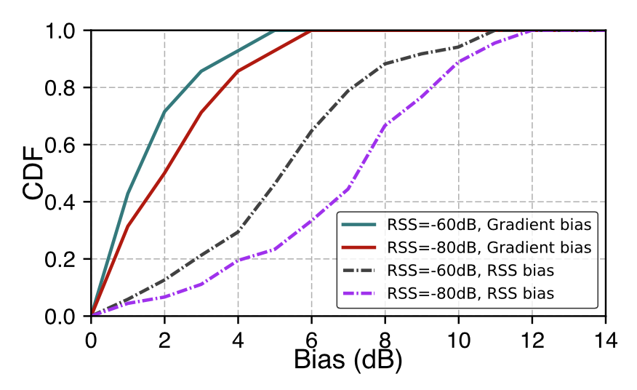
Key Insight
The spatial relationships of multiple RSS fingerprints from neighbouring locations would be more robust than individual RSS fingerprints from one single location.
Leverage Fingerprint Spatial Gradient
Notes:
The key insight of the new form is that the spatial relationships of multiple RSS fingerprints from neighbouring locations would be more robust than individual RSS fingerprints, for example, if some AP adjusts its transmission power, the RSS values perceived at multiple neighbouring locations would be all affected, thus keeping the distance between these locations’ fingerprints similar with that before. Just as shown in the figure, we collect and re-collect the RSS fingerprints at the same location a day before and after, although the RSS bias from the same locations is large, the RSS Gradient bias which means the bias between a location and its nearby location’s RSS difference is smaller.

Slide 10
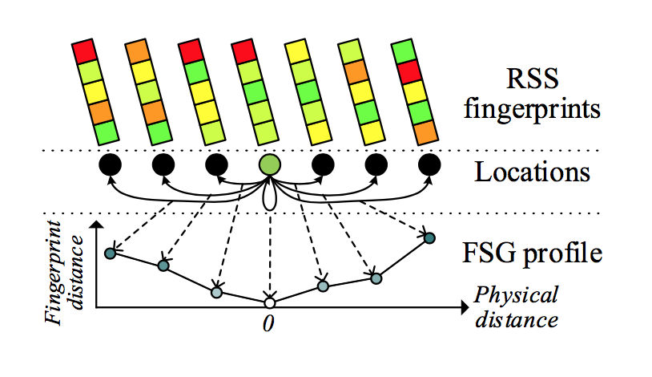

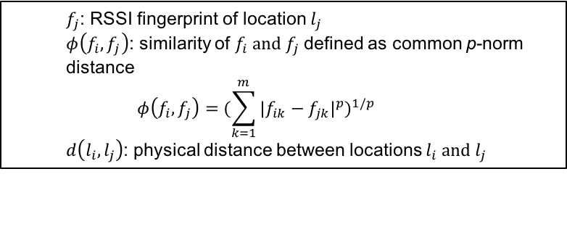
FSG Specification
The FSG profile for $l_{i}$ defined as :
$$g_{i}=\left\{<d\left(l_{i}, l_{j}\right), φ\left(f_{i}, f_{j}\right)>, i−r≤j≤i+r\right\}$$
$f_{j}$: RSSI fingerprint of location $l_{j}$
$φ\left(f_{i}, f_{j}\right)$: similarity of $f_{i} and f_{j}$ defined as common p-norm distance
$$φ\left(f_{i}, f_{j}\right)={(\sum_{k=1}^{m}{{|f_{ik}−f_{jk}|}^{p}})}^{1/p}$$
$d\left(l_{i}, l_{j}\right)$: physical distance between locations $l_{i} and l_{j}$
Notes:
Based on this insight, we propose and leverage the FSG form, as shown in the figure, for a specific location, the FSG profile describes the fingerprint similarity trend between the fingerprint of that location and several of its neighbouring locations. Specifically, the FSG profile for a location l_i is defined as the formula above. Where the X-coordinate is the physical distance to the current location and the Y-coordinate is the fingerprint distance, note that we select two locations from the same distance, and put them at different sides from the current location, so in theory the FSG profile exhibits a “V-” like shape as the fingerprint would first decrease to zero and then increase

Slide 11
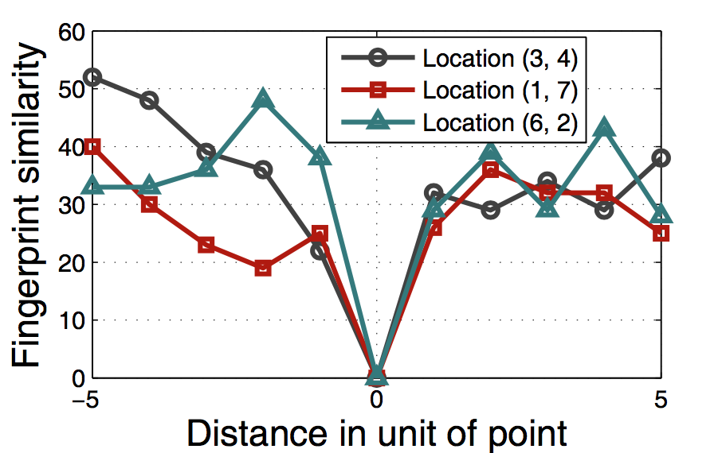
FSG Specification
The FSG profile for $l_{i}$ defined as :
$$g_{i}=\left\{<d\left(l_{i}, l_{j}\right), φ\left(f_{i}, f_{j}\right)>, i−r≤j≤i+r\right\}$$
Notes:
These are three FSG profiles from different locations

Slide 12
FSG Advantages
Leverage Fingerprint Spatial Gradient
Temporally stable & Spatially distinctive
Certain spatial neighbouring relationships would be more stable
Notes:
The advantage of the FSG is it exploits the spatial constraints among multiple fingerprints from a set of elected multiple nearby locations .
The FSG thus turns out to be more stable than the absoulte individual RSS fingerprints over time
The rationale is that certain spatial neighbouring relationships would be more stable than individual RSS fingerprints

Slide 13
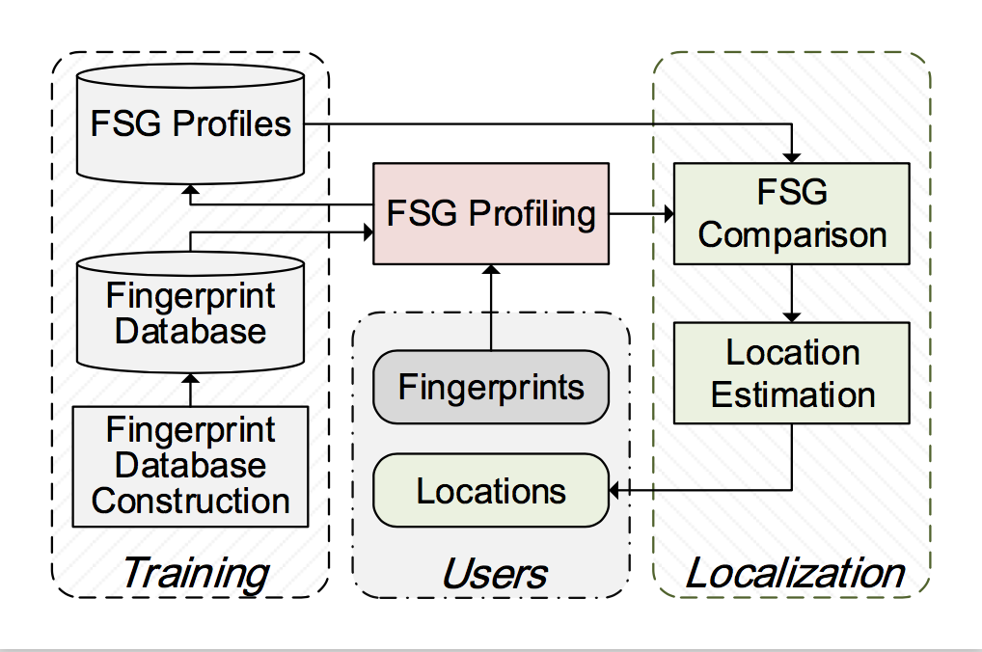
System Overview
Computed within constant time
Inputs are no more than traditional fingerprints
Notes:
And we design a system named ViVi using FSG instead of traditional RSS fingerprints to indoor locate. Compared with other indoor localization systems, ViVi is what we say Gain without Pains,
[CLICK]the system’s inputs are no more than traditional RSS fingerprints but it can mitigate fingerprints spatial ambiguity and temporal instability,
[CLICK]the core contributions lie in the introduction of an FSG profiling module along with an FSG comparison module, and the two modules can also be computed within constant time.

Slide 14
Challenges
How to select the nearby points set from the single location to generate the most useful FSG?
How to compare the similarity between two FSG?
How to locate according to a query fingerprint?
Notes:
Now, we have define and understand the advantage of the FSG, there are still three challenges remains there, first, to construct each locations’ FSG profile, we need to consider the fingerprints from the nearby locations, so how to select the most useful nearby points? Second, in the FSG comparing stage, how to compare two FSG profiles? Last but not the least, when a user upload just one single query fingerprint, how to locate according to the fingerprint?

Slide 15
Challenges
How to select the nearby points set from the single location to generate the most useful FSG?
How to compare the similarity between two FSG?
How to locate according to a query fingerprint?
Notes:
Let’s think about the first challenge: How to select the nearby points

Slide 16
Profiling a Reference Location
Obtaining the most stable and distinctive FSG
Minimizing Local Gradient (MLG)
Maximizing Global Gradient (MGG)
Optimizing Spatial Stability (OptSS)
Notes:
The principle we select the nearby locations is to make the FSG profile more stable and distinctive
We design Miniming Local Gradient and Maximizing Global Gradient methods
But recalling the key insight of FSG is to exploit spatial fingerprint relationships that are stable over time, we propose another method for FSG profiling by choosing a set of neighbouring fingerprints that optimize the spatial stability (OptSS) in terms of fingerprint similarity. Just as shown in the right figure, at each distance range, we select two locations which enjoy the smallest fingerprint distance variances with target locations.

Slide 17
Challenges
How to select the nearby points set from the single location to generate the most useful FSG?
How to compare the similarity between two FSG?
How to locate according to a query fingerprint?

Slide 18
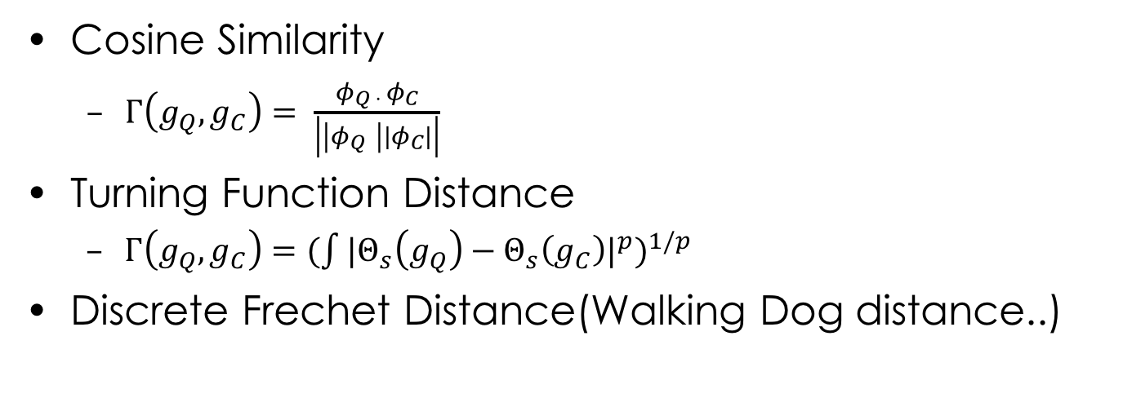
Comparing FSG
Cosine Similarity
$Γ\left(g_{Q},g_{C}\right)= \frac{φ_{Q · }φ_{C}}{\left|\left|φ_{Q }\right||φ_{C}|\right|}$
Turning Function Distance
$Γ\left(g_{Q},g_{C}\right)={(\int{{|Θ_{s}\left(g_{Q}\right)−Θ_{s}\left(g_{C}\right)|}^{p}})}^{1/p}$
Discrete Frechet Distance(Walking Dog distance..)
Notes:
Then let’s think about how to compare two FSG profiles, our goal is to explore proper similarity measures to recognize the FSG profiles from the same locations and disrecognize those of different locations. just as explained before, a FSG profile can be viewed as a point set in the space when treating the physical distance as X-coordinate and the fingerprint distance as Y-coordinate for each neighbor, comparison of two FSG profiles can thus be solved by shape matching techniques. There are three comparing methods we considered, cosine similarity, turning function distance and discrete frechet distance(walking dog distance), the performance of the three methods will compare in the experiments chapter.

Slide 19
Challenges
How to select the nearby points set from the single location to generate the most useful FSG?
How to compare the similarity between two FSG?
How to locate according to a query fingerprint?
Notes:
The last but not the least is how to profile a query fingerprint.

Slide 20
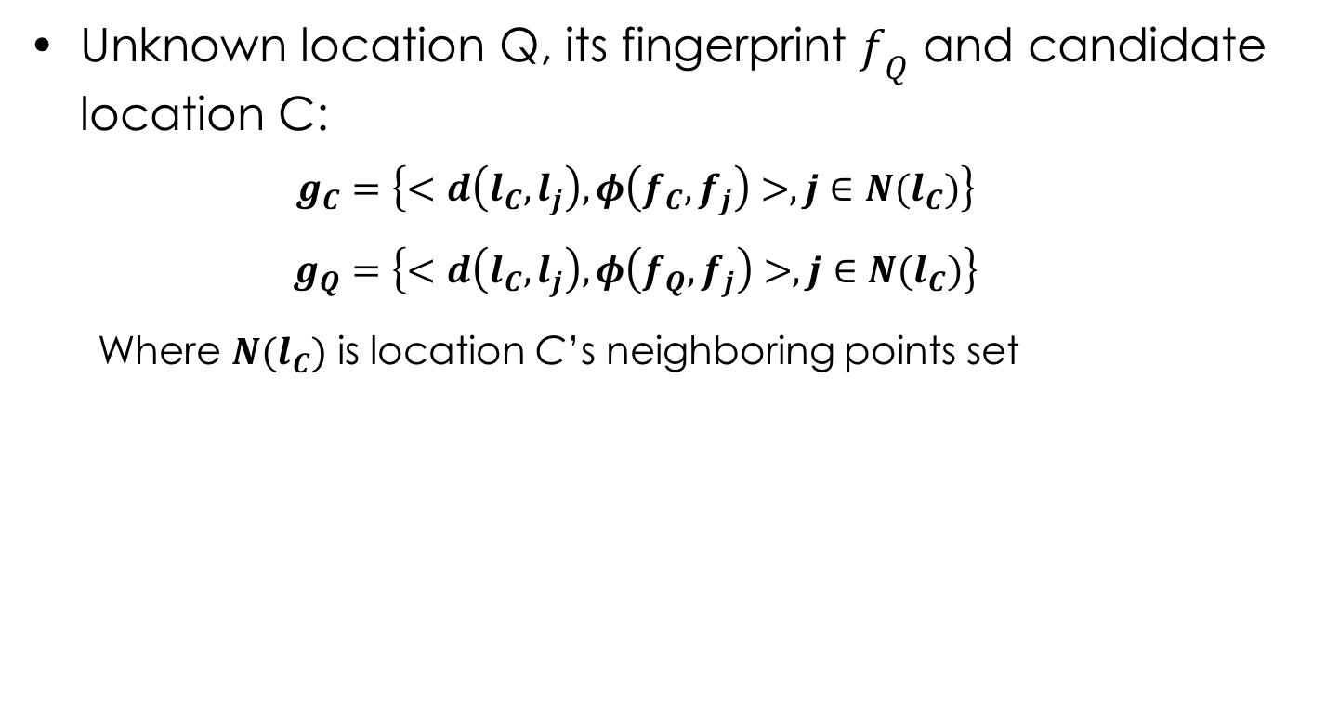
Profiling a Query Fingerprint
Unknown location Q, its fingerprint $f_{Q}$ and candidate location C:
$$g_{C}=\left\{<d\left(l_{C}, l_{j}\right), φ\left(f_{C}, f_{j}\right)>,j∈N(l_{C})\right\}$$
$$g_{Q}=\left\{<d\left(l_{C}, l_{j}\right), φ\left(f_{Q}, f_{j}\right)>,j∈N(l_{C})\right\}$$
Where $N(l_{C})$ is location C’s neighboring points set
Notes:
The above FSG profiling task is completed in the offline training phase, based upon an ordinary radio map. In the online localization phase, the FSG profile of a query fingerprint is not fixed and depends on the specific targeted reference point. For example, when comparing a query fingerprint f_q from unknown location l_q against a specific candidate reference location l_c. If the FSG profile of the candidate l_C is g_c and the FSG for the query turns out to be g_q. Note that beside the neighbouring point set N(lC),we also substitute the candidate location coordinates into the query location for FSG profiling. Provided the reference FSG profile, each query FSG profile can be generated in constant time without the need of searching for spatial neighbours

Slide 21
Profiling a Query Fingerprint
Unknown location Q, its fingerprint $f_{Q}$ and candidate location C:
$$g_{C}=\left\{<d\left(l_{C}, l_{j}\right), φ\left(f_{C}, f_{j}\right)>,j∈N(l_{C})\right\}$$
$$g_{Q}=\left\{<d\left(l_{C}, l_{j}\right), φ\left(f_{Q}, f_{j}\right)>,j∈N(l_{C})\right\}$$
Where $N(l_{C})$ is location C’s neighboring points set
Notes:
The key advantage by doing so is that when the query fingerprint comes from the same location with the reference one, the generated FSG profiles tend to be similar. In contrast, if the fingerprint is from a different location, the FSG profiles will be significantly different since the constructed query FSG profile does not exhibit similar spatial patterns. It is because the query fingerprint does not necessarily hold similar gradients with the reference location’s neighouring fingerprints even if itself is similar to the reference fingerprint (Two fingerprints that are both similar to a third one are not necessarily similar to each other).

Slide 22
Profiling a Query Fingerprint
Unknown location Q, its fingerprint $f_{Q}$ and candidate location C:
$$g_{C}=\left\{<d\left(l_{C}, l_{j}\right), φ\left(f_{C}, f_{j}\right)>,j∈N(l_{C})\right\}$$
$$g_{Q}=\left\{<d\left(l_{C}, l_{j}\right), φ\left(f_{Q}, f_{j}\right)>,j∈N(l_{C})\right\}$$
Where $N(l_{C})$ is location C’s neighboring points set
Same location
1-m away
2-m away
Notes:
As in left figure when comparing with different queries collected from the same locations, the generated querying FSG profiles appear to be consistently similar to the reference one. In contrast, as indicated by the middle figure, different patterns appear in the FSG profiles of queries from neighbouring locations only 1-meter away. Such chaotic differences are further significantly increased when matching queries from locations that are 2-meter away, as shown in the right figure. Form these we can see the spatial distinctive of FSG

Slide 23
Evaluations & Results How much gains we can get without pains?

Slide 24
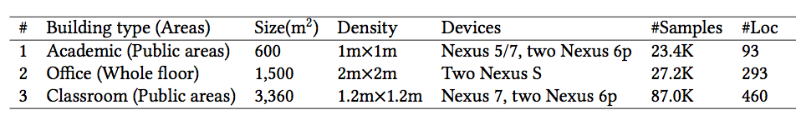
Experiment
4 Devices
Google Nexus 5
Google Nexus 6p*2
Google Nexus 7 pad
HUAWEI Mate 8
3 Experiment areas
Academic: 23.4k samples
Office: 27.2k samples
Classroom: 87.0k samples
Experiment measurements
Each location 60 measurements
4 Baselines
Horus (Winet’08)
TW-KNN (Pervasive Computing’14)
KLDiv
GIFT (TIE’16)
Notes:
We prototype ViVi on 4 different smartphones and conduct experiments in 3 different building with the implementation of four different state-of-the-art approaches as comparison, the data collection details are summarized in the Table. When collecting fingerprints for training, we employ a typical sampling frequency for 1HZ and at each location we collect 60 fingerprints and use the average fingerprint as the representative

Slide 25
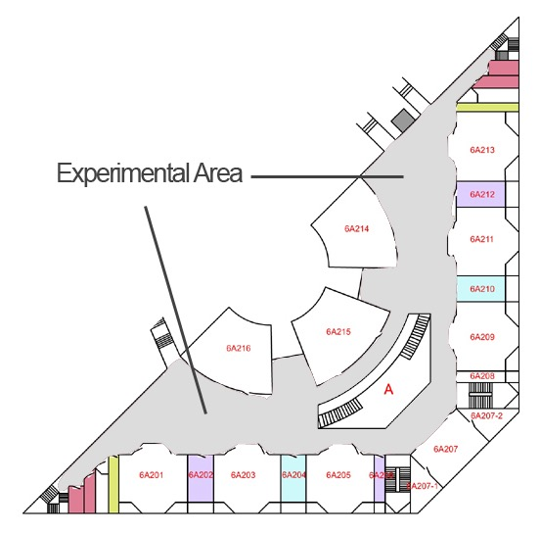
Experiment
Office
Academic
Classroom
Notes:
These figures show the floor plans of different experimental areas. Although the three buildings are similar on building structure, the user behavior patterns are pretty different. For example, there are many people in the office building in daytime, which will be almost empty in the night. The classroom building are crowded or empty to different extents depending on the course schedule. While there are a reasonable number of users in the academic building most of the time.

Slide 26
Explore best metric
Three profiling methods
Three FSG similarity
OptSS+CS achieves the highest accuracy with mean accuracy of 3.6m and 95th percentile error of 6.7m.
Notes:
We first explore the best FSG profiling approach and the best FSG similarity metric. We integrate the results of different phones from all experimental areas for evaluation. As shown in the two figures, the combination of OptSS and CS yields the best performance with mean accuracy of 3.6m

Slide 27
Performance in different areas
Average accuracy in three areas: 3.3m,4.3m,3.8m
Smaller areas yields better accuracy
Different areas
Notes:
We evaluate the performance in three different experimental floors as illustrated before. As seen ViVi yields an average accuracy of 3.3m in the academic building, 4.3m in the office building and 3.8m in the classroom building. The result also demonstrate the denser sample locations in smaller areas yield better accuracy, which confirms with various previous works

Slide 28
Performance comparison
Average accuracy outperforms ：
Horus by 18.2%
GIFT by 21.7%
TW-KNN by 25.0%
KLDiv by 30.8%
Our system can combine TW-KNN and Horus
Different methods
Notes:
As shown, ViVi achieves the best performance among all comparative systems. The average accuracy outperforms Horus by 18.2%, GIFT by about 21.7% and exceeds TW-KNN by 25.0% and KLDiv both by 30.8%.
And our work can combine TW and Horus, because in the FSG profiling we just use traditional fingerprints and Euler distance, and as shown in the figure, when we use TW fingerprint, the performance is better.
The encouraging performance gains are achieved without introducing any extra costs. Further improvements could be obtained by combining more enhanced techniques.

Slide 29
Performance comparison
System latency(Average time delays for 1000 queries):
ViVi: 0.33s per query
Horus: 0.28s per query
TW-KNN: 0.77s per query
GIFT: 0.84s per query
Parameter Study
Different nearby points’ range
Different AP number
Notes:
We randomly select one query fingerprint from a set of queries and ViVi returns the locate results. Then we average the time delays for 1000 such queries. For each comparative method, we run the same process and calculate the average running time. The average query delay of ViVi is similar with or shorter than previous works
And we also conduct experiments to select the best parameters including what is the best ap number and nearby points number we need to select

Slide 30
Conclusion
A new form based on RSS fingerprint
An underlying spatial properties of nearby fingerprints
More stable and distinctive than the original RSS fingerprints.
Present a system ViVi to incorporate FSG
Gain without the pains of resorting to additional information or restrictions or vulnerable RSS model assumptions.
Median accuracy outperforms 4 state-of-the-art approaches by more than 20%
Notes:
So, that’s out work
The contributions are from two parts:
First, we design a new form FSG, FSG is more stable and distinctive than the original RSS fingerprints
Second, based on the new form, we design a system named ViVi, the system’s input is no more than traditional fingerprints but can get better accuracy, that is what we say a “Gain without pain” localization system!

Slide 31
Thanks!
Q&A
Jingao Xu
Tsinghua University
xujingao13@gmail.com
Notes:
[Start]. That's all. Thanks for listening.

