Slide 1
Statistical Analysis of Sign Language Recognition with CNNs
Final Presentation
Advanced Topics of AI – P
21.01.2026
Julia Xu

Slide 2
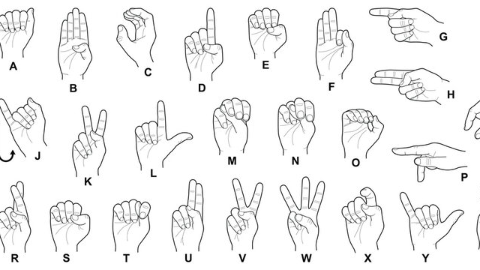
Sign Language Recognition Using Simple CNNs
Topic

Slide 3
Project Workflow
Week 1
Project Workflow Definition
Experimental Setup Definition
Week 2
Initial Setup
1 Train Iteration --> project feasibility evaluation
Week 3-4
Experimental Pipeline Setup for multiple iterations
Week 0
Project Topic Selection
~ Mid November
Week 5-7
Training session
each model trains 100+ times
Week 8-9
Evaluation
Week 10
Visualization
Boxplots, Confusionmatrix
Week 11-12
Report Documentation
Metric computation/
collection
~ Christmas Break
~ End January

Slide 4
Agenda
Research Plan
Model Variants
Experiment Setup
Results
  Training
  Statistical Analysis
Conclusion

Slide 5
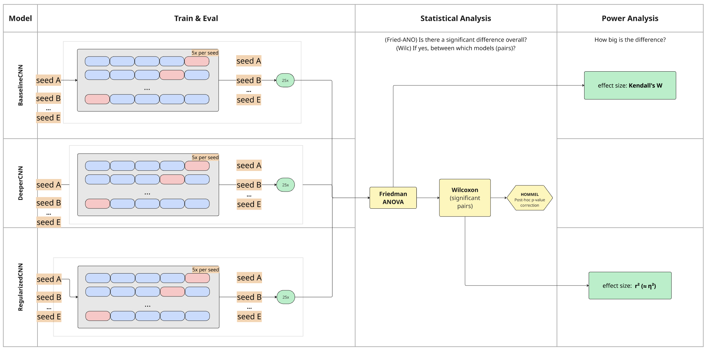
1. Research Plan

Slide 6



2. Model Variants/Groups
CNN model variants:
  BaselineCNN: 2-layered CNN
  w/ dropout 0.3
  DeeperCNN: 3-layered CNN
  w/ dropout 0.3
  RegularizedCNN: 3-layered CNN
  w/ dropout 0.5
MobileNetV3 small:
  Pretrained
  Discarded due to very high accuracies
Hugging Face. Model card for mobilenetv3 small 100.lamb in1k. https://huggingface.co/timm/mobilenetv3_small_100.lamb_in1k. [Accessed 21-11-2025]

Slide 7
3. Experiment Setup
Preprocessing:
  Dataset: Kaggle ASL Alphabet (200x200 images)
  10% subset, resizing to 224x224:
    Train samples: 8700
Training:
    Macbook Apple M2 chip, 8-core CPU and 8-core GPU
    device: mps
    5 times repeated 5-fold CV per group per seed → 75 measurements
Khan, Anas and Nagaraj, Akash. Asl alphabet. https://www.kaggle.com/datasets/grassknoted/asl-alphabet. [Accessed 03-11-2025]

Slide 8
3. Experiment Setup
Statistical Analysis:
  Friedman ANOVA
  Wilcoxon signed-rank test
  Post-hoc Hommel correction
Effect Analysis:
  Friedman ANOVA: effect size Kendall’s W
  Wilcoxon: effect size r
Janez Demšar. Statistical comparisons of classifiers over multiple data sets. J. Mach. Learn.Res., 7:1–30, December 2006
G. HOMMEL. A stagewise rejective multiple test procedure based on a modified bonferronitest. Biometrika, 75(2):383–386, 1988

Slide 9
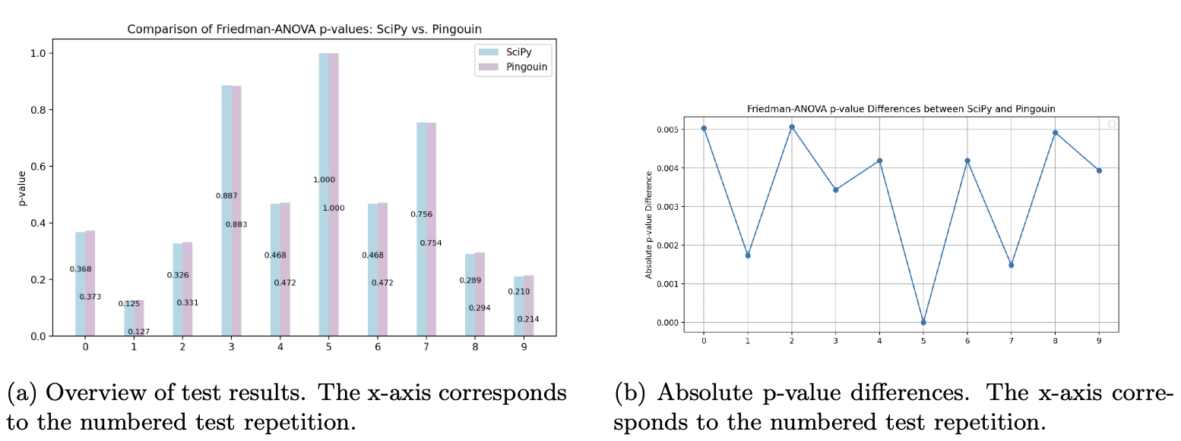
Excursion: scipy vs. pingouin
Results of 10x repeated statistical tests implementation of scipy and pingouin with three example 1x25 vectors → using scipy
scipy. friedmanchisquare SciPy v1.16.2 Manual. https://docs.scipy.org/doc/scipy-1.16.2/reference/generated/scipy.stats.friedmanchisquare.html. [Accessed 27-11-2025].
scipy. wilcoxonSciPy v1.16.2 Manual. https://docs.scipy.org/doc/scipy-1.16.2/reference/generated/scipy.stats.wilcoxon.html. [Accessed 27-11-2025]

Slide 10
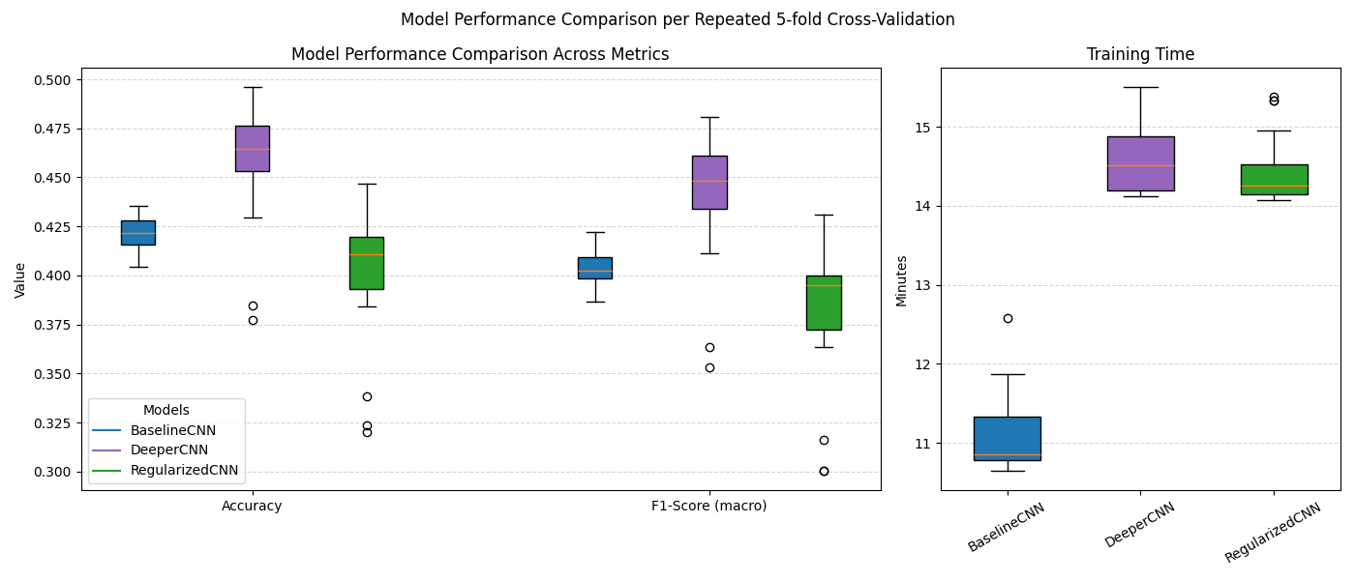
4. Results: Training Outcome
DeeperCNN best accuracy, f1-score values
Longest training for DeeperCNN as well

Slide 11
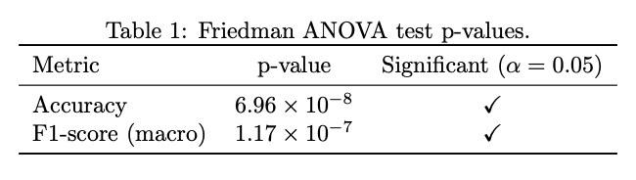
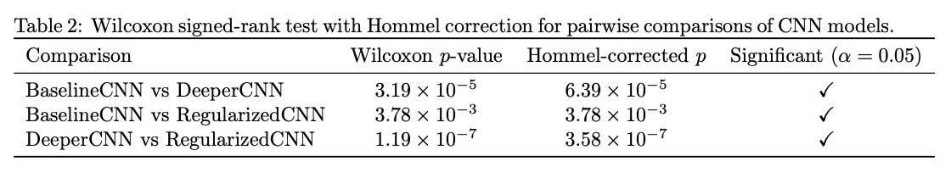
4. Results: Statistical Analysis
Friedman ANOVA
Post-hoc Hommel corrected Wilcoxon (acc)
Fernanda Fiel Peres. Effect sizes for nonparametric tests. Biochemia Medica, 36(1), December2025

Slide 12
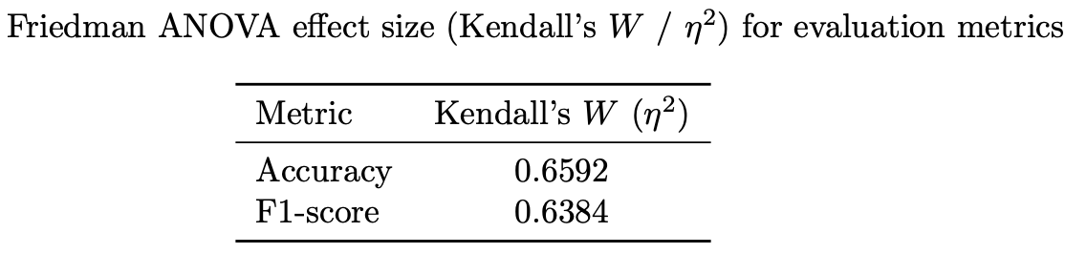
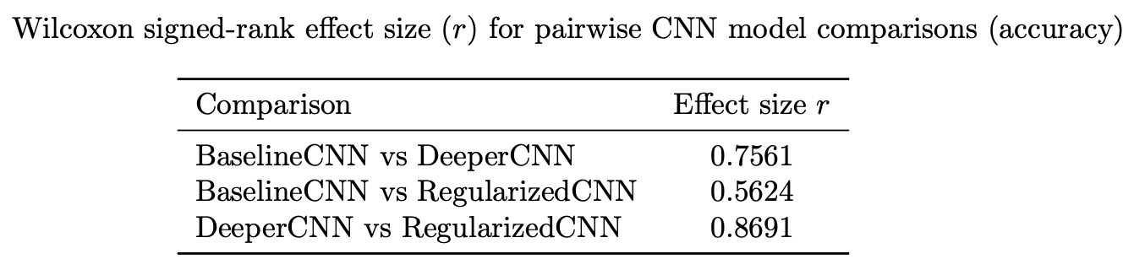
4. Results: Effect Analysis
Effect size for Friedman ANOVA: Kendall’s W
Effect size for Wilcoxon Test:
r
Fernanda Fiel Peres. Effect sizes for nonparametric tests. Biochemia Medica, 36(1), December2025

Slide 13
Conclusion
Friedman ANOVA: compare all modes together
  there exists a statistical significance among the CNN variants
Wilcoxon signed-rank: compare model pairs
  → Each model pair is significantly different (most BaselineCNN vs. RegularizedCNN)
Effect sizes:
  For Friedman ANOVA: very similar, acc slightly higher power
  For Wilcoxon: highest effect size for DeeperCNN vs RegularizedCNN

Slide 14
Thank you.

