Slide 1
Mastodon → Blender/SciView
NG protocol: context, thoughts, plans
Follow us here: https://imagesc.zulipchat.com/#narrow/stream/327470-Mastodon/topic/Blender
v0.1: May 12, 2022, written by Vladimir Ulman
v0.x: you’re welcome here!

Slide 2
Some notes from my early days with SciView and SimViewer
I’m operating with the notion of Source and Sink
Both operate with a set of objects
Source – holds a set of all original objects
Sink – holds own display objects requested to be displayed
  Two independent sets of objects, the only link between them was an ID attribute
  One original object may have associated multiple display objects
  There’s not necessarily a pure one-to-one mapping
  I used to use categories of displayed objects
    Shape-driven (spheres, lines, vectors)
    Function-driven
      Normal local content – a placeholder display of a cell, e.g. Sphere
      Debug local content – aux display related to the cell, e.g. a flag or vector that shows e.g. movement vector, trajectory
      Normal global content – content not related to any cell, e.g. a frame of a scene
      Debug global content – similar to the normal gl. Content
    User at Sink could show/hide various categories
    Source submitted all display requests, user at Sink filtered what to display
    Source could decide not to send everything to save communication bandwidth
    Amount of data to be displayed was thus controlled both at Source and Sink
Message: I like that user at the Sink have additional own control
SciView didn’t have a notion of time → Was showing only the current content (but I believe the notion of time can be introduced)

Slide 3
Some notes from my early days with SciView and SimViewer → Consequences & Wishes
Source – holds a set of all original objects
Sink – holds own display objects requested to be displayed
Two independent sets of objects, the only link between them was an ID attribute
I used to use categories of displayed objects
    Shape-driven (spheres, lines, vectors) performance gain – instancing
    Function-driven another resolution axis – finer control when aux data is displayed
New thing: Time attribute Blender has time axis, we can have a “history bag”
    Moving along time axis in Blender is really user comfortable (one keypress! ...or with a mouse)
    Can show development of the content
    Can show “versions” of the same data
      It’s an abuse of “time” semantics → widens the semantics and takes-in the “function-driven” aspect from categories
      Deeping the abuse: Time as a string! → Visibility containers (aliased to Buckets, see next slide)
      Buckets… the abuse turned into a feature, yay!
Source submits display requests to the Sink (show these 5 spheres)
Sink may send back update requests and event requests (update position of this sphere, focus on that sphere)
The requests act on a displayed object (either it defines it, or reports an activity on it)
Within a Sink, every displayed object should know its:
  Source → for a feedback line, facilitates user’s filtering ability
    Bucket → semantics grouping, one (and only) additional level to facilitate user’s filtering ability
      Category → technical necessity, should be renamed to (Reference) Shape

Slide 4
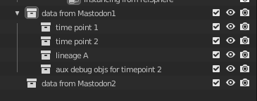
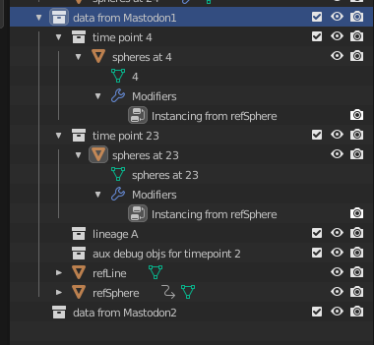
“Buckets” at Blender side
Technically it is a Collection
There can be a hiearchy of Buckets (Collections)
  Two levels: 1st level list of sources, 2nd level list of buckets --------→
  Two levels: Source level, Bucket level
Bucket holds objects from one source (e.g., Mastodon, EG)
  … that shall be visible only at exactly one frame (integer number)
  … or that shall be visible always, at any frame (integer -1)
        Possible extension: Interval? Easy for V.U. atm.
        Possible extension: Set? Hard for V.U. atm.
  … and that shall be semantically related (only for the user filtering comfort)
Every Bucket has own identification name (string), e.g. “projectNick TP = 4”
  Identification must be unique within its Source level
Bucket may contain Shapes
  These Shapes are “from” the same Source
  and belong semantically together
  and are thus visible under the same condition
  A Shape Blender object is technically… well… a Table
    One row is one position/occurence of the Shape
    Columns are position, color, Shape related extras, etc.
    Blender displays (owing to us-provided Geometry Nodes)
      One instance of the Shape for every row in that table
      At the position
      The Shape is possibly further adjusted as a result of
        The Geometry Nodes pipeline
        Shape related extras attributes in the table
Source
Bucket
Shape
This Mesh
contains
the Table
Attached
GeometryNodes
Reference
Geometry

Slide 5
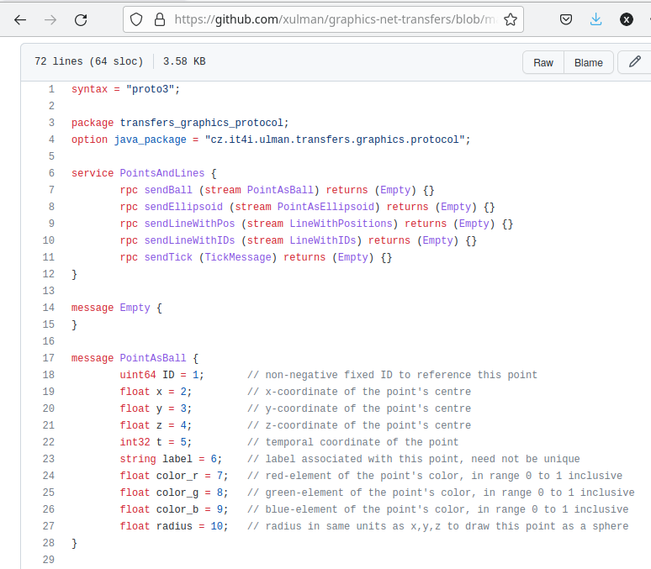
“Buckets” at Blender side
An arriving object to be displayed should provide: Example protocol to be improved:
Source (IP + showName string,
this provides the underlying messaging subsystem)
Bucket to which it belongs (within the Source): String
Reference shape: Should be enum
  Let’s encode this into the name of the message
  DisplaySphere(…), DisplayLine(…)
Params of that shape (e.g. centre coordinate, radius)
ID of this under which the Source will recognize it
The Source and Shape are in fact implicit parameters
Message needs to contain only the data in bold
If this layout is Okay, we could move to discussing
the communication scheme
Examples:
How to communicate Bucket, Colors (color palletes)?
Define next timepoint always from scratch, or as an
update from some other timepoint, or allow both?
Delete obj. messages yes/no?

