Slide 1
Open chromatin in human neuron and astrocyte samples

Slide 2
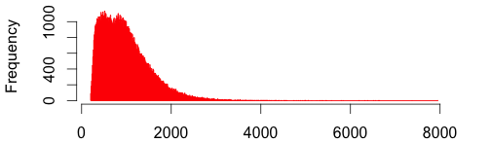
Open chromatin in human neuron and astrocyte by ATAC sequencing
Open chromatin region width ranges from 201 to 7943 bp
Open chromatin covers 1% to 1.9% of the genome (9 samples)
Asli did peak call with MAC2

Slide 3
Neuron and astrocyte have different open chromatin
42K to 68K shared peaks in 2 or more samples, and 131794 regions
Neuron and astrocyte have separate peak sets

Slide 4
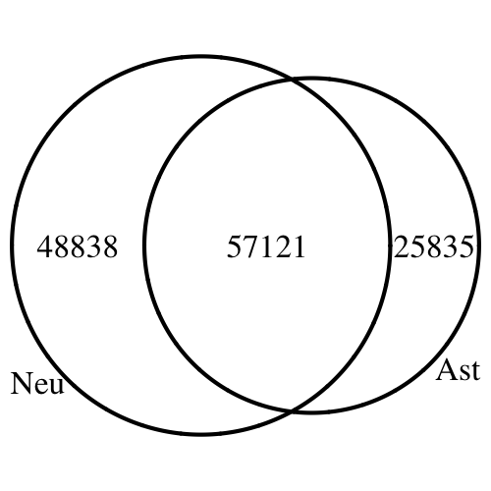
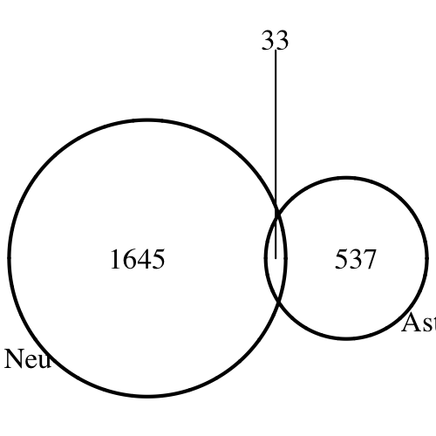
Cell type-specific open promoters
L: shared and cell type-specific peaks
R: Genes whose promoters covered by cell type-specific peaks

Slide 5
Open chromatin relative to genetic features
Proportion of each genetic feature’s open chromatin part in base pair unit
5’UTR is highly enriched, promoter second, 3’UTR has the least

Slide 6
Open chromatin relative to genetic features
Proportion of each genetic feature’s open chromatin part divided by proportion of open chromatin over genome (odds ratio)
5’UTRs are roughly 15 times more enriched, promoters are roughly 7 times more

Slide 7
Open chromatin relative to genetic features
Genetic features proportions that are covered by at least one open chromatin peak
Intergenic and genes are highly covered because they are long
Roughly 40% of all promoters have open chromatids

Slide 8
ADSP integration
244 genomic variants from ADSP study (LOD > 15)
2 are in open chromatin in all 3 astrocyte samples: rs9809820, rs11717133
3 are in open chromatin in all 6 neuron samples: rs191267549, rs11717133, rs74944275
Odd ratio of the top ADSP variants being in open chromatin is 0.86 to 1.63 (no enrichment)
variant | gene | consequence
rs9809820 | SELT | upstream_gene_variant
 | SERP1 | intron_variant
rs11717133 | LINC00886 | intron_variant
 | ENSR00001485372 | regulatory_region_variant
rs191267549 | NANOS1 | missense_variant
 | EIF3A | downstream_gene_variant
 | ENSR00000362682 | regulatory_region_variant
rs74944275 |  | intergenic_variant

Slide 9
Open chromatin in human neuron and astrocyte samples

Slide 10
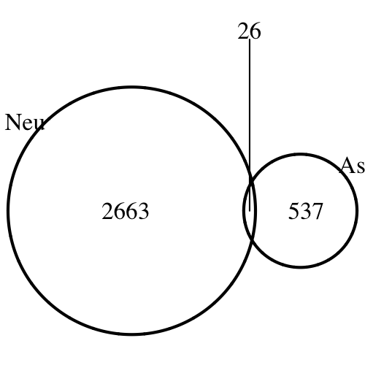
Open promoter genes (cell specific)
Statistical model identified 33720 neuron-specific and 50859 astrocyte-specific open chromatin regions (Asli)
Promoters of 2689 genes in neuron and 563 genes in astrocyte were covered
More astrocyte open chromatin in total, but much less in the promoters (follow-up)
Neuron genes were enriched with metabolic process, astrocyte genes were enriched with immune response

