Slide 1
Open chromatid in human neuron and astrocyte samples

Slide 2
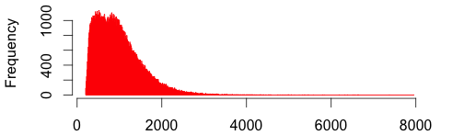
Open chromatid in human neuron and astrocyte by ATAC sequencing
Open chromatin region width ranges from 201 to 7943 bp
Open chromatin covers 1% to 1.9% of the genome (9 samples)
Asli did peak call with MAC2

Slide 3
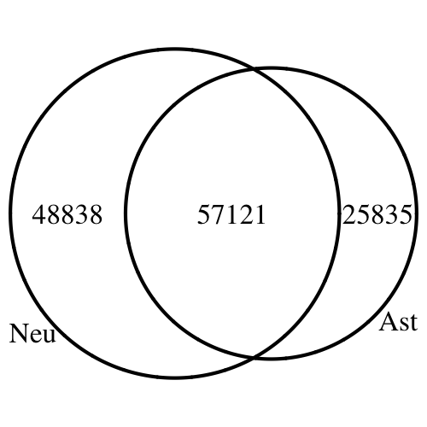
Neuron and astrocyte have different open chromatid
16K to 34K unique peaks each sample, and 42K to 68K shared peaks
We only use shared peaks, which represent 131794 unique regions
Neuron and astrocyte have separate peak sets (venn numbers by pulling replicates together)
We identified neuron/astrocyte-specific peaks with statistical model

Slide 4
Open chromatin relative to genetic features
Proportion of each genetic feature’s open chromatin part in base pair unit
5’UTR is highly enriched, promoter second, 3’UTR has the least

Slide 5
Open chromatin relative to genetic features
Proportion of each genetic feature’s open chromatin part divided by proportion of open chromatin over genome (odds ratio)
5’UTRs are roughly 15 times more enriched, promoters are roughly 7 times more

Slide 6
Open chromatin relative to genetic features
Genetic features proportions that are covered by at least one open chromatin peak
Intergenic and genes are highly covered because they are long
Roughly 40% of all promoters have open chromatids

Slide 7
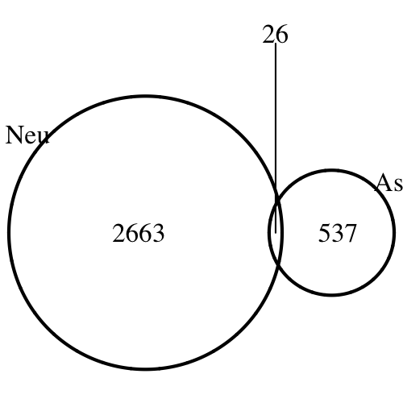
Open promoter genes (cell specific)
Statistical model identified 33720 neuron-specific and 50859 astrocyte-specific open chromatin regions (Asli)
Promoters of 2689 genes in neuron and 563 genes in astrocyte were covered
Neuron genes were enriched with metabolic process, astrocyte genes were enriched with immune response

Slide 8
ADSP integration
244 genomic variants from ADSP study (LOD > 15)
2 are in open chromatid in all 3 astrocyte samples: rs9809820, rs11717133
3 are in open chromatid in all 6 neuron samples: rs191267549, rs11717133, rs74944275
Odd ratio of the top ADSP variants being in open chromatin is 0.86 to 1.63 (no enrichment)
variant | gene | consequence
rs9809820 | SELT | upstream_gene_variant
 | SERP1 | intron_variant
rs11717133 | LINC00886 | intron_variant
 | ENSR00001485372 | regulatory_region_variant
rs191267549 | NANOS1 | missense_variant
 | EIF3A | downstream_gene_variant
 | ENSR00000362682 | regulatory_region_variant
rs74944275 |  | intergenic_variant

