Slide 1
Link Stat3 with Alzheimer’s Disease

Slide 2
Alignment
Expression estimation
Gene filter
Generalized linear model
App genes; aging genes
Regulator detection
Notes:
RNA-sequencing reads were aligned to mouse transcriptome with bowtie. The mouse transcriptome was built from GRCm38 genome assembly and the latest Ensembl annotations. Transcript expression in transcripts per million (TPM) were estimated with RSEM. Log2-transformed TPM were modeled by a generalized linear model (GLM) with four predictors: age (2m, 4m, 5m, 6m), App, age-app interaction, and experiment batch. Genes that were well modeled were chosen by two criteria: R squared bigger than 0.5 and F-statistics q-value (FDR) smaller than 0.05. App-related genes were identified as those that have absolute effect size bigger than 0.2 and p-value small than 0.05 in any of the app-related predictors in the GLM. We used the same strategy to identify the age-related genes. Potential master regulators were identified with iRegulon.

Slide 3
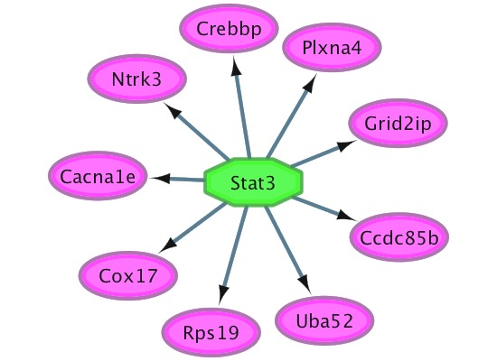
ATCG
61 App-related genes from the GLM
Compute enriched motifs from 9713 candidate motifs (take 500bp upstream of TSS region)
Map enriched motifs to transcription factors

Slide 4
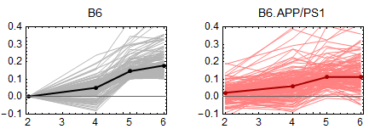
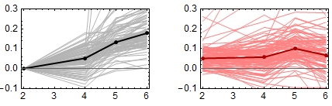
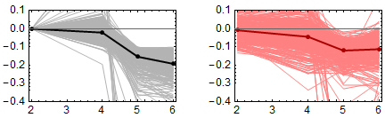
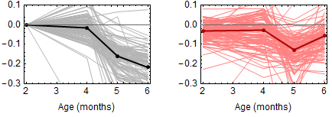
N = 132
oxidation-reduction process | 2 x 10⁻⁷
metabolic processes | 7 x 10⁻⁷
ribosome | 2 x 10⁻¹⁶
Alzheimer’s disease | 1 x 10⁻³
N = 95
proton transport | 4 x 10⁻⁸
oxidative phosphorylation | 5 x 10⁻¹⁸
Alzheimer’s disease | 1 x 10⁻⁹
neurogenesis | 3 x 10⁻¹⁹
neuron differentiation | 9 x 10⁻¹⁹
long-term potentiation | 3 x 10⁻⁵
N = 276
nervous system development | 1 x 10⁻⁶
Jak-STAT signaling pathway | 3 x 10⁻⁴
N = 113
The JAK-STAT signaling pathway starts going down from 4 month in the normal aging brain. However, this downward process turns back in the 6 month APP/PS1 mice.
It is worth noting that this gene group is also enriched with nervous system development, which links the traditional immune signaling pathway with neural system.
Notes:
We looked into each gene’s effects from the generalized linear model, and identified co-regulating gene groups. A total of 95 genes that consistently increase in B6 brains, start going down from 5 to 6 month in the APP/PS1 mice (second group). This gene group is enriched with proton transport, oxidative phosphorylation, and Alzheimer’s disease. On the other hand, a total of 113 down-regulating gene that are enriched with nervous system development and JAK-STAT signaling in B6 brains start going up in 5 month APP/PS1 brains. In the first and third group, normal up-regulating (first) and down-regulating (third) genes start attenuating in the 5 month APP/PS1 mice.

Slide 5
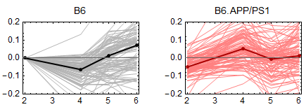
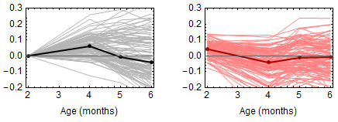
Early AD signals at 4 months
N = 36
N = 98
?
N = 99
regulation of vasodilation | 3 x 10⁻⁵
neurotrophin production | 5 x 10⁻⁵
negative regulation of vascular endothelial growth factor receptor signaling | 5 x 10⁻⁴
endocytosis | 1 x 10⁻³
chemokine signaling pathway | 3 x 10⁻³
A group of 98 genes that do not express until 6 month in B6 brain turn up as early as 4 month in APP/PS1 mice
Another 99 down-regulating signal in 6 month B6 brain show at 4 month APP/PS mice.
Notes:
Early signatures, accelerated aging. Normally a 5-6 months signal appearing at 4 months.

Slide 6
List
JAK-STAT signaling pathway in more detail
STAT3 interacting proteins: AR, ELP2, EP300, EGFR, HIF1A, JAK1, JUN KHDRBS1, MTOR, MYOD1, NDUFA13, NFKB1, NR3C1, NCOA1, PML, RAC1, RELA, RET

Slide 7
Stat3-interacting proteins
Modeling the 2-6 month WT/APP mRNA data revealed four Stat3-interacting proteins have significant APP effects in the RNA level, in terms of p-value and effect size. The 4 genes are: Ep300, Ndufa13, Nfkb1, Ncoa1.
Interestingly, the four gene’s APP effect all appears at 6 month, which is the same as Stat3. This striking concord pattern indicates they function together in the pathology of the later stage AD brain. Co-IP experiments on the four proteins, together with Stat3, will provide mechanistic insights.
Another two Stat3-interacting proteins, Mtor and Stat1, showed significant aging effects, but not APP effect. Given that the aging effect was also at 6 month, they might be a necessary component of the Stat3-mediated AD pathology.

Slide 8
Progress
A well-defined TF network is not ready. Different databases have poor overlaps (TRED, ITFP, CENTIPEDE, iRegulon).

