Slide 1
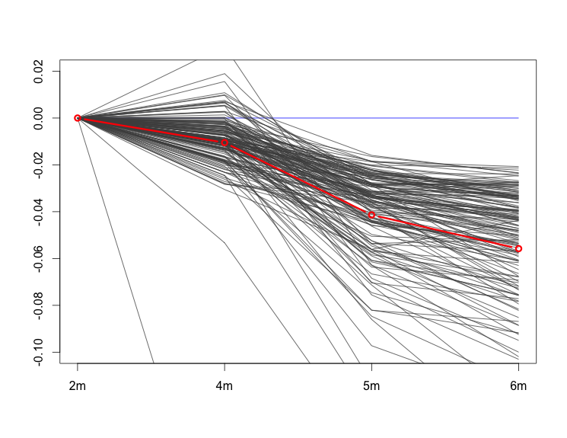
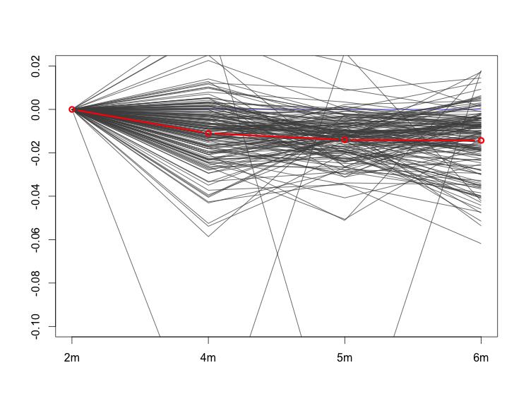
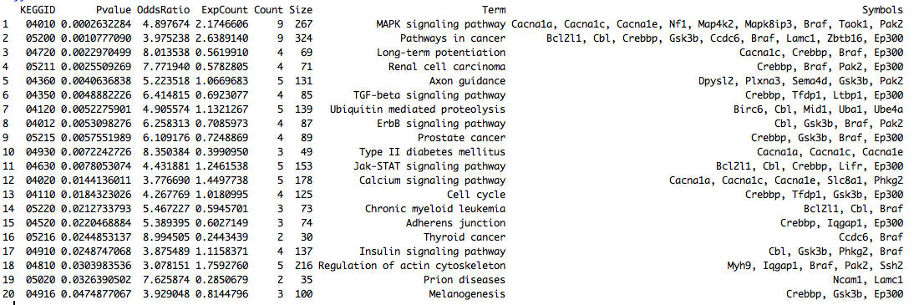
160 genes
A group of 160 genes decrease from 5 to 6 month in WT, but not as much in APP. This gene group is enriched with LTP. This is also the strongest APP signal from the model.

Slide 2
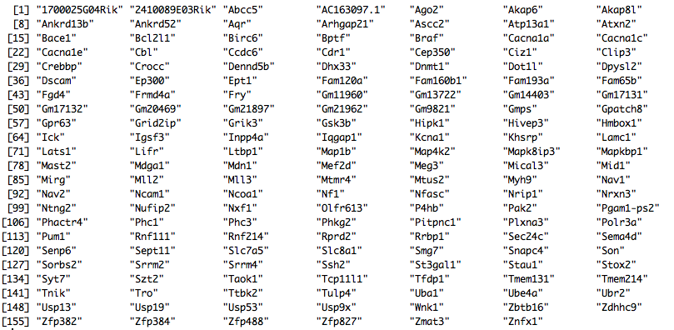
160 genes

Slide 3
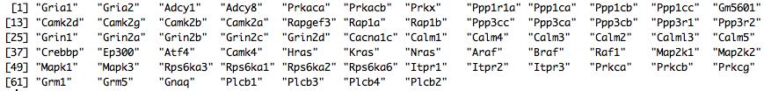
LTP KEGG genes

