Slide 1
RNA sequencing data discussion

Slide 2
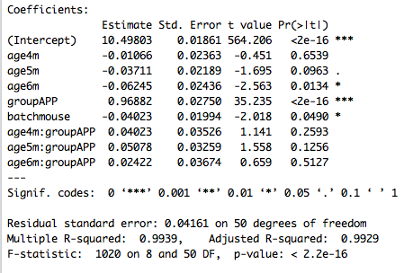
General Linear regression
2m (5/5)
4m (9/5)
5m (13/11)
6m (7/5)
WT/APP
mean of 2m, WT, batch1
4m when WT
5m when WT
6m when WT
APP when 2m
when batch2
4m when APP
5m when APP
6m when APP

Slide 3
Generalized linear model
Pipeline to mine app-mutation- and age-related genes
Maximal expression > 3.78
Expressed in more than 1/10 samples
R squared > 0.5
F-test q-value (FDR) < 0.05
P-value of App-predictors < 0.05
Regression parameter > 0.2
P-value of Age-predictors < 0.05
Regression parameter > 0.2

Slide 4
Generalized linear model
Pairwise t-test genes
Pathway
GLM-identified cohorts
Co-expression modules
PCA on GE and GLM parameters
PCA on modules to identify Eigengene
Five month APP stratification
Normalize to two month samples
Retina

Slide 5
Genes clusters with APP effect
App effect does not appear until 6 month
App effect appears in as early as 2 month and does not go further
App effect appears in 2 month, stay in 4 month, additional change appears in 5 and 6 month
App effect appears briefly in 5 month, but not before or after
App effect appears in 2 month, stay in 4 month, but additional change appears in 5 month
App effect appears in 4 month and 6 month
App effect appears in 5 month and 6 month
App effect appears in 2 month, and additional change appear in 4 month but not afterward
App effect appears in 2 month, stay in 4 and 5 month, but additional change appears in 6 month
App effect appears in 4 and 5 month

Slide 6
Genes clusters with age effect
Age effect on 5 and 6 month, no additional App-dependent age effect
Age effect only on 6 month without App-dependent age effect
Age effect on 5 and 6 month, additional App-dependent age effect on 6 month
Age effect from 4 to 6 month, no App-dependent age effect
Both Age and App-dependent age effect on 6 month
App-dependent age effect on 6 month
Age effect from 4 to 6 month, additional App-dependent age effect from 5 to 6 month

Slide 7
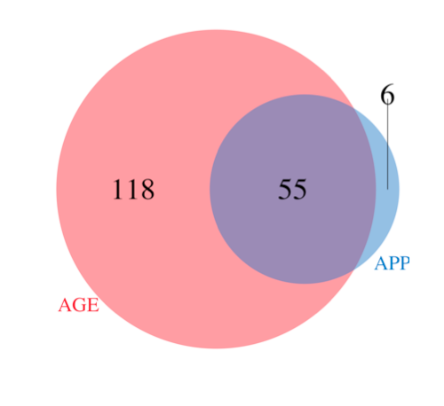
GLM genes

Slide 8
HC on GLM genes

Slide 9
HC on GLM genes

Slide 10
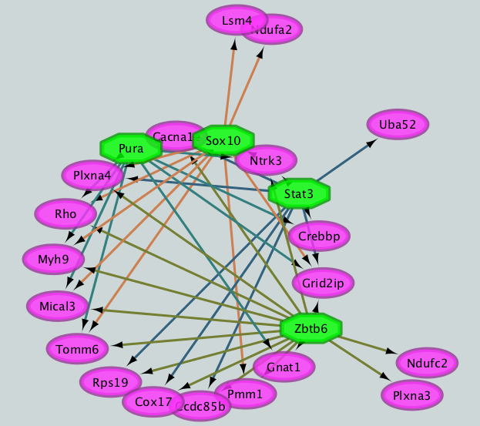
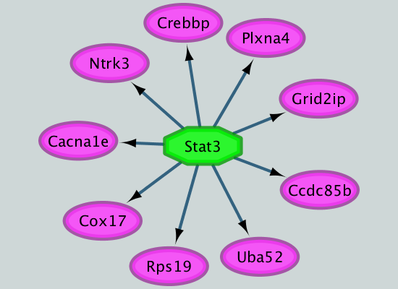
Pathway
Stat3 is a potential master regulator for Alzheimer’s disease

Slide 11
Pathway

Slide 12
General Linear regression
2m
4m
App 456
5m
6m

Slide 13
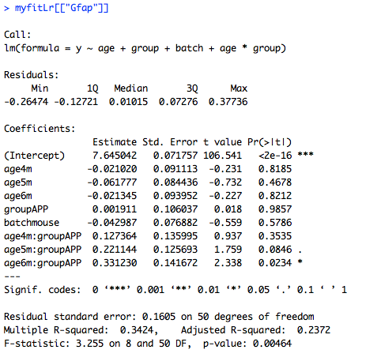
Gene
C1qa and C1qc are included in the working list, but more could show up with less stringent criteria.

Slide 14
C1qa: all of the brain samples

Slide 15
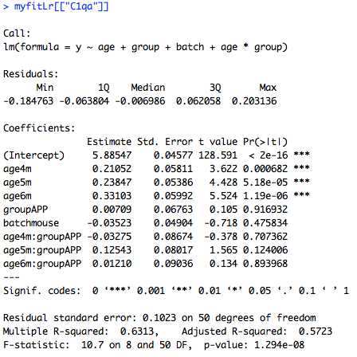
C1qa in the brain: 2 batches
C1qa increases over month significantly, but there is no effect on APP mutant

Slide 16
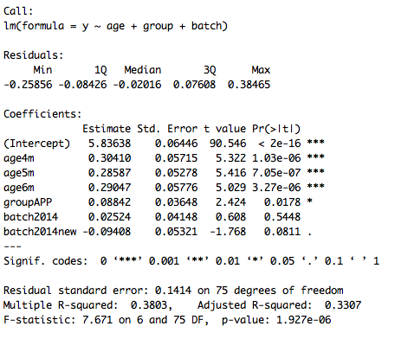
C1qa in the brain: 3 batches
P-value shows significance by pooling all 3 batches together. However, the effect is very small 0.08842, which represent a 6% increase.

Slide 17
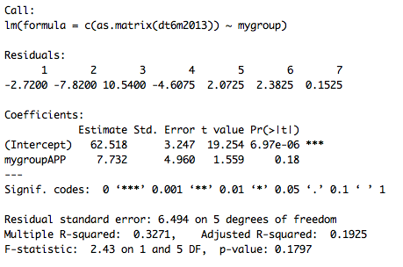
C1qa in the brain: 2013 6m only
P-value is 0.18 if we only take the 6m samples from 2013 batch

Slide 18
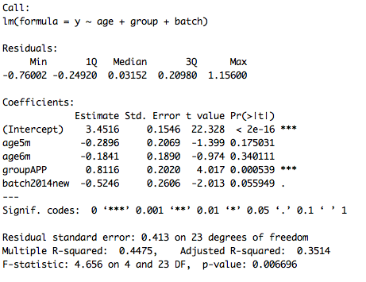
C1qa: all the retina samples
There is a strong APP effect on retina samples, with a effect size of 0.8116, represents 75% increase. P-value is 0.000539. Looks it is mostly come from the 2 month sample from the boxplot.

Slide 19
Pipeline for expression estimation
Quality control
Trimmomatic, FASTX
Alignment
Bowtie
1484L-584
Expression Estimation
RSEM
1484L-584

Slide 20
2013 and 2014 samples

Slide 21
HC on 2014 samples

Slide 22
Mouse 1559

Slide 23
Hierarchical clustering
Take off mouse 1559
Batch correction by regression

Slide 24
Hierarchical clustering
Take off mouse 1559
Batch correction by regression
Normalize on 2 month

Slide 25
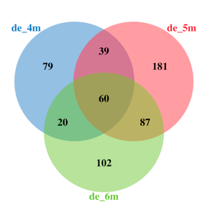
DE genes in pipeline 1
Batch correction with linear regression (2014 and 2014 new)
Normalize [456] month WT samples to 2m WT per gene
Normalize [456] month APP samples to 2m APP per gene
Pair-wise t-test for [456] month WT/APP

Slide 26
HC use differential genes

Slide 27
Polynomial GLM
2m
4m
5m
6m
WT/APP

Slide 28
Polynomial GLM

Slide 29
Polynomial DE genes

Slide 30
Polynomial GLM

Slide 31
Discussion
Supervised clustering with Lasso

Slide 32
Sample median correlation
Gene Filter
Max > 5 in TPM
B: 38216 -> 13738
R: 38216 -> 12590
Median correlation
Spearman
Mouse 226941
APP 6m 2013
Mouse 3310
APP 2m 2014

Slide 33
Spike ins: App and Prnp
Mouse ID: 265182 Brain APP 6m 2013

Slide 34
2013 and 2014 samples

Slide 35
2014 previous and new samples

Slide 36
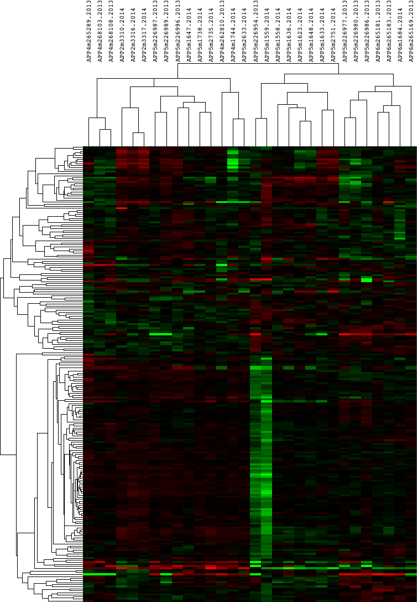
Cluster3 and Java Tree
APP-related genes: 115
Functional enrichment
Protein phosphate
Transcriptional activity
MAM domain
Axon guidance

Slide 37
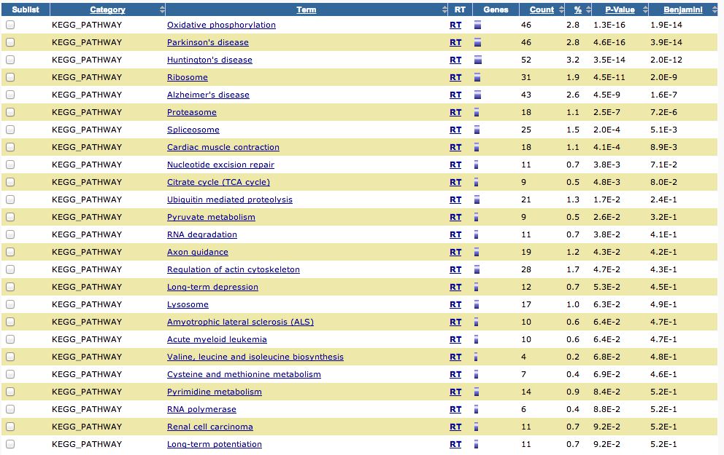
t-test between two 5 month APP clusters
1833 genes shown significantly different with FDR < .05. Enriched pathways shown above.

Slide 38
Experiment design
2m
4m
5m
6m
WT/APP
Brain | 2 month |  | 4 month |  | 5 month |  | 6 month
 | WT | HET | WT | HET | WT | HET | WT | HET
2014-new |  | 2 | 2 | 4 |  |  |  | 4
2014 | 5 | 3 | 7 | 1 | 13 | 11 | 7 | 1
2013 |  |  | 4 | 4 |  | 7 | 4 | 3
total | 5 | 5 | 13 | 9 | 13 | 18 | 11 | 8
Retina | 2 month |  | 4 month |  | 5 month |  | 6 month
 | WT | HET | WT | HET | WT | HET | WT | HET
2014-new |  | 2 |  |  |  |  |  | 4
2014 | 5 | 2 |  |  | 5 | 3 | 6 | 1
total | 5 | 4 |  |  | 5 | 3 | 6 | 5

