Slide 1
Outline
Bulk RNA-sequencing on LOAD samples (Apoe, ApoE4, Bin1, Cd2ap, Clu)
Use the public single cell RNA-sequencing data in neurobiology projects
Identify marker cells with Enrichment test
Identify marker cells with PMCA (Robyn)

Slide 2
Clu: Homozygous KO
The protein encoded by this gene is a secreted chaperone that can under some stress conditions also be found in the cell cytosol. It has been suggested to be involved in several basic biological events such as cell death, tumor progression, and neurodegenerative disorders. Hg: The protein encoded by this gene is a secreted chaperone that can under some stress conditions also be found in the cell cytosol. It has been suggested to be involved in several basic biological events such as cell death, tumor progression, and neurodegenerative disorders. Alternate splicing results in both coding and non-coding variants.

Slide 3
Bin1: Heterozygous KO
This gene encodes several isoforms of a nucleocytoplasmic adaptor protein, one of which was initially identified as a MYC-interacting protein with features of a tumor suppressor. Isoforms that are expressed in the central nervous system may be involved in synaptic vesicle endocytosis and may interact with dynamin, synaptojanin, endophilin, and clathrin. Isoforms that are expressed in muscle and ubiquitously expressed isoforms localize to the cytoplasm and nucleus and activate a caspase-independent apoptotic process. Studies in mouse suggest that this gene plays an important role in cardiac muscle development. Alternate splicing of the gene results in ten transcript variants encoding different isoforms. Aberrant splice variants expressed in tumor cell lines have also been described..

Slide 4
Apoe: Homozygous KO and huTG
The protein encoded by this gene is a major apoprotein of the chylomicron. It binds to a specific liver and peripheral cell receptor, and is essential for the normal catabolism of triglyceride-rich lipoprotein constituents. This gene maps to chromosome 19 in a cluster with the related apolipoprotein C1 and C2 genes. Mutations in this gene result in familial dysbetalipoproteinemia, or type III hyperlipoproteinemia (HLP III), in which increased plasma cholesterol and triglycerides are the consequence of impaired clearance of chylomicron and VLDL remnants. Alternative splicing results in multiple transcript variants.

Slide 5
Cd2ap: Heterozygous KO
This gene encodes a scaffolding molecule that regulates the actin cytoskeleton. The protein directly interacts with filamentous actin and a variety of cell membrane proteins through multiple actin binding sites, SH3 domains, and a proline-rich region containing binding sites for SH3 domains. The cytoplasmic protein localizes to membrane ruffles, lipid rafts, and the leading edges of cells. It is implicated in dynamic actin remodeling and membrane trafficking that occurs during receptor endocytosis and cytokinesis. Haploinsufficiency of this gene is implicated in susceptibility to glomerular disease.

Slide 6
Hierarchical clustering the samples
Apoe-KO and ApoE4-hgTG are similar
Homozygous strains (Apoe, ApoE4, Clu) have stronger signal than heterozygous ( Bin1, Cd2ap)

Slide 7
Up and down genes identified by a linear model
Cutoff: P-value < 0.05, log2 fold change 0.1
Clu-KO has strongest signal (homozygous)
Bin1-KO has weakest signal (heterozygous)

Slide 8
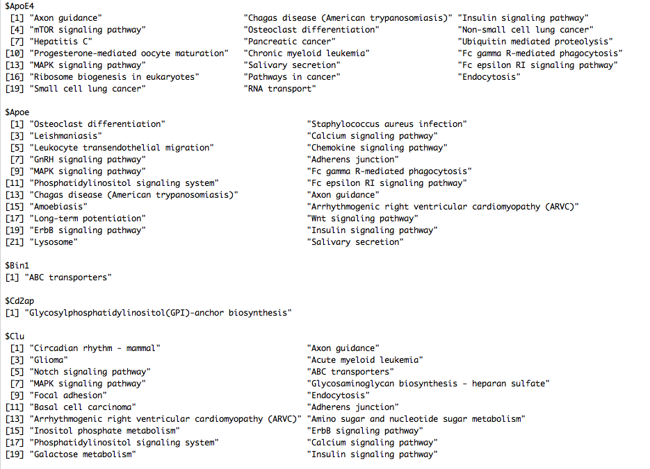
KEGG enrichment for UP genes: cutoff: P-value < 0.01

Slide 9
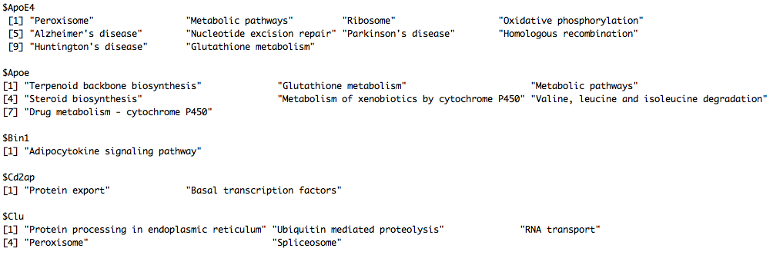
KEGG enrichment for DOWN genes: cutoff: P-value < 0.01

Slide 10
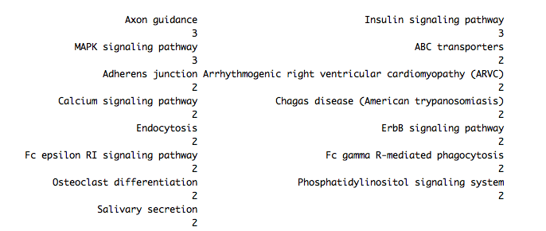
Shared KEGG
Shared enriched KEGG in UP genes
Shared enriched KEGG in DOWN genes

Slide 11
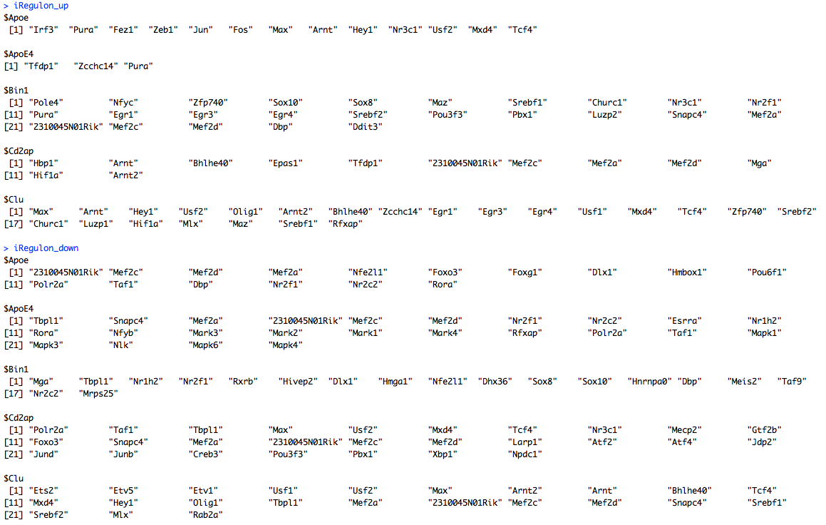
Key regulators (motifs in 500bp upstream TSS)

Slide 12
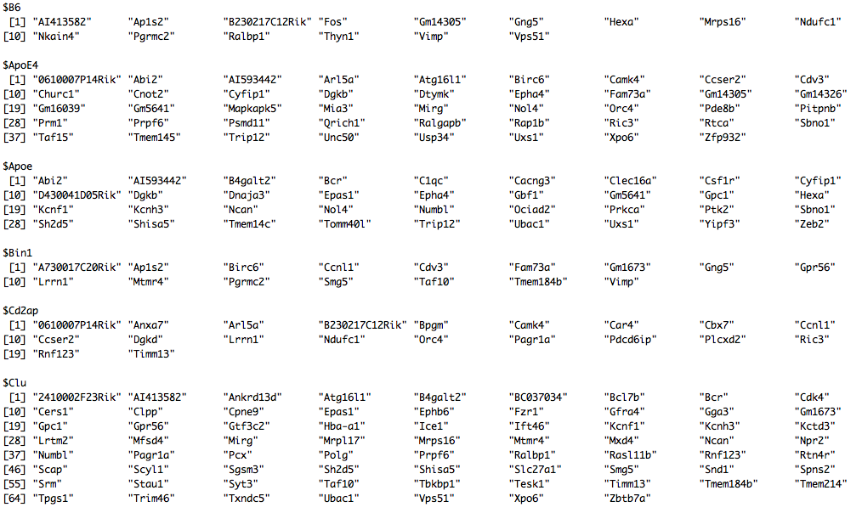
Define sample signature genes
Bayesian inference on a generalized linear model -→ 95% credible interval > 64 (TPM)
Signature group 1: appear in 1-2 samples -→ Signature group 2: appear in 1-5 samples (130, 183, 178, 151, 166, 163)

Slide 13
Single Cell RNA sequencing on 3005 Cortical Cells
Reference: Cell types in the mouse cortex and hippocampus revealed by single-cell RNA-seq. Science. 2015. Sten Linnarsson
Individual RNA molecules were counted using unique molecular identifiers
Molecularly distinct classes of cells were identified by clustering (9 major classes and 47 subclasses)
We used a generalized linear model to decompose the 47 cell type’s gene expression profiles
First mode on beta with a Bayesian inference used as expression estimate
To assign a gene as a marker of astrocyte, 95% credible interval of the βastrocyte from GLM needs to be 3+
Repeate for neuron, oligodendrocytes, et al.
Remove genes that appear in all cell types (more than 20, 30, 40 cells)
μ = β(astrocyte) ∗ astrocyte + β(neuron) ∗ neuron +...+β(basal) ∗ basal
y ∼ NB(μ, ρ)
carterdev:3838/SCR

Slide 14
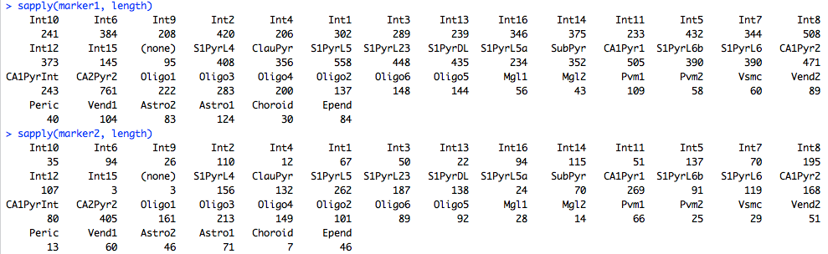
Marker genes for 47 cortical cells
Marker 1: appear in less than 47 cells
Marker 2: appear in less than 10 cells

Slide 15
From marker genes to marker cells (Hypergeometric P-value)

Slide 16
From marker genes to marker cells: PMCA (Robyn)

Slide 17
Map the samples to 47 cortical cell types with PMCA
Detect App and aging genes from bulk RNA-sequencing
Estimate each gene’s expression in 47 cortical cell types from single cell RNA-sequencing
Infer cell compositions of the bulk RNA-sequencing using PMCA
Group | Summary
APP | Int2 and Int8 are APP specific
WT2m | ClauPyr,S1PyrL5,S1PyrL23,S1PyrL6 are WT2m specific
WT4m | Int16,Int14,SubPyr,Pvm1,Astro2,Astro1 are WT4m specific
APP4m & APP5m | Int15 is specific to APP4m and APP5m
APP4m | Oligo2 & Oligo6 are specific to APP4m
APP4m | Oligo 1 is anti-associated to APP4m
APP5m | Oligo5 is anti-associated with APP5m
APP6m | Int1 may be specific to APP6m but the evidence is weaker for this association

Slide 18
Following are amended slides to answer questions from the meeting

Slide 19
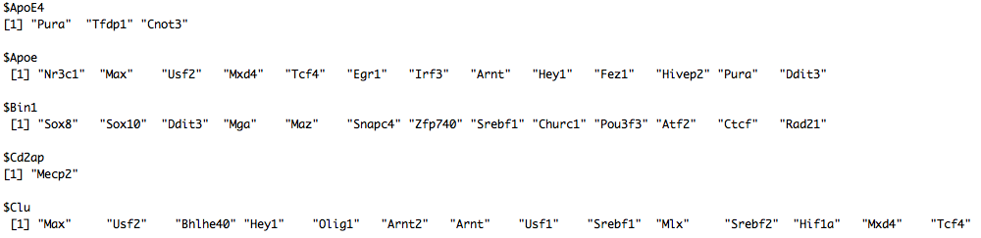
1: Key regulators by pooling up/down genes together

Slide 20
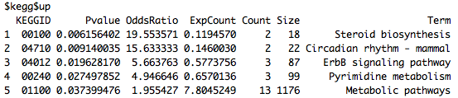
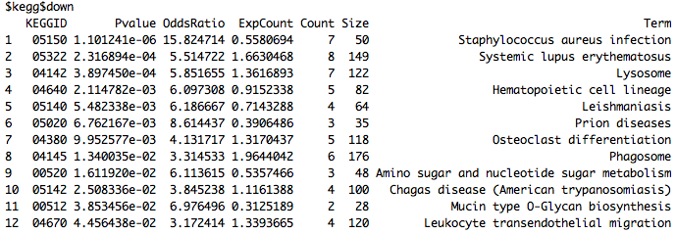
2: ApoE4 vs Apoe samples

Slide 21
3: Log2 TPM distribution

Slide 22
3: Log2 TPM distribution

Slide 23
3: Log2 TPM distribution

Slide 24
4: File List in Excel
File | Description
vsB6.xlsx | 5 Sheet, significant genes versus B6 for each of the 5 transgenic strains
vsB6_kegg_up.xlsx | 5 Sheet, KEGG of significant up genes for each of the 5 transgenic strains
vsB6_kegg_down.xlsx | 5 Sheet, KEGG of significant down genes for each of the 5 transgenic stains
Apoe.xlsx | 4 Sheet, UP/DOWN genes and KEGG
OutRegulator.xlsx | 5 Sheet, regulator<->target pairs for each of the 5 transgenic strains
marker.xlsx | 2 Sheet, genes shared in 1-2 samples (Sheet1) and shared in 1-5 samples (Sheet2)

