Slide 1
AD Project Updates

Slide 2
Samples
Brain | 2 month |  | 4 month |  | 5 month |  | 6 month
 | WT | HET | WT | HET | WT | HET | WT | HET
2014 | 5 | 3 | 7 | 1 | 13 | 11 | 7 | 1
2013 |  |  | 4 | 4 |  | 7 | 4 | 5
total | 5 | 3 | 11 | 5 | 13 | 18 | 11 | 6
Retina | 2 month |  | 4 month |  | 5 month |  | 6 month
 | WT | HET | WT | HET | WT | HET | WT | HET
2014 | 5 | 3 |  |  | 5 | 3 | 7 | 1
2013
total | 5 | 3 |  |  | 5 | 3 | 7 | 1

Slide 3
Analysis
Quality control
Trimmomatic, FASTX
Alignment
Bowtie
Expression Estimation
RSEM
1484L-584
./Dropbox/AD/rsem.xlsx
1484L-584

Slide 4
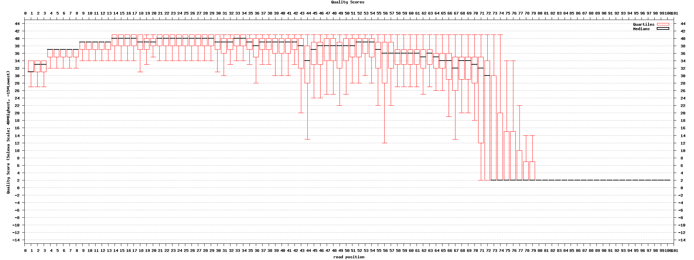
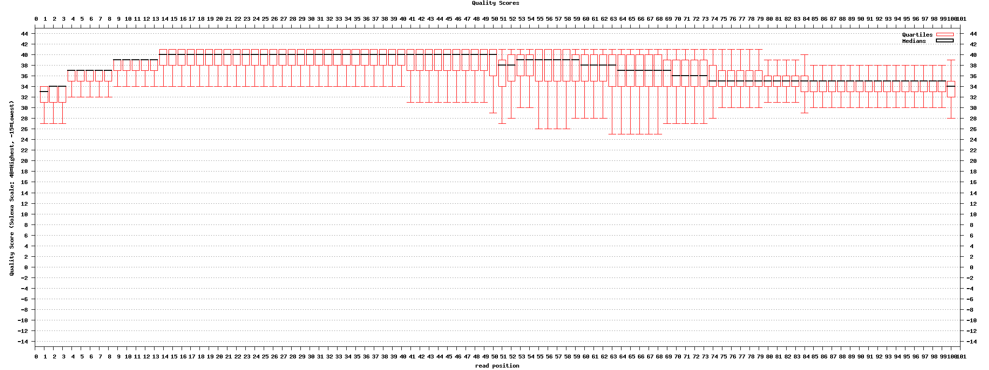
Low quality
ID: 1484
Normal

Slide 5
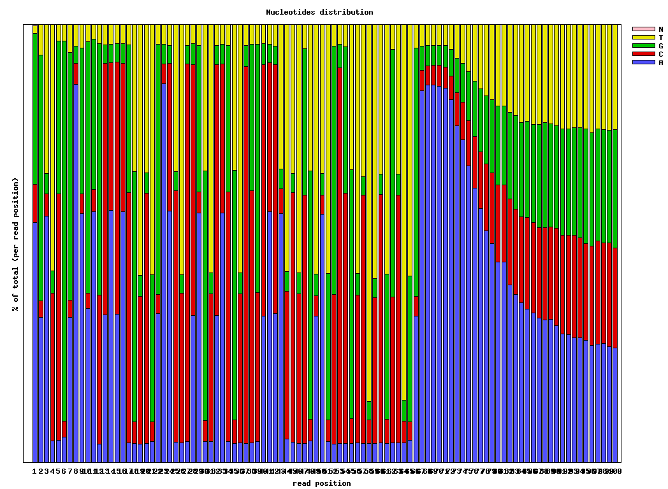
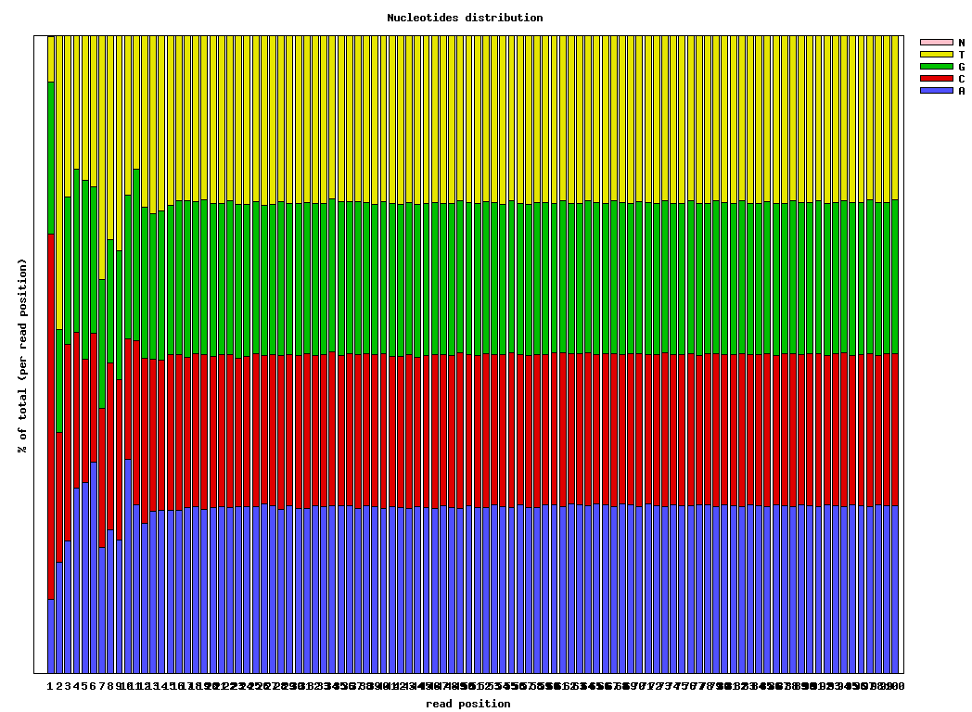
Low quality
ID: 1484
Normal

Slide 6
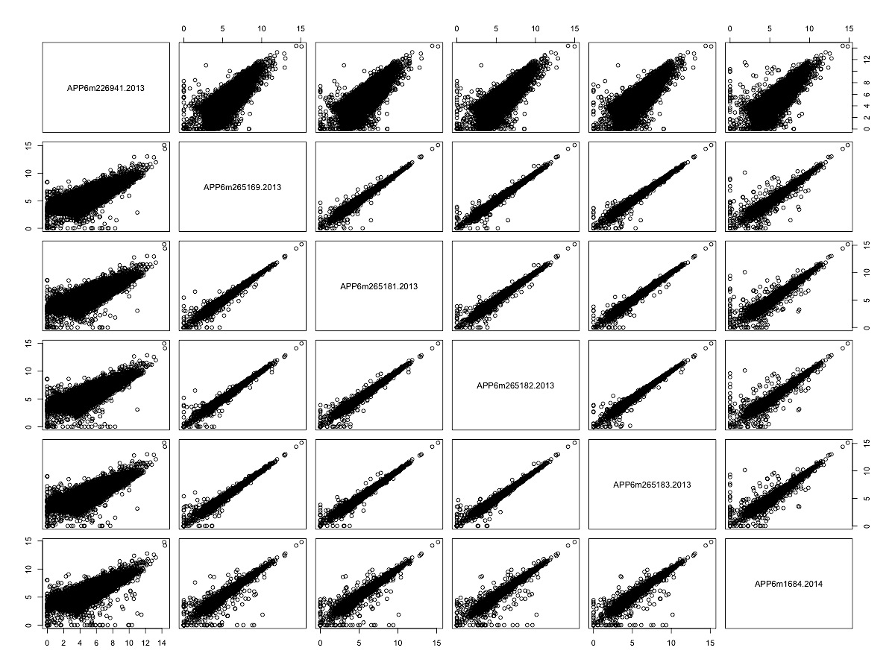
Median correlation: brain
TPM with gene filter
#: 38216 - 11868
Median Pearson Correlation
ID: 226941
ID: 226941

Slide 7
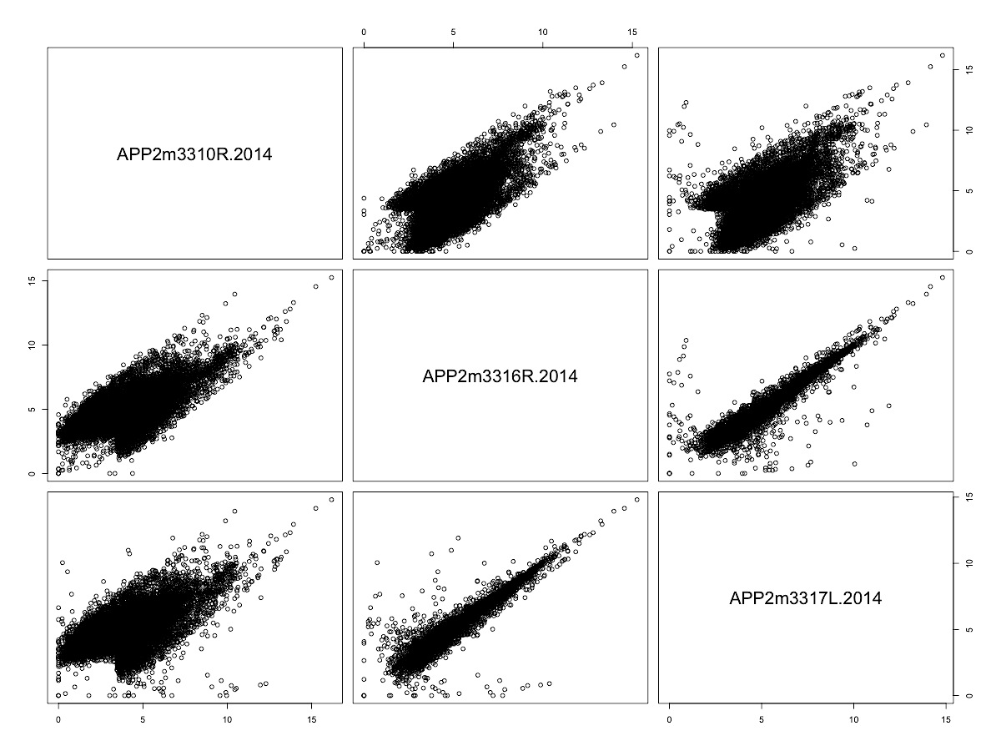
Median correlation: retina
TPM with gene filter
#: 38216 - 12499
Median Pearson Correlation
ID: 3310
ID: 3310

Slide 8
App and Prnp: brain
ID: 265182

Slide 9
App and Prnp: retina

Slide 10
Samples
Brain | 2 month |  | 4 month |  | 5 month |  | 6 month
 | WT | HET | WT | HET | WT | HET | WT | HET
2014-new |  | 2 | 2 | 4 |  |  |  | 4
2014 | 5 | 3 | 7 | 1 | 13 | 11 | 7 | 1
2013 |  |  | 4 | 4 |  | 7 | 4 | 3
total | 5 | 5 | 13 | 9 | 13 | 18 | 11 | 8
Retina | 2 month |  | 4 month |  | 5 month |  | 6 month
 | WT | HET | WT | HET | WT | HET | WT | HET
2014-new |  | 2 |  |  |  |  |  | 4
2014 | 5 | 2 |  |  | 5 | 3 | 6 | 1
total | 5 | 4 |  |  | 5 | 3 | 6 | 5

Slide 11
batch effects of brain samples

Slide 12
batch effects of brain samples
Gene selection: ANOVA
Y ~ Time + Type + Time * Type
#: 11857 - 8743
PCA

Slide 13
batch effects of brain samples

Slide 14
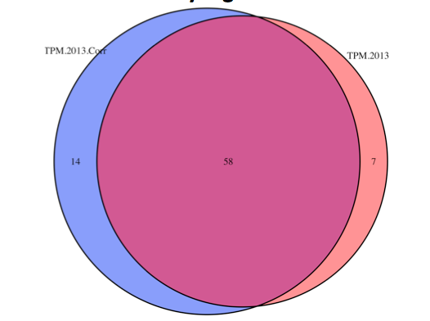
Effects of the batch effect correction
Brain | 2 month |  | 4 month |  | 5 month |  | 6 month
 | WT | HET | WT | HET | WT | HET | WT | HET
2014 | 5 | 3 | 7 | 1 | 13 | 11 | 7 | 1
2013 |  |  | 4 | 4 |  | 7 | 4 | 5 - 2
total | 5 | 3 | 11 | 5 | 13 | 18 | 11 | 4
P < 0.01 by regression test
TPM.2013: TPM of 6m 2013 samples
TPM.2013.Corr: The regression residuals

Slide 15
PCA on brain samples

Slide 16
PCA on brain samples

Slide 17
2m: all 2014

Slide 18
4m

Slide 19
5m

Slide 20
4, 5, 6 months

Slide 21
Suggestions and future directions

