Slide 1
AD Project Updates

Slide 2
Analysis
QC with FASTX and Trimmomatic
ID: 1484
TPM with gene filter
Median Pearson Correlation
ID: 226914 and 3310
Batch correction
Regression on PC1
Gene selection: ANOVA
#: 11857 – 8743
Control gene: App, Prnp
ID: 265182
Pairwise comparison
Regression on PCA residual
Gene / Pathway
Clustering

Slide 3
Hierarchical clustering: All
Hierarchical clustering to samples based on expression profiles of 2186 genes (top 25% standard variation) using the Pearson’s correlation coefficient as measure of similarity and average linkage clustering.

Slide 4
Hierarchical clustering: WT
Hierarchical clustering to samples based on expression profiles of 2186 genes (top 25% standard variation) using the Pearson’s correlation coefficient as measure of similarity and average linkage clustering.

Slide 5
Hierarchical clustering: APP
Hierarchical clustering to samples based on expression profiles of 2186 genes (top 25% standard variation) using the Pearson’s correlation coefficient as measure of similarity and average linkage clustering.

Slide 6
Hierarchical clustering: 5m
Hierarchical clustering to samples based on expression profiles of 2186 genes (top 25% standard variation) using the Pearson’s correlation coefficient as measure of similarity and average linkage clustering.

Slide 7
Pairwise comparison: APP vs WT
Linear regression, p value less than 0.01 w/o multiple comparison correction

Slide 8
Pairwise comparison: APP vs WT
Prnp
Psen1
App

Slide 9
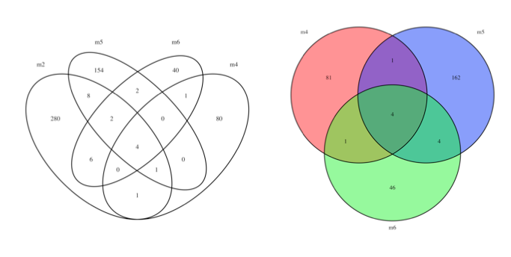
Brain: APP vs WT
Not much overlaps

Slide 10
Genes: APP vs WT
Kcnip3
Calcium-dependent transcriptional repressor
May play a role in the regulation of PSEN2 proteolytic processing and apoptosis. Together with PSEN2 involved in modulation of beta-amyloid formation
Enriched in astrocytes
Tef and Egr4 are transcriptional factors.
Reduced expression of Dhcr24 was found to be related with AD.

Slide 11
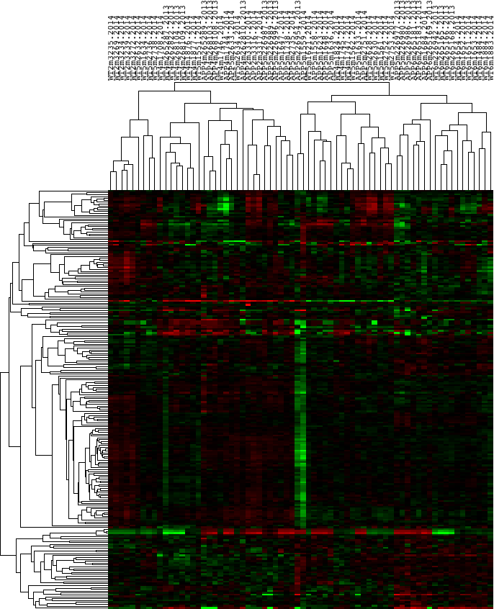
Cluster
Clustering on APP-related genes
223 genes
2, 4, 6 month WT vs APP
P < .05
TPM(max) > 8
Log2(max) – Log2(min) > 1

Slide 12
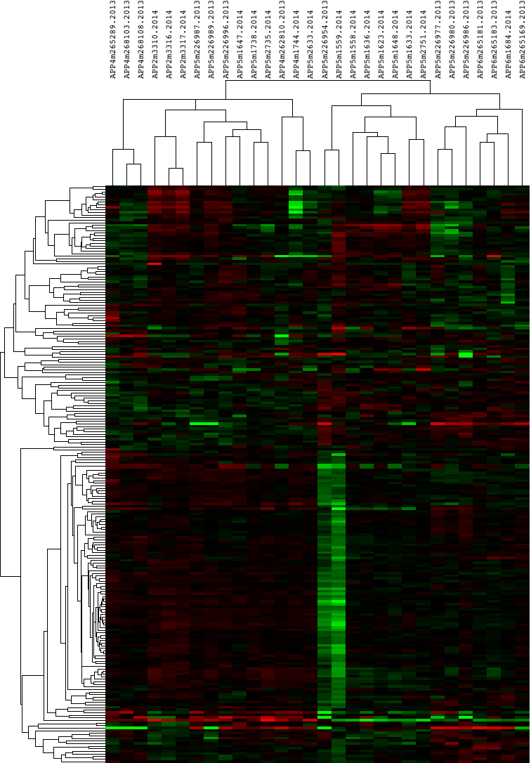
Clustering on APP-related genes
Protein phosphate
Transcriptional activity
MAM domain
Axon guidance

Slide 13
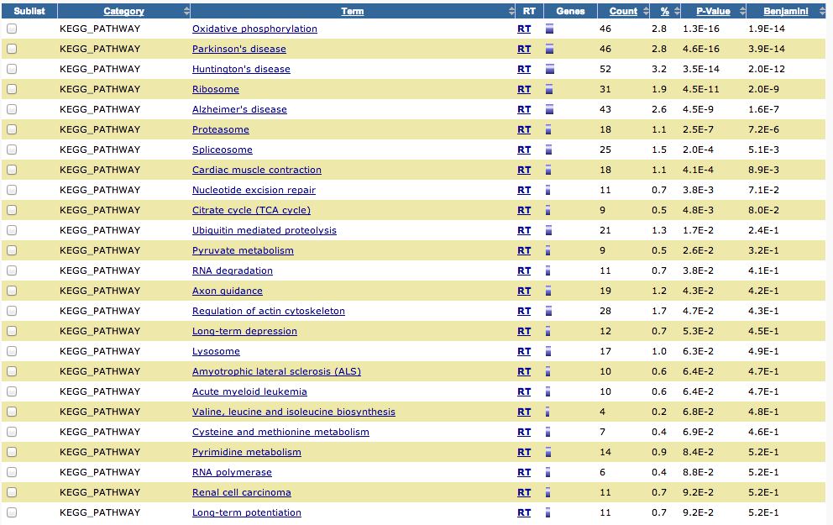
t-test between the two 5 month APP clusters
1833 genes shown significantly different with FDR < .05. Enriched pathways shown above.

Slide 14
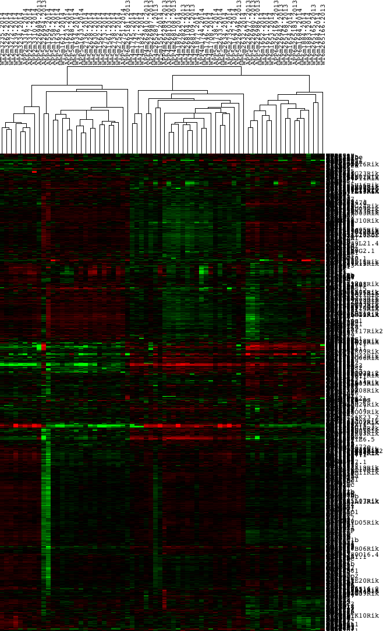
Clustering on all highly variant genes
1229 genes
TPM(max) > 8
Log2(max) – Log2(min) > 1

Slide 15
GWAS and top hits

Slide 16
Genes and pathways
6 months start showing symptoms and do not have any at 2, 4, 5 months period
Genes that are specifically different between the 6m WT and 6m APP would be interesting

Slide 17
The B6 and C3H
Build a hybrid transcriptome with transcripts from B6 and C3H strains
Report the single best alignment, suppress multiple alignments (Bowtie)l
Report the single best alignment, keep multiple alignments (Bowtie)l
Expression estimation by B6 and C3H (EMASE)

Slide 20
