Slide 1
Basic Concepts, Practical Issues and Statistical Methods in Bridging Studies
Shein-Chung Chow, Ph.D.
Professor
Department of Biostatistics & Bioinformatics
Duke University Medical Center
Durham, NC, USA
September 16, 2005

Slide 2
Outline
Background
Taiwan Experience
FDA’s Perspectives
Basic Concepts
Practical Issues
Statistical Methods
Concluding Remarks

Slide 3
Background - What?
ICH E5 (1997). Guideline on Ethnic Factors in the Acceptability of Foreign Data
A bridging study is defined as a supplemental study performed in the new region to provide pharmacodynamic or clinical data on efficacy, safety, dosage, and dose regimen in the new region that will allow extrapolation of the foreign clinical data to the new region. Such studies could include additional pharmacokinetic information.

Slide 4
Background - Why
The impact of ethnic factors
  Efficacy and safety
  Dosage and dose regimen
Minimize duplication of clinical data
  Extrapolation of foreign data to a new region
Harmonization of regulatory requirements
  Acceptability of foreign clinical data

Slide 5
An Example
Consider a clinical trial for evaluating efficacy and safety of a study medication for treatment of schizophrenia
Primary study endpoint is PANSS (Positive and Negative Symptom Score)
Responses in different patient populations due to ethnic differences are different
  White
  Black
  Oriental
  Hispanic

Slide 6
SUMMARY STATISTICS OF PANSS
----------------------------------------------------------------------------------------------------------------------------------------
BASELINE ENDPOINT
------------------------------------------------ ------------------------------------------------
RACE ALL SUBJECTS TEST ACTIVE CONTROL ALL SUBJECTS TEST ACTIVE CONTROL
------------------------ -------------- -------------- -------------- -------------- -------------- --------------
ALL SUBJECTS
N 364 177 187 359 172 187
MEAN 66.3 65.1 67.5 65.6 61.8 69.1
S.D. 16.85 16.05 17.54 20.41 19.28 20.83
MEDIAN 65.0 63.0 66.0 64.0 59.0 67.0
RANGE ( 30 - 131) ( 30 - 115) ( 33 - 131) ( 31 - 146) ( 31 – 145) ( 33 - 146)
WHITE
N 174 81 93 169 77 92
MEAN 68.6 67.6 69.5 69.0 64.6 72.7
S.D. 17.98 17.88 18.11 21.31 21.40 20.64
MEDIAN 65.5 64.0 66.0 66.0 61.0 70.5
RANGE ( 30 - 131) ( 30 - 115) ( 33 - 131) ( 31 - 146) ( 31 - 145) ( 39 - 146)
BLACK
N 129 67 62 129 66 63
MEAN 63.8 63.3 64.4 61.7 58.3 65.2
S.D. 13.97 12.83 15.19 18.43 16.64 19.64
MEDIAN 64.0 63.0 65.5 61.0 56.5 66.0
RANGE ( 34 - 109) ( 38 - 95) ( 34 - 109) ( 31 - 129) ( 31 - 98) ( 33 - 129)
ORIENTAL
N 5 2 3 5 2 3
MEAN 71.8 72.5 71.3 73.2 91.5 61.0
S.D. 4.38 4.95 5.03 24.57 20.51 20.95
MEDIAN 72.0 72.5 72.0 77.0 91.5 66.0
RANGE ( 66 - 76) ( 69 - 76) ( 66 - 76) ( 38 - 106) ( 77 - 106) ( 38 - 79)
HISPANIC
N 51 24 27 51 24 27
MEAN 64.5 61.4 67.3 64.6 61.9 67.1
S.D. 18.71 16.78 20.17 20.60 16.71 23.58
MEDIAN 63.0 60.0 68.0 66.0 59.5 67.0
RANGE ( 33 - 104) ( 35 - 102) ( 33 - 104) ( 33 - 121) ( 33 - 90) ( 33 - 121)
----------------------------------------------------------------------------------------------------------------------------------------

Slide 7
An Example
Schizophrenia Example
  Is the observed differences in mean and standard deviation between Caucasian and Asian a concern?
  What differences in mean and standard deviation will have an impact on drug effect?
Concerns
  No gold standards
  No scientific foundation or justification
  Heterogeneity among regulatory agency, industry, and academia due to different interpretation of the ICH guideline

Slide 8
Background - How?
Review of the complete clinical data package (CCDP)
  Population of the new region
  Pharmacokinetic data
  Any preliminary pharmacodynamic data
  Dose-response data
Contact a bridging study
  Extrapolate the foreign efficacy and/or safety data to the new region

Slide 9
Taiwan Experience
Evaluation process
  Bureau of Pharmaceutical Affairs (BPA)
  Center for Drug Evaluation (CDE)
  Clinical Review Committee
Remarks
  Criteria for bridging evaluation
    Check list
    Determination of ethnic difference?
  List of products that require no verification of ethnic insensitivity

Slide 10
Sponsor | BPA | CDE
Bridging Data Package
Summary for the
Consideration of Bridging
study
Accept
Submission
Checking List
CDE acceptance
verification
Technical Review
(Designate
reviewer)
Expert Consultants
(Statistical, Clinical,
Pharmacokinetics
Reviewers)
Review meeting
Evaluation Process
Schedule Sponsor
meeting
Supplement
Sponsor meeting
Result of Evaluation:
1. No Bridging study
required
2. Bridging study is required
- Type of Bridging study
Clinical Review
Committee
Review report and
recommendation:
1. No Bridging
study required
2. Bridging study
is required-Type of
Bridging study
Notification

Slide 11
Products Requiring No Verification of Ethnic Insensitivity
Drugs for treatment of AIDS
Drug for organ transplantation
Topical agents
Nutrition supplements
Cathartics prior to surgery
Radiolabeled diagnostic pharmaceuticals
The drug is the only choice of treatment for a given severe disease
Drugs for life-threatening disease have demonstrated a breakthrough efficacy
Lacking adequate trial subjects for any drug used for rare disease

Slide 12
Products Requiring No Verification of Ethnic Insensitivity
Anticancer drugs
Drugs with breakthrough efficacy
Drugs of single use
Drugs with different salt of the same composition and the same administered route have been approved internal
Drugs for chronic psychologic or immunological diseases and conducting clinical trails internal difficulty
Each compounds of new combination drug have been proved internal, and the efficacy is the same as the single compound
Drugs with the mechanism, administered route, efficacy and adverse effect, similar to the approved drugs
New combination composed of single compound of approved combination or compounds of approved combination has the same efficacy as approved combination

Slide 13
FDA’s Perspectives
O’Neill (2003). The ICH E5 Guidance: An Update on Experiences with its Implementation
Majority of NDA’s contain foreign clinical trial data, often used as primary evidence of efficacy and safety – rarely, does the entire data base on efficacy consist of foreign clinical data
Until recently, discussion have rarely been held with sponsors during IND/NDA development stages that specifically consider bridging strategies when relying on foreign clinical data

Slide 14
FDA’s Perspectives
Some, but not all review divisions, during the process of evaluation of the clinical efficacy data examine regional differences in efficacy and safety
Most multi-national trials have included patients from Western Europe, U.S., Canada, New Zealand and Australia
  Minimal but increasing experience with Latin America and Eastern Europe
Few examples of formal bridging studies done in the U.S. that were performed subsequent to development of a complete clinical data package, and that were carried out in response to an FDA request

Slide 15
FDA’s Perspectives
Generally, when FDA asks for more data/studies, it is because the clinical trial evidence in the NDA is not convincing and other formal phase 3 studies conducted in the U.S. are needed
Despite the inclusion of foreign clinical data in an FDA sponsors have anticipated an FDA request by carrying out U.S. trials without being asked
As trials come from new regions, it may become critical to agree in advance on the sources of data
There has not often been a prospective evaluation during the IND of differential PK, PD or clinical endpoints to treatment response

Slide 16
Basic Concepts
Consistency (Shih 2001)
  The results from the new region is consistent with the results from the original region
Reproducibility/Generalizability (Chow et al., 2002)
  The results from the original region is reproducible and/or generalizable at the new region
Similarity, Equivalence/Non-inferiority (Liu et al., 2002; Hung, 2003)
  The results from the new region can be shown to be similar, equivalent or non-inferior to that of the original region

Slide 17
Practical Issues
Is it a one-way street?
  EU US AP
Regulatory requirements
  Different interpretations
  Different regulations
What type of bridging studies are required?
  Clinical studies?
  PK/PD studies?
Sample size?

Slide 18




Consistency
Shih (2001). Controlled Clinical Trials, 22, 357-366.
Results of K reference studies from the CCDP are available :
New (small) local study result from the new region :
First, construct the predictive probability function , which provides a measure of the plausibility of given the results

Slide 19


Consistency
Then compare with the plausibility of each of the actually observed
The result is considered consistent with the previous results if and only if

Slide 20
Consistency
Shih (2001) recommended …
Consistency <=> falls within the
previous experience of
Bayesian most plausible prediction

Slide 21
Reproducibility/Generalizability
Chow, S.C., Shao, J., and Hu, O.Y.P. (2002). Journal of Biopharmaceutical Statistics, 12, 385-400.
Statistical Criteria
  Reproducibility
  Generalizability
Sensitivity Index
  A measure, which is derived based on the difference in two patient populations, to determine the chance of reproducibility and generalizability based on the observed clinical data

Slide 22
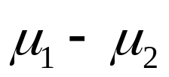



Sensitivity Index
Notations
= the difference in mean response between
treatment 1 and treatment 2
= the common variance of the two treatments
= the change in the difference in mean
response between treatments due to ethnic
difference
= the change in variance due to ethnic
difference

Slide 23
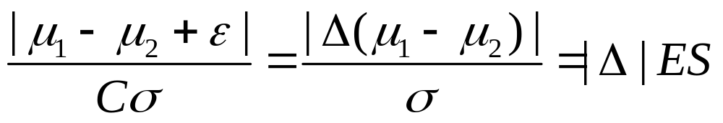

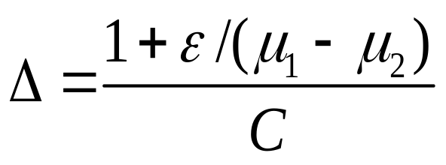
Sensitivity Index
Consider
where ES is effect size and is the sensitivity index

Slide 24
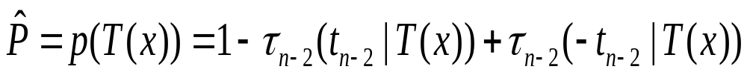



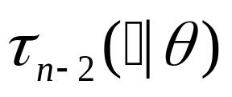

Reproducibility/Generalizability
Reproducibility probability
where represents the observed data from the clinical trial conducted at the original region, is the value of based on ,
denotes the distribution of the non-central t distribution with n-2 degrees of freedom with the non-centrality parameter .

Slide 25
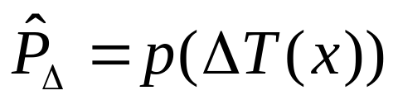


Reproducibility/Generalizability
Generalizability probability
  When is know,
In practice, is usually unknown.
  May consider a maximum possible value of
  or a set of values to carry out a sensitivity analysis.

Slide 26
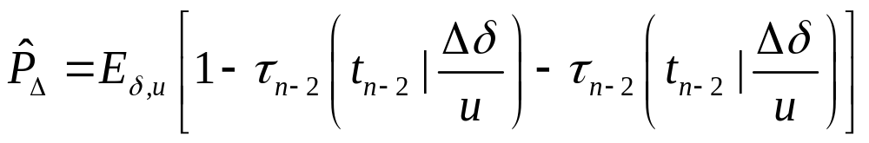





Reproducibility/Generalizability
Bayesian approach
where has the gamma distribution with the shape parameter and the scale parameter and given has the
normal distribution .

Slide 27

Reproducibility/Generalizability
Chow et al. (2002) recommended …
Step 1: For a given clinical data set observed from one or several clinical trials at the original region, calculate the reproducibility probability. If the reproducibility meets regulatory requirement, then stop and conclude that bridging studies are not needed; otherwise go to the next step.
Step 2: Identify the sensitivity index
Step 3: Compare the value of with regulatory criteria (if applicable) to determine whether a bridging study is required.

Slide 28



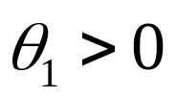
Similarity, Equivalence/Non-inferiority
Hung et al. (2003). Statistics in Medicine, 22, 213-225.
Let be the therapeutic effect
  Original region
  New region
Data (from the original region) available for
  has been established
Want to test hypotheses of

Slide 29
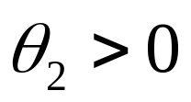
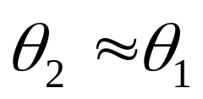
Regulatory Requirement in New Region
Show ?
Show ?
Why not show that is not inferior to and superior to placebo?
  Choosing non-inferiority margin
  Hypotheses
  Statistical methods
  Sample size

Slide 30
Choosing Non-inferiority Margin
ICH E10-Guidance on choice of control group and related design and conduct issues in clinical trials. Food and Drug Administration, July 2000
Should be based on both statistical reasoning and clinical judgment and should reflect uncertainties in the evidence of which the choice is based, and should be suitably conservative
Should not be greater than the smallest effect size that the active drug would be reliably expected to have compared with placebo in the setting of a placebo-controlled trial
.

Slide 31
Choosing Non-inferiority Margin
D’Agostino, et al. (2003). Statistics in Medicine, 22, 169-186
Active control is superior to a placebo
  Historical data
Constancy assumption
  The historical difference hold in future new trials if the placebo is employed
Putative placebo comparison
  C vs P historical placebo-controlled data
  C vs T active-control data

Slide 32

Choosing Non-inferiority Margin
Hung et al. (2003). Statistics in Medicine, 22, 213-225.
where r is a fixed constant between 0 and 1
Jones et al. (1996) suggests r=0.5
Commonly employed : r=0.2

Slide 33
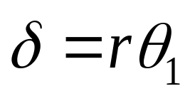
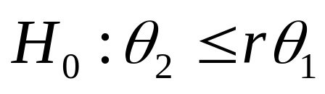

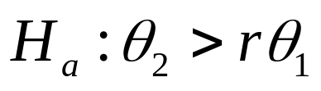
Hypotheses for Non-inferiority
Non-inferiority margin
Hypotheses

Slide 34

Practical Issues
Assay sensitivity
Constancy assumption
Variability of (i.e., estimate of C-P)
Small number of available historical placebo-controlled studies
No available placebo-controlled studies

Slide 35
Statistical Methods
Chow.S.C. and Shao, J. (2005). Statistics in Medicine, Vol. 24, No. 21, In press
Account for variability of (i.e., estimate of C-P)
Valid regardless whether historical data is available
The proposed method is relatively conservative and hence may require a large sample size for bridging clinical studies

Slide 36
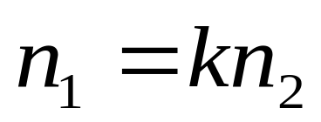
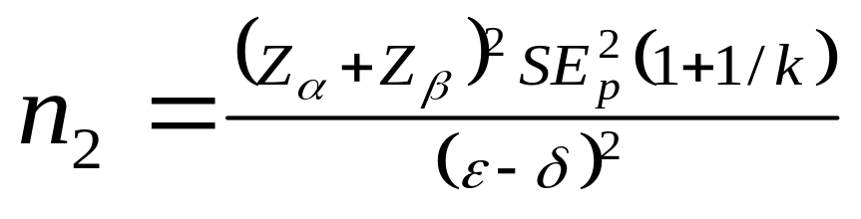
Sample Size Calculation
Chow.S.C. and Shao, J. (2005). Statistics in Medicine, Vol. 24, No. 21, In press

Slide 37
Concluding Remarks
Harmonization?
  Regulatory requirements/perspectives
  Interpretations
Methodologies must be consistent
  Criteria for bridging evaluation
  Trial procedures
  Statistical procedures
Potential use of genomic data in bridging clinical data from the original region to a new region with ethnic difference

Slide 38
Selected References
[1] Chow, S.C. and Shao, J. (2002). A note on statistical methods for assessing therapeutic equivalence. Controlled Clinical Trials, 23, 515-520.
[2] Chow.S.C. and Shao, J. (2005). On non-inferiority margin and statistical tests in active control trials. Statistics in Medicine, 24, No.21, In press.
[3] Chow, S.C., Shao, J., and Hu, O.Y.P. (2002). Assessing sensitivity and similarity in bridging studies. Journal of Biopharmaceutical Statistics, 12, 385-400.
[4] D’Agostino, R.B., Massaro, J.M., and Sullivan, L.M. (2003), Non-inferiority trials: design concepts and issues – the encounters of academic consultants in statistics. Statistics in Medicine, 22, 169-186
[5] Hung, H.M.J. (2003). Statistical issues with design and analysis of bridging clinical trial. Presented at the 2003 Symposium on Statistical methodology for Evaluation of Bridging Evidence, Taipei, Taiwan.
[6] Hung, H.M.J., Wang, S.J., Tsong, Y., Lawrence, J. and O’Neil, R.T. (2003). Some fundamental issues with non-inferiority testing in active controlled trials. Statistics in Medicine, 22, 213-225.

Slide 39
Selected References
[7] ICH E5 (1997). International Conference on Harmonization Tripartite Guideline on Ethnic Factors in the Acceptability of Foreign Data. The U.S. Federal Register, 83, 31790-31796.
[8] ICH E10 (2000). International Conference on Harmonization Tripartite Guidance on choice of control group and related design and conduct issues in clinical trials. Food and Drug Administration, DHHS, July, 2000.
[9] Liu, J.P., Hsueh, H.M., and Hsiao, C.F. (2002). Bayesian approach to evaluation of the bridging studies. Journal of Biopharmaceutical Statistics, 12, 401-408.
[10] O’Neill, R.T. (2003). The ICH E5 Guidance: An update on experiences with its implementation. Presented at the 2003 Symposium on Statistical methodology for Evaluation of Bridging Evidence, Taipei, Taiwan.
[10] Shao, J. and Chow, S.C. (2002). Reproducibility probability in clinical trials. Statistics in Medicine, 21, 1727-1742.
[11] Shih, W.J. (2001). Clinical trials for drug registrations in Asian pacific countries: proposal for a new paradigm from a statistical perspective. Controlled Clinical Trials, 22, 357-366.

