Slide 1
Decode the Encode
Characterization, and beyond…
Distribution
Linear regression
Enrichment
Network decomposition
Association
Interaction

Slide 2
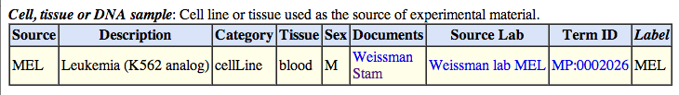
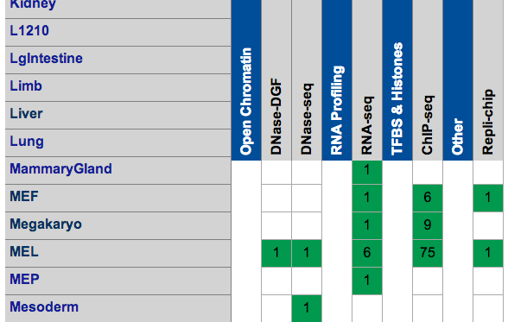
Mouse ENCODE
Intergenic
promoter
Gene 1
promoter
Gene 2
Marks
0 1 1 0 0 1 0 1 1 0 0 0 0 0 0 0 1 1 0 0
0 1 0 0 0 1 0 1 1 0 0 0 0 0 0 0 0 1 1 0
0 1 1 0 0 1 0 1 1 0 0 0 0 0 0 0 1 1 0 0
0 1 0 0 0 1 0 1 1 0 0 0 0 0 0 0 0 1 1 0

Slide 3
Coverage of marks
Notes:
Roughly 50% of the marks fall within non-genetic region.

Slide 4
Enrichment

Slide 5
Length of marks
Most marks could sit right on the edge

Slide 6
Greg: once we find interactions between marks, we can think about CAPE, look at the direction of interactions
It is more meaningful to think on marks, instead of patterns
M
M
Promoter
EXON
EXON
per gene
per sample
Log2(TPM) 0/1/2
.
0/1 in TX region
Number
Exon
Promoter (TSS)
T-STOP-S (terminator)
Length
Intensity
.
GE
MP
Using forward regression with AIC on complete additive and first order interactive model

Slide 7
Mouse ENCODE
 | RNA | H3k4me1 | H3k4me3 | H3k27ac | H3k27me3 | CTCF | Polr2a
Cerebellum |  | UCSD-REN Adult 8 weeks
ES-Bruce4 |  | UCSD-REN Embryonic day 0
Heart |  | UCSD-REN Adult 8 weeks
Kidney |  | UCSD-REN Adult 8 weeks
Liver |  | UCSD-REN Adult 8 weeks
MEL |  | UCSD-REN
Intestine |  | UCSD-REN Adult 8 weeks
Spleen |  | UCSD-REN Adult 8 weeks
Testis |  | UCSD-REN Adult 8 weeks
Thymus |  | UCSD-REN Adult 8 weeks
Brain |  | UCSD-REN Embryonic day 14.5
genome
m1
m2
m3
m4
t1
t2
samples
genomic regions based on marks
epi-genotype: assign for each sample
epi-QTL: linear regression

Slide 8
Genome in 200bp unit
13627618
Genome (6)
Marked
~400,000 per sample, ~3%
1726,971 all samples, 12.7%
m1
m2
m3
m4
t1
t2
Samples (11)
RNA-seq quality is low with 20-60% alignment rates from RSEM, and as high as 82% of reads dropped from quality control by Trimmomatic
Some samples, such as the testis probably should be taken off.

Slide 9
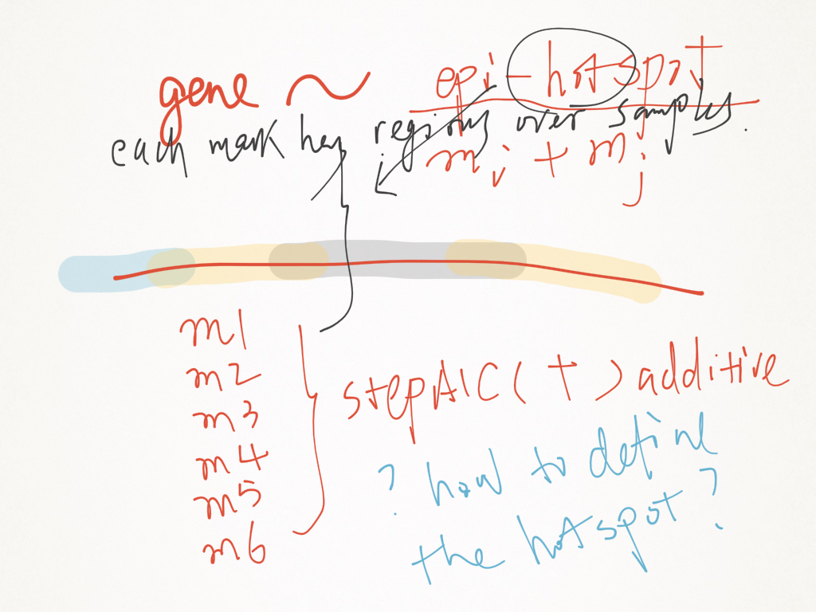
Draw figures, think about what to do next
Effects of individual mark on activation and repression of genes?
Interaction between marks?

Slide 10
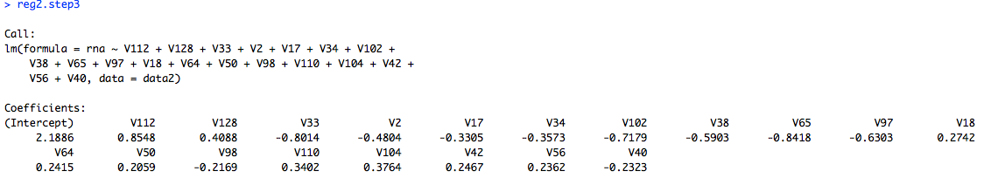

Slide 11
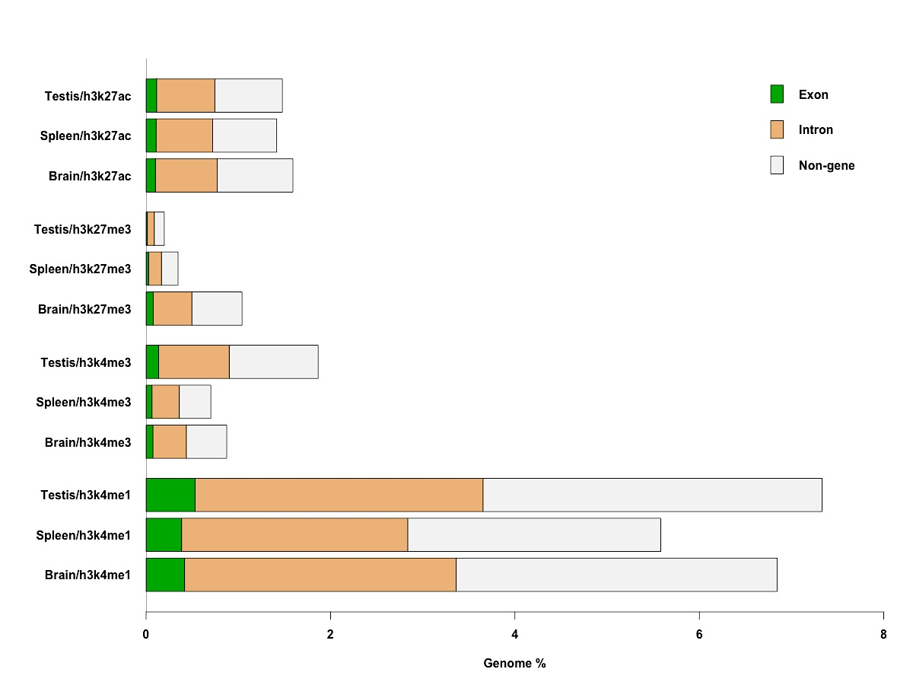
Distribution of marks
TSS
TSS
Gene 1
Gene 2
Marks
0 1 1 0 0 1 0 1 1 0 0 0 0 0 0 0 1 1 0 0
0 1 0 0 0 1 0 1 1 0 0 0 0 0 0 0 0 1 1 0
H3k27ac
Individual length, Frequency, Intensity
** Distribution of length **
H3k27me3
H3k4me3
H3k4me1
Notes:
Roughly 50% of the marks fall within non-genetic region.

Slide 12
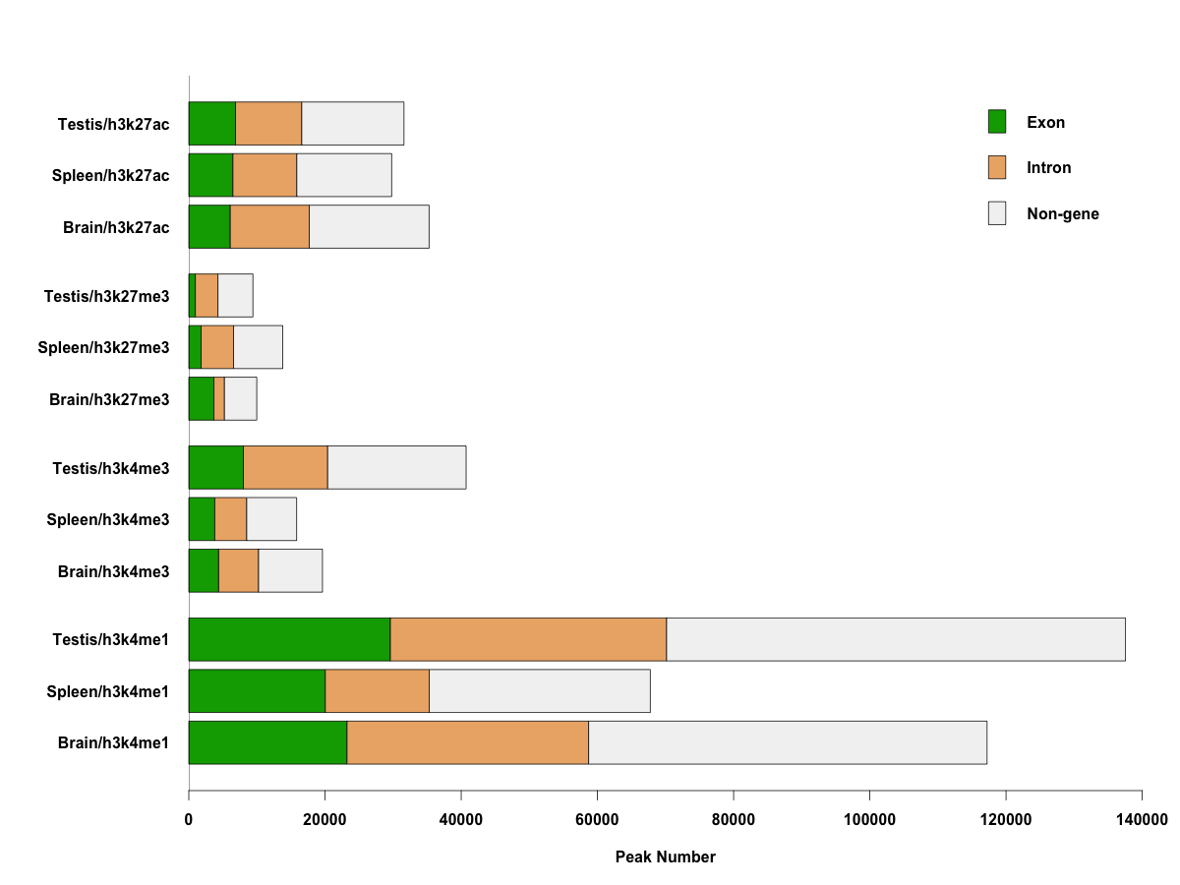
Distribution of marks
TSS
TSS
Gene 1
Gene 2
Marks
0 1 1 0 0 1 0 1 1 0 0 0 0 0 0 0 1 1 0 0
0 1 0 0 0 1 0 1 1 0 0 0 0 0 0 0 0 1 1 0
H3k27ac
How about the enrichment patterns around the TSS?
Plot the coverage dynamics around the TSS
H3k27me3
H3k4me3
H3k4me1

Slide 13
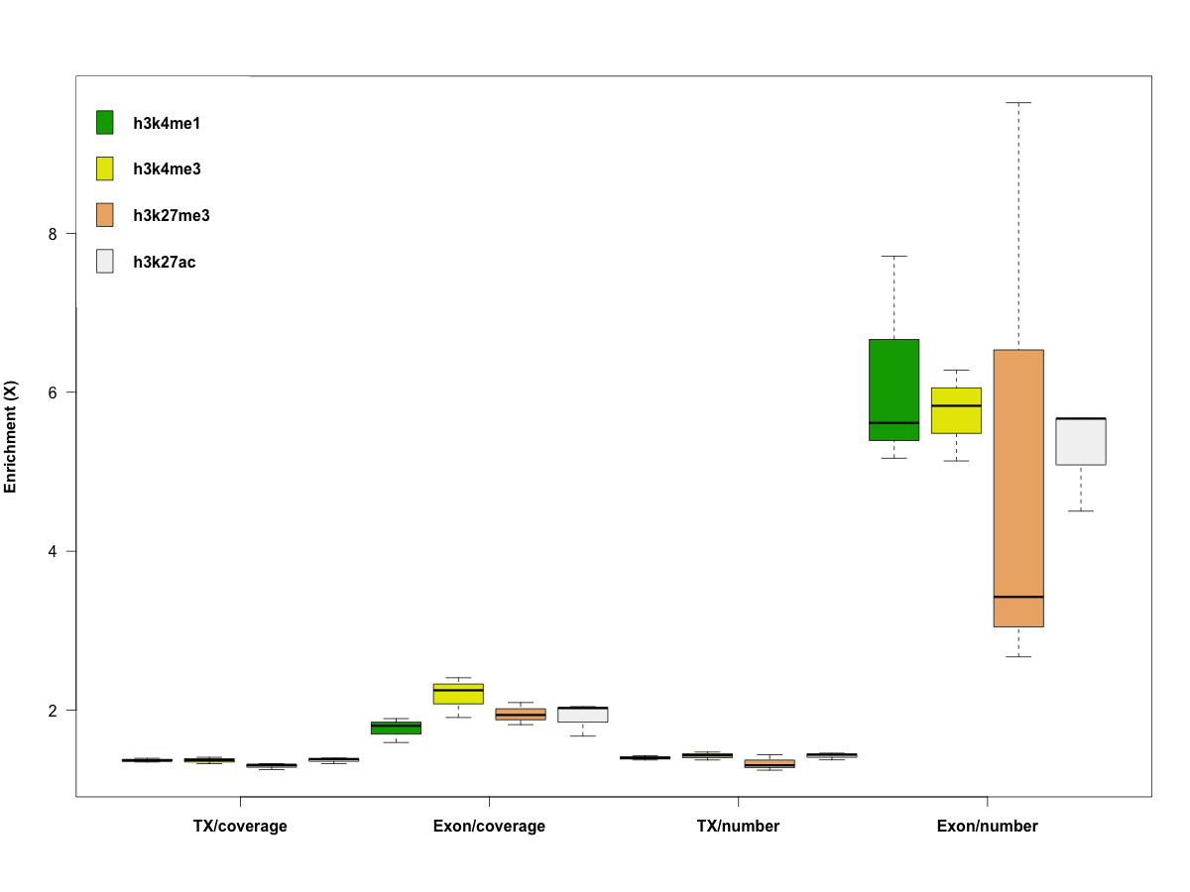
Enrichment over TX and Exon
High enrichment in exon/number
Big difference between exon/coverage and exon/number?
Specificity in 1st, 2nd exons and so on?
The mark combinations!

Slide 14
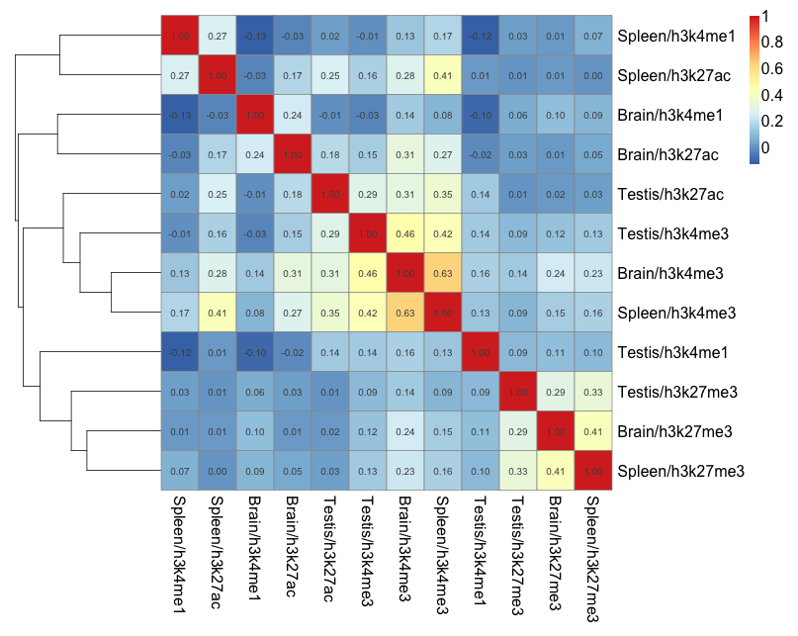
Pearson’s correlation

Slide 15
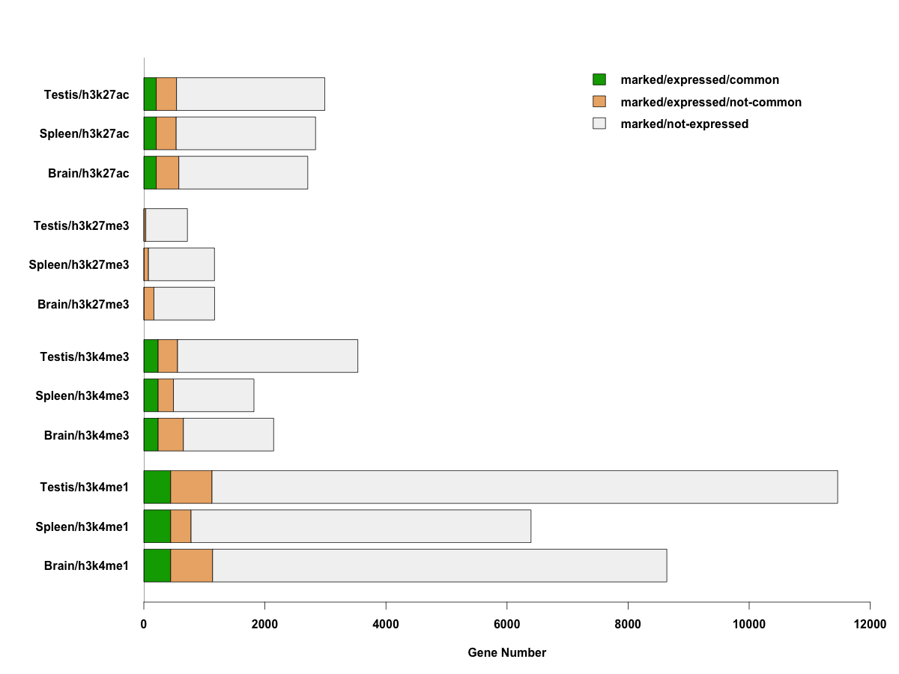
Association with gene expression
TSS
Mark
Promoter (-2K to 2K bp of TSS)
EXON

Slide 16
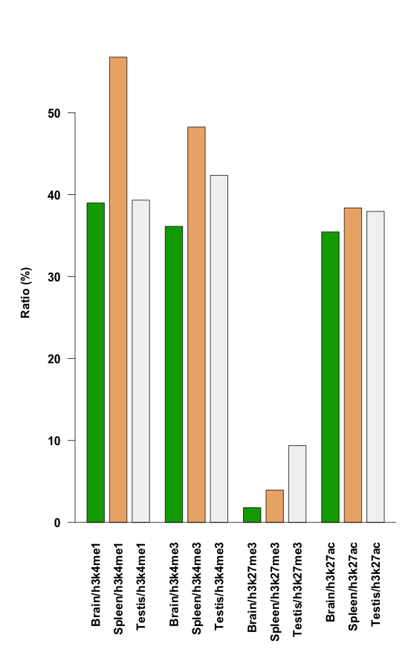
Association with gene expression
Is h3k27me3 special in terms of tissue specificity?
other marks combination?
single gene across different samples
H3k27me3 appears to be significant lower.
Individual genes in different samples?

Slide 17
Network decomposition
TSS
TSS
Gene 1
Gene 2
To map epigenetic interaction in terms of mark to mark and mark to gene transcription influences
How individual marks affect each other?
How multiple marks combine to affect gene transcription?
transcription
Pick “genotypes” A, B, C
To decompose interactions between A, B, C; affects on other “genotypes”
net effects on transcription

