Slide 1
Decode the Encode
Characterization, and beyond

Slide 2
Epigenetic, transcriptional, and post-transcriptional regulation

Slide 3
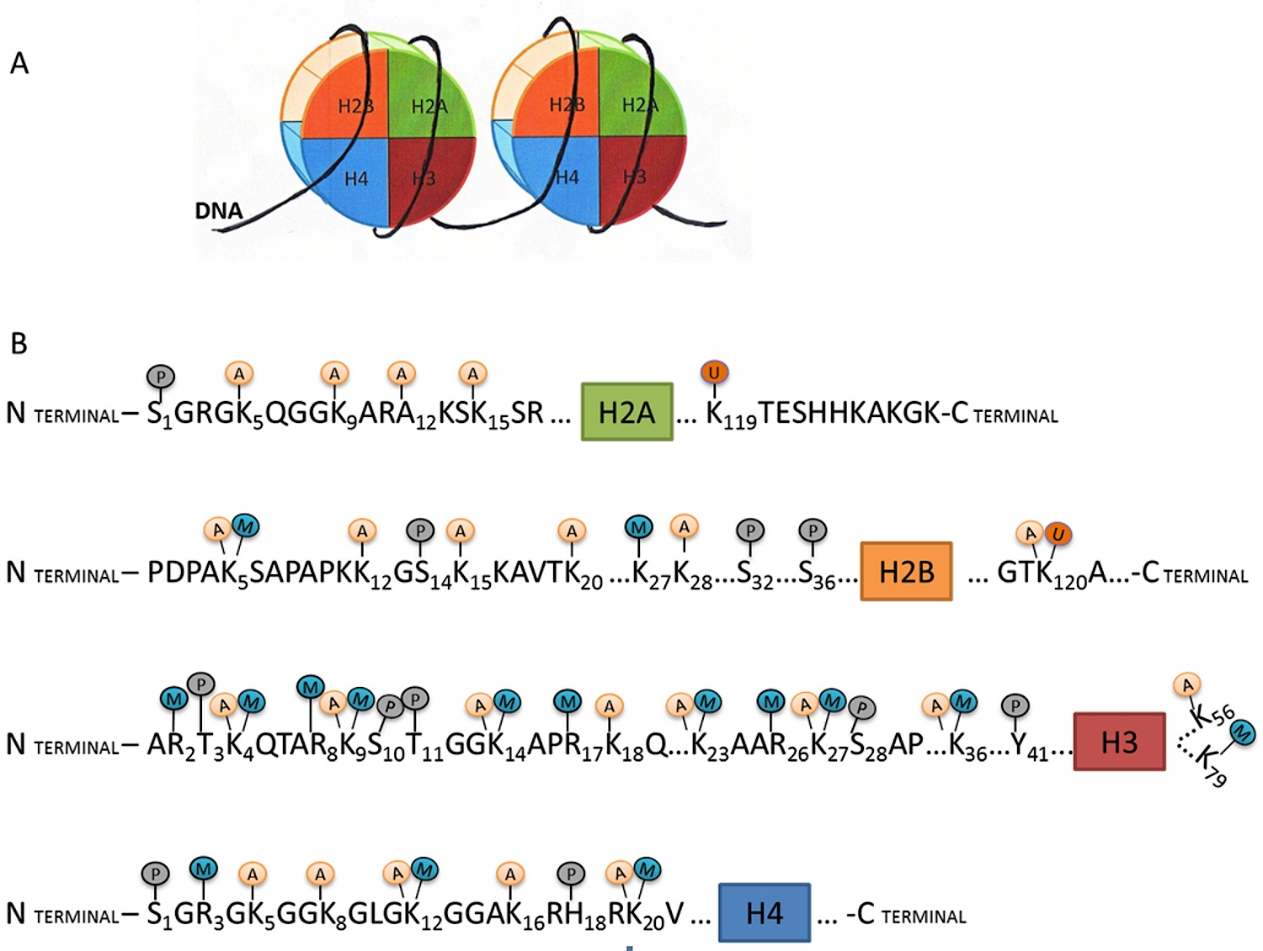
Histone modification

Slide 4
Hypothesis
M1
M2
GENE
0 0 0 1 1 1 1 1 0 1 0
Samples: Cerebellum, ES-Bruce4, Heart, Kidney, Liver, MEL, Intestine, Spleen, Testis, Thymus, Brain
Histone marks: H3k4me1, H3k4me3, H3k27ac, H3k27me3, CTCF, Polr2a
Transcription factors: CTCF, Polr2a
Gene expression

Slide 5
Epi-genome hotspots
Mark 1
S1
S2
.
.
.
S10
S11
0 1 0 0 0 1 0 0 0 0 1 1 1 1 1 0 1 0
1 0 0 0 0 1 0 0 0 0 0 0 0 0 0 0 0 0
…
0 1 1 0 0 1 0 0 1 0 0 0 0 1 1 0 0 1
0 1 0 0 0 1 0 0 0 0 0 0 1 0 0 0 0 1
1 1 1 0 0 1 0 0 1 0 1 1 1 1 1 0 0 1

Slide 6
Hotspots over the genome

Slide 7
Epi-genome hotspots
Mark 1
Mark 2
…
Mark 4

Slide 8
Hotspots over the genome

Slide 9
HPC progress
(hotspots.rdt)
Combined hotspots for marks (not TFs)
(epigeno2.rdt)
(rna.rdt)
Epi-genotype for marks and TFs
RNA Log2(TPM)
(pho-1.rdt … pho-10.rdt)
Correlation between each mark, TF and RNA Pearson’s: pho and p value
(epi.per.gene1.rdt, p < .05)
(epi.per.gene2.rdt, beta >)
Select HOTSPOTS for pair-wise regression
Linear regression

Slide 10
Epigenetic Network
Epi-genomic hotspots
Epi-genotype
Assign for each sample, each mark
Epi-QTL
Linear regression

