Slide 1
GNetLMM
June 20, 2018
Dept. of Genetics & Pharmacogenomics
Translational Medicine

Slide 2
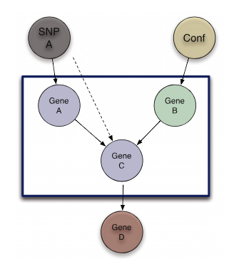
GNetLMM method
Genome-wide eQTL scan
Each C, search A and B to form V structure
Update SNP-C association by conditioning on B

Slide 3
Project 5: trans-eQTL analysis using GNetLMM
Rationale:
Cis-eQTL explains 30% of genetic heritability on gene expression, suggesting a critical role of trans-eQTL. However, to identify trans-eQTL is more challenging because it requires more statistical power. GNetLMM is a new method that could boosts the statistical power to detect trans-eQTL.
Executive summary:
Dataset in place (Fairfax et al. 2014 on monocyte)
The method was tested using toy data
To do:
QC the data
Implement the method on monocyte data

