Slide 1
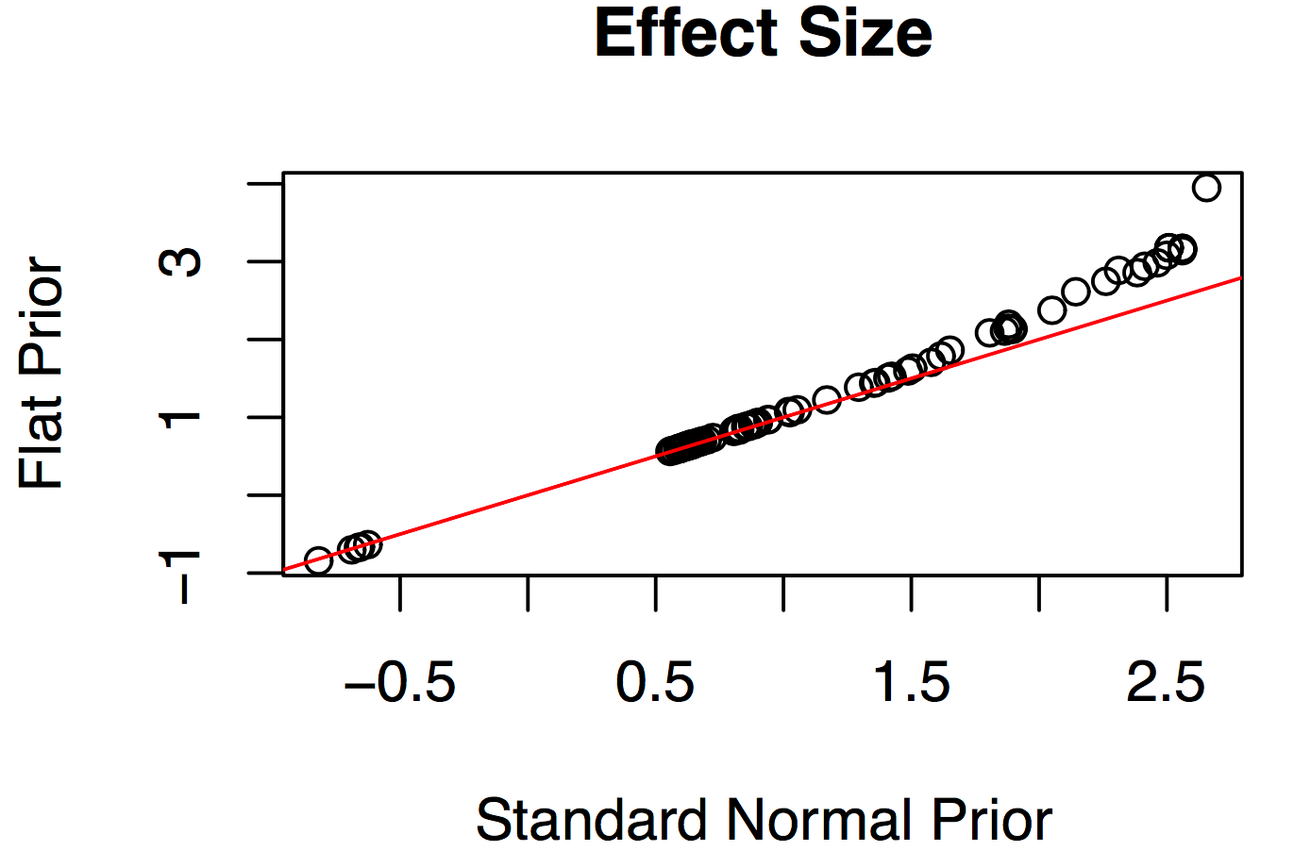
Supplementary Figure 1
Notes:
Supplemental Figure 1. Effect size estimation of the top 100 variants by ordered categorical models with standard normal (X-axis) or uniform distribution (Y-axis) as priors of variant effect.

Slide 2
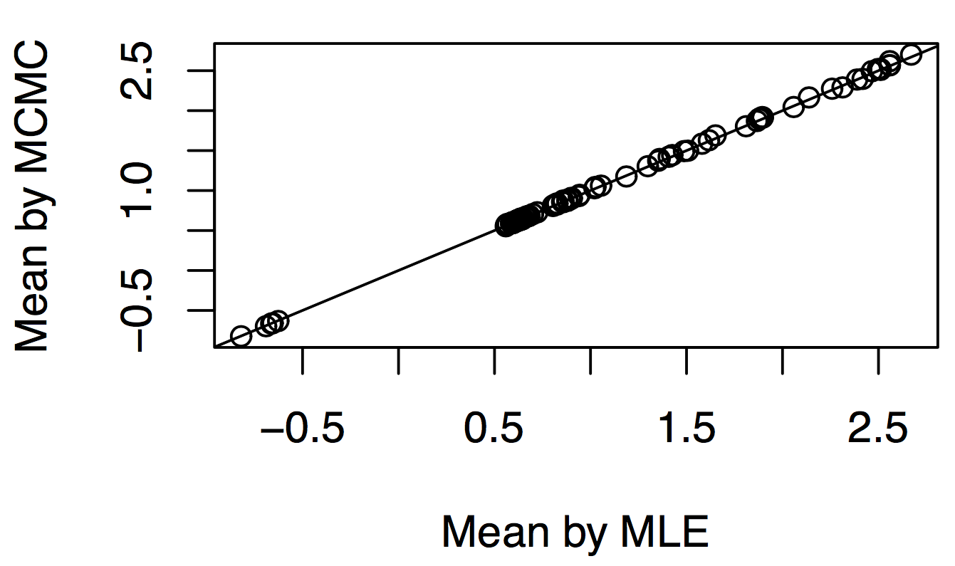
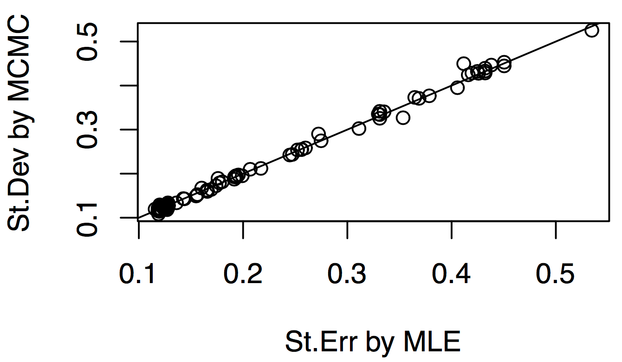
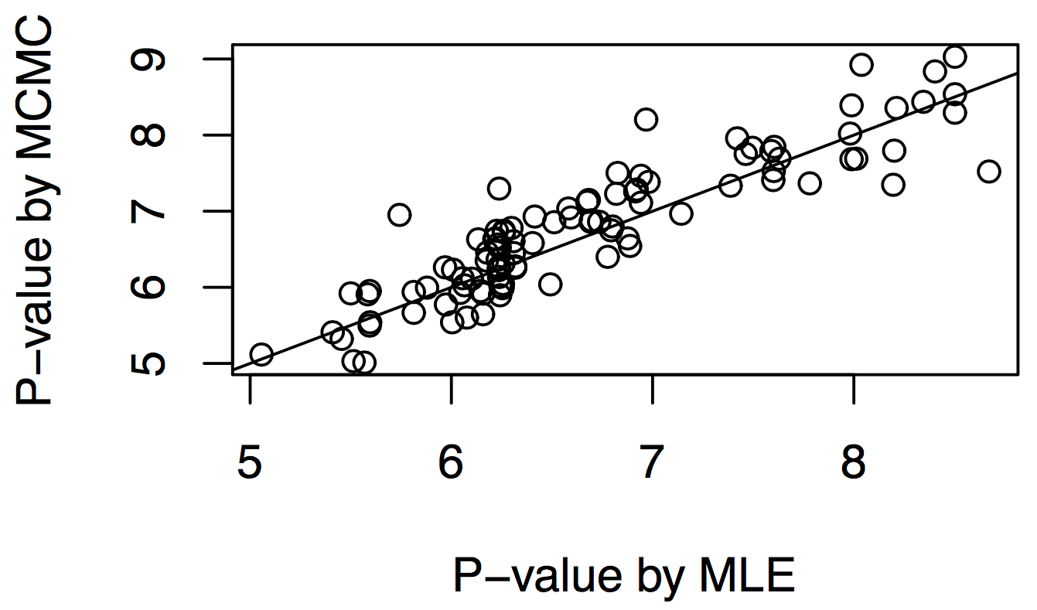
Supplementary Figure 2
A
B
C
Notes:
Supplemental Figure 2. Variant effects computed by MLE versus MCMC methods. Simulation results showed (A) the two methods report consistent expected means of variants effects; (B) standard error estimation of variant effect mean by MLE and standard derivation estimation of variant effect parameter by MCMC are fairly consistent; and (C) the tail p-values that we proposed are in general consistent with the standard frequentist p-values.

Slide 3
Supplementary Figure 3
Notes:
Supplemental Figure 3. Interaction tests for covariates estimated by MCMC sampling in Bayes-GLMM. No interactions were detected between any pair of covariates (age, sex, APOE/e2, APOE/e4).

Slide 4
Supplementary Figure 4
Notes:
Supplemental Figure 4. Genome-wide variants in the ADSP WGS cohort stratified by chromosomes. Red bars represent the number of total variants, blue bars represent the number of variants that passed the quality check (Methods), and green bars represent variants that pass the quality check and occur at MAF greater than 0.01.

Slide 5
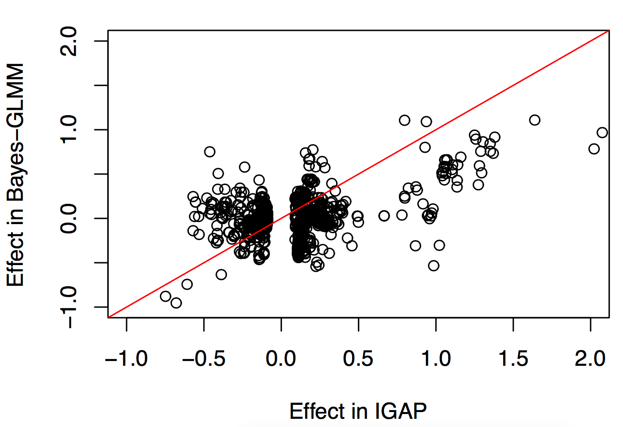
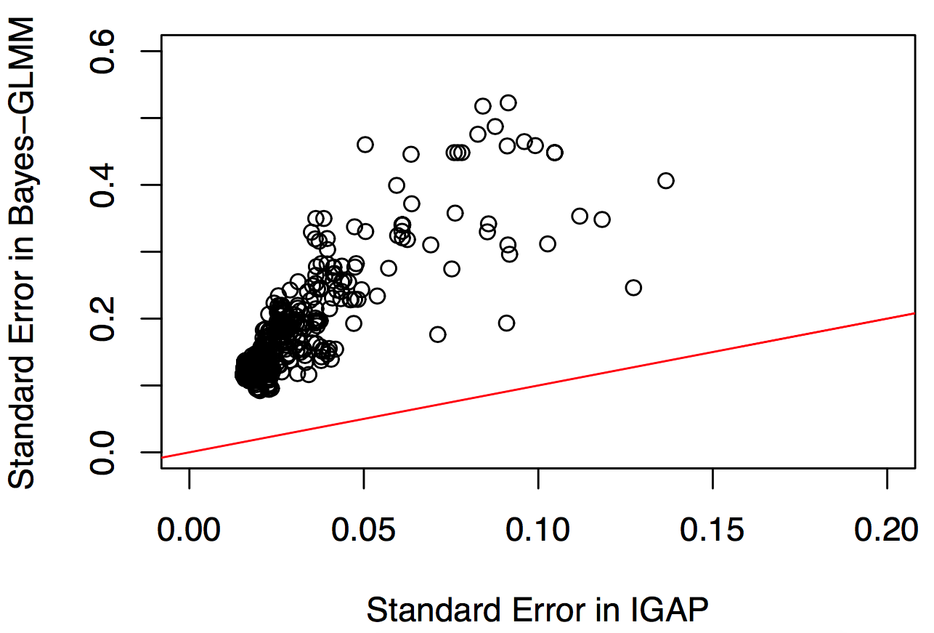
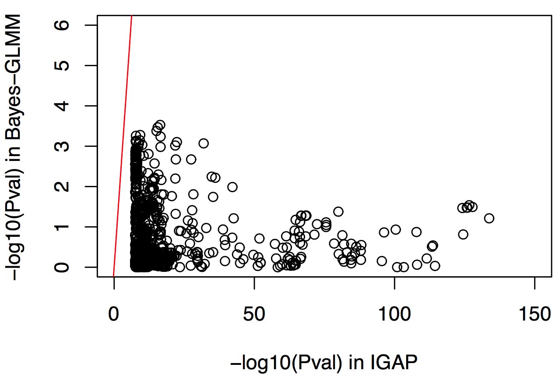
Supplementary Figure 5
A
B
C
Notes:
Supplemental Figure 5. Effect of the top 1000 IGAP variants in ADSP. IGAP Stage 1 results were plotted in the x-axis. ADSP results, as estimated by Bayes-GLMM without integrating prior information, were plotted in the y-axis.

Slide 6
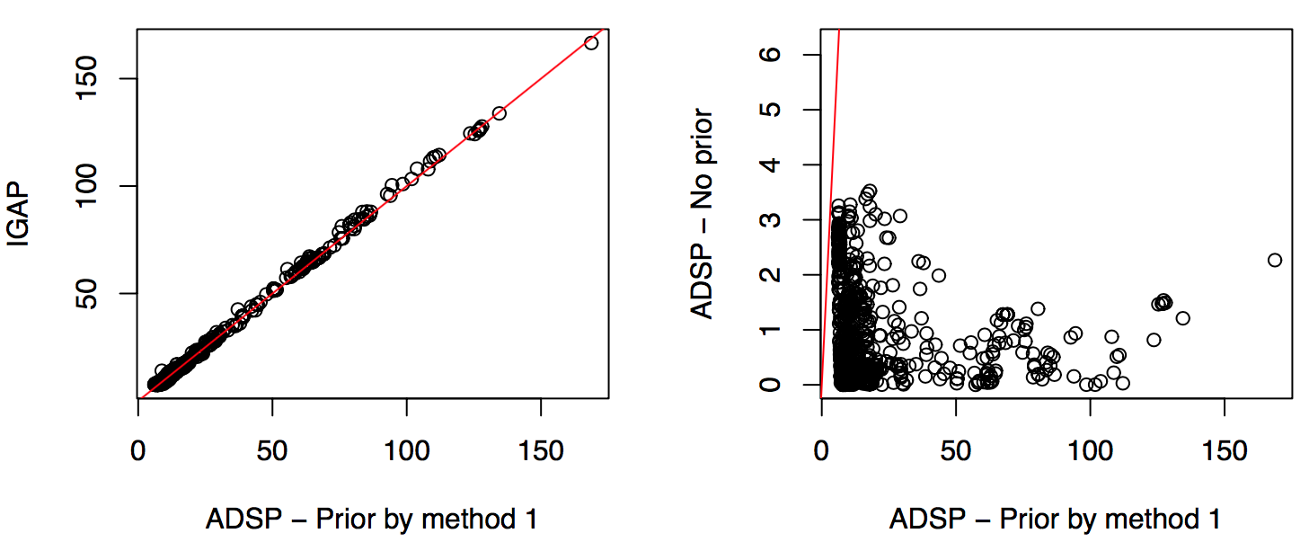
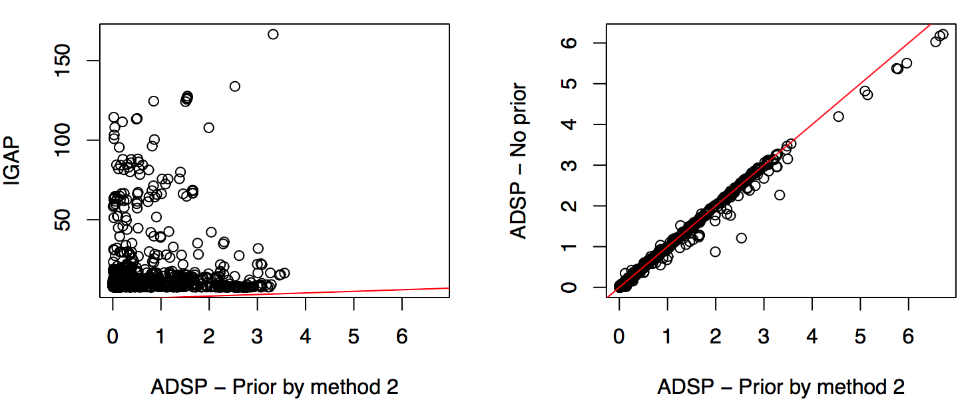
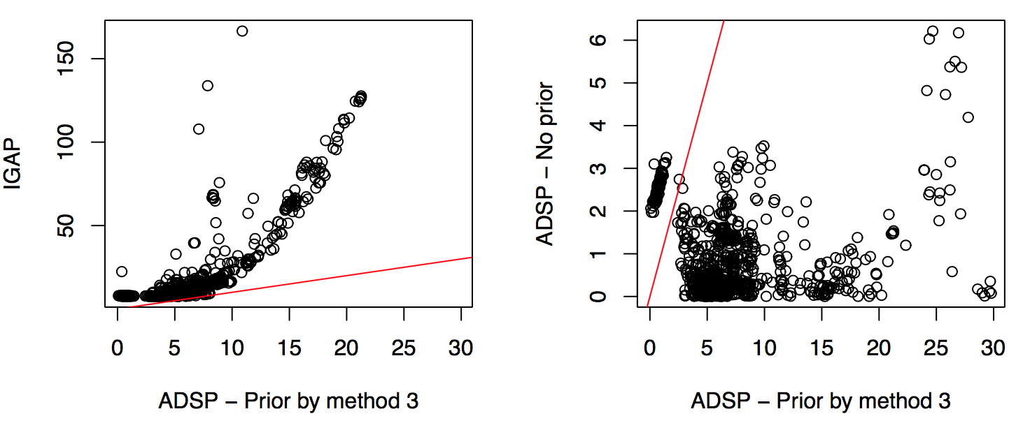

Supplementary Figure 6
A
B
C
D
Notes:
Supplemental Figure 6. Posterior P-values (tail probability in –log10 scale, x-axis) versus prior P-values in IGAP (y-axis, left) and posterior P-values with no priors (y-axis, right). The four methods as listed in Supplemental Table 3 were used in specifying the priors. (A) Method 1 resulted in IGAP priors dominating posterior P-values (left) that did not reflect the results without priors (right). (B) Method 2 led to posterior influences dominated by ADSP data (right) that did not match IGAP results (left). (C,D) Methods 3 and 4 allowed IGAP priors to effectively influence ADSP results. Method 4 was chosen over Method 3 because by modeling the standardized effect size (t) as an independent variable in Method 4, it avoids the influence of variance estimation ($σ$) on effect size estimation (t * $σ$).

Slide 7
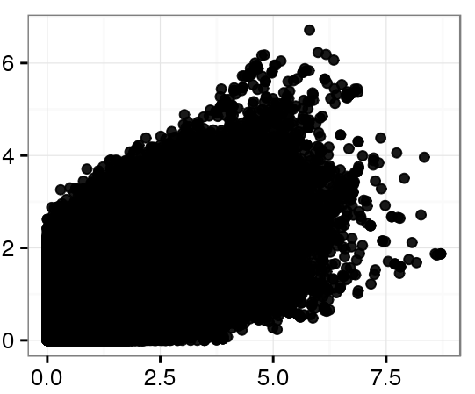
Supplementary Figure 7
-log₁₀P (Binary Model)
log₁₀P (Categorical Model)
Notes:
Supplemental Figure 7. P-values of the GWAS were distorted by collapsing the ADSP four-level categorical diagnostic variables as binary. Bayes-GLMM was used to test 10.3 million genomic variants with MAF greater than 0.01 generalized linear model, using either the four-level categorical variable or a collapsed binary variable to mimic case-control status.

Slide 8
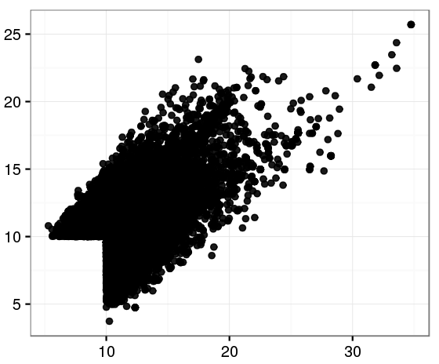
Supplementary Figure 8
LOD (Coding Scheme B)
LOD (Coding Scheme A)
Notes:
Supplemental Figure 8. Results of GWAS using numerical variables shows inconsistency due to numeric coding scheme. The four categorical levels of AD diagnosis in ADSP (no, possible, probable, definite) were transformed to numerical by two rules: Coding Scheme A with 0, 0.25, 0.5, 1; and Coding Scheme B with 0, 0.33, 0.66, 1. Variants with LOD results greater than 10 in either of the two schemes were plotted (23,388 variants). Analysis was performed using a linear mixed model in QTLRel, comparing the nested null and full models to estimate the significance of a variant. The full models were the same as described in the text (Materials and Methods: Model Estimations) whereas the null models ignored the variant, g, as a linear predictor. In MLE, the null-to-full model improvements was quantified by LOD, which equals log likelihood difference between the full and null models using the MLE estimation of model parameters divided by log(10).
$$LOD= −(\log\left(P\left(data | θ_{p}^{n}\right)\right)−log⁡(P(data|θ_{p}^{f})))/log⁡(10)$$
$θ_{p}^{n}$ and $θ_{p}^{f}$ were the MLE of the parameter spaces under the null and full models, respectively.

