Slide 1
Supplementary Figure 1
Notes:
Supplementary Figure 1. No interaction was detected between each pair of the covariates (age, sex, APOE/e2, APOE/e4). Interactive effects were estimated by MCMC sampling in Bayes-GLMM.

Slide 2
Supplementary Figure 2
Notes:
Supplementary Figure 2. Genome-wide variants in ADSP WGS cohort stratified by chromosomes. Per chromosome, the red bar represents number of total variants, blue bar represents number of variants that passed the quality check, green bar represents variants that pass the quality check and show MAF larger than 1%.

Slide 3
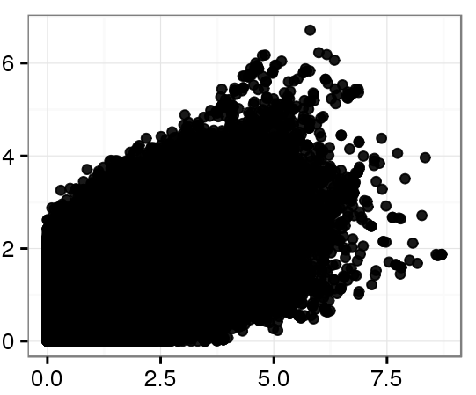
Supplementary Figure 3
Binary (-log10(P))
Categorical (-log10(P))
Notes:
Supplementary Figure 3. P-values of the GWAS on ADSP were distorted by collapsing ADSP’s 4 level categorical variables as binary. 10.3 million genomic variants with MAF > 0.01 were tested by generalized linear model. Bayes-GLMM were used for the two GWAS.

Slide 4
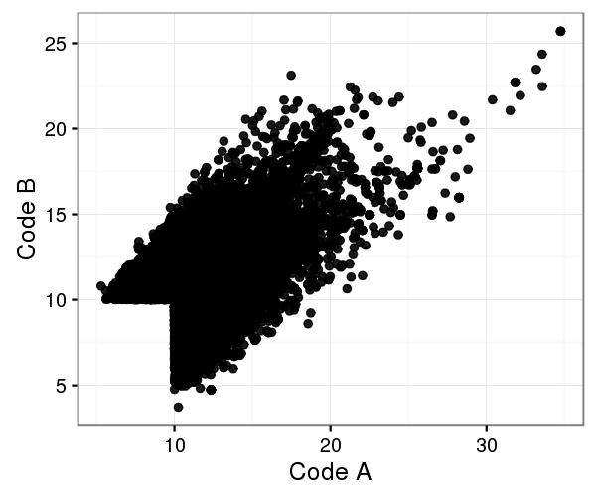
Supplementary Figure 4
Notes:
Supplementary Figure 4. GWAS of ADSP by QTLRel. QTLRel requires response variable as numerical. The 4 categorical levels of AD status in ADSP (no, possible, probable, definite) were transformed to numerical by two rules: (Code A) 0, 0.25, 0.5, 1; and (Code B) 0, 0.33, 0.66, 1. X and Y are LOD results of QTLRel following the two rules. Variants with LOD results larger than 10 in any of the two rules were plotted (n = 23388).

