Slide 1
TFH paper

Slide 2
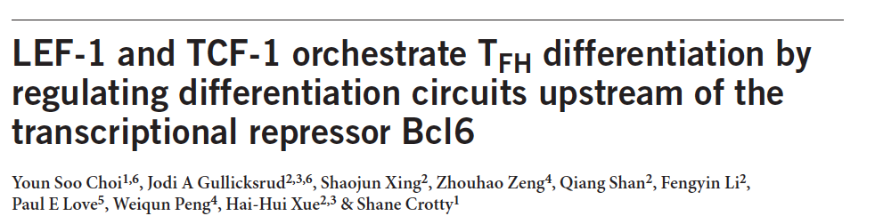
Nature Immunology

Slide 3
Compare with our samples
Cells 3 days (RNA-seq) and 8 days (microarray) after immunization

Slide 4
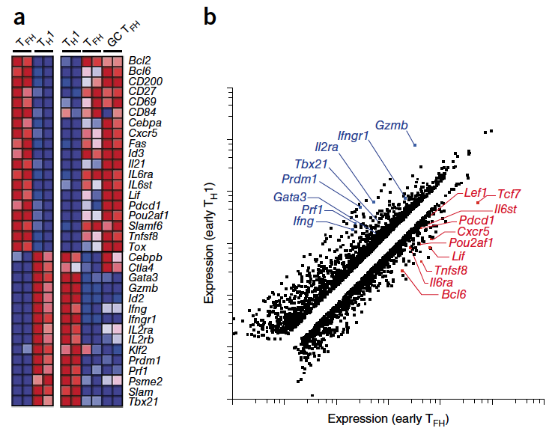
Chosen genes

Slide 5
25 out of 35 genes in Figure 1.

Slide 6
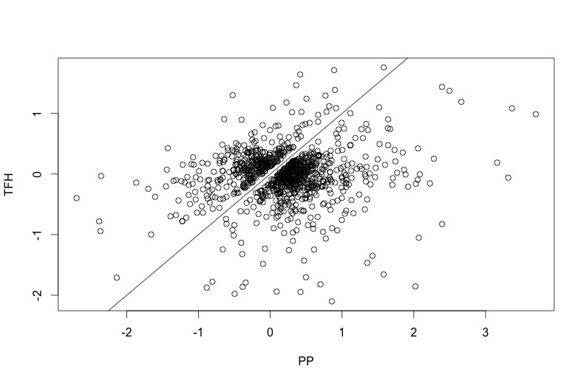
Many genes are disparate

Slide 7
Compare with our samples
Cells 3 days (RNA-seq) after immunization

Slide 8
1159 genes in the plot (same genes for clustering in the last slide)
295 are significantly different (p-value < 0.05 and log fold change > 0.5, red)

Slide 9
New to do

Slide 10
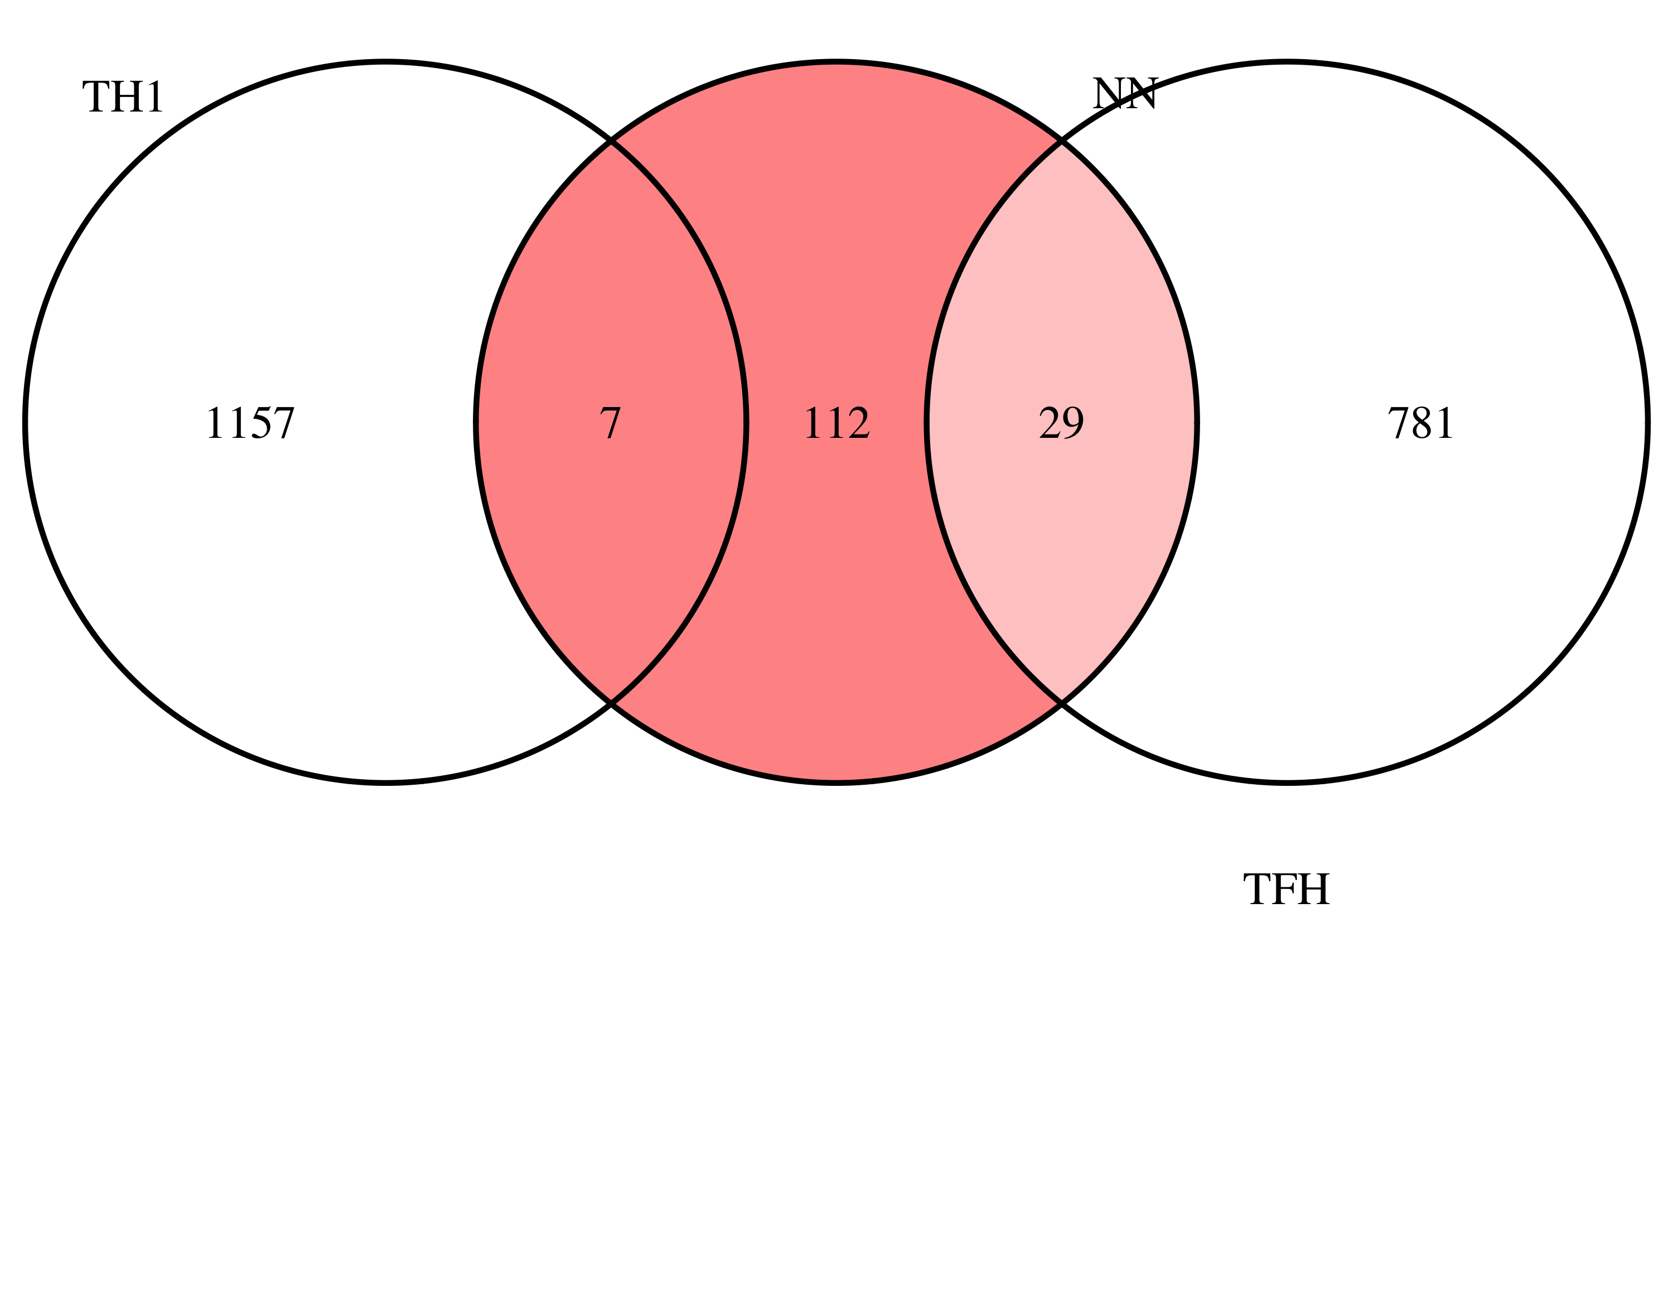


N
TFH
TFH and NP overlaps
Cnr2, Ei24, Ikzf2, Klrb1c, Lpxn, Slc26a2, Smad3, Tnfsf14
TH1 and PP overlaps
Capn2, Ccdc12, Cdc25b, Dnase1l1, Fkbp1a, Gng2, Il10ra, Itga4, Maf, Mical1, Myo1g, Ppil1, Slc20a1, Vim

Slide 11
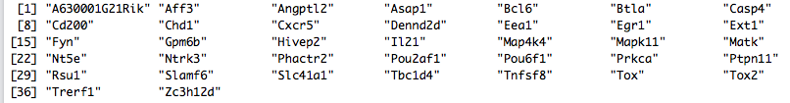
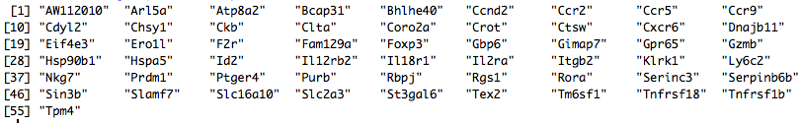
TFH and PP overlaps
TH1 and NP overlaps

