Slide 1
TFH paper

Slide 2
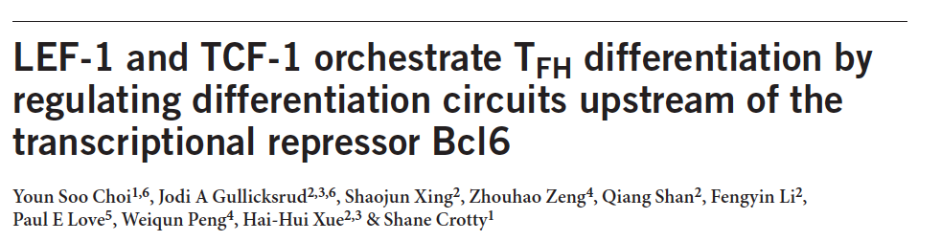
Nature Immunology

Slide 3
Compare with our samples
Cells 3 days (RNA-seq) and 8 days (microarray) after immunization

Slide 4
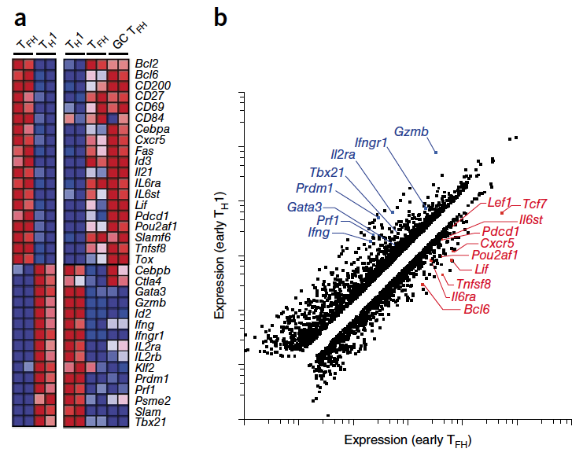
Chosen genes

Slide 5
25 out of 35 genes in Figure 1.

Slide 6
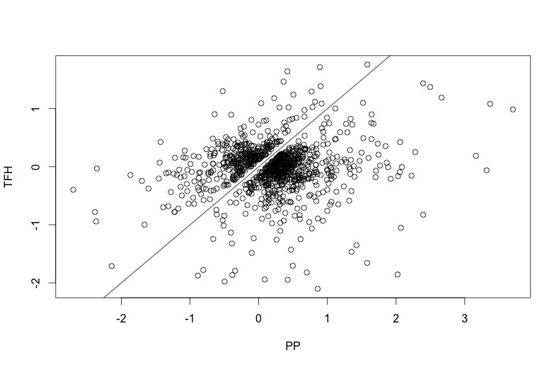
Many genes are disparate

Slide 7
Compare with our samples
Cells 3 days (RNA-seq) after immunization

Slide 8
1159 genes in the plot (same genes for clustering in the last slide)
295 are significantly different (p-value < 0.05 and log fold change > 0.5, red)

Slide 9
New to do

