Slide 1
Comparison between the IL21 and YAA samples

Slide 2
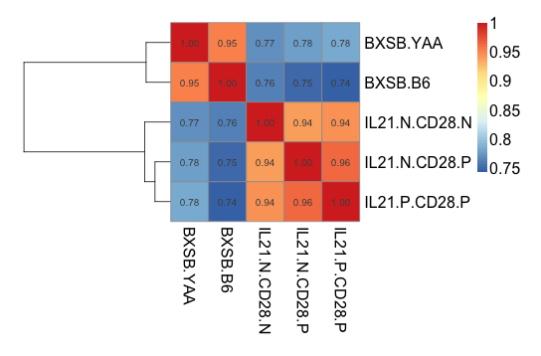
BXSB^{B6} and BXSB^{YAA}

Slide 3
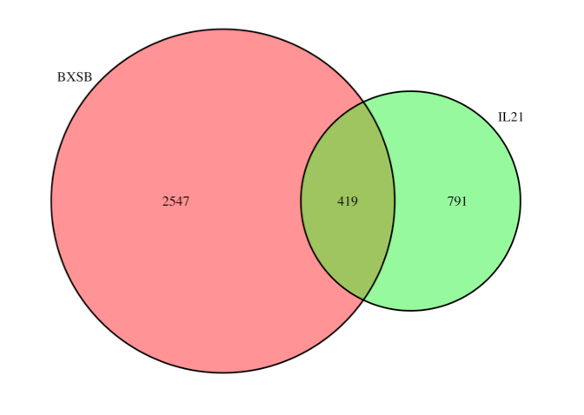
BXSB^{B6} and BXSB^{YAA}

Slide 4
BXSB^{B6} and BXSB^{YAA}
 | IL21^{N}ICOS^{N} | IL21^{N}ICOS^{P} | IL21^{P}ICOS^{P}
BXSB^{B6} | 106*** | 52 | 28
BXSB^{YAA} | 24 | 93 | 116***
Fisher’s test: p value equals 2.2e-16
Chi-square test: p values equal 6.613e-12 and 1.52e-13 for BXSB^{B6} and BXSB^{YAA}

Slide 5
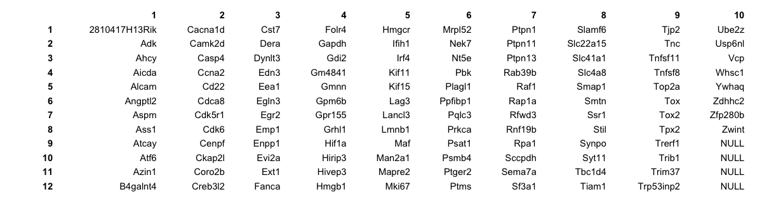
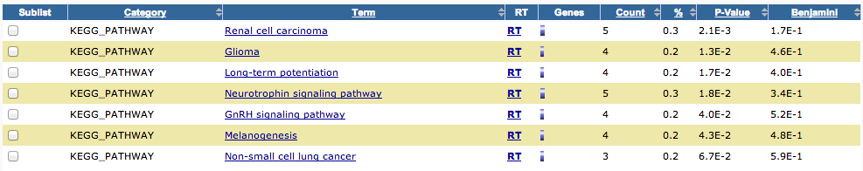
BXSB^{B6} and BXSB^{YAA}

Slide 6
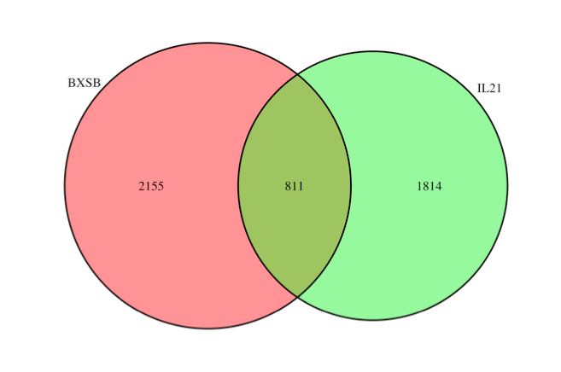
BXSB^{B6} and BXSB^{YAA}

Slide 7
BXSB^{B6} and BXSB^{YAA}
 | IL21^{N}ICOS^{N} | IL21^{N}ICOS^{P} | IL21^{P}ICOS^{P}
BXSB^{B6} | 190*** | 100 | 68
BXSB^{YAA} | 43 | 193 | 217***
Fisher’s test: p value equals 2.2e-16
Chi-square test: p values equal 6.613e-12 and 1.52e-13 for BXSB^{B6} and BXSB^{YAA}

Slide 8
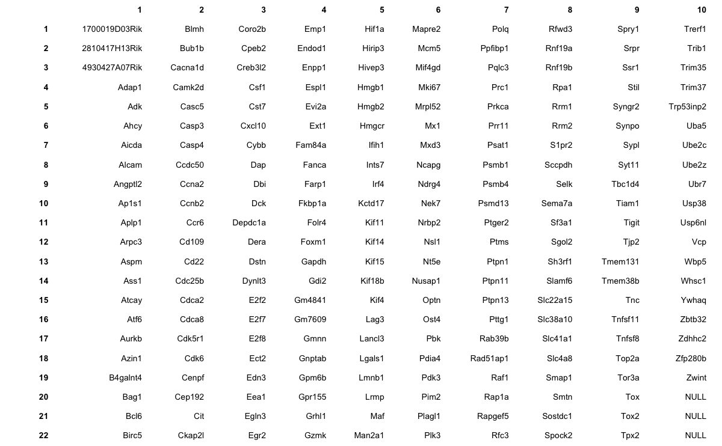
BXSB^{B6} and BXSB^{YAA}

Slide 9
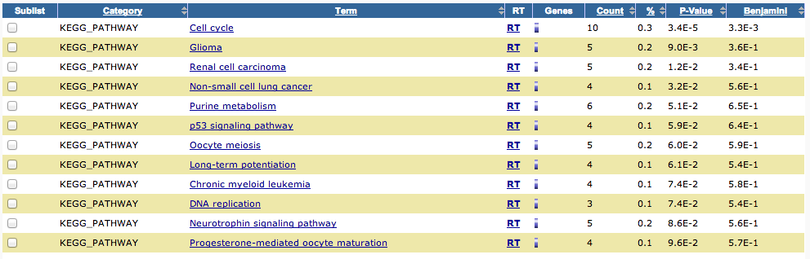
BXSB^{B6} and BXSB^{YAA}

Slide 10
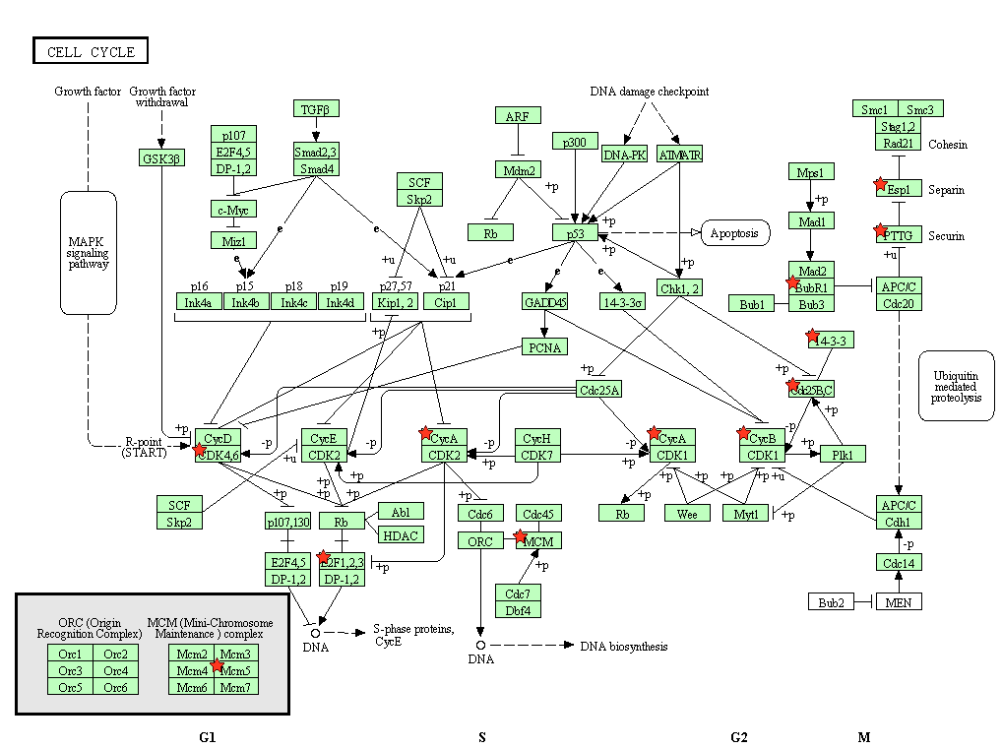

Slide 11
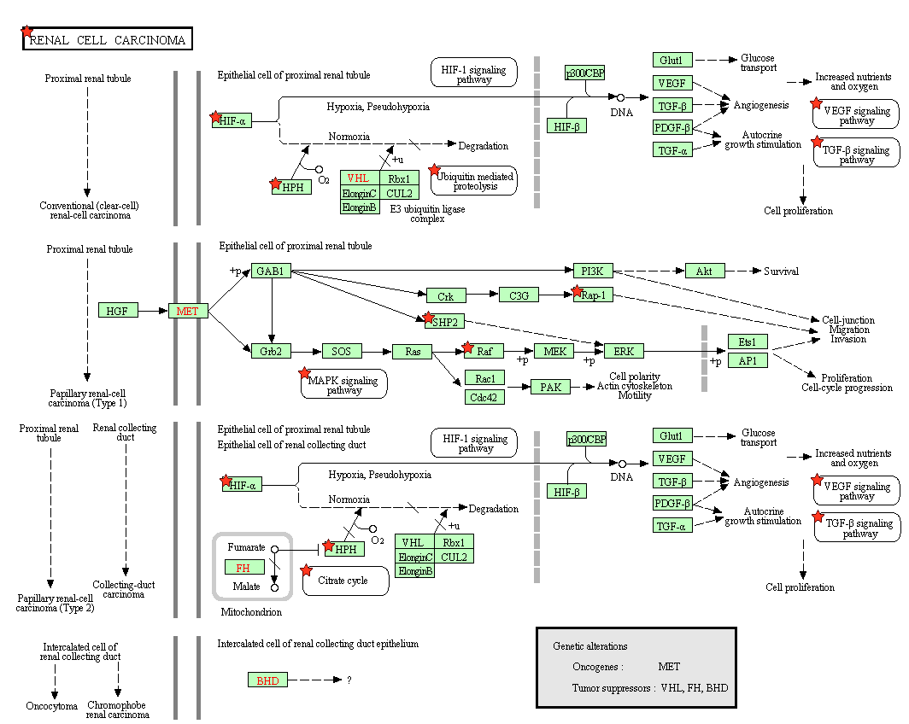

Slide 12
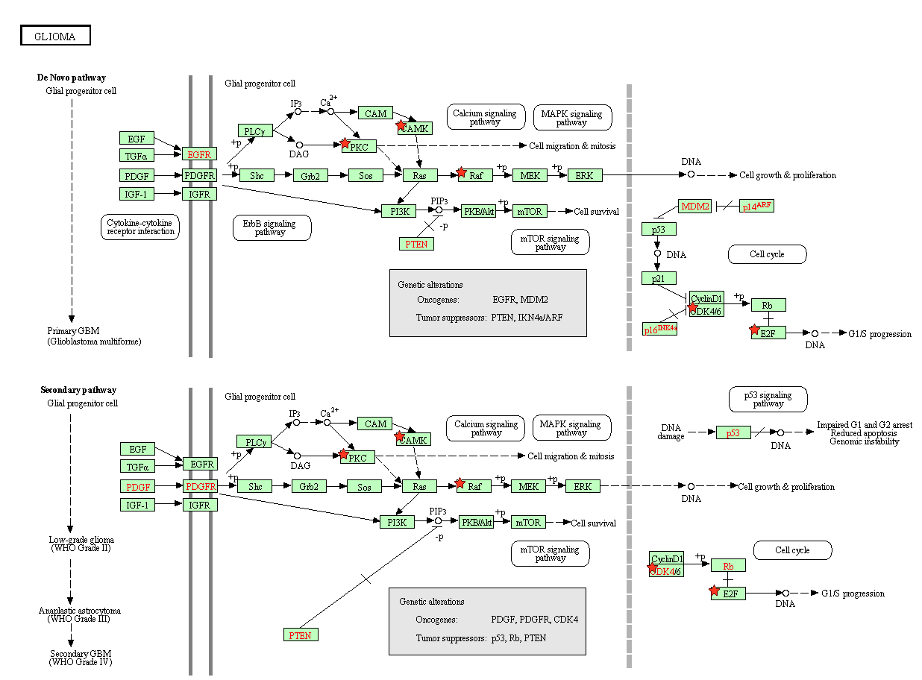

Slide 13
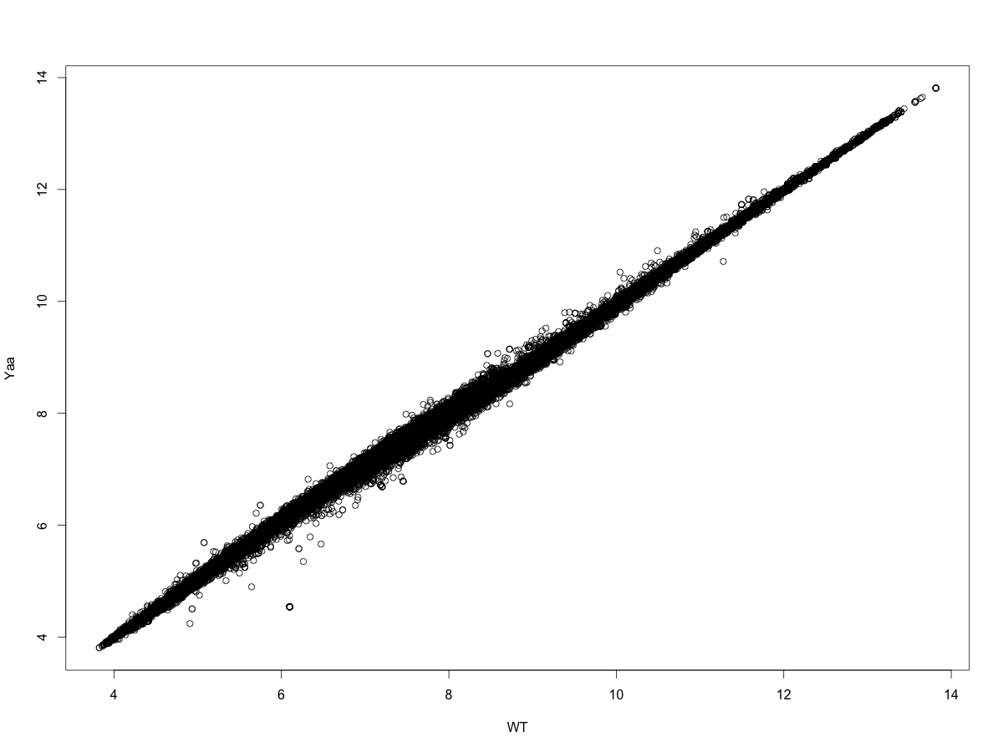
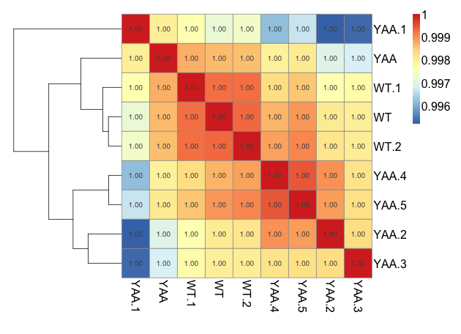
B6^{B6} and B6^{YAA}

Slide 14
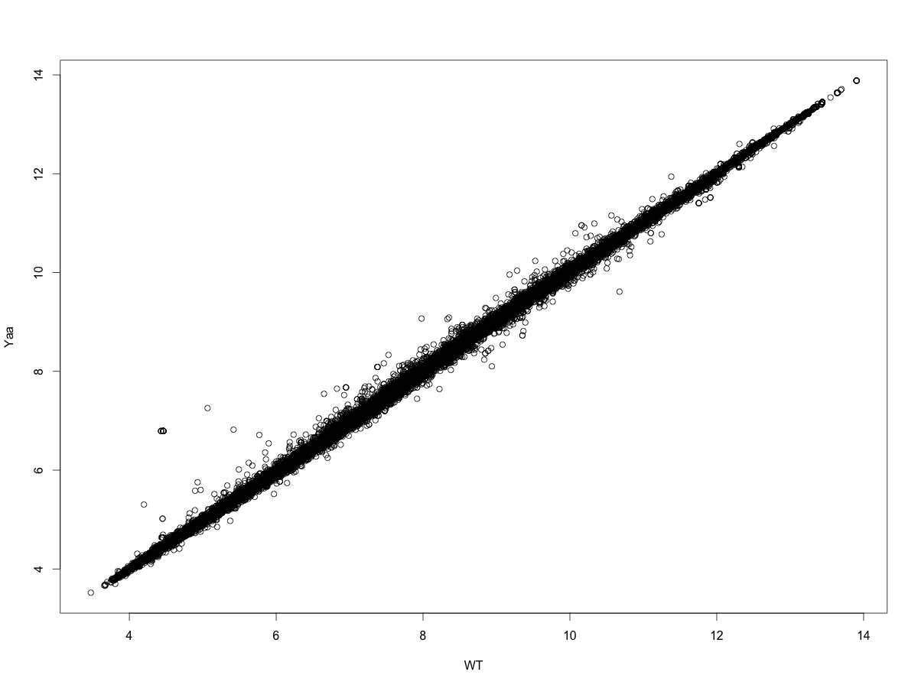
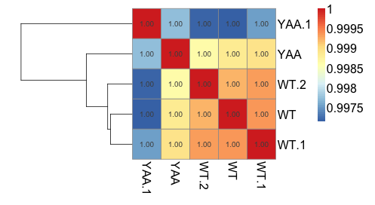
B6^{B6} and B6^{YAA}

Slide 15
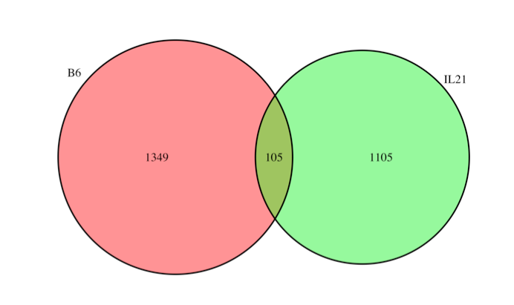
B6^{B6} and B6^{YAA}

Slide 16
B6^{B6} and B6^{YAA}
 | IL21^{N}ICOS^{N} | IL21^{N}ICOS^{P} | IL21^{P}ICOS^{P}
B6^{B6} | 13*** | 1 | 4
B6^{YAA} | 20 | 32 | 35***
Fisher’s test: p value equals 0.0002367
Chi-square test: p values equal 0.001503 and 0.1139 for B6^{B6} and B6^{YAA}

Slide 17
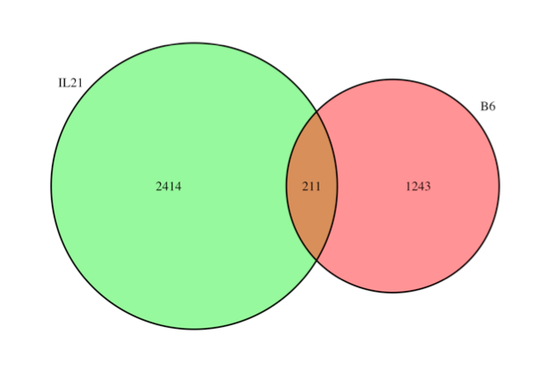
B6^{B6} and B6^{YAA}

Slide 18
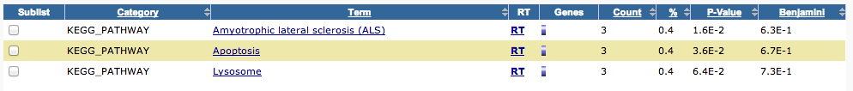
B6^{B6} and B6^{YAA}
 | IL21^{N}ICOS^{N} | IL21^{N}ICOS^{P} | IL21^{P}ICOS^{P}
B6^{B6} | 24 | 7 | 13
B6^{YAA} | 30 | 64 | 73***
Fisher’s test: p value equals 9.774e-06
Chi-square test: p values equal 0.006294 and 9.712e-05 for B6^{B6} and B6^{YAA}

Slide 19
IL21 and YAA samples

Slide 20
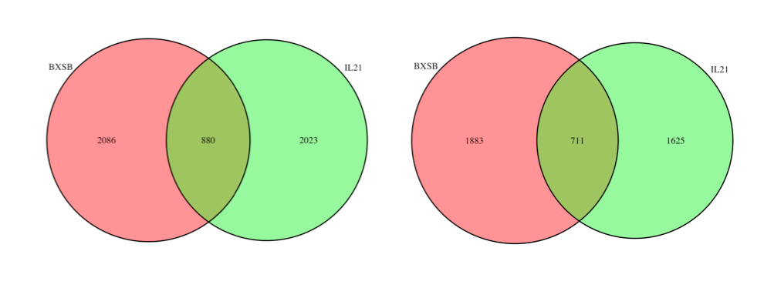
BXSB^{B6/YAA} and IL21
BXSB: significant genes between BXSB^{B6} and BXSB^{YAA}
IL21: significant genes between NN, NP, and PP

Slide 21
BXSB^{B6/YAA} and IL21
 | IL21^{N}ICOS^{N} | IL21^{N}ICOS^{P} | IL21^{P}ICOS^{P}
BXSB^{B6} | 200*** | 108 | 70
BXSB^{YAA} | 46 | 211 | 245***
Filter: max read count larger than 100
 | IL21^{N}ICOS^{N} | IL21^{N}ICOS^{P} | IL21^{P}ICOS^{P}
BXSB^{B6} | 165*** | 83 | 63
BXSB^{YAA} | 40 | 181 | 179***
Fisher’s test: p value equals 2.2e-16

Slide 22
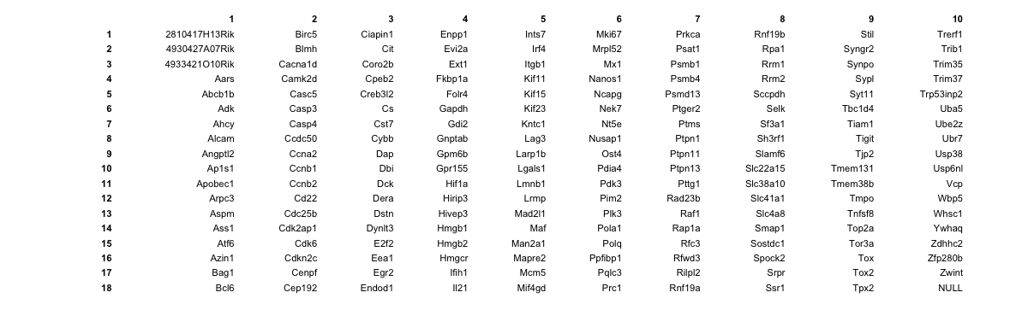
BXSB^{B6/YAA} and IL21

Slide 23
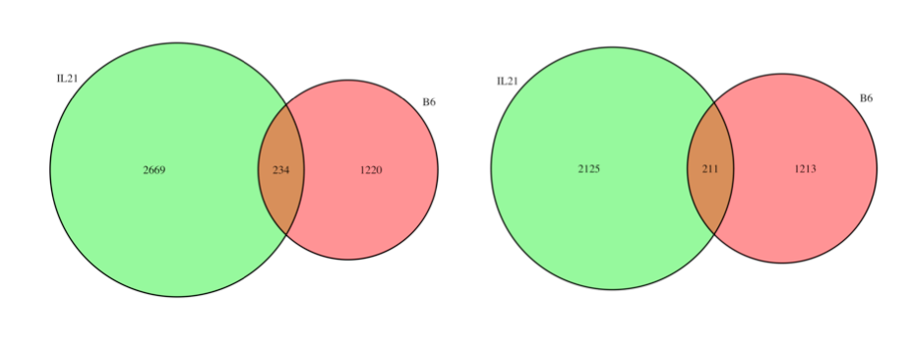
B6^{B6/YAA} and IL21
B6: significant genes between B6^{B6} and B6^{YAA}
IL21: significant genes between NN, NP, and PP

Slide 24
B6^{B6/YAA} and IL21
 | IL21^{N}ICOS^{N} | IL21^{N}ICOS^{P} | IL21^{P}ICOS^{P}
B6^{B6} | 27 | 9 | 13
B6^{YAA} | 32 | 75 | 78***
Filter: max read count larger than 100
 | IL21^{N}ICOS^{N} | IL21^{N}ICOS^{P} | IL21^{P}ICOS^{P}
B6^{B6} | 22 | 7 | 10
B6^{YAA} | 30 | 69 | 73***
Fisher’s test: p value equals 1.319e-06

Slide 25
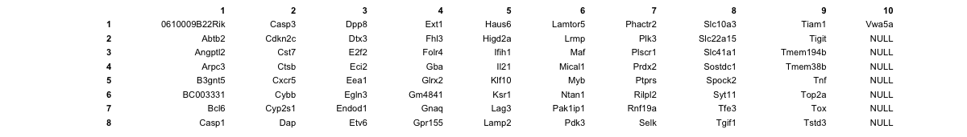
B6^{B6/YAA} and IL21

Slide 26
File
 | IL21^{N}ICOS^{N} | IL21^{N}ICOS^{P} | IL21^{P}ICOS^{P}
B6^{B6} | 1 | 2 | 3
B6^{YAA} | 4 | 5 | 6
./Yaa/list.xlsx

Slide 27
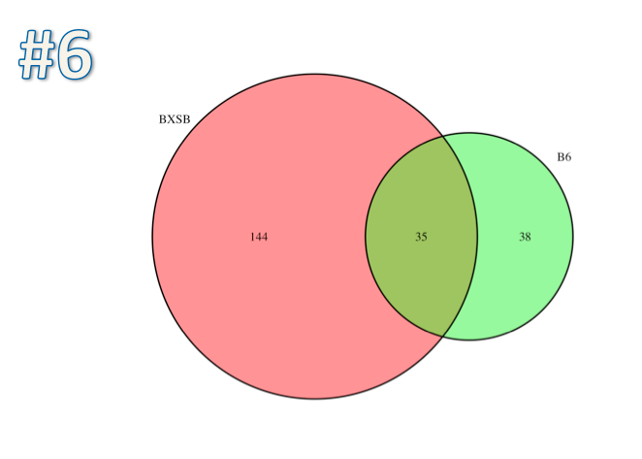
PP/YAA

Slide 28
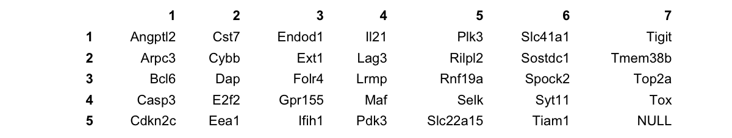
PP/YAA

Slide 29
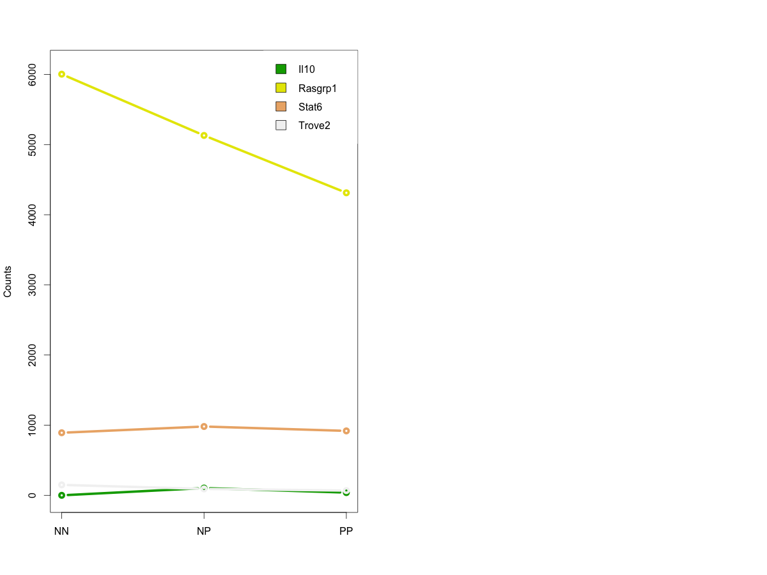
GWAS/MGI hints
Rasgrp1 appears as significant in both Il21 and BXSB experiments, with the same trend

