Slide 1
Genetic mechanisms of BXSB-mediating SLE acceleration

Slide 2
Y-linked autoimmune acceleration
The Yaa-mutation is a translocation from the telomeric end of the X chromosome onto the Y chromosome
Yaa-mutation is associated with the accelerated development of systemic lupus erythematosus (SLE)
BXSB genome backbone also contributes to SLE acceleration.
Genetic mechanisms are not clear.

Slide 3
Materials and Methods
Exome sequencing
BXSB
RNA sequencing
BXSB, BXSB^{B6Y}
Microarray
B6, B6^{YAA}
FASTQ trim
FASTQ trim
Normalization (RMA)
Alignment: Bowtie
Alignment: Bowtie
B6 and BXSB pseudo-genome
DE genes
Variant call
samtools, GATK, VarScan
Expression estimation: RSEM
BXSB pseudo-genome
DE, pathway, Immgen
Microarray: CD3CD4 T-cells
RNA sequencing: Splenic cells from 10 week old BXSB and BXSB.B6Y
BXSB.B6Y males carry the B6 Y chromosome in place of the mutant Yaa-containing Y chromosome of BXSB inbred male mice.

Slide 4
RNA sequencing
Aligning to BXSB pseudo-genome increases alignment rate by approximately 1%.

Slide 5
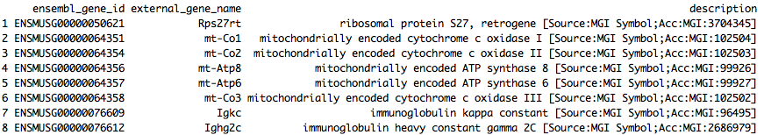
Outlier genes
Igkc and Ighg2c are both annotated for Immunoglobulin (Ig) and T-cell receptor (TcR) Igkc high and twice more in BXSB. Ighg2c higher in BXSB.B6Y. What are they doing?

Slide 6
Outlier genes
I took off the outlier genes and re-normalize the TPM for downstream analysis.

Slide 7
Transcriptional processes in BXSB and BXSB.B6Y splenic cells are very different
q-value < 0.05, log2 fold change > 0.3
1724 out of 9678 are differential
Why the signal so strong?

Slide 8
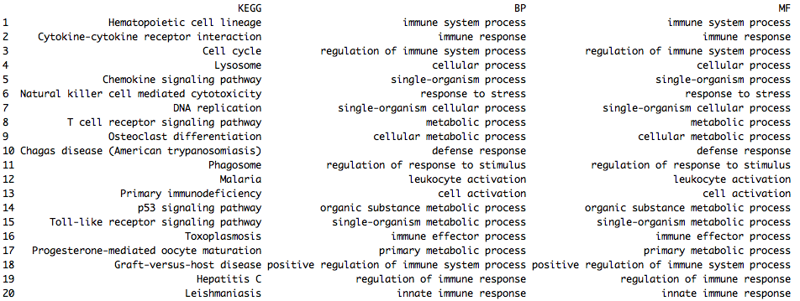
Differential genes are also immunological genes

Slide 9
Transcriptional differences between B6 and B6.YAA
p-value < 0.05
977 out of 21755 are differential

Slide 10
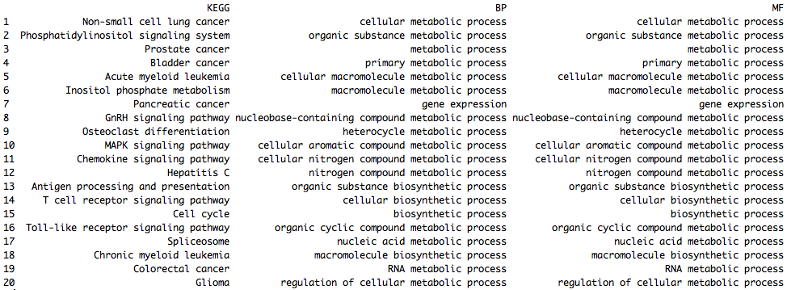
Differential genes are metabolic

Slide 11
Interaction between YAA and genomic backgrounds
DE1: Yaa-targeting genes in the B6 background
B6
Yaa-
B6
Yaa+
DE2: Yaa-targeting genes in the BXSB background
BXSB
Yaa-
BXSB
Yaa+
Intersection between DE1 and DE2 are Yaa-genes irrelevant of genomic background
DE2-specific genes reflect interaction between Yaa locus and BXSB genomic background
DE1-specific genes reflect interaction between Yaa locus and B6 genomic background

Slide 12
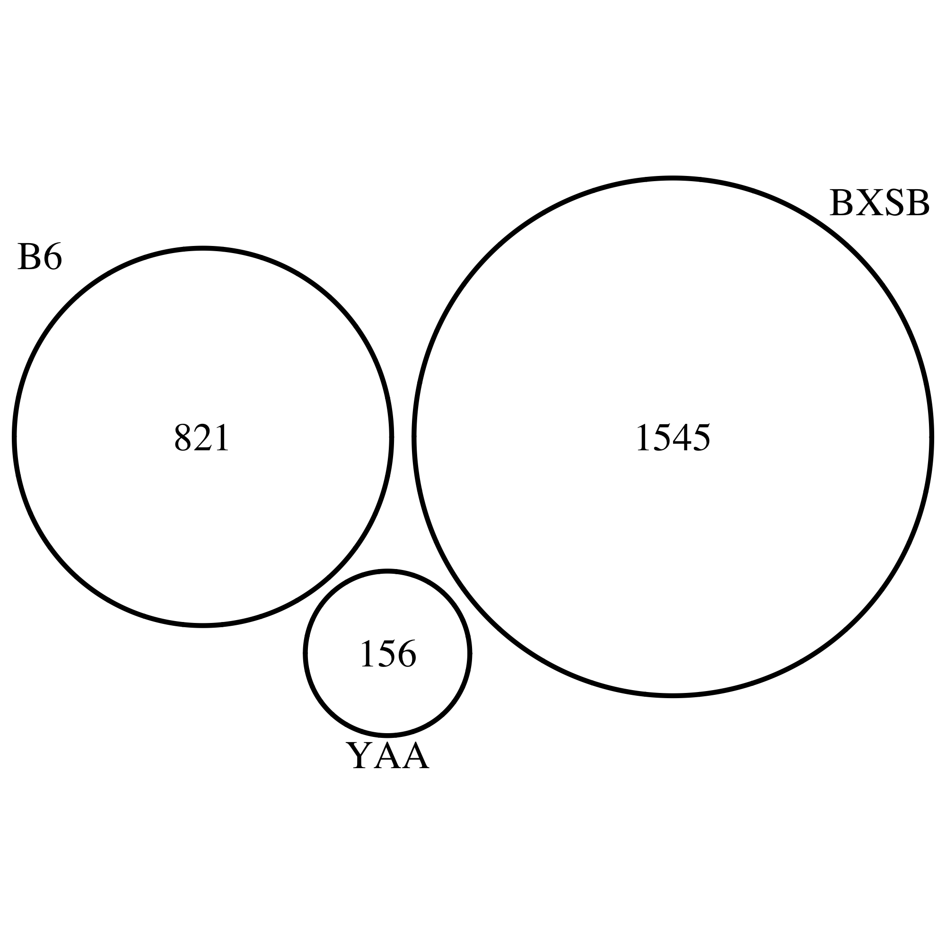
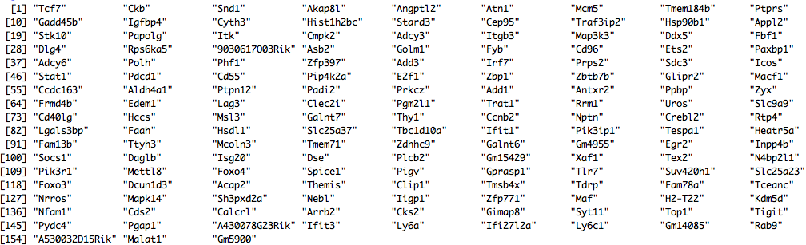
Strong BXSB-specific signal

Slide 13
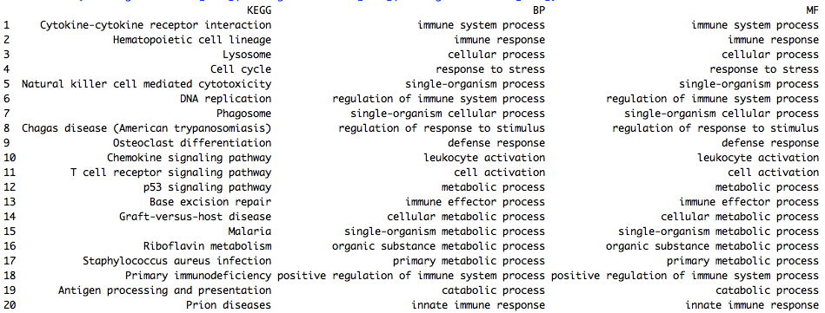
BXSB-specific genes are immunological

Slide 14
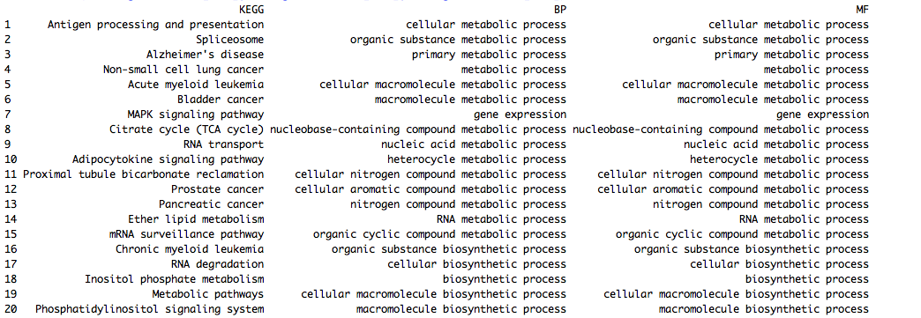
B6-specific genes are metabolic

Slide 15
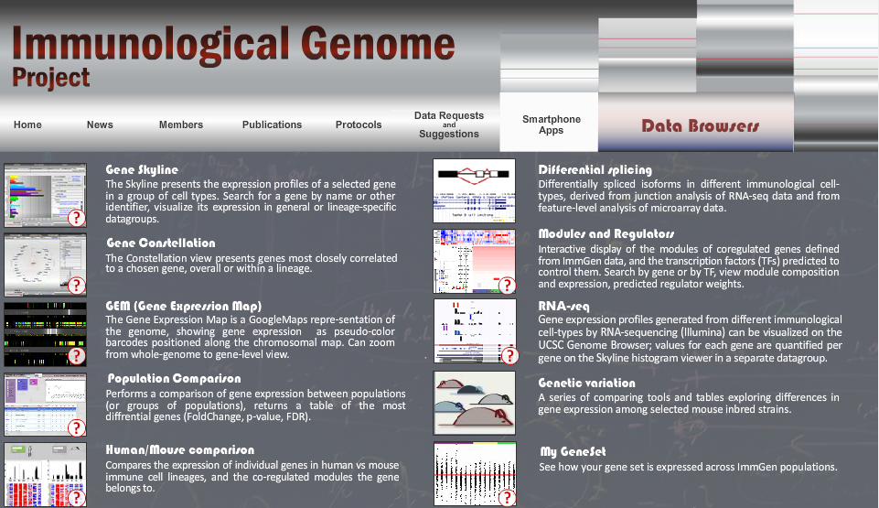
ImmGen modules

Slide 16
BXSB-specific genes in Immgen modules
Top regulators of module 24: Klf9, Tcfec, Ctbp2, Creg1, Tcfe3
Top regulators of module 25: Cebpb, Irf5, Ciita, Atf6

Slide 17
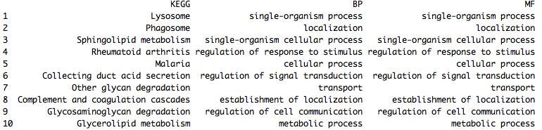
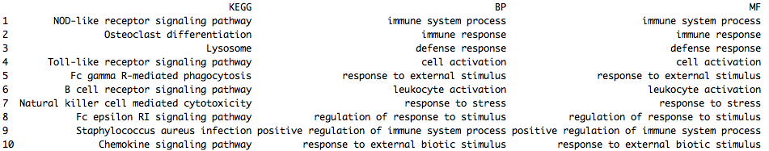
Module 25 is interesting
Module 24
Module 25

Slide 18
Genomic differences of B6 and BXSB

Slide 19
Predict variant’s effect

Slide 20
Discussion
Biology of ImmGen modules
Map BXSB-specific signal to cell subtypes (ImmGen) and IL21 signaling
BXSB variants-affecting genes

Slide 21
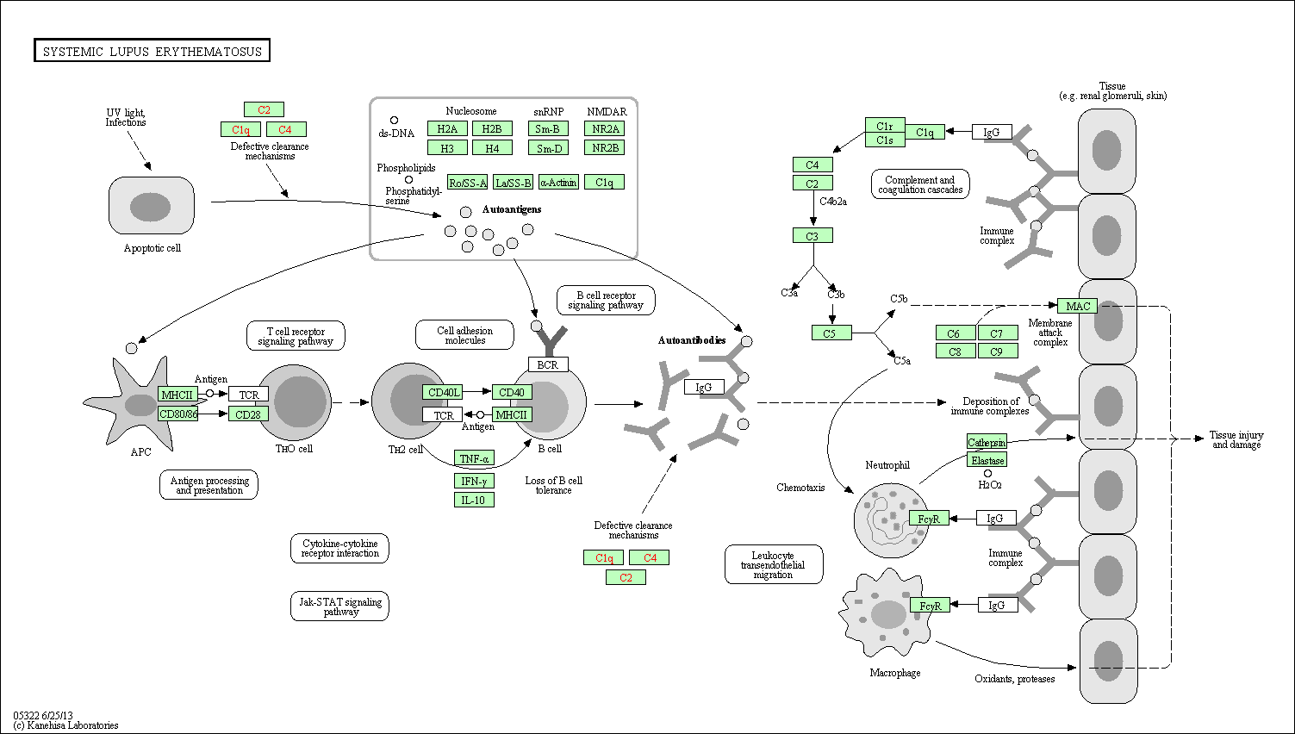
KEGG: SLE

Slide 22
Facts, questions, and approaches
What we know?
YAA mutation was identified to be a translocation from the telomeric end of the X chromosome onto the Y chromosome
YAA locus contains Tlr7 gene, but the exact genomic range is unclear
The accelerated development of SLE in male BXSB mice is associated with the genetically abnormal YAA locus in its Y chromosome
BXSB mice with a B6 Y chromosome do not develop the disease
C57BL/6J mice carrying the YAA gene are indistinguishable from wild type controls
What we have?
B6 and BXSB genome (Steve Munger)
RNA-seq on wild type BXSB and BXSB with B6 Y chromosome
Microarray on wild type B6, and B6 with BXSB Y chromosome
Differential genes, GO, KEGG, and master regulators
What are the questions and how to approach?
What are the genomic differences between BXSB and B6 that are functional?
How to refine the YAA locus?
How to infer a model from the differential genes between BXSB and BXSB^{B6(Y)} in terms of protein cascade?
How the BXSB background cooperate with the extra YAA locus on Y chromosome to accelerate SLE development?
Identify the differential genes between BXSB WT and B6 with BXSB Y chromosome
Integrate the IL21 data or not? How?

Slide 23
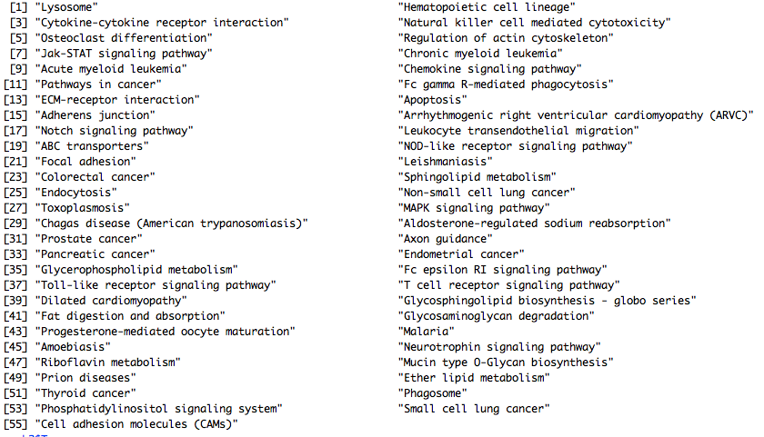
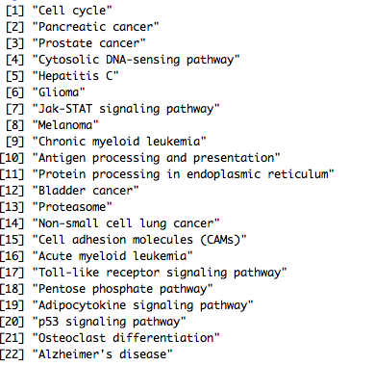
BXSB is the only SLE-causing

Slide 24
IL21 signaling?
 | IL21^{N}ICOS^{N} | IL21^{N}ICOS^{P} | IL21^{P}ICOS^{P}
BXSB^{B6} | 190*** | 100 | 68
BXSB^{YAA} | 43 | 193 | 217***
Fisher’s test: p value equals 2.2e-16
Chi-square test: p values equal 6.613e-12 and 1.52e-13 for BXSB^{B6} and BXSB^{YAA}

