Slide 1
Permutation-based maximum covariance analysis (PMCA): a method to integrate two datasets
19 April 2016

Slide 2
Problem: extract similar patterns from two datasets
Data: parallel measurements of two variables from the same group of samples
The two variables could be gene and protein expression, gene expression and cell-type compositions, cell activity and behaviors
Instead of physical samples, the “sample” could be some entities, such as a group of genes, time series

Slide 3
Data: two parallel measurements from the same group of samples
p and q measurements on two aspects of the n samples
Maximum covariance analysis (MCA) by John Prohaska in 1976 in climate science

Slide 4
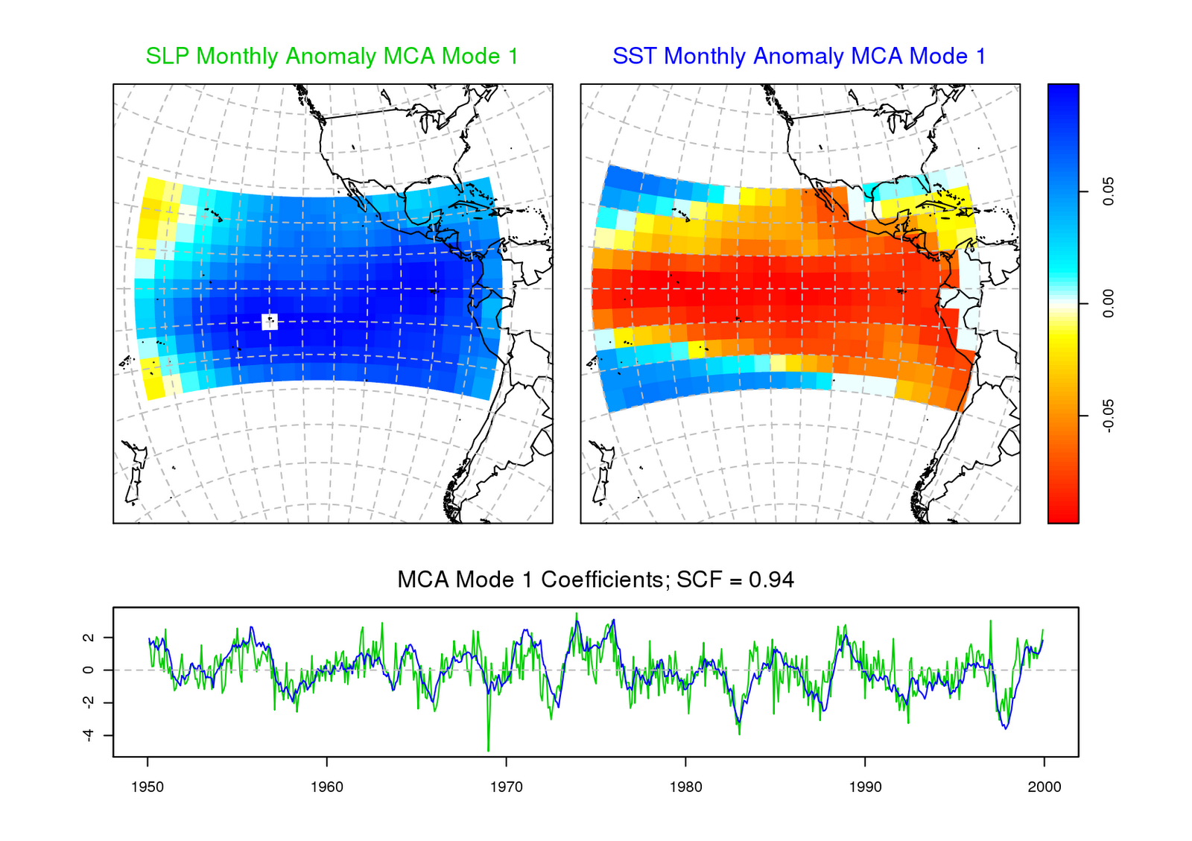
MCA proposed by John Prohaska in1976
Measurements of sea level pressure (181 by 59) and Sea surface temperature (32 by 59)

Slide 5
Mathematical setup of maximum covariance analysis (MCA)
u and v be arbitrary unit column vector in length p and q, and represent a pattern in X and Y
a and b, 1 x n vectors, are projections of X and Y onto u and v
MCA seeks optimal u and v that maximize covariance of a and b

Slide 6
Mathematical setup of maximum covariance analysis (MCA)
Maximal c obtained by setting u and v the leading mode of the SVD of cov(X, Y)
Succeeding SVD modes maximize succeeding c

Slide 7
Mathematical setup of maximum covariance analysis (MCA)

Slide 8
MCA proposed by John Prohaska in1976
Measurements of sea level pressure (181 by 59) and Sea surface temperature (32 by 59)

Slide 9
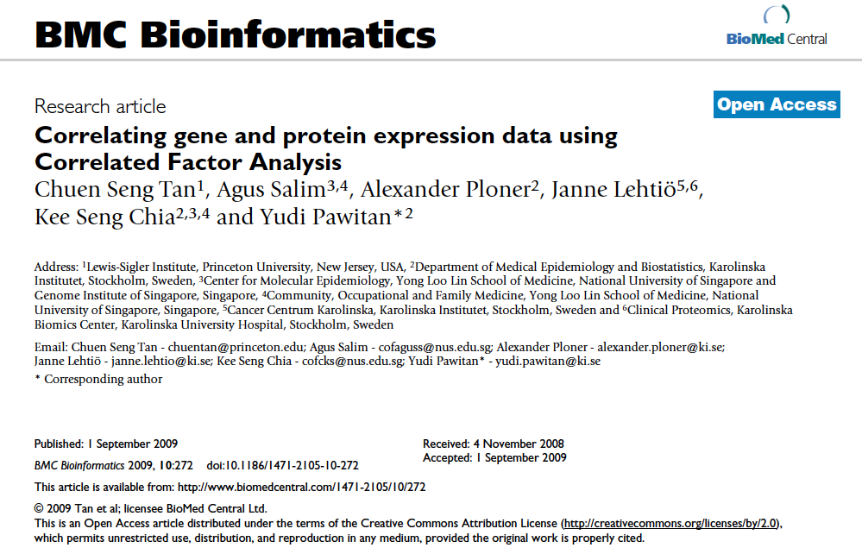

Slide 10
CFA: Pawitan et al.
NCI: gene and protein expressions in 59 cancer cell lines
Interest: co-functioning genes and proteins
How many pattern pairs to focus?
Empirical null distribution of the SVD deviance by permutation
[s1, s2, s3, s4, s5, s6]
Genes and proteins in each pattern
Cumulative correlation

Slide 11
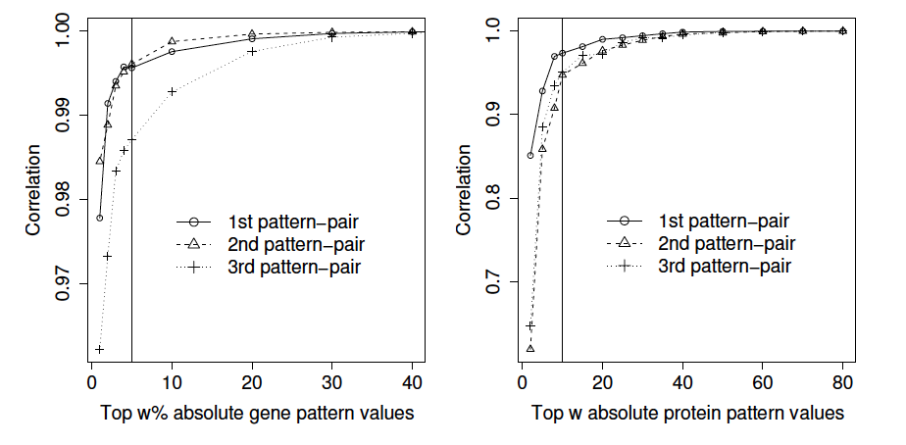
CFA: Pawitan et al.
However, assignment of w by finding the “shoulder” of the above graph is not clear

Slide 12

Bulk RNA sequencing
B6^{APP} transgenic mice were made by co-injecting two vectors encoding mutant APP and mutant PSEN1
APP (amyloid precursor protein) and PSEN1 (presenilin 1) mutations are great risky factors for early-onset AD
Aβ plaque, showed at around 5m in B6^{APP}
2m (5/5)
4m (9/5)
5m (13/11)
6m (7/5)
B6^{WT}/B6^{APP}
Gareth Howell & Harriet Williams

Slide 13
Identify genotype- and age-related genes
R squared > 0.5; F-test q-value (FDR) < 0.05
P-value of genotype- or age-related predictors < 0.05; absolute effect size > 0.2
108 out of 179 have measurements in single cell RNA-seq

Slide 14
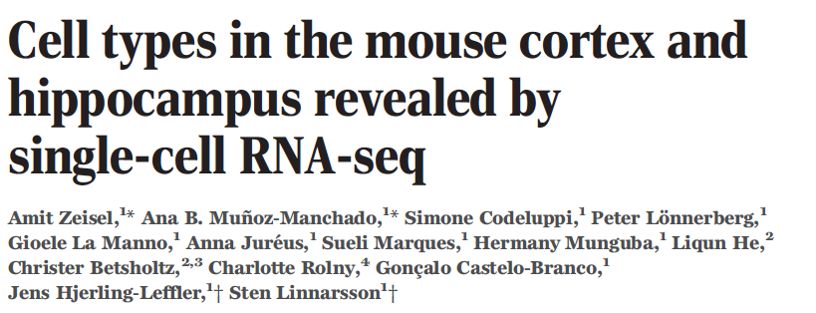
3005 cortical cells, 48 cell types

Slide 15
Clustering the 48 cell types by 108 chosen genes

Slide 16
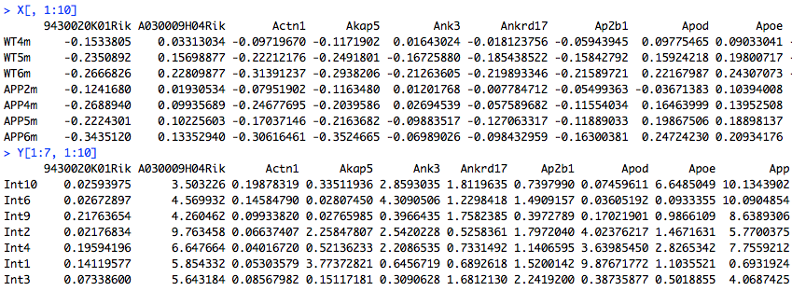


MCA setup
X: bulk RNA-seq on 59 samples and 8 groups (8 x 108)
Subtract 2m WT from the other 7 groups (7 x 108)
Y: single cell RNA-seq on 48 cells (48 x 108)
Objective: pair the 48 cells to the 7 pseudo-samples

Slide 17
MCA: variance, u and v
variance
First U vector
First V vector

Slide 18
MCA: A and B

Slide 19
Permutation-based MCA (R. Ball)
Homogenous and heterogeneous regression of X and Y on A
Scale Zx and Zy in row (R)?
Change the dynamics of Zx’s and Zy’s column vectors
Do scales matter when permuting per row?

Slide 20
Permutation-based MCA (R. Ball)
Absolute difference between Zx and Zy components as measure of similarity
Shuffle each row of Y, and repeat b times to obtain empirical distribution of score(i,j,k)

Slide 21
Permutation-based MCA (R. Ball)
PC1-PC2, real score smaller than the 0.05 quantile of the random scores

Slide 22
Permutation-based MCA (R. Ball)
Multiple comparison correction by controlling FPR
Initial w = apply(Zx, 2, sd): why sd?
Iteratively update w as w/tau
Compare real scores with w/tau up to 2nd PC
Matched patterns

Slide 23
Results
Lost of function of oligodendrocytes and microglia during AD progression

Slide 24
End

Slide 25
Gene expression of the 47 cell types quantified by a GLM
We model each gene in the following model:
y ∼ NB(μ, ρ), where y is the UMI count for the gene in a given sample
μ = β(astrocyte) ∗ astrocyte + β(neuron) ∗ neuron +...+β(basal) ∗ basal, where basal is the total molecular count of the cell
Prior(β, ρ) ∼ cauchy(0, 10)
Model parameters were estimated by MCMC sampling, and summarized by the first mode

Slide 26
APP2m and CA2Pyr2

