Slide 1
Integrating single cell and bulk RNA-seq with PMCA

Slide 2
Experiment design
2m (5/5)
4m (9/5)
5m (13/11)
6m (7/5)
WT/APP

Slide 3
Gene expression estimation for bulk RNA-seq
Quality control
Trimmomatic, FASTX
Alignment
Bowtie
Expression Estimation
RSEM

Slide 4
Model bulk RNA-seq data

Slide 5
Pipeline to identify APP- and aging-related genes
R squared > 0.5
F-test q-value (FDR) < 0.05
P-value of App-predictors < 0.05
Absolute effect size (log2fc) > 0.2
P-value of Age-predictors < 0.05
Absolute effect size (log2fc) > 0.2

Slide 6
Stratify the APP genes
App effect does not appear until 6 month
App effect appears in as early as 2 month and does not go further
App effect appears in 2 month, stay in 4 month, additional change appears in 5 and 6 month
App effect appears briefly in 5 month, but not before or after
App effect appears in 2 month, stay in 4 month, but additional change appears in 5 month
App effect appears in 4 month and 6 month
App effect appears in 5 month and 6 month
App effect appears in 2 month, and additional change appear in 4 month but not afterward
App effect appears in 2 month, stay in 4 and 5 month, but additional change appears in 6 month
App effect appears in 4 and 5 month

Slide 7
Stratify the aging genes
Age effect on 5 and 6 month, no additional App-dependent age effect
Age effect only on 6 month without App-dependent age effect
Age effect on 5 and 6 month, additional App-dependent age effect on 6 month
Age effect from 4 to 6 month, no App-dependent age effect
Both Age and App-dependent age effect on 6 month
App-dependent age effect on 6 month
Age effect from 4 to 6 month, additional App-dependent age effect from 5 to 6 month

Slide 8
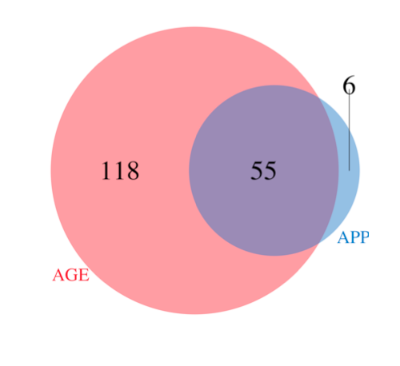
Merge the APP and aging genes
108 of the 179 genes by merging app and aging genes have measurements in single cell RNA-seq
These 108 genes were used for PMCA analysis

Slide 9
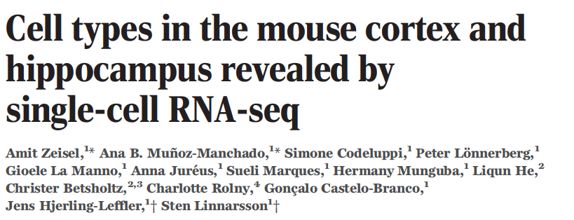
Single cell RNA-sequencing on 3005 cortical cells
Individual RNA molecules were counted using unique molecular identifiers (UMI)
Molecularly distinct classes of cells were identified by clustering (9 major classes and 47 subclasses)
Cell types in the mouse cortex and hippocampus revealed by single-cell RNA-seq. Science. 2015.

Slide 10
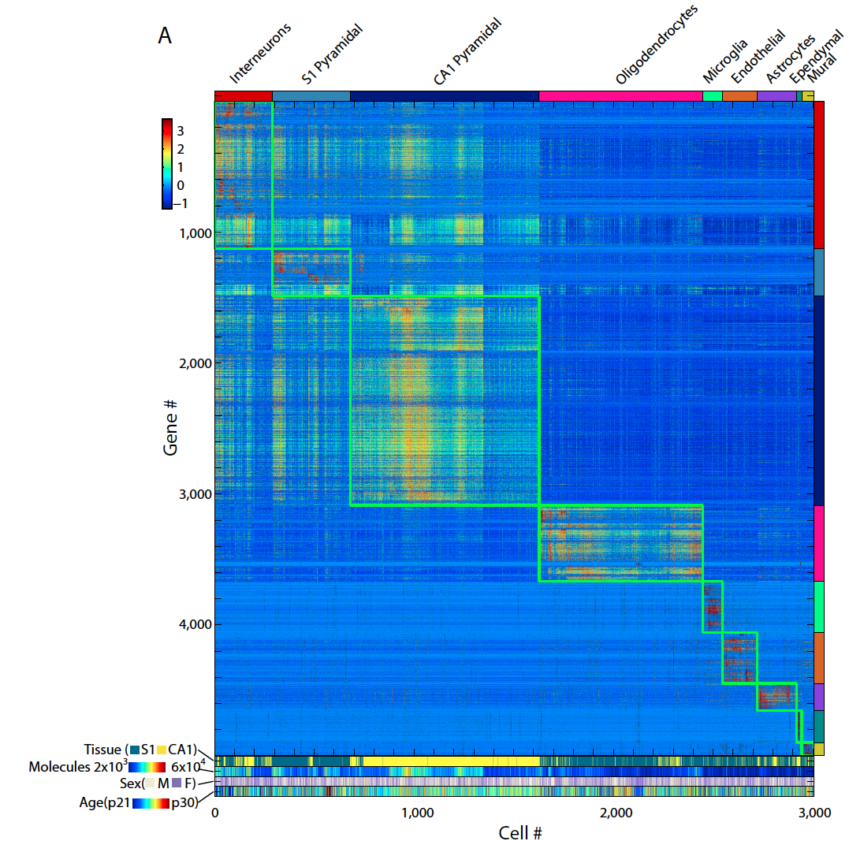
Cluster the 3005 cells into 9 major and 47 subtypes (graph from original paper)

Slide 11
Gene expression profiles of the 47 cell types were quantified by a generalized linear model
We model each gene in the following model:
y ∼ NB(μ, ρ), where y is the UMI count for the gene in a given sample
μ = β(astrocyte) ∗ astrocyte + β(neuron) ∗ neuron +...+β(basal) ∗ basal, where basal is the total molecular count of the cell
Prior(β, ρ) ∼ cauchy(0, 10)
Model parameters were estimated by MCMC sampling, and summarized by the first mode

Slide 12
Cluster the 47 cell types by the 108 chosen genes

Slide 13
PMCA setup
Bulk RNA-seq
Single cell RNA-seq
Gene expression from 8 groups defined by 4 ages (2m, 4m, 5m, 6m) and 2 genotypes (WT, APP)
Normalize all signal to 2m WT
X matrix: 7 by 108
Gene expression estimation from 47 cell types
Y matrix: 47 by 108

Slide 14
MCA
y = SVD(Cov(X, Y))$d

Slide 15
Results

Slide 16
APP2m and CA2Pyr2

