Slide 1
Eif4g3 Project
July 14, 2015

Slide 2
Method
Take only Non-polysomic samples
Filter genes: maximum bigger than 20
Log2 fold change bigger than 0.2 (15% increase)
P-value < 0.2
90 genes

Slide 3
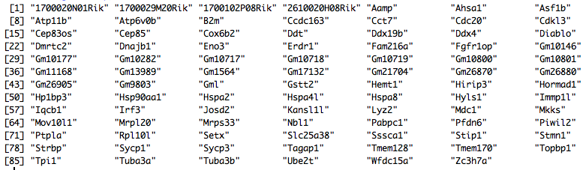
Genes
Differential genes in the Non-polysomic fraction (p-value < 0.2)
Spermatogenesis genes
Transcription factors

Slide 4
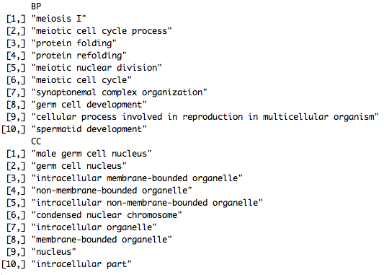
GO enrichment

Slide 5
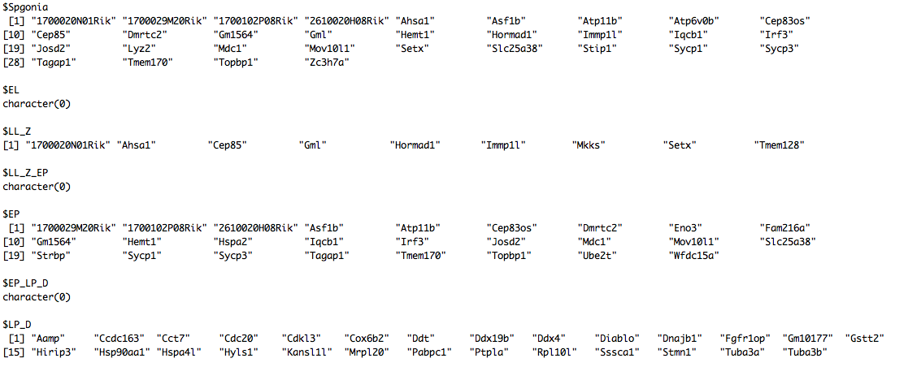
Cell marker genes
Marker gene numbers
P-value (enrichment test)
Overlap genes

