Slide 1
Eif4g3 Project
Sep 4, 2015

Slide 2
Mutant non-polysomic up genes overlap dramatically with EP genes
Enrichment test of the 285 non-polysomic up genes in signatures of EL, EP, et al (R)
86 out of 285 mutant non-polysomic up genes are also EP genes

Slide 3
Overlapping genes increase from 8 to 18
With Eif4g3 mutation, EP cells that gradually increase were stalled in the non-polysomic fraction during translation (EP staining?)

Slide 4
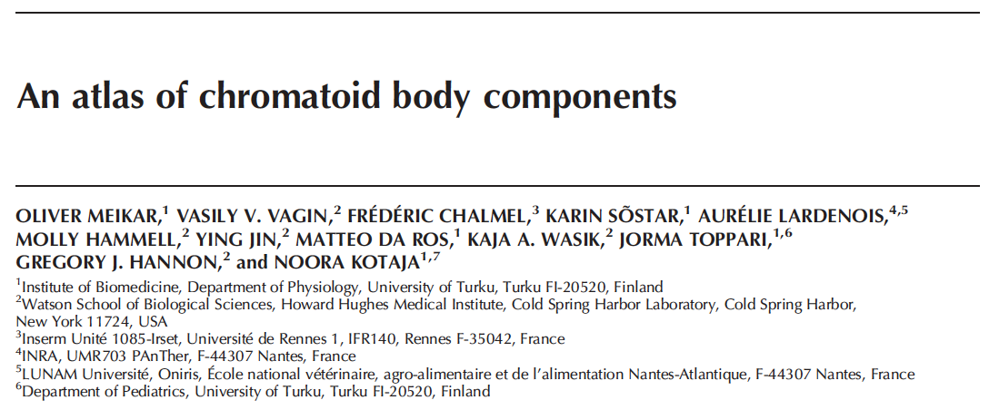
CB, as cytoplasmic granule, is unique to the haploid spermatids
This study characterized the full RNA and protein composition of CB

Slide 5
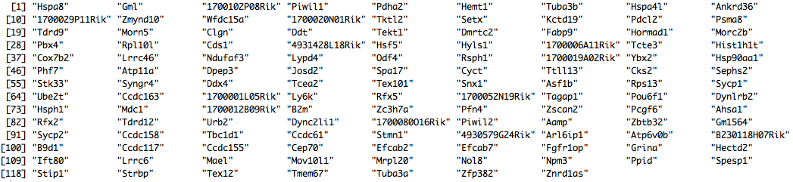
Overlaps with CB genes and proteins
11 out of 153 CB proteins are mutant non-polysomic up genes (pval: 0.0056)
124 out of 4059 CB genes are mutant non-polysomic up genes (pval: 0.015)
CB accumulate large amount of piRNA, which are invisible in our library
The 11 overlapping CB proteins are interesting

Slide 6
Explore from experiment design, instead of Hspa2
Model:
y ~ F + G + F * G
y: gene expression over 18 samples
F: sample fraction (IN, NONP, PLM)
G: genotype (WT, MT)

Slide 7
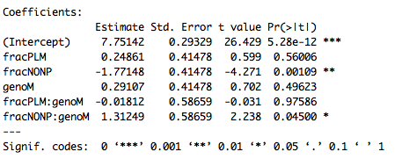
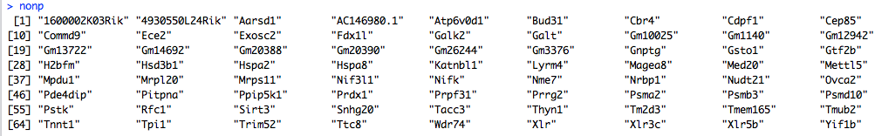
Fraction-specific effect of the Eif4g3 mutation
215 mutant genes
21 PLM-specific mutation genes
72 NONP-specific mutation genes (Hspa2)

