Slide 1
Eif4g3 Project
May 8, 2015

Slide 2
Outline
Expression estimation
Hspa2 and genes concord with Hspa2
Differential between polysomic WT and MT
Differential RBP binding to the C3H and MT Eif4g3 transcripts

Slide 3
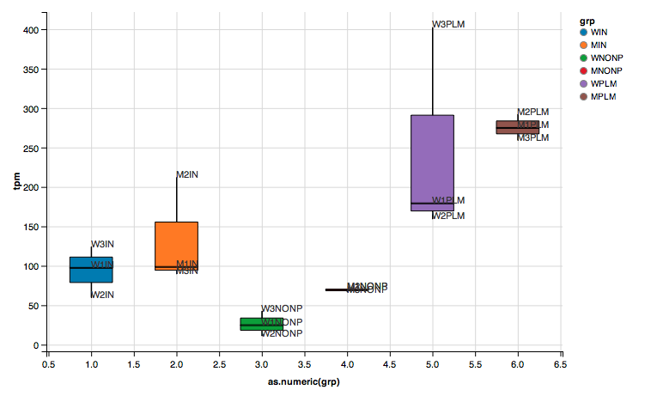
Hspa2
Hspa2 transcript expression in TPM.
Non-polysomic Hspa2 transcript in mutant samples are significantly higher than wild type samples

Slide 4
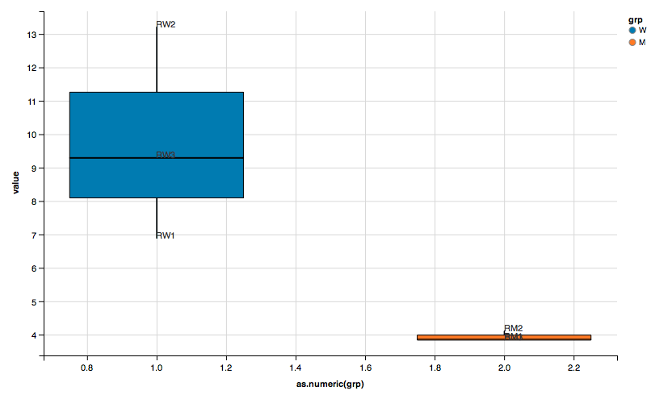
Hspa2
P-value: 0.0117
Normalize the polysomic Hspa2 transcript level to the non-polysomic level.
Significantly fewer polysomic in the mutant samples.

Slide 5
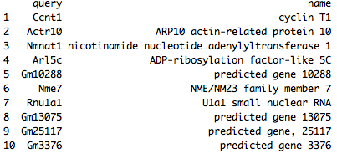
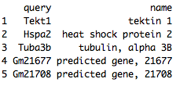
Concord genes
Up (left) and down (right) regulated genes in terms of polysomic to non-polysomic ratio
Tekt1 predominantly expressed in the testis, and was localized to the spermatocytes and round spermatids in the seminiferous tubules, indicating a role in spermatogenesis
Gm21677 and Gm21708 locate at chromosome Y

Slide 6
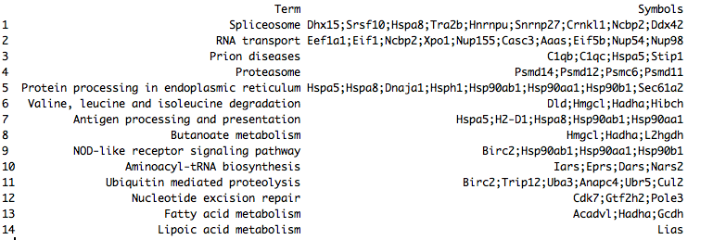
Polysomic only
339 and 84 genes were up- and down-regulated (p-value < 0.05) between the polysomic WT and MT

Slide 7
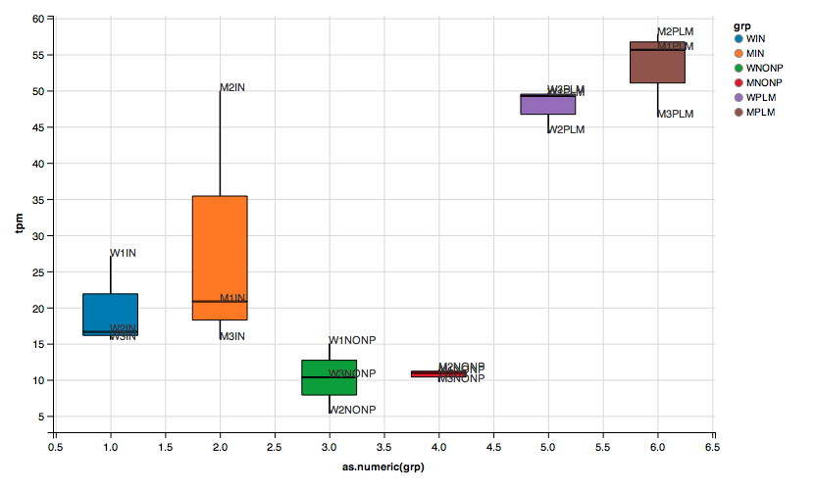
Eif4g3
Eif4g3 transcript expression in TPM.
No trend

Slide 8
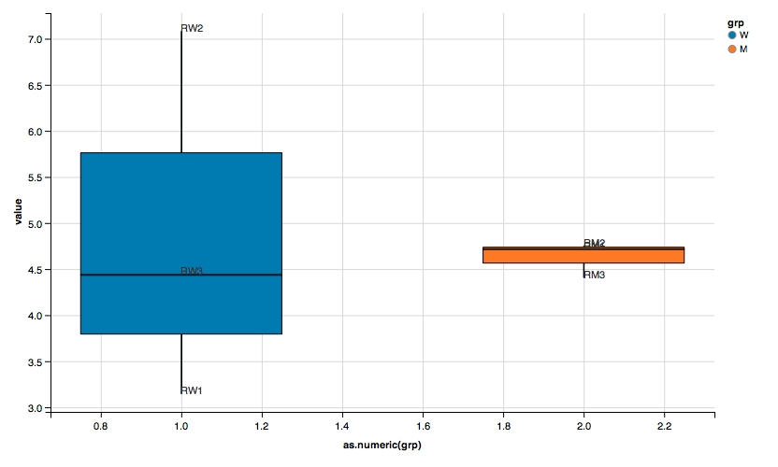
Eif4g3
Polysomic to non-polysomic ratio
No trend

Slide 9
How Eif4g3 mutants sterilized the mice?
Eif4g3 has no change in the transcriptional level.
Do mutant Eif4g3 function differently in the post-transcriptional level (as a scaffold protein)?
Call variants, define the consensus sequences
Search the Eif4g3 binding proteins, WT and MT
Identify the differential binding patterns.
What are the functions of the differential binding?

Slide 10
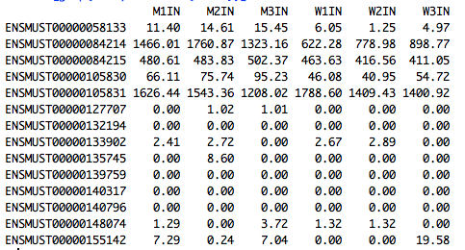
Eif4g3 transcripts
14 Eif4g3 transcripts, but maybe only 4 matter

Slide 11
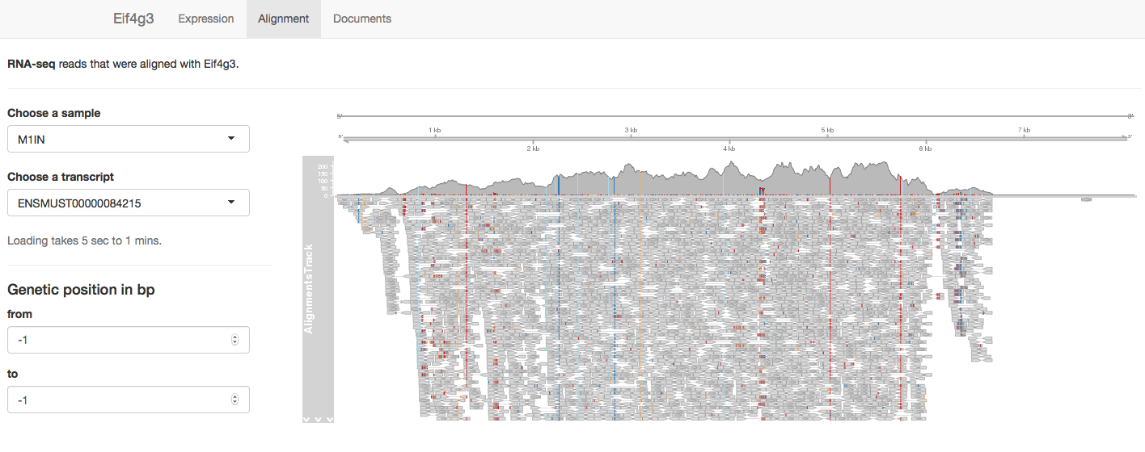
How the sequences are different?

Slide 12
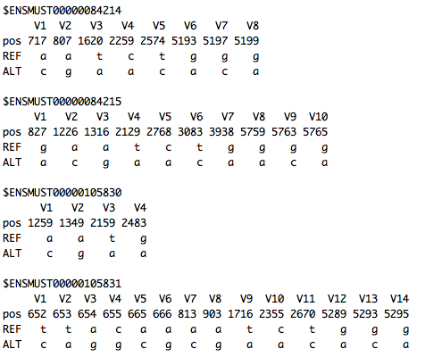
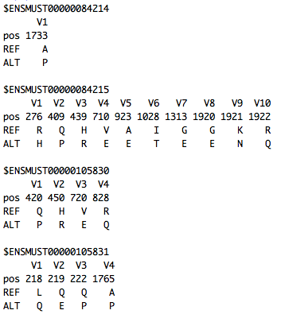
SNPs and differences in the peptide sequences
We confirmed the G-C mutant, and uncovered more

Slide 13
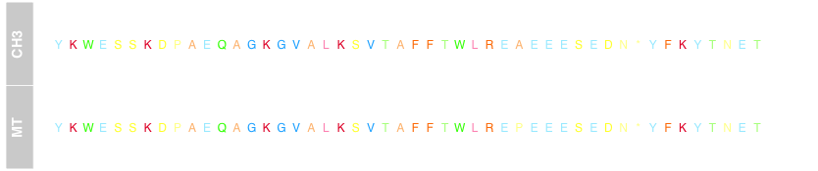
Peptide sequence

Slide 14
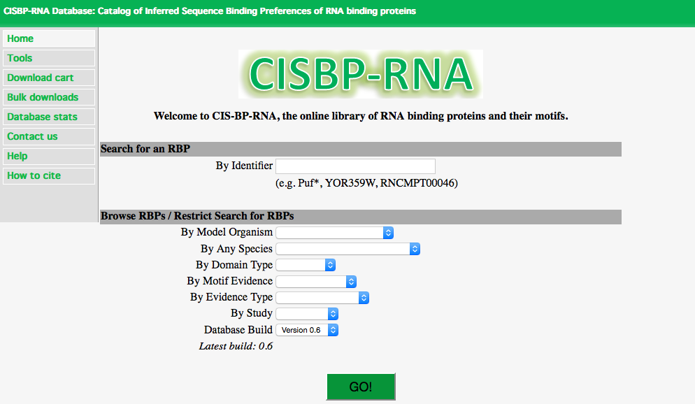
RNA Binding Protein database

Slide 15
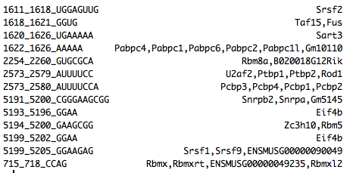
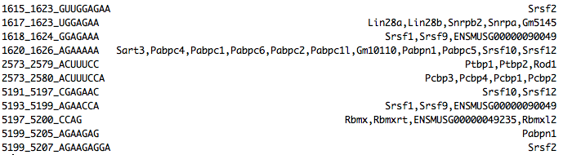
Eif4g3 may function differently as follow ENSMUST00000084214

Slide 16
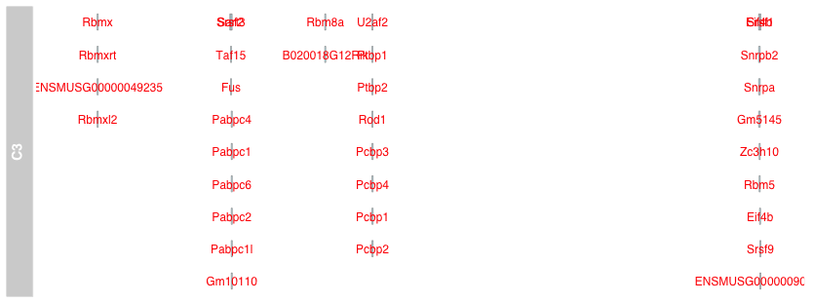
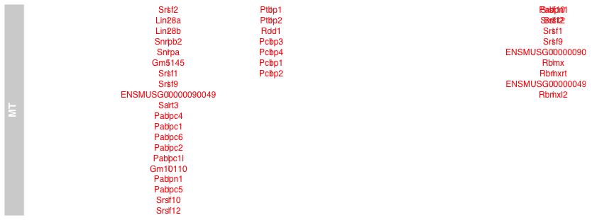
Eif4g3’s different binding patterns

Slide 17
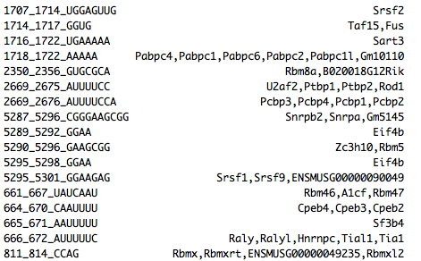
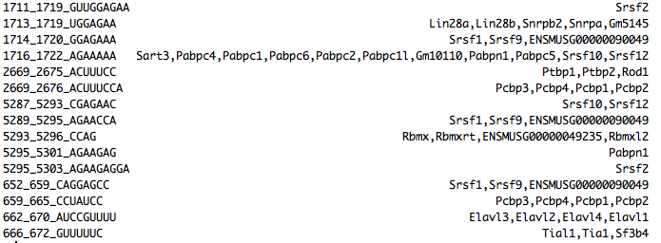
Eif4g3 may function differently as follow ENSMUST00000105831

Slide 18
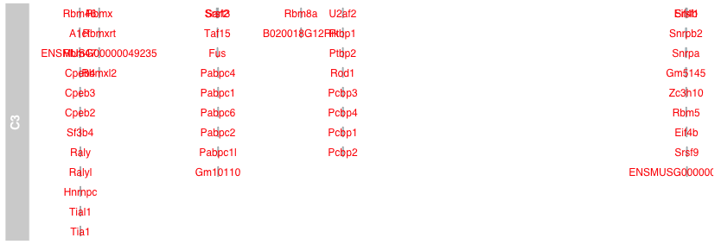
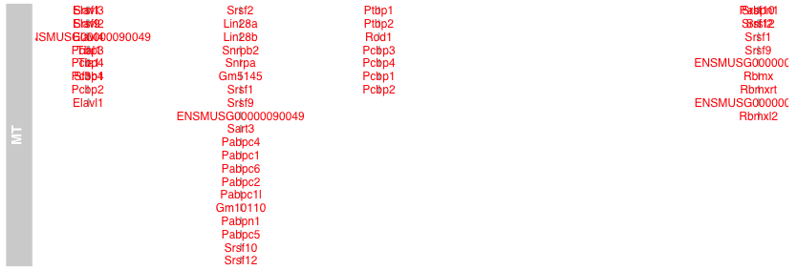
Eif4g3’s different binding patterns

Slide 19
Future directions

