Slide 1
Eif4g3 Project
10-23, 2015

Slide 2
Samples and preliminary analysis
Biology: Eif4g3 point mutation cause sterile male mice, we are looking for the mechanisms in the transcript level
Genotypes: WT (C3H) and MT (Eif4g3 point mutation)
Testis fractions: IN (total testis), NONP (non-polysomic fraction), PLM (polysomic fraction)
3 replicates per group: 2 x 3 x 3
RNA-seq reads were trimmed, aligned to C3H transcriptome, summarized to TPM (transcripts per million)
Spike-ins were discarded because spike-ins reads relative to total reads were not consistent

Slide 3
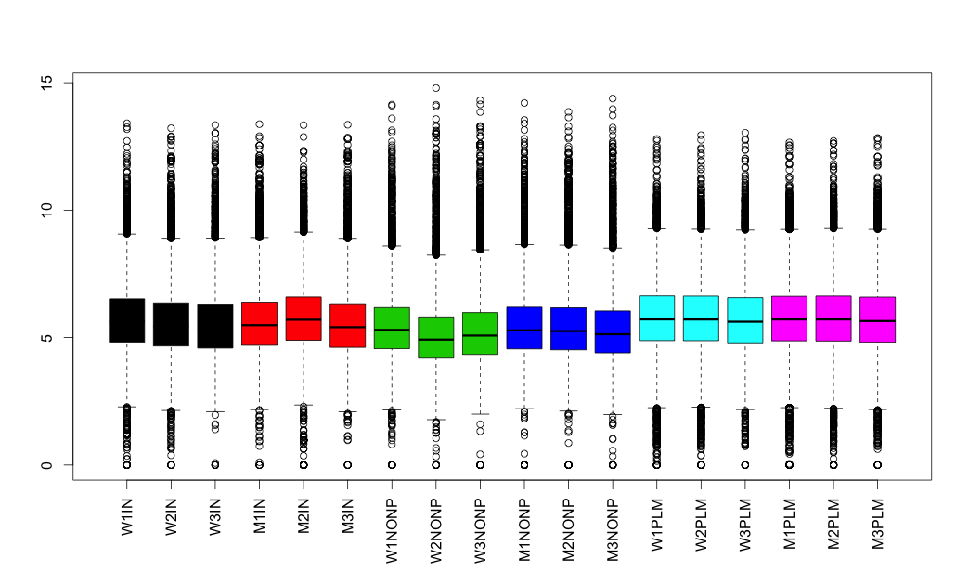
9580 genes, 6 groups, 18 samples
y: log2 TPM

Slide 4
Hspa2 mRNA expression
Significant up-regulation in the non-polysomic fraction
We want to extract all the genes that follows the Hspa2 pattern

Slide 5
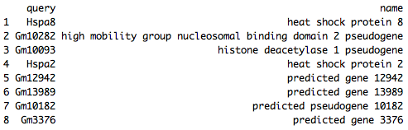
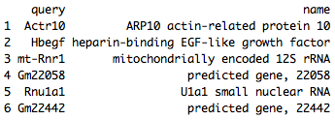
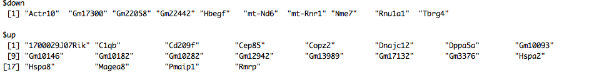
Pairwise t-test, WT vs MT
Differential genes in the Non-polysomic fraction (p < 0.05)
Differential genes in the Non-polysomic fraction (p-value < 0.1)
By running t-test on the two non-polysomic groups, (1) we are treating each genes separately and (2) not using information from the polysomic and total samples.

Slide 6
Another t-test, with relaxed criteria
Filter genes: maximum bigger than 20
Log2 fold change bigger than 0.2 (15% increase)
P-value < 0.2
90 genes
This list might be relevant in biology, but the method was very very exploratory.

Slide 7
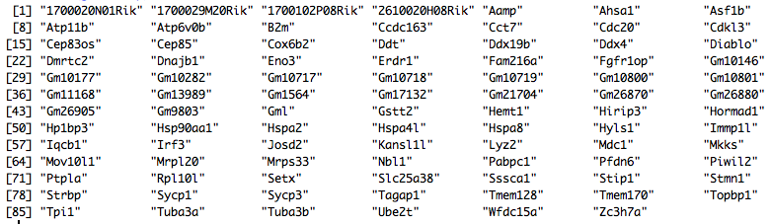
Genes
Differential genes in the Non-polysomic fraction (p-value < 0.2)
Spermatogenesis genes
Transcription factors

Slide 8
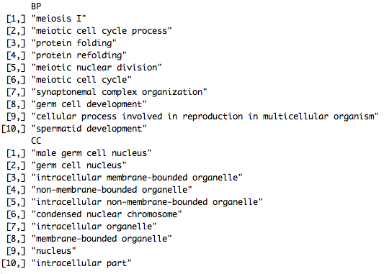
GO enrichment

Slide 9
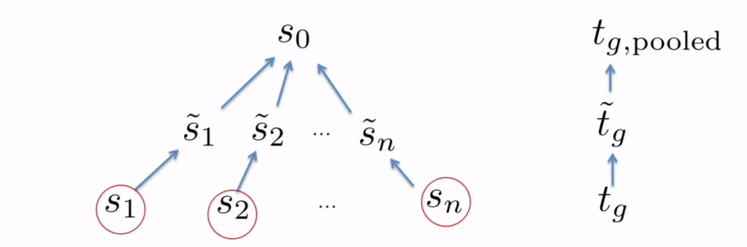
Empirical Bayesian method
Empirical Bayesian method borrows information among genes
It shrinks each gene’s standard deviation to the average of all
It is helpful in experiments with small sample sizes

Slide 10
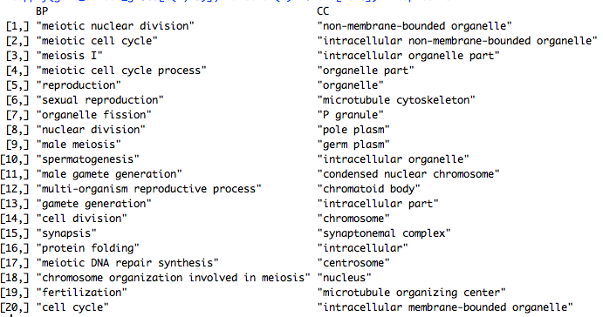
Genes match the Hspa2 pattern
Mutant samples showed up-regulation in non-polysomic fraction (285).
The genes are very relevant with meiotic processes

Slide 11
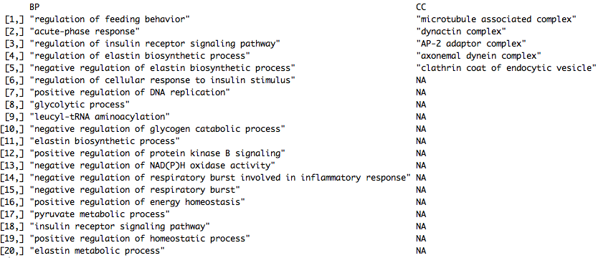
Mutant down genes in non-polysomic seem irrelevant
Mutant samples show down regulation in the non-polysomic fraction (55)

Slide 12
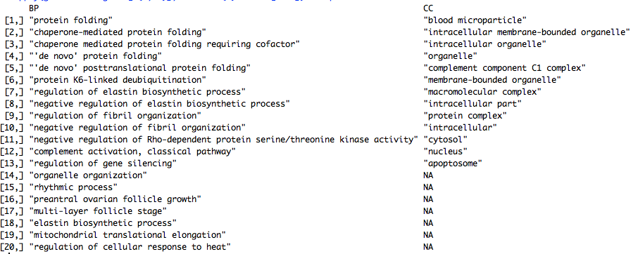
Mutant genes for total testis samples
Mutant samples show differential expression in total testis (90 in total, 61 up)
Irrelevant to meiotic processes

Slide 13
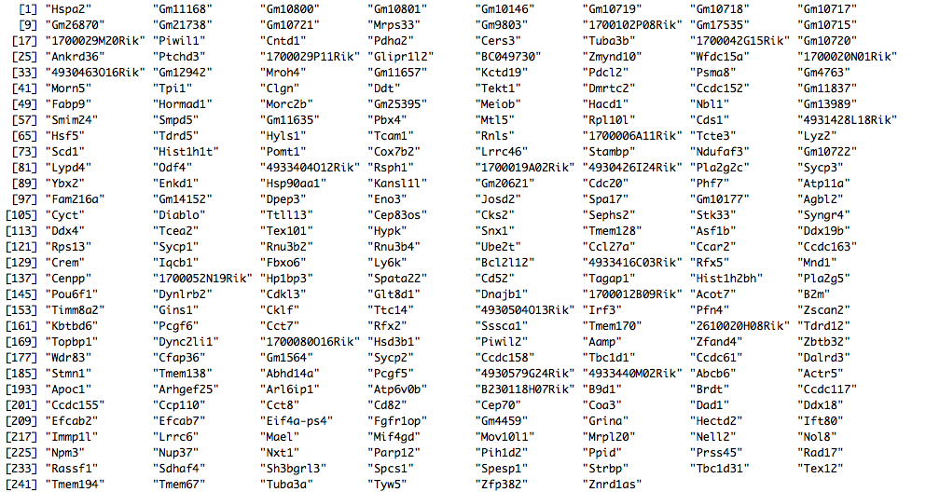
Normalize to total testis?
246 genes by taking off up-genes for the total samples

Slide 14
Linear regression model from experiment design
Model:
y ~ F + G + F * G
y: gene expression over 18 samples
F: sample fraction (IN, NONP, PLM)
G: genotype (WT, MT)

Slide 15
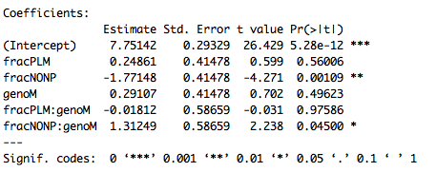
Fraction-specific effect of the Eif4g3 mutation

Slide 16
Output
* Intercept: mean value of the 3 WIN samples
* fracPLM: change from WIN to WPLM
* fracNONP: change from WIN to WNONP
* genoM: change from WIN to MIN
* fracPLM:genoM: change from WIN to MPLM, but conditional on changes from WIN to WPLM and WIN to MIN
* fracNONP:genoM: change from WIN to MNONP, but conditional on changes from WIN to WNONP and WIN to MIN

Slide 17
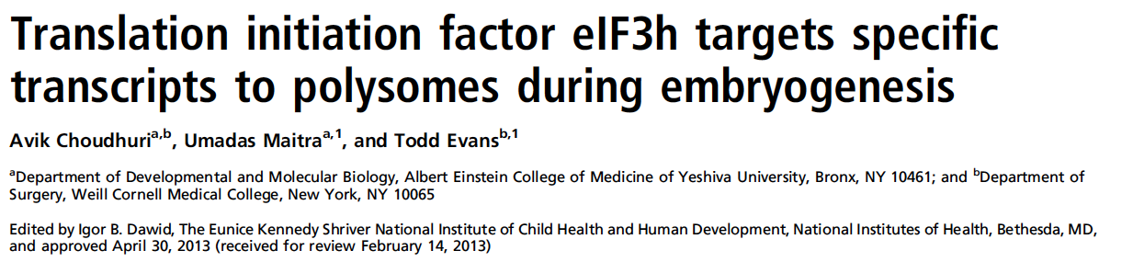
TS < 0.25, which correlates with a fracPLM:genoM estimate smaller than -2
Expression abundance > 1 RPKM in wild type polysomic sample
Explicit decrease between polysomic wild type and mutant, minimal 2 fold decrease

Slide 18
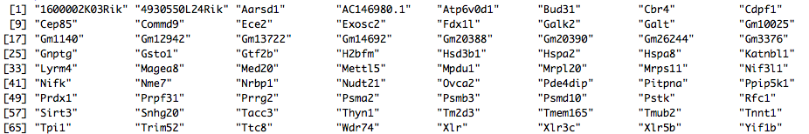
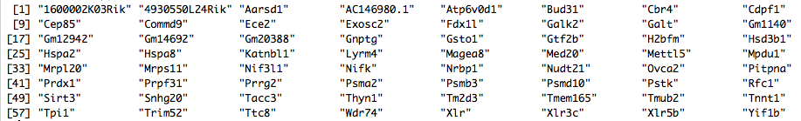
72 non-polysomic genes, 64 up, 50 by Evan’s criteria

Slide 19
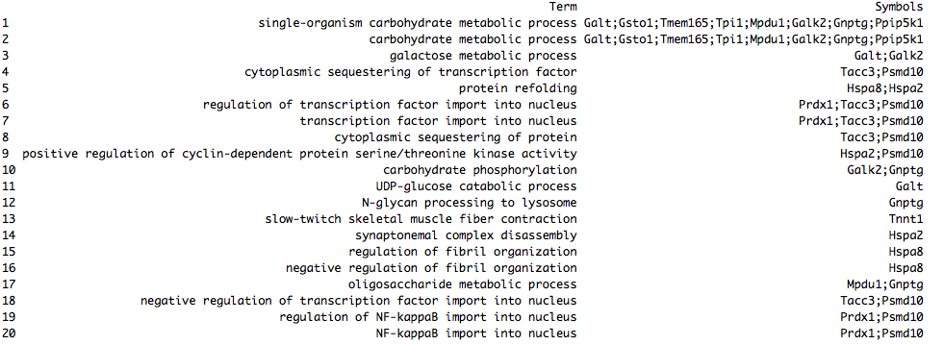
GO:BP for the 72

Slide 20
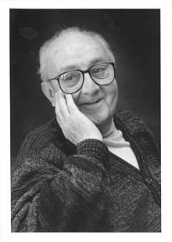
Statistical modeling
“Essentially, all models are wrong, but some are useful.”
George E.P. Box
1919 – 2013

Slide 21
Chromosomes of 246 Bayes genes
Only 1 in X chromosome: 1700080O16Rik

Slide 22
Chromosomes of 64 LM genes
9 in X chromosome, enriched.
Xlr, Xlr3c, Magea8, Psmd10, 4930550L24Rik, Xlr5b, H2bfm, Gm1140, Gm14692

Slide 23
Chromosomes of 64 LM genes
Overlap was little. The 5 overlapping genes are: Hspa2, Gm12942, Tpi1, Hsd3b1, Mrpl20
This reminds us the ebayes and linear model methods are very different

