Slide 1
Eif4g3 Project
August 7, 2015

Slide 2
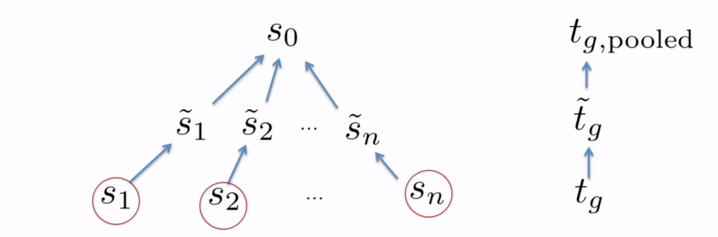
Empirical Bayesian method
Empirical Bayesian method borrows information between genes
It shrinks each gene’s standard deviation to the average of all
It is helpful in experiments with small sample sizes

Slide 3
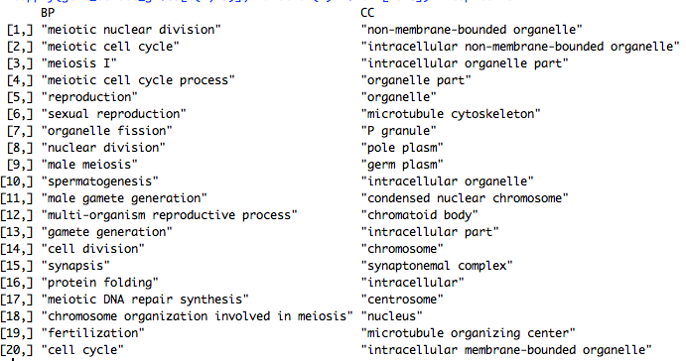
Genes match the Hspa2 pattern
Mutant samples showed up-regulation in non-polysomic fraction (285).
The genes are very relevant with meiotic processes

Slide 4
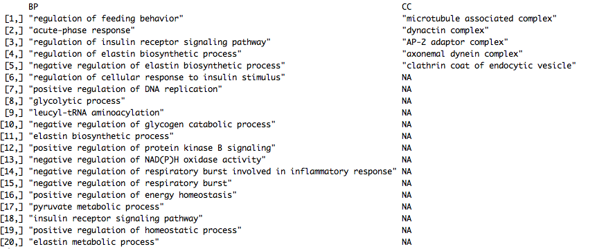
Mutant down genes in non-polysomic seem irrelevant
Mutant samples show down regulation in the non-polysomic fraction (55)

Slide 5
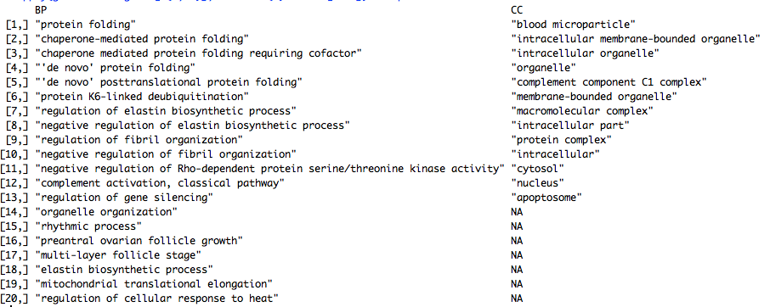
IN genes
Mutant samples show differential expression in total testis (90)
Irrelevant to meiotic processes, suggesting a post-transcriptional mechanism of Eif4g3 mutation in infertility

Slide 6
Master regulators of IN genes
Red: transcription factor. Green: IN differential genes. Size: connection number

Slide 7
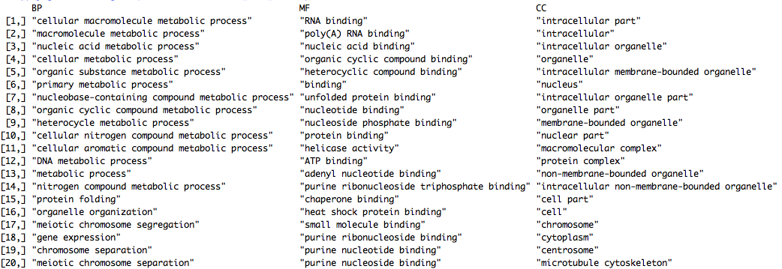
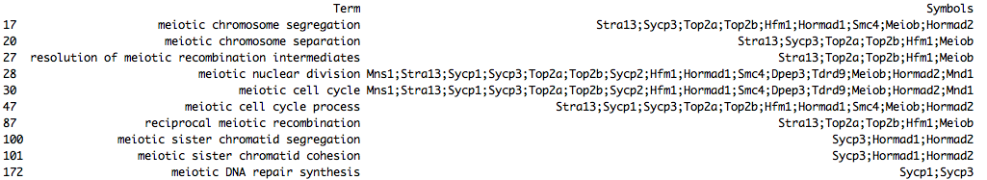
Polysomic genes are meiotic-related

Slide 8
Mutant non-polysomic up genes increase in meiotic stages
Expression profiles of the 285 Hspa2-matching genes in meiotic stages

Slide 9
PCA

Slide 10
Genes drive PC1
Genes that gradually increase in transcription were stalled in translation with Eif4g3 mutation

Slide 11
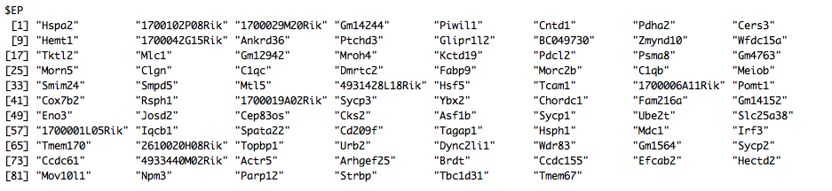
Cell marker genes
Marker gene numbers
P-value (enrichment test)
Overlap genes
EP are mostly enriched.

Slide 12
Hspa2-binding proteins
Genes match Hspa2 mRNA pattern also interact with Hspa2 at protein level
Source: STRING

Slide 13
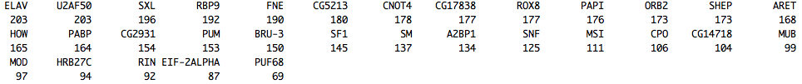
RBP analysis lacks specificity
RBP binds to 3’UTR of 294 transcript of Hspa2 matching genes
Sources: RBPmap, CISBP, RAID

