Slide 1
idTRAX deep-dive

Slide 2
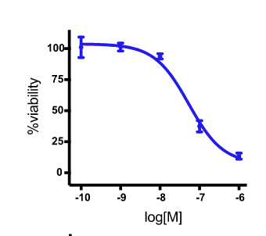
Algorithm overview
Compounds screening
Kinase inhibition profiles
Compound | Gene 1 | Gene 2 | Gene 3 | …
x1 | 0 | 20 | 80 | .
x2 | 35 | 7 | 20 | .
… | . | . | . | .
Hit/No-hit?
Hit/No-hit ~ kinase inhibition profiles
Notes:
GSK PKIS-I library of kinase inhibitors (ChEMBL)

Slide 3
Hit/No-hit ~ kinase inhibition profiles
To find the minimum number of kinases that inform the SVM predictions (hit/no-hit) the best (MAXIS: maximum information set)
This is a typical feature selection and classification problem
MR-SVM
Cluster the kinases into groups, and quantify each group’s importance in the SVM model (pharmacological linkage)
This represents importance of a kinase group
Linkage group score
Quantify, for each kinase, whether it is more frequently and/or more strongly inhibited by either the hits or the non-hits
This represents importance of an individual kinase
Bk score

Slide 4
?s
SVM vs lasso
Kinase profile data in more details; how to make new kinase profile data from ChEMBL database

