Slide 1
idTRAX deep-dive

Slide 2
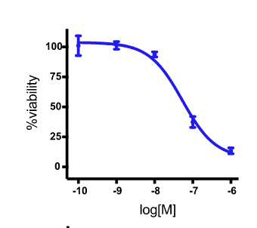
Algorithm overview
Compounds screening
Kinase inhibition profiles
Compound | Gene 1 | Gene 2 | Gene 3 | …
x1 | 0 | 20 | 80 | .
x2 | 35 | 7 | 20 | .
… | . | . | . | .
Hit/No-hit?
Hit/No-hit ~ kinase inhibition profiles
Notes:
GSK PKIS-I library of kinase inhibitors (ChEMBL)

Slide 3
Hit/No-hit ~ kinase inhibition profiles
To find the minimum number of kinases that inform the SVM predictions (hit/no-hit) the best (MAXIS: maximum information set)
This is a typical feature selection and classification problem
MR-SVM
Cluster the kinases into groups, and quantify each group’s importance in the SVM model (pharmacological linkage)
This represents importance of a kinase group
Linkage group score
Quantify, for each kinase, whether it is more frequently and/or more strongly inhibited by either the hits or the non-hits
This represents importance of an individual kinase
Bk score

Slide 4
?s
SVM vs lasso
Kinase profile data in more details; how to make new kinase profile data from ChEMBL database
Kinase inhibition profile data: how do we know those are inhibition?
Generalize to other non-kinase protein-coding genes?
What are the disease areas where CRISPR works better to find effective targets?

Slide 5
Talk w Hassan on 9/22/2019
Id-TRAX features
Able to identify selective targets to certain cells by deconvolving compound screening results where no selectivity was found in the compound level
Able to identify synergetic targets that deliver better efficacy than individually

