Slide 1
ADSP WGS project

Slide 2
Variants by ADSP consortium
ALL: 27.9 million; PASS: 25.5 million; MAF: 10.3 million
ADSP released VCF for 578 out of 584 samples, 570 out of the 578 had disease status

Slide 3
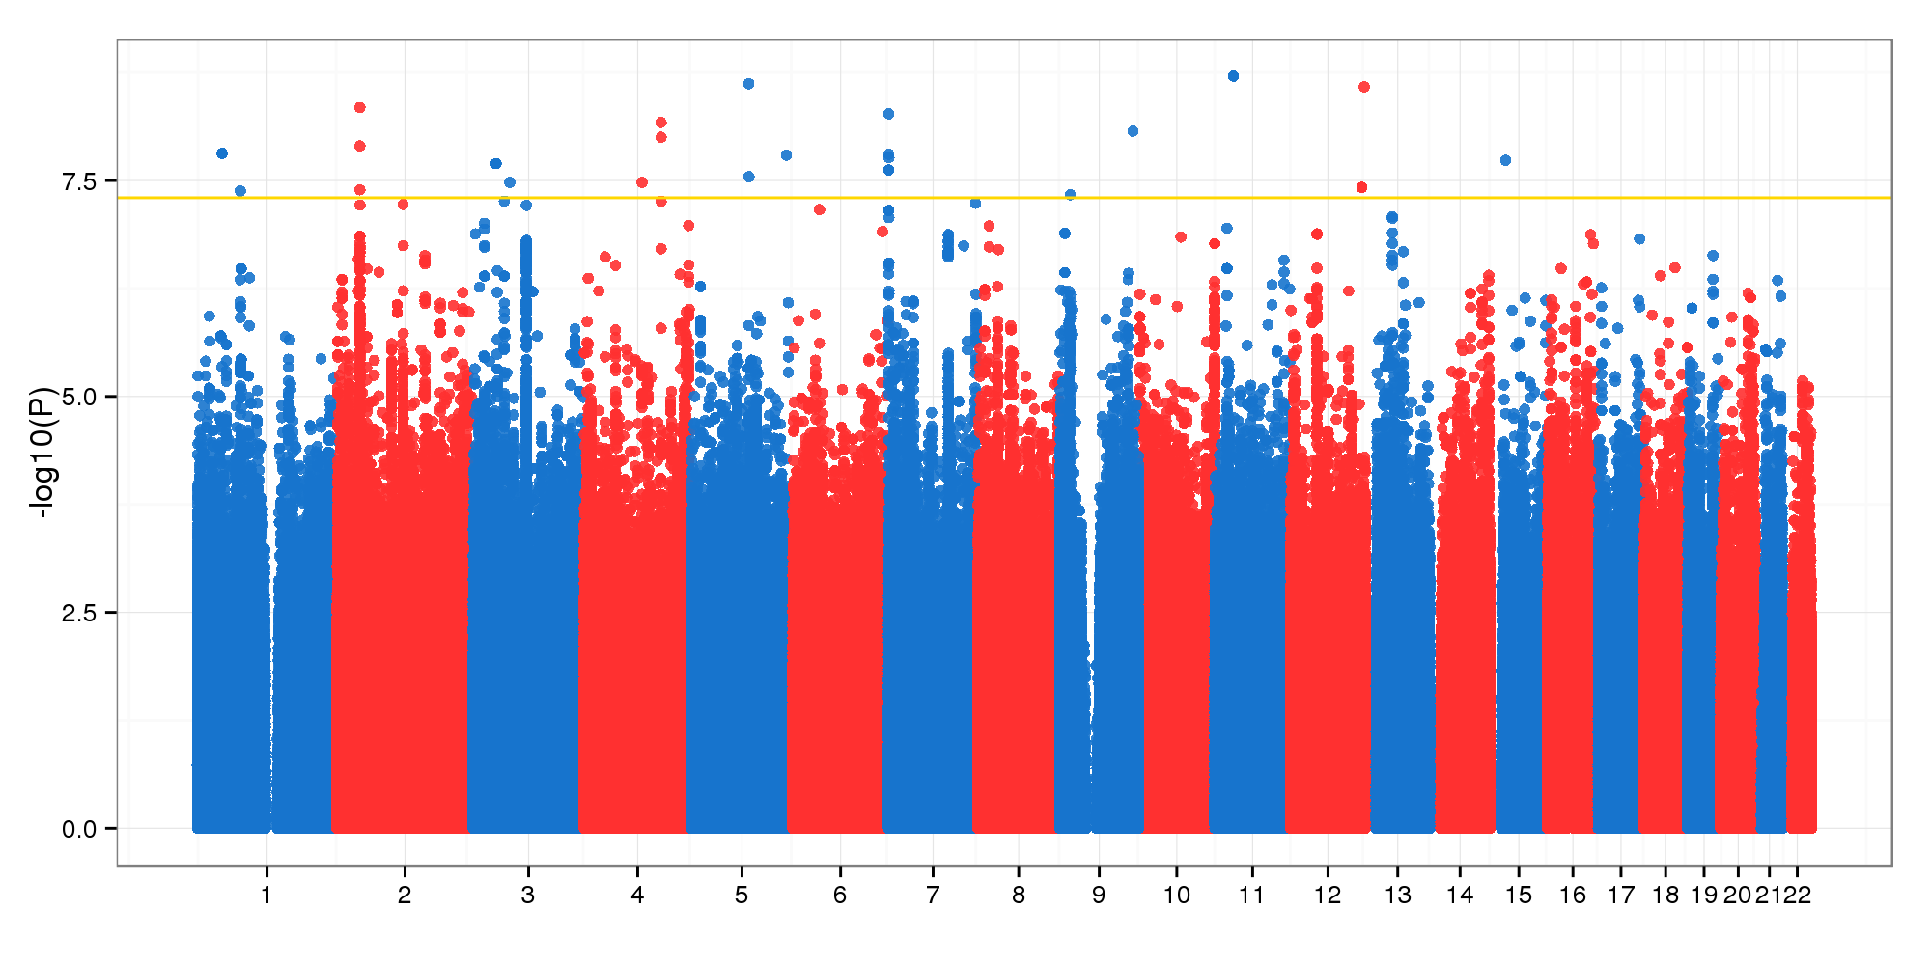
GWAS of ADSP WGS using ADSP’s variants
Method: BAYES.GLMM without kinship correction
Covariates: Age, Sex

Slide 4
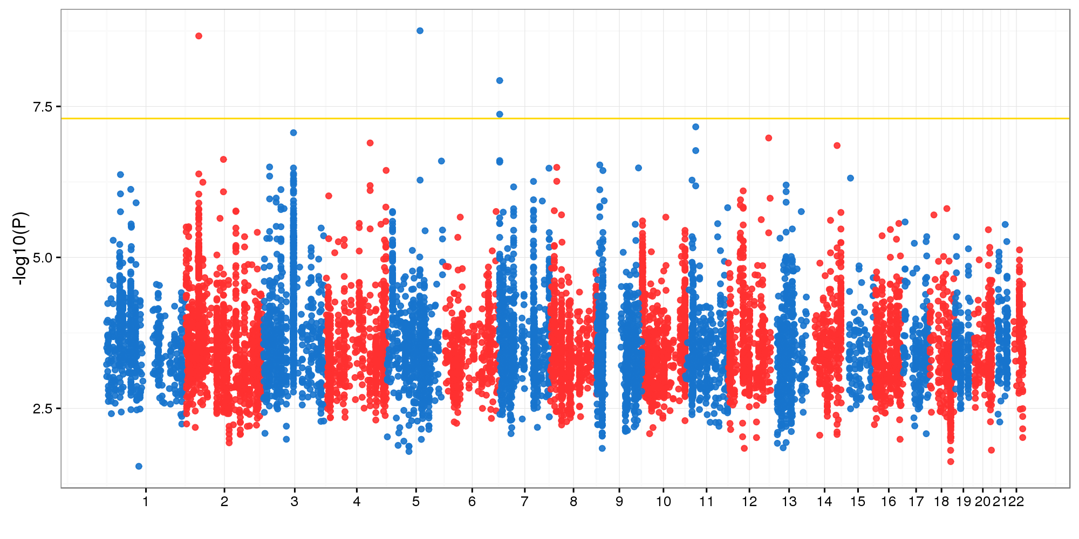
GWAS of ADSP WGS using ADSP’s variants
Method: BAYES.GLMM with kinship correction
Covariates: Age, Sex

Slide 5
4 significant variants in 3 loci, all intergenic
MAF 0.02 (5:102726073_C/T) and 0.05 (7:580540_A/G, 7:580735_C/A)

Slide 6
chr2:40973289_C/T
MAF 0.479
IGAP does not support

Slide 7
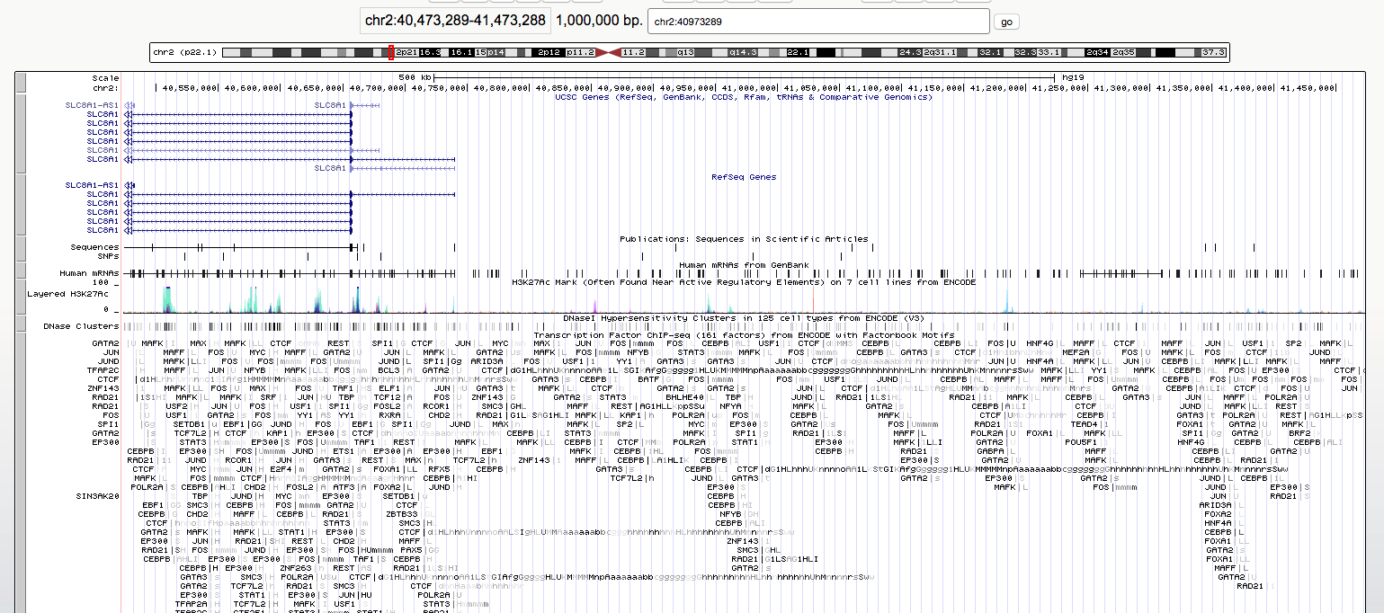
chr2:40973289_C/T

Slide 8
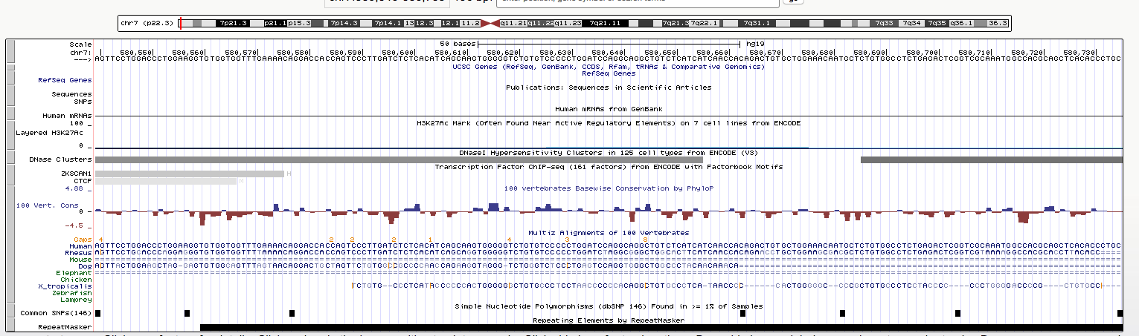
chr7:580540 and chr7:580735

Slide 9
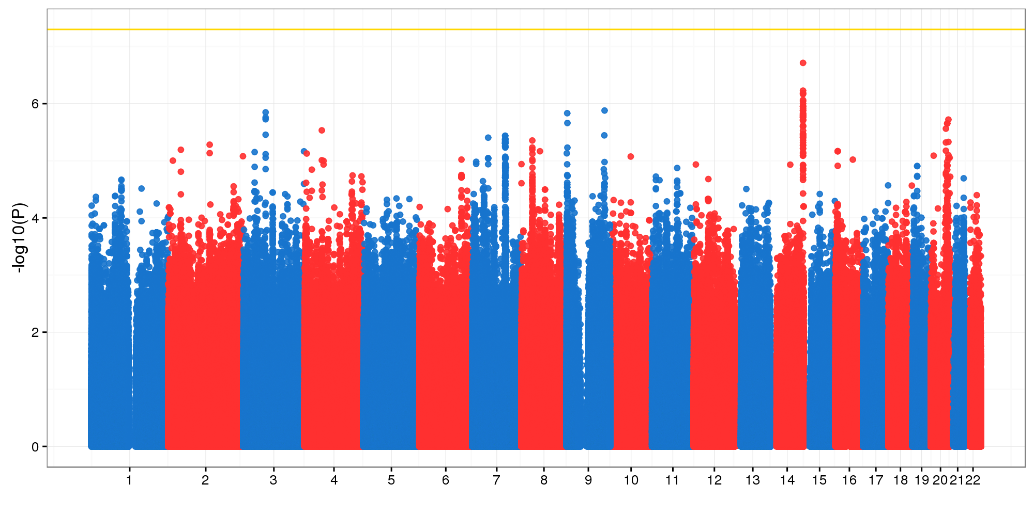
GWAS of ADSP WGS using ADSP’s variants
Method: BAYES.GLMM without kinship correction
Covariates: Age, Sex
Binary phenotype

Slide 10
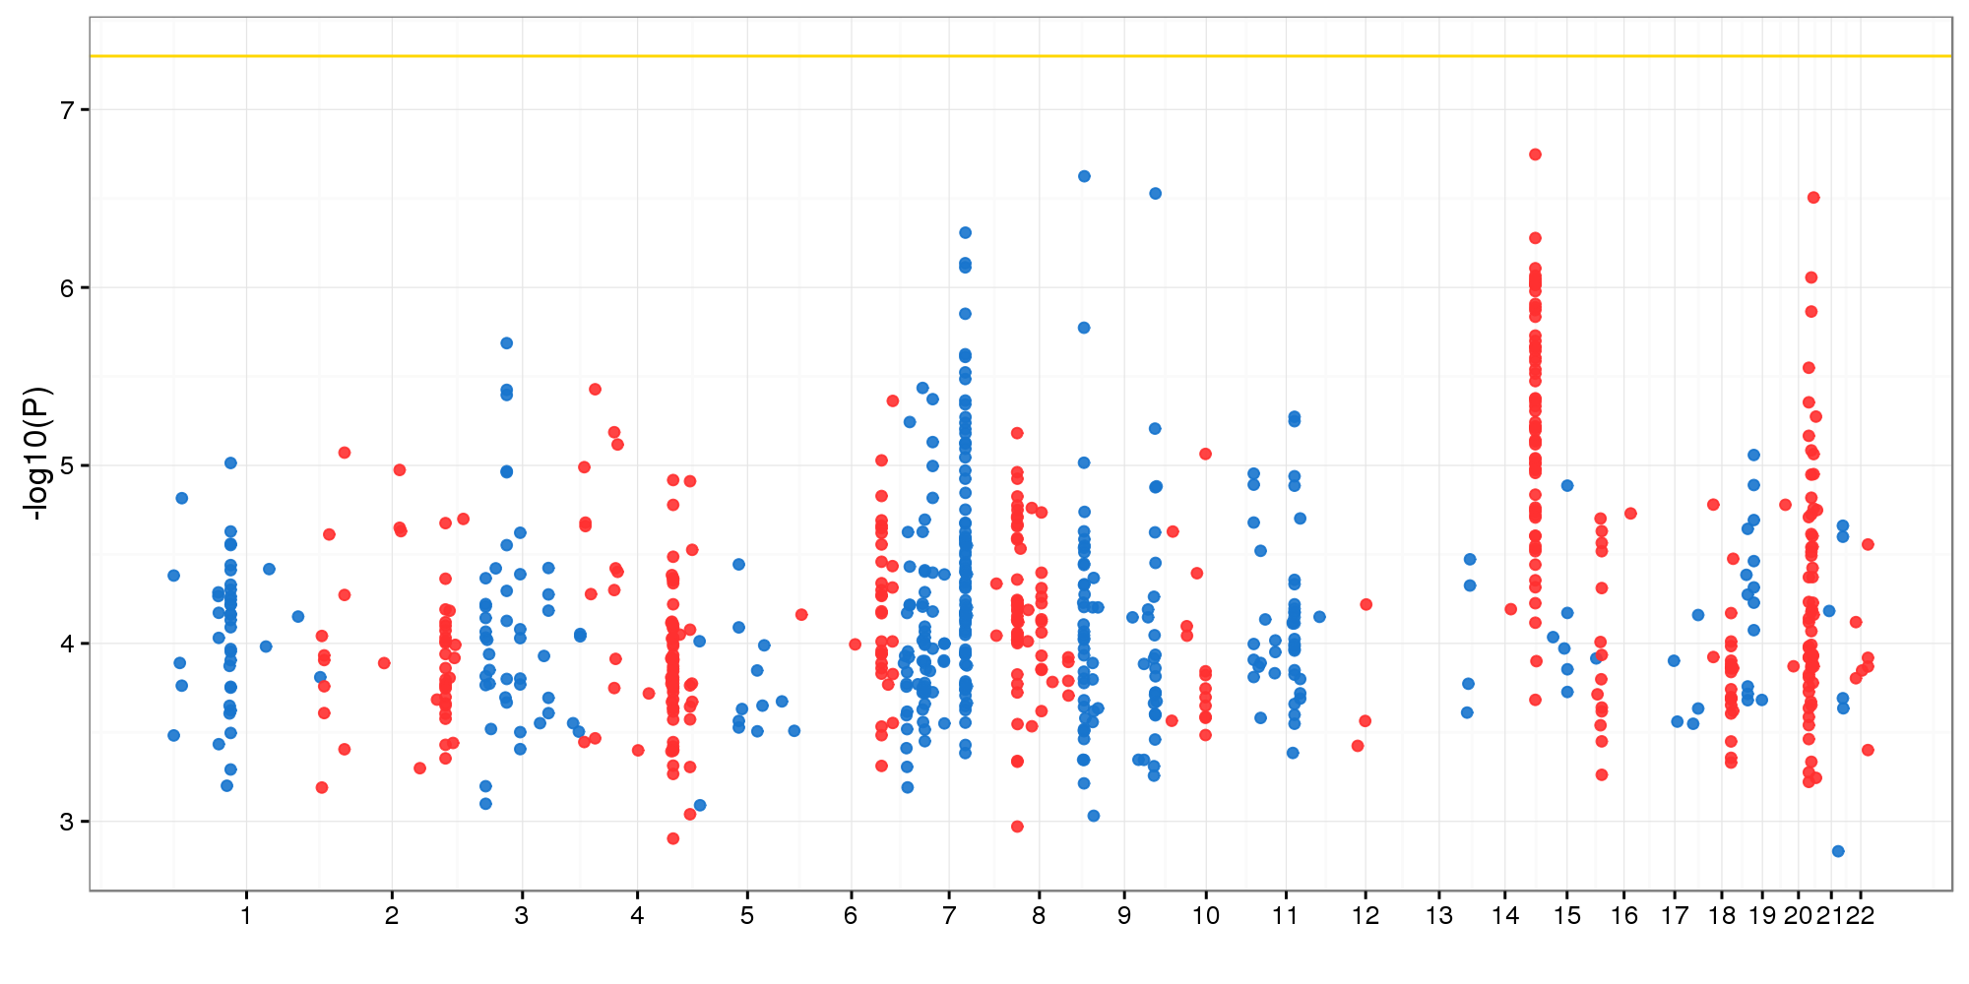
GWAS of ADSP WGS using CS’s variants
Method: BAYES.GLMM with kinship correction
Covariates: Age, Sex
Binary phenotype

