Slide 1
Supplementary Figure 6
rs429358
rs7412
rs429358
rs7412
Notes:
Supplementary Figure 6. APOE locus by models with (up) and without (bottom) APOE allele types.

Slide 2
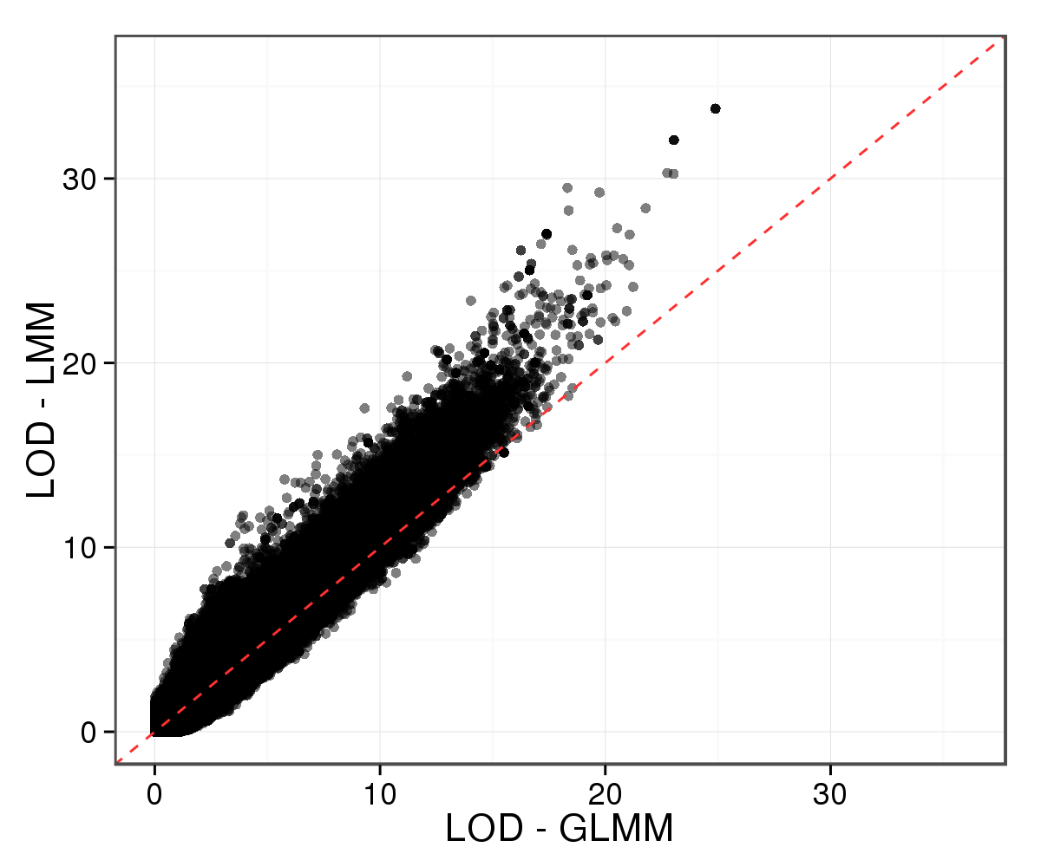
Supplementary Figure 10
A
B
C
Notes:
Supplementary Figure 10. Comparison between GLMM and LMM. (A) QQ-plot of GWAS LOD by GLMM and LMM. (B) Variants with the most different LOD values by GLMM and LMM. (C) Genotype frequencies of rs34827707 in the four AD populations.

Slide 3
Supplementary Figure 11
A
B
Notes:
Supplementary Figure 11. Top 20 variants from Alzheimer’s disease forum.

Slide 4
Supplementary Figure 11
Notes:
Supplementary Figure 11. Top 20 variants from Alzheimer’s disease forum.

Slide 5
Figure 1
A
B
C
D
E
F
Notes:
Figure 1. Summary statistics of the ADSP whole genome sequencing project participants. A. AD diagnosis for 576 individuals across 111 families. B. Age distributions of individuals in each AD status. C. APOE allele-type composition. D. APOE allele-type composition in each AD status. E. Sex composition. F. Sex composition in each AD status.
Note:
ADSP project released whole genome sequencing of 584 individuals in total. However, 6 of them were diagnosed as other dementia and unknown. Another 2 subjects miss the age information, which left 576 individuals in the graph.

Slide 6
Figure 2
A
B
Notes:
Figure 2. Generalized linear mixed model. (A) IBS kinship relatedness of individual pairs. In and out mean in or out of the same family from the recorded pedigree. (B) Mode (point) and 95% CI (error bar) of covariates posterior distributions by sampling.

Slide 7
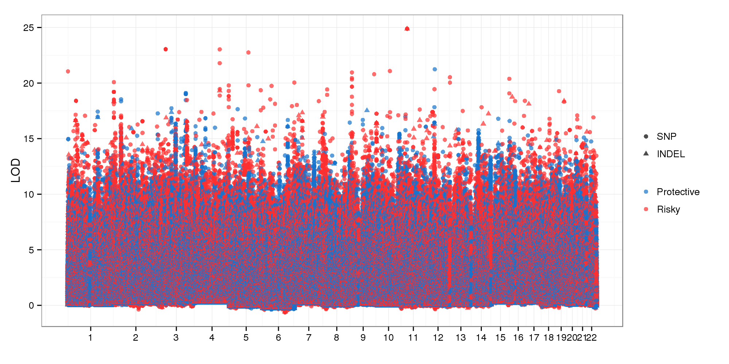
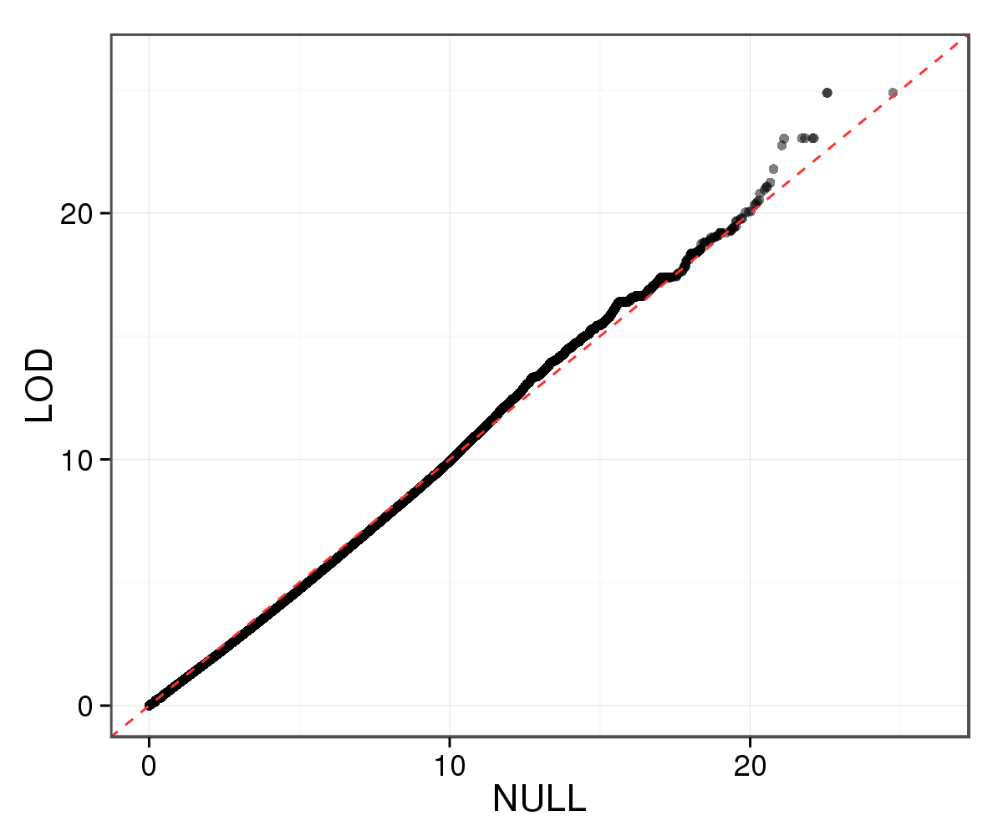
Figure 3
A
B
C
Place holder
Notes:
Figure 3. (A) GWAS Manhattan. (B) QQ plot of GWAS LOD from true and randomized genotypes of each variants. (C) Null distribution of LOD scores from permutation.

Slide 8
Figure 4
A
C
B
Notes:
Figure 4. (a) 244 variants with LOD value at least 15 by the additive model. (b) Effect sizes of variants surrounding the first peak by point estimation (x) and sampling (y). (c) WAIC and LOC profiles in the region.
Comment: B: include variants from all 73 ranges

Slide 9
Figure 5
A
B
MUT^{-/-}
MUT^{-/+}
MUT^{+/+}
Notes:
Figure 5. NANOS1 locus. (a) LOD in NANOS1 locus by additive GWAS. (b) Genotype stratification of rs191267549 (c) and combination of rs191267549 and APOE/e4 by AD status.
Comment: (1) Network graph for NANOS1-affecting genes and pathways. (2) NANOS1 transcript levels in normal and AD samples from other studies.

Slide 10
Figure 6
A
B
C
Notes:
Figure 6. GWAS by epistasis models. Color: Blue and red mean protective and risky by adding up main and interactive effects. Size: LOD increment from additive to epistasis models.

Slide 11
Figure 7
A
B
MUT^{-/-}
MUT^{-/+}
MUT^{+/+}
C
A2^{-/-}/MUT^{-/-}
A2^{-/-}/MUT^{-/+}
A2^{-/-}/MUT^{+/+}
A2^{-/+}/MUT^{-/-}
A2^{-/+}/MUT^{-/+}
A2^{-/+}/MUT^{+/+}
A2^{+/+}/MUT^{-/+}
Notes:
Figure 7. LRG2 locus. (a) LOD in LRG2 locus by the epistasis GWAS with interaction between variant and APOE/e2. (b) Genotype stratification of rs966384 (c) and combination of rs966384 and APOE/e2 by AD status.
Comment: Network and transcript analysis for LRG1, same as NANOS1.

Slide 12
Supplementary Figure 1
A
B
Notes:
Supplementary Figure 1. Summary statistics of the ADSP variants. 12.6 million bi-allelic SNP (a) and 1.5 million bi-allelic INDEL (b), with MAF cutoff 0.01, were included in the GWAS.

Slide 13
Supplementary Figure 2
Notes:
Supplementary Figure 2. Functional consequences of 14.1 million ADSP variants predicted by Ensembl VEP.
Comment: Log2-transformed scales look flat and lose the contrast. Given this is supplementary, we can afford the space waste.

Slide 14
Supplementary Figure 3
Notes:
Supplementary Figure 3. Distribution of the random effect by estimating the null model.

Slide 15
Supplementary Figure 4
Notes:
Supplementary Figure 4. No interaction was detected between each pair of the covariates (age, sex, APOE/e2, APOE/e4).
Comment: Even though Age is not a significant factor, it might interact with other factors. Include the interaction combinations with Age for now.

Slide 16
Supplementary Figure 5
Notes:
Supplementary Figure 5. Genetic consequences of the 244 variants that passed the LOD threshold 15.

Slide 17
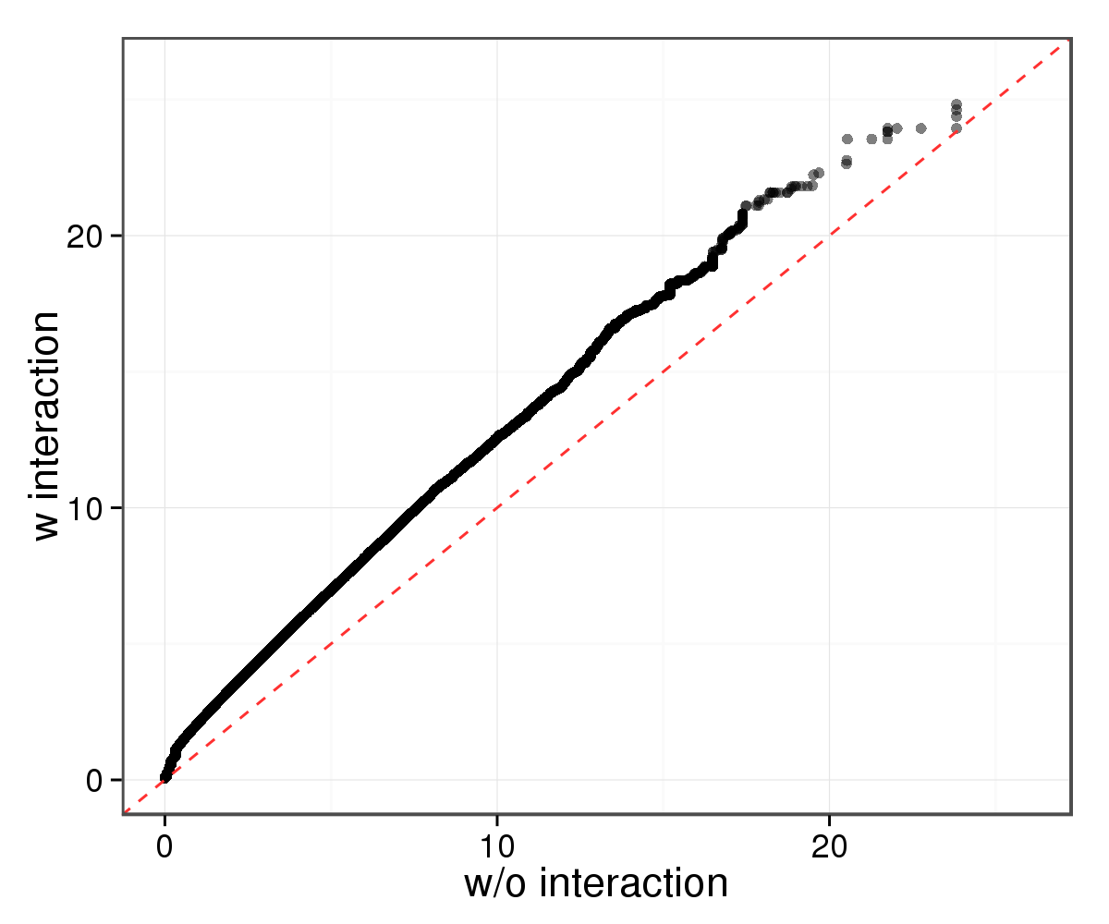
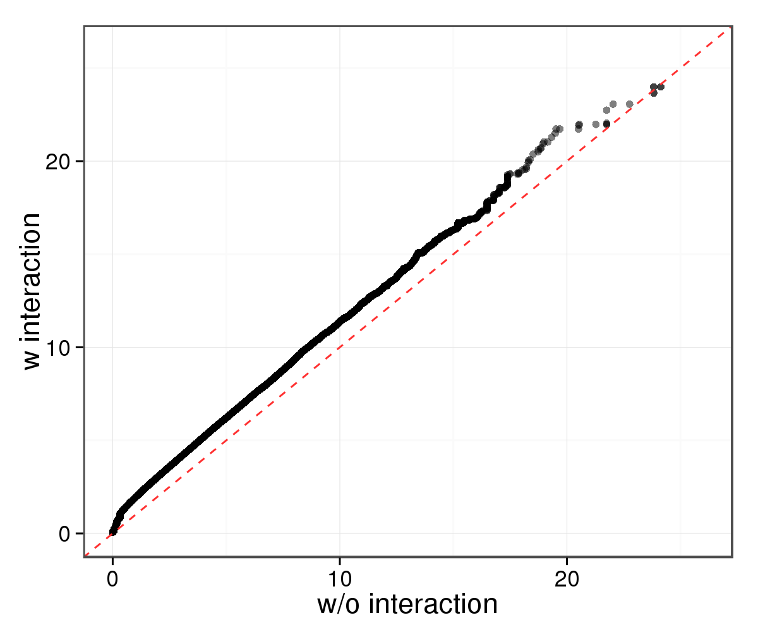
Supplementary Figure 7
A
B
C
D
Notes:
Figure 7. GWAS by epistasis models. (a, c) QQ-plot of LOD for GWAS by additive and epistasis models. The additive model included age, sex, Apoe2, Apoe4, and a variant, whereas an additional interaction term between APOE/e2 (a) or APOE/e4 (c) and the variant was included in the epistasis models. (b) Consequences of APOE/e2-interacting variants. (d) Consequences of APOE/e4-interacting variants.

Slide 18
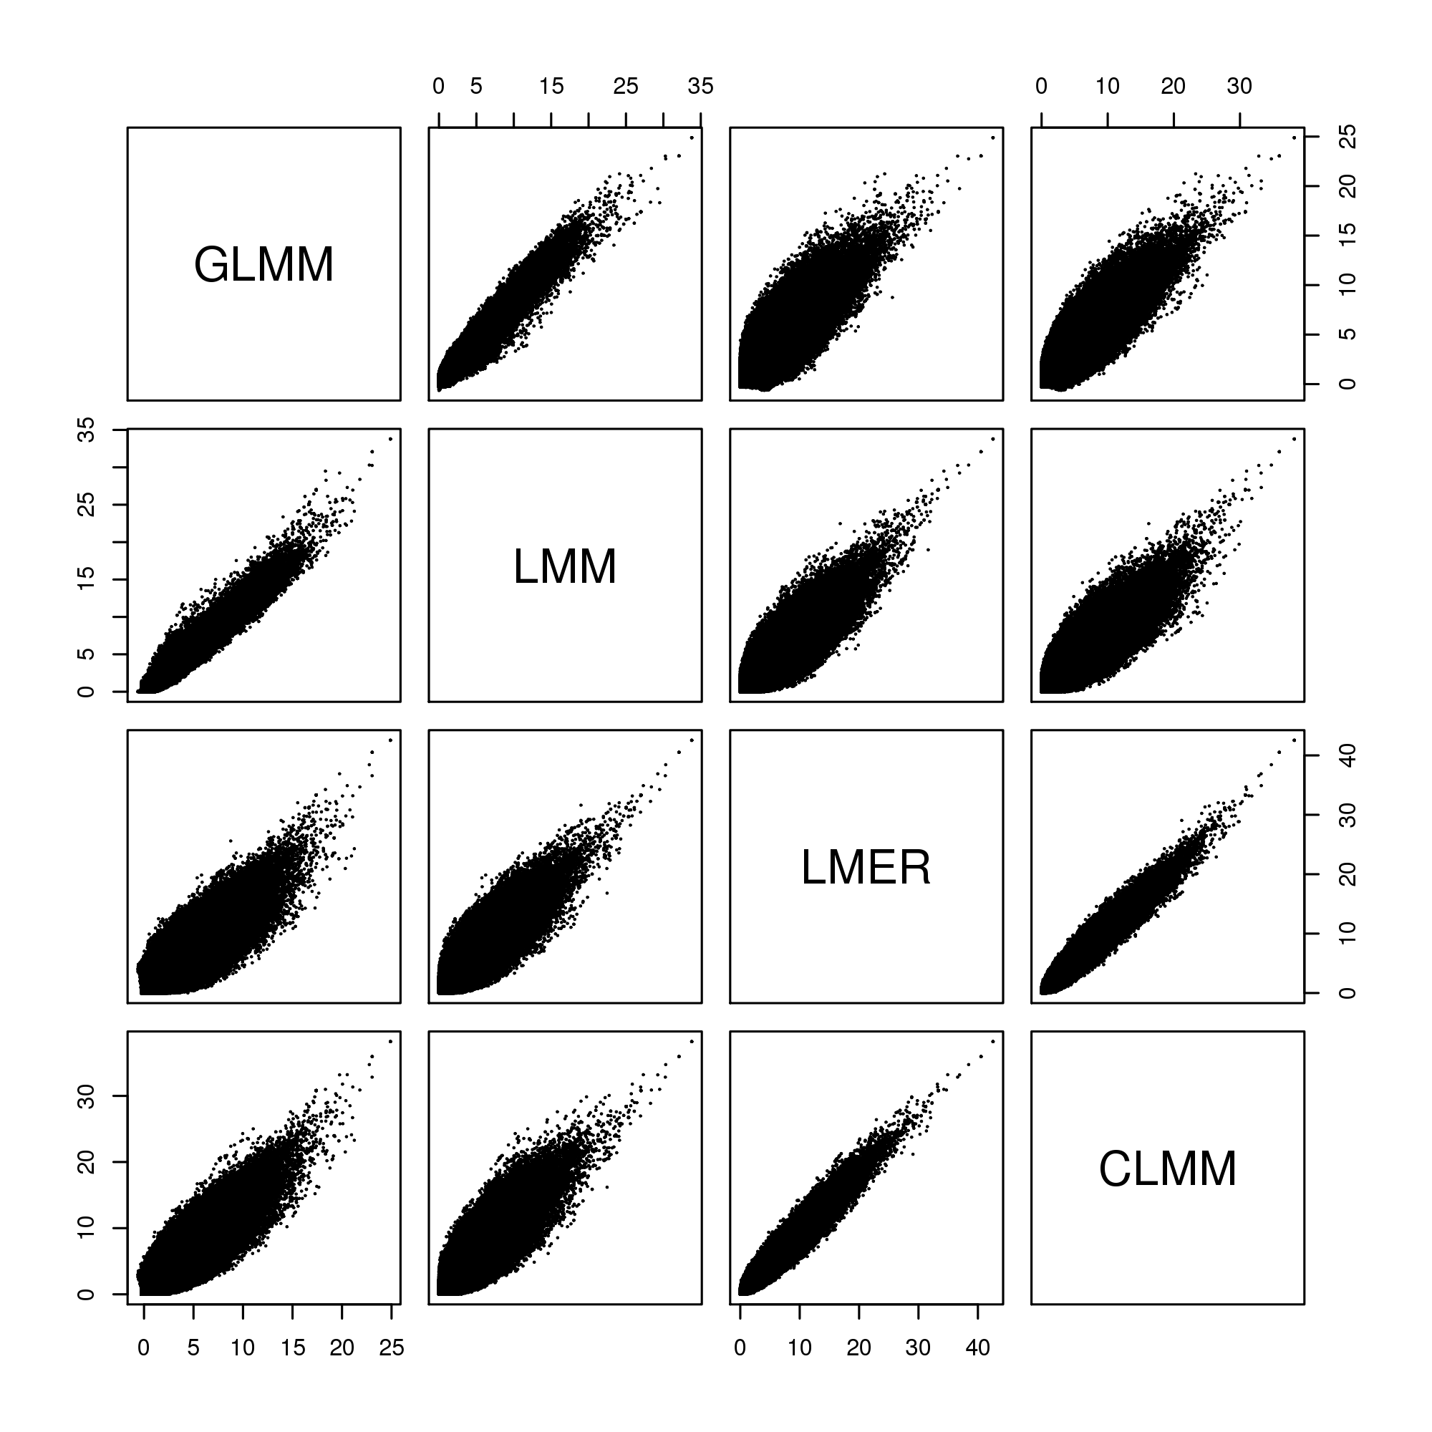
Supplementary Figure 8
A
B
C
Notes:
Supplementary Figure 8. (a) Pairwise scatterplot of LOD by four models. GLMM: generalized linear mixed model. LMM: linear mixed model. LMER: hierarchical linear model with family-wise correction. CLMM: categorical hierarchical linear model with family-wise correction. (b) Correlation of top LOD by four models. Variants were selected by aggregating the top 5% in any of the four models.

Slide 19
Supplementary Figure 9
Notes:
Supplementary Figure 9.

Slide 20
Supplementary Figure
Notes:
Supplementary Figure. Correlation of kinship matrices by including all autosomes (autosome) and by taking each of the 22 autosome off.

