Slide 1
Figure 1
A
B
C
D
E
F
G
H
Notes:
Figure 1. Summary statistics of the ADSP whole genome sequencing project participants.
A. AD diagnosis for 576 individuals across 111 families. B. Age distributions of individuals in each AD status. C. APOE allele-type composition. D. APOE allele-type composition in each AD status. E. Sex composition. F. Sex composition in each AD status.
G. IBS kinship relatedness of individual pairs. In and out mean in or out of the same family from the recorded pedigree. H. Mode (point) and 95% CI (error bar) of covariates posterior distributions by sampling.
Note:
ADSP project released whole genome sequencing of 584 individuals in total. However, 6 of them were diagnosed as other dementia and unknown. Another 2 subjects miss the age information, which left 576 individuals in the graph.

Slide 2
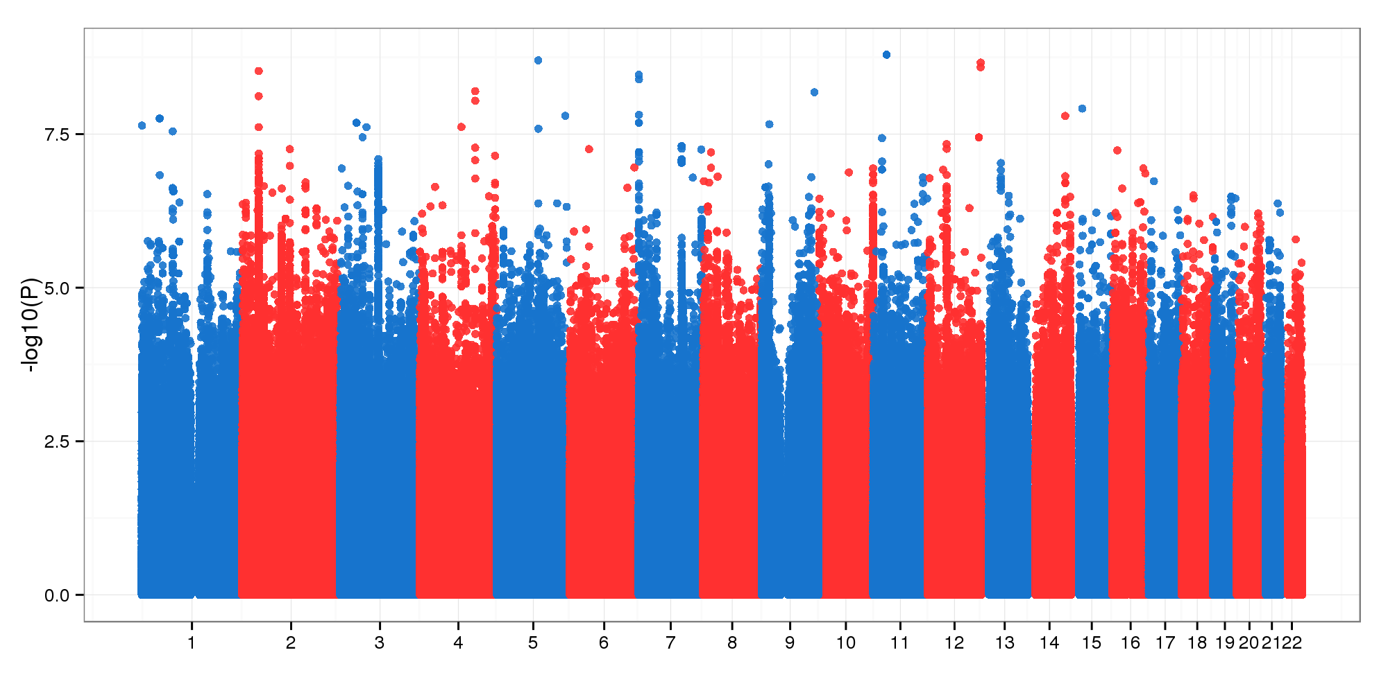
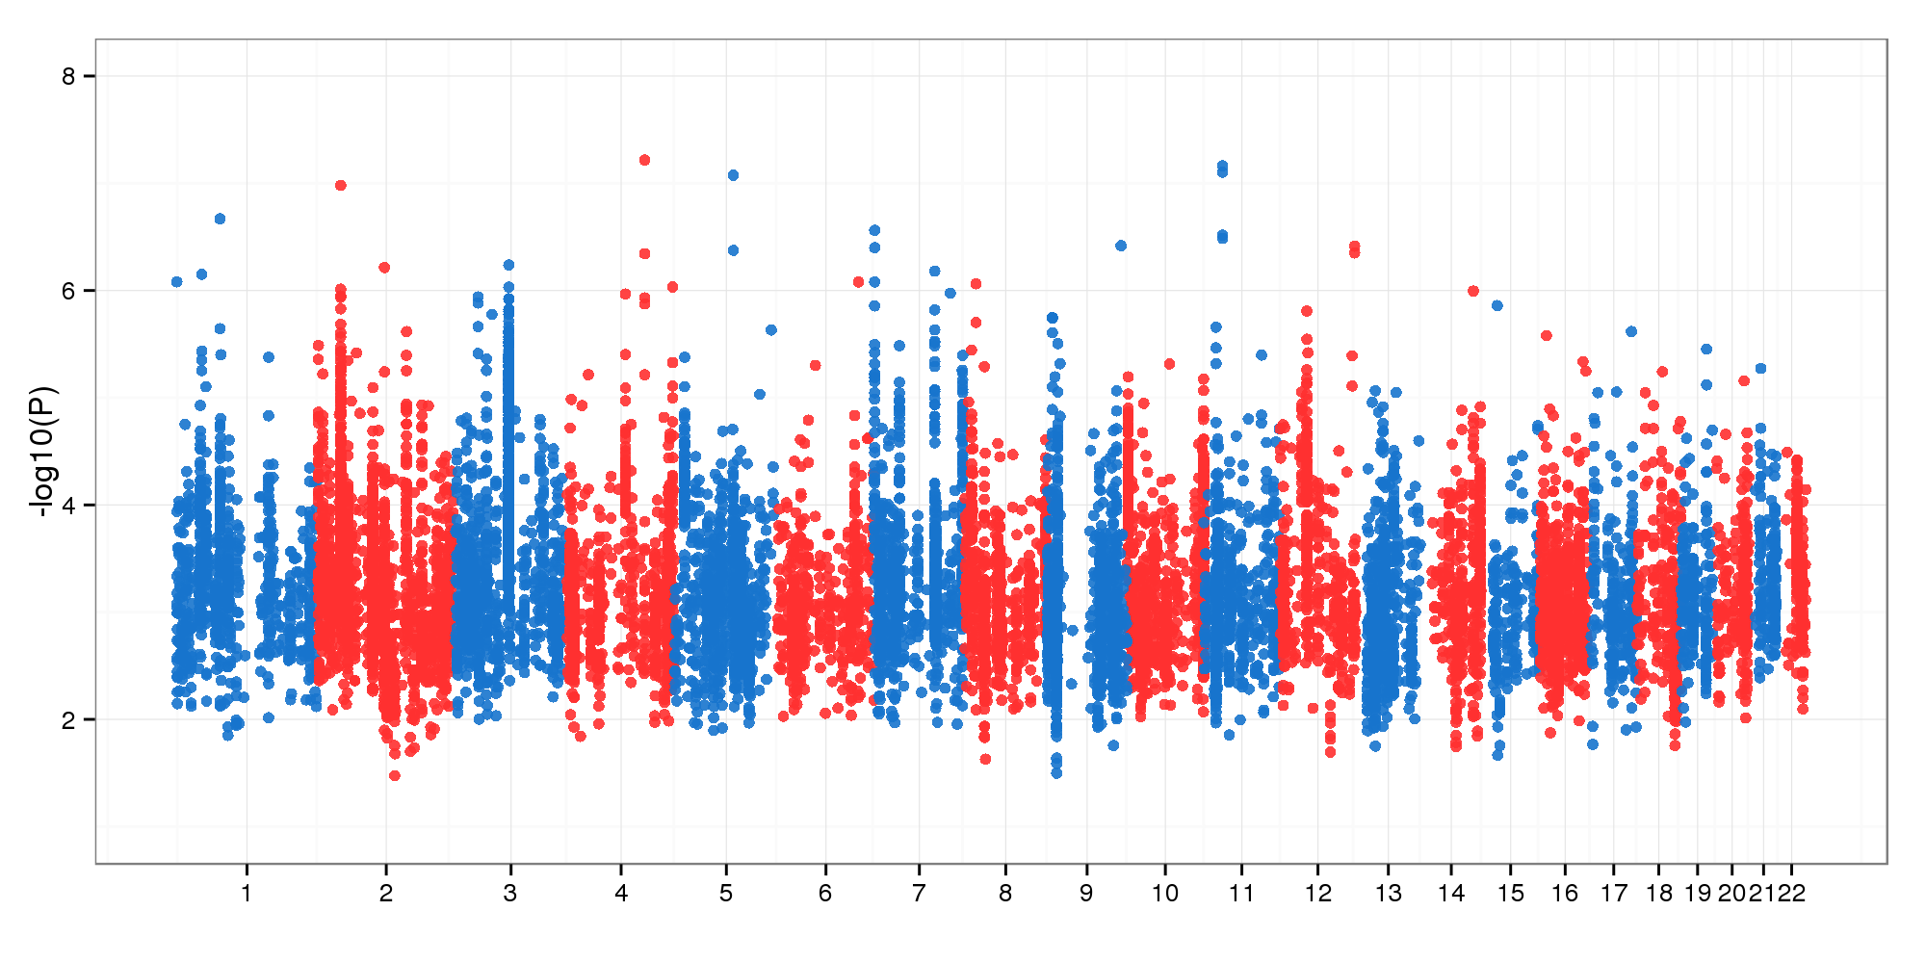
Figure 2
A
B
Notes:
Figure 2. (a) GWAS on 14.1 genomic variants by bayes-glmm without kinship correction. Model parameters were estimated by MLE. (b) GWAS on filtered variants. Model parameters were estimated by MCMC sampling.

Slide 3
Figure 3
A
C
B
D
Notes:
Figure 3. (a) 244 variants with LOD value at least 15 by the additive model. (b) Functional consequences of the top 244 variants.
(c) LOD in NANOS1 locus by additive GWAS. (d) Genotype stratification of rs191267549.

Slide 4
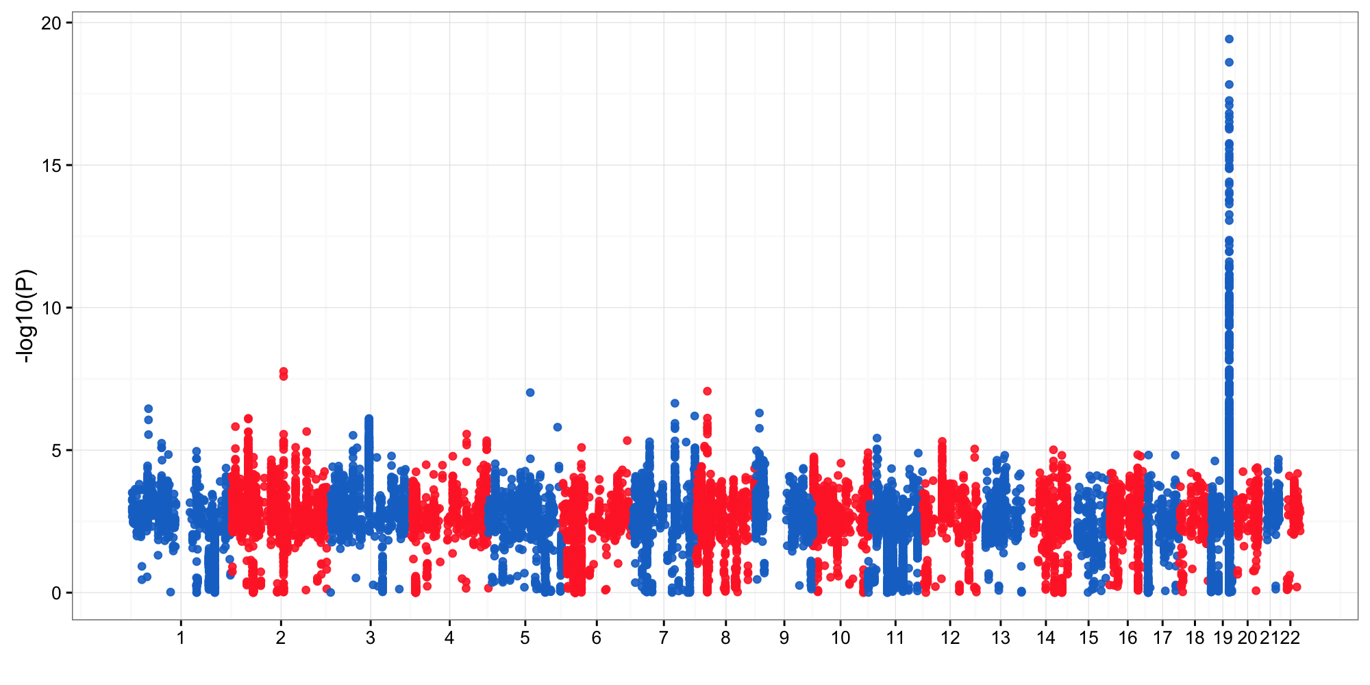
Figure 4
A
B
Show prior, post without prior and post with prior together
Notes:
Figure 2. (a) GWAS on 14.1 genomic variants by bayes-glmm without kinship correction. Model parameters were estimated by MLE. (b) GWAS on filtered variants. Model parameters were estimated by MCMC sampling.

Slide 5
Figure 5
A
B
MUT^{-/-}
MUT^{-/+}
MUT^{+/+}
Show examples
Notes:
Figure 3. (a) 244 variants with LOD value at least 15 by the additive model. (b) Functional consequences of the top 244 variants.
(c) LOD in NANOS1 locus by additive GWAS. (d) Genotype stratification of rs191267549.

Slide 6
Supplementary Figure 1
Notes:
Supplementary Figure 1. No interaction was detected between each pair of the covariates (age, sex, APOE/e2, APOE/e4).
Comment: Even though Age is not a significant factor, it might interact with other factors. Include the interaction combinations with Age for now.

Slide 7
Supplementary Figure 2
A
B
C
Notes:
Supplementary Figure 2. Summary statistics of the ADSP variants. 12.6 million bi-allelic SNP (a) and 1.5 million bi-allelic INDEL (b), with MAF cutoff 0.01, were included in the GWAS.
(c) Functional consequences of 14.1 million ADSP variants predicted by Ensembl VEP.
Comment: Log2-transformed scales look flat and lose the contrast. Given this is supplementary, we can afford the space waste.

Slide 8
Supplementary Figure 6
rs429358
rs7412
rs429358
rs7412
Notes:
Supplementary Figure 6. APOE locus by models with (up) and without (bottom) APOE allele types.

Slide 9
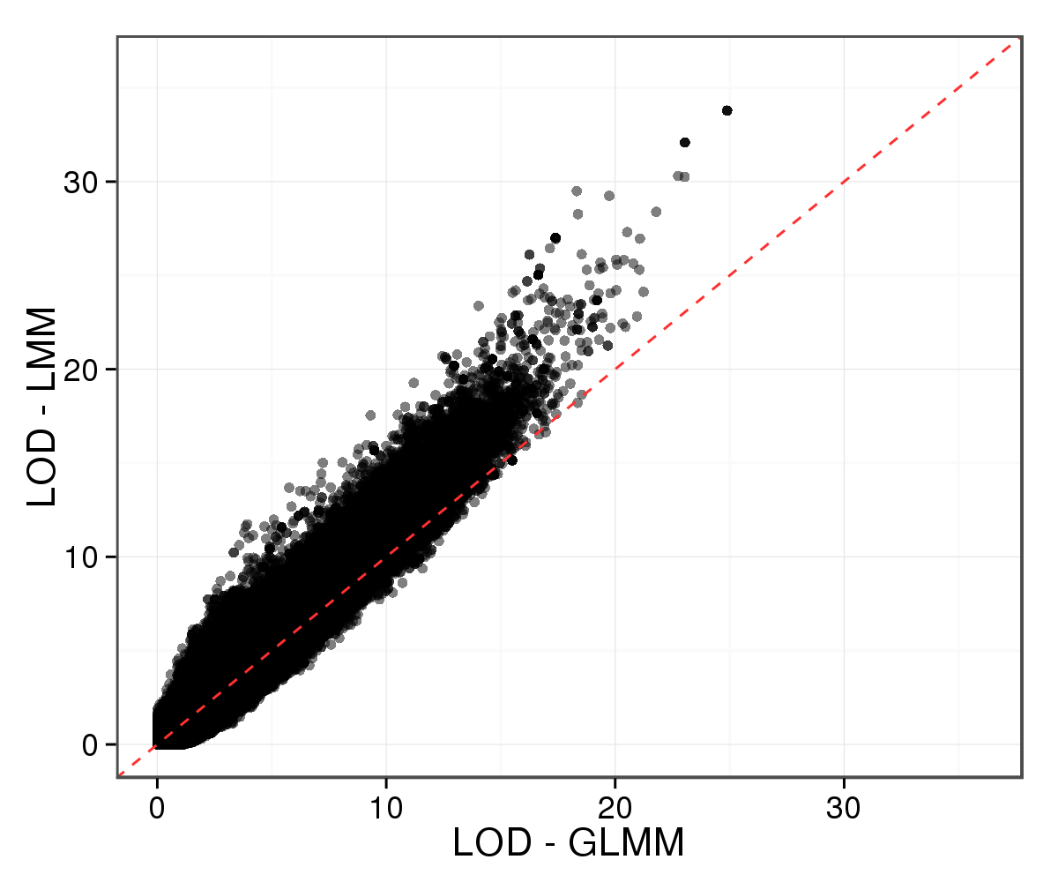
Supplementary Figure 10
A
B
C
Notes:
Supplementary Figure 10. Comparison between GLMM and LMM. (A) QQ-plot of GWAS LOD by GLMM and LMM. (B) Variants with the most different LOD values by GLMM and LMM. (C) Genotype frequencies of rs34827707 in the four AD populations.

Slide 10
Supplementary Figure 11
A
B
Notes:
Supplementary Figure 11. Top 20 variants from Alzheimer’s disease forum.

