Slide 1
NANOS1

Slide 2
Risky missense variant
MUT^{-/-}
MUT^{-/+}
MUT^{+/+}
L: LOD score of variants in +/- 250 Kb range of rs191267549. R: Genotype of rs966384 (up)
Diseases associated with NANOS1 include atherosclerosis (APOE4 is also related with atherosclerosis)
GO annotations include RNA binding and translation repressor activity
Mutant locus is an open region in neuron by ATAC sequencing

Slide 3
GO annotation
Molecular Function:
metal ion binding; protein binding; RNA binding; translation repressor activity; zinc ion binding
Biological Process:
cell migration; epithelial cell migration; negative regulation of translation; positive regulation of nuclear-transcribed mRNA catabolic process, deadenylation-dependent decay; regulation of translation
Cellular Component:
cytoplasm; perinuclear region of cytoplasm

Slide 4
Canonical pathways
NANOS1 is not annotated in KEGG

Slide 5
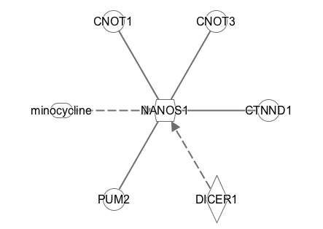
IPA interaction
Solid line: protein-protein binding
Minocycline, as a chemical drug, decrease expression of NANOS1 mRNA
Mutant DICER1, as a enzyme, increase expression of human NANOS1 mRNA

Slide 6
Gene expression paper
Integrative genomics identifies APOE/e4 effectors in Alzheimer’s disease
Paper retracted, but claimed the RNA-seq and analysis parts still stand
NANOS1 appeared in multiple modules: Magneta, Green Yellow, Blue
Appended excel file contains functional relevance of each module

Slide 7
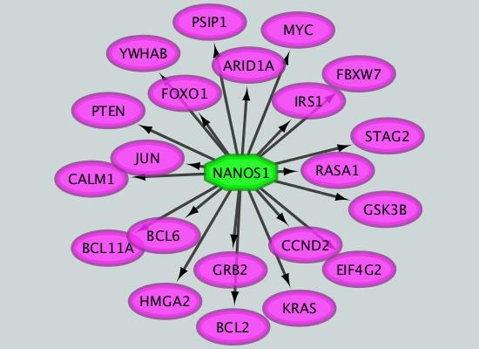
NANOS1 target genes, as a TF
Tools: iRegulon

Slide 8
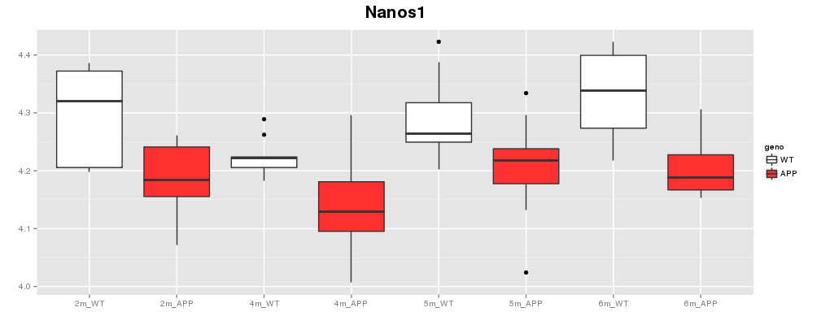
NANOS1 in mouse (Gareth data)

Slide 9
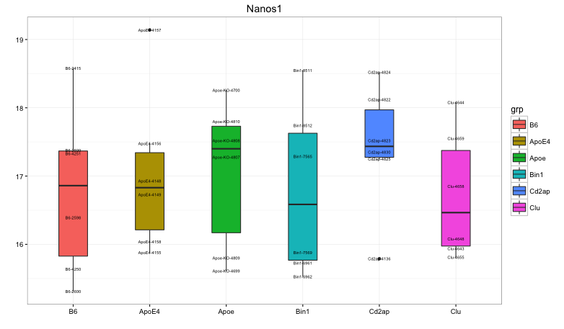
NANOS1 in mouse (Gareth data)
No trends in the B6, ApoE4, Apoe, Bin1, Cd2ap, Clu dataset

