Slide 1
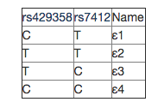

APOE SNP
The two SNP that determine APOE allele types
Adapted from SNPedia
REF: T C
GMAF: 0.15 0.07
The two SNP in ADSP
Results

Slide 2
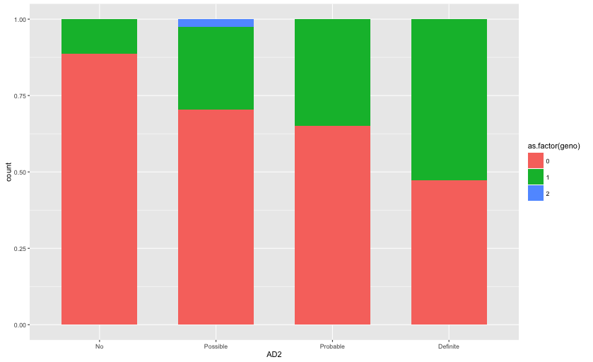
rs429358

Slide 3
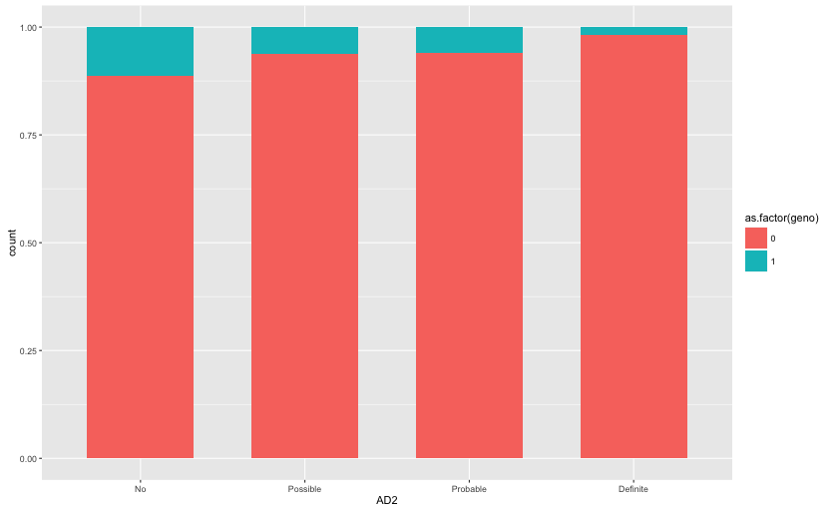
rs7412

Slide 4
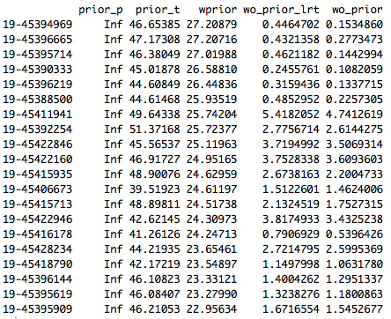
Top posterior variants

Slide 5

APOE SNP
Ref: T
Ref: C
33 22 23 24 34
rs7412
rs429358

Slide 6
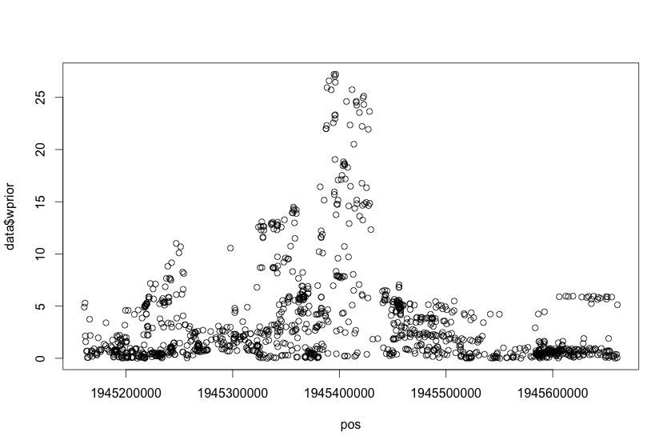
Posterior with prior

Slide 7
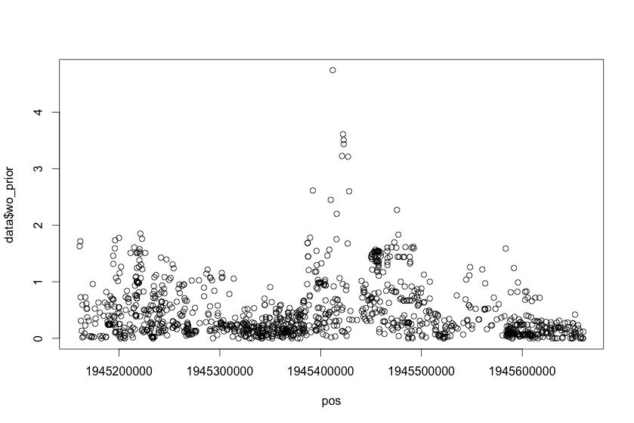
Posterior without prior

Slide 8
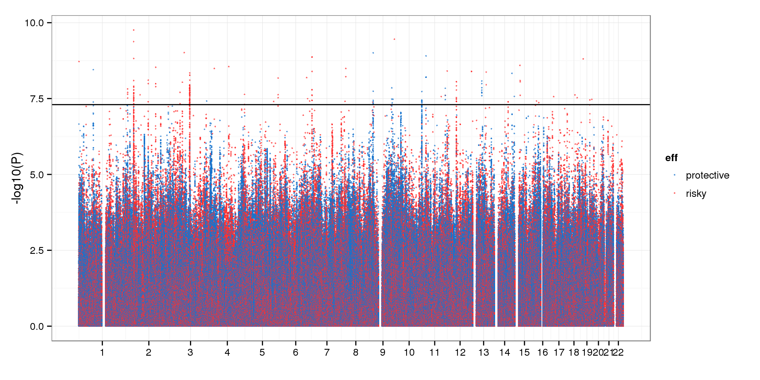
PLINK on ADSP (MAF 0.05)
Explain the reasons from this graph to the non-significant one to open the manuscript

