Slide 1
Identifying the genetic variants to make APOE4-sensitized mouse models for Alzheimer’s disease using ADSP data

Slide 2
Models

Slide 3
Strategy to choose genetic variants to make APOE-sensitized mouse models
Fit bi-SNP and bi-IND (MAF > 0.01) with GLMM
GLMM LOD (top 0.001 in model 1 or model 2)
AD effect > 1 (epistasis: sum of SNP, APOE4, SNP*APOE4)
Function prediction (inframe, missense)
Mouse brain expression (Allan brain atlas)

Slide 4
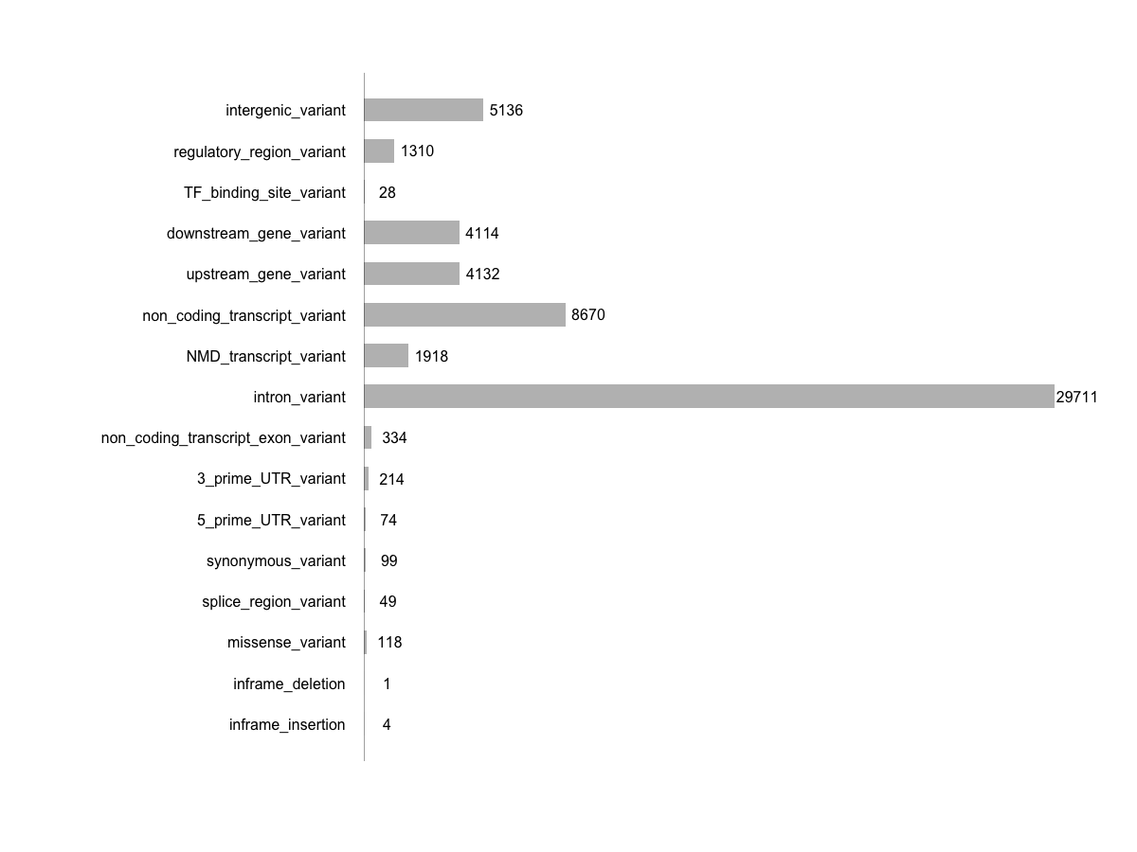
Variants before the functional prediction filtering

Slide 5
The 18 genes and 20 variants
carterdev:3838/Adsp_beta
Calcium signaling: PTPRU, TACSTD2, RYR2, PKD1, PPIP5K2

Slide 6
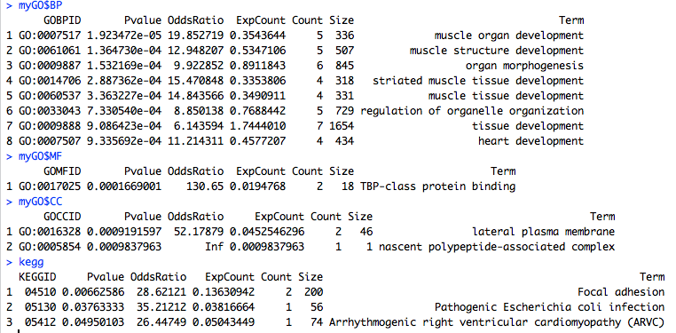
GO and KEGG enrichment for the 18 genes

