Slide 1
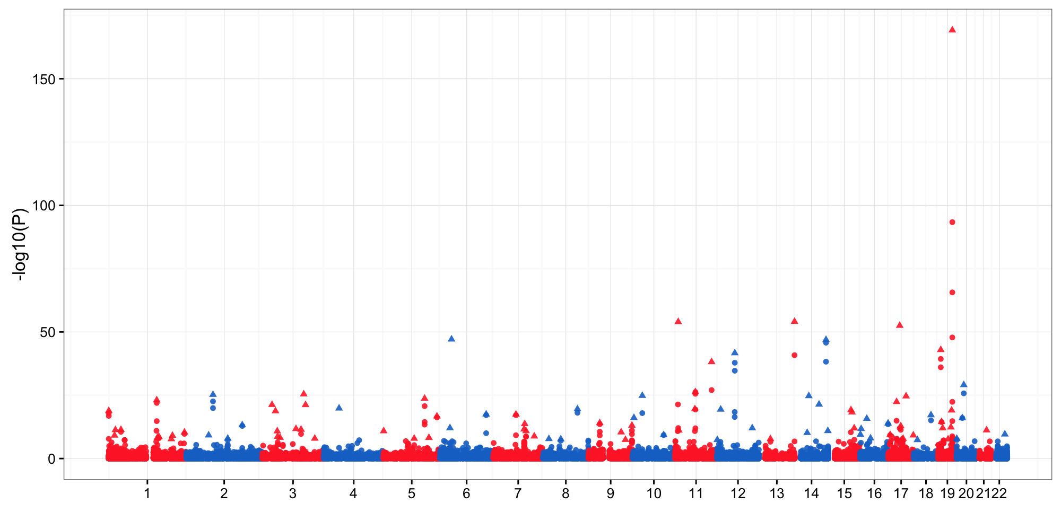
APOE
ADM
TMCO3
HNF1B
FGD2
CCNK

Slide 2
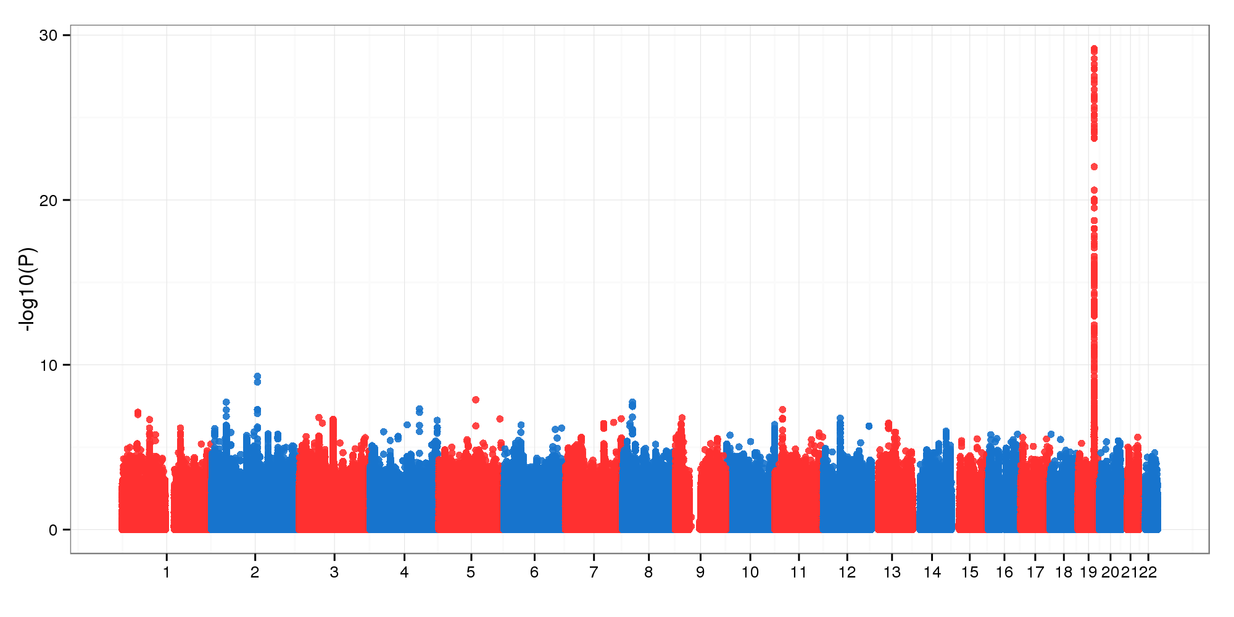
APOE
BIN1
SLC8A1
NUDT12
CLU

