Slide 1
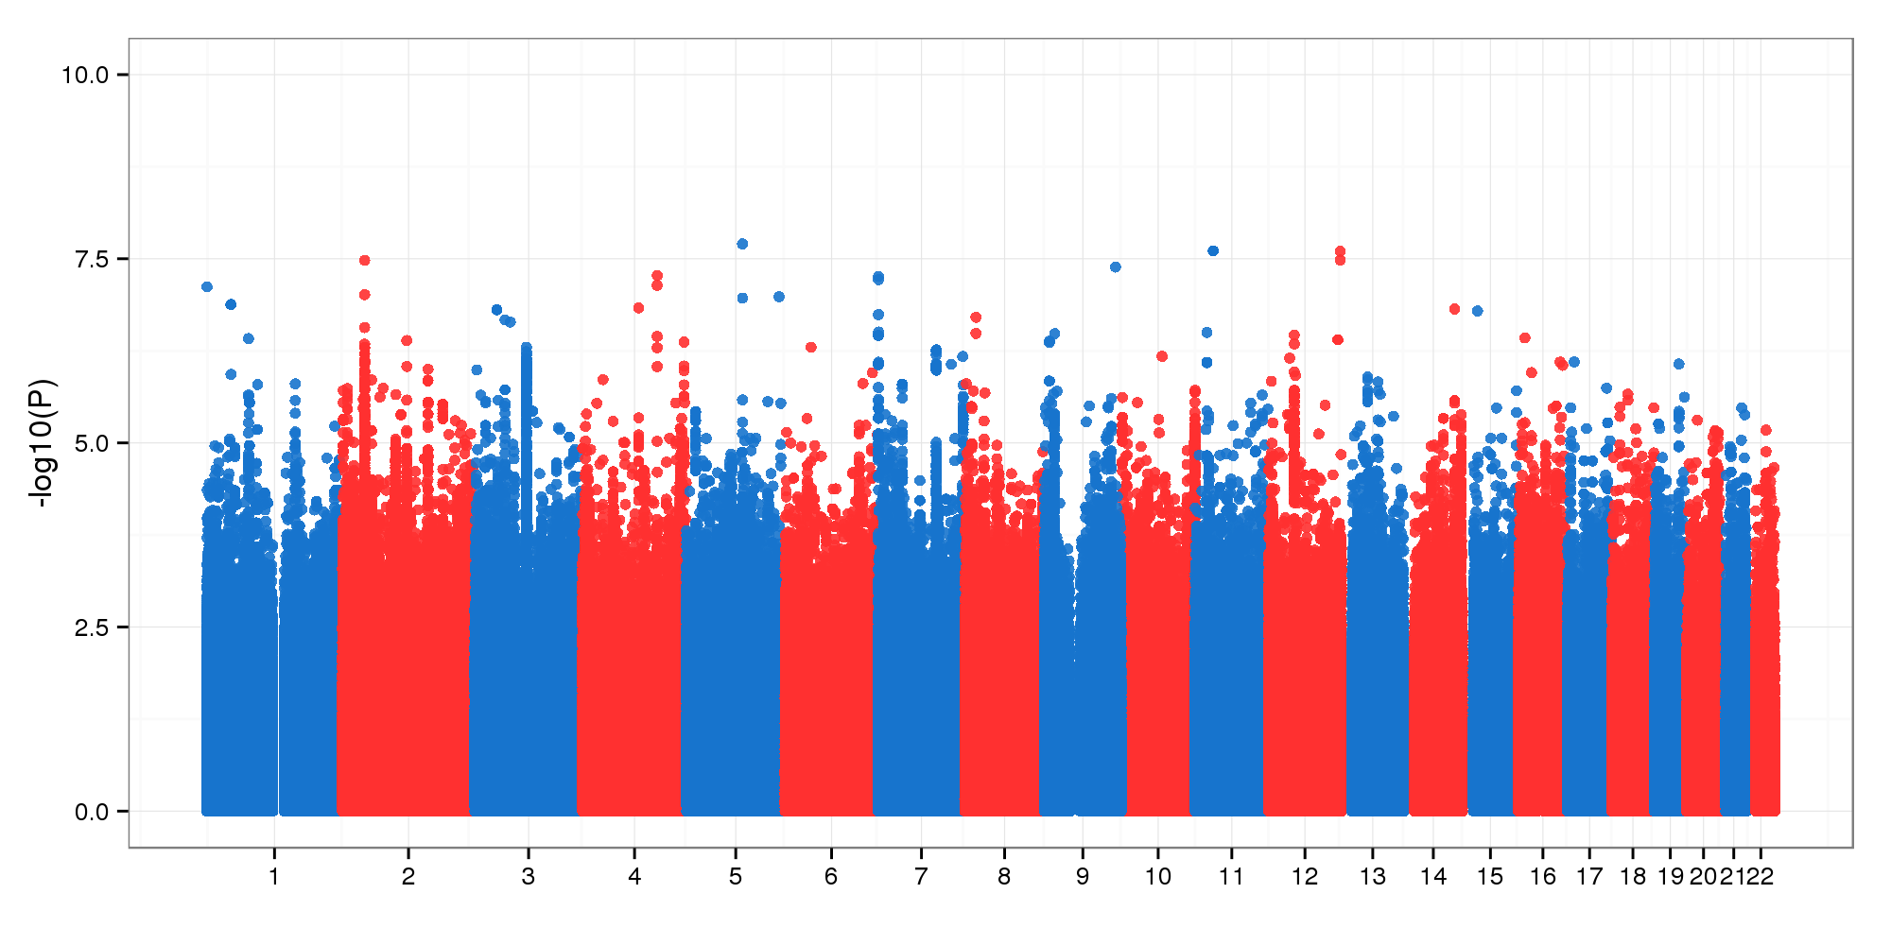
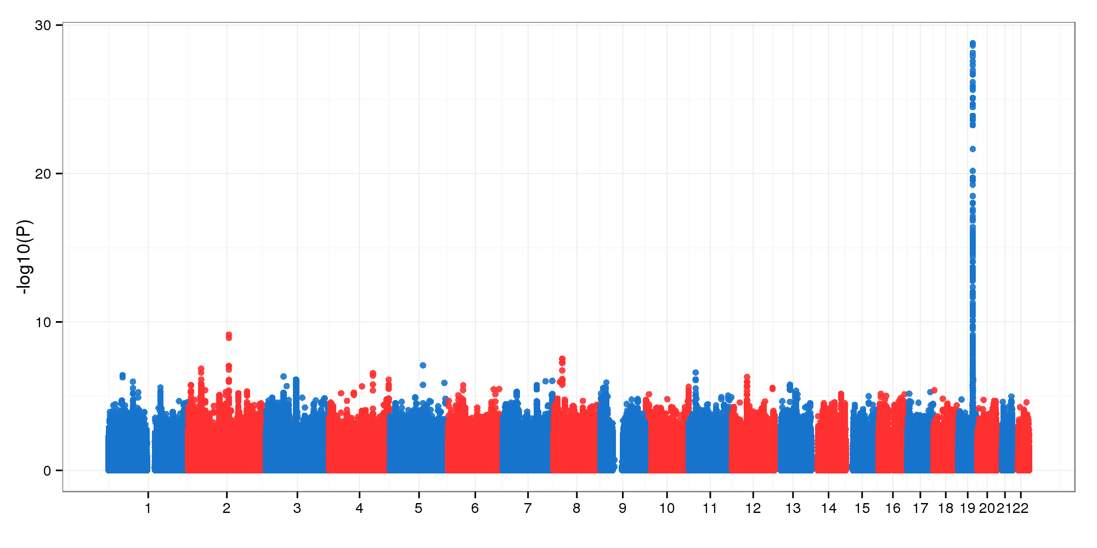

A Bayesian framework for Generalized Linear Mixed Models in Genome-wide Association Studies
Xulong Wang, Vivek Philip, Gregory W. Carter
The Jackson Laboratory, Bar Harbor, ME USA
ABSTRACT
Recent technical and methodological advances have greatly expanded genome-wide association studies (GWAS). The advent of low-cost whole-genome sequencing facilitates high-resolution variant identification, and the development of linear mixed models (LMM) allows improved identification of putatively causal variants. While essential for correcting false positive associations due to population stratification, LMMs have been restricted to numerical variables. However, phenotypic traits in association studies are often categorical, coded as binary case-control or ordered variables describing disease stages. Furthermore, optimally integrating the results of prior studies remains a methodological challenge. To address these issues, we have devised a method for genomic association studies that implements a generalized linear mixed model (GLMM) in a Bayesian framework, called Bayes-GLMM. Bayes-GLMM has four major features: support of categorical variables; cohesive integration of previous GWAS results for related traits by Bayesian modeling; correction for sample relatedness by mixed modeling; and model estimation by both MCMC sampling and maximal likelihood estimation. To demonstrate our method, we applied Bayes-GLMM to the whole-genome sequencing cohort in the Alzheimer's Disease Sequencing Project (ADSP). This study contains 576 individuals distributed across 111 families, each with Alzheimer's disease diagnosed at four confidence levels. The profound population structure in these data required a mixed model approach, and the categorical trait necessitated a generalized model. In summary, this work provides the first implementation of a flexible, generalized mixed model approach in a Bayesian framework.
RESULTS
GWAS by Bayes-GLMM
To identify the most risky and protective LOAD variants, additive effects of the 14.1 million variants were tested independently by Bayes-GLMM. Model parameters were estimated by MLE.
Alzheimer’s disease sequencing project (ADSP)
We applied Bayes-GWAS to ADSP dataset. ADSP was initiated by NIA and NHGRI to discover novel genomic variants for late-onset Alzheimer’s disease (LOAD). As the first cycle, ADSP released whole genome sequences (WGS) results of 576 individuals from 111 families and 3 races. Each individual was diagnosed with one of the four AD levels: no (80), possible (81), probable (360), and definite (55). Additional sample information includes family pedigree, race, ethnicity, age, sex, and APOE e2/e3/e4 genotypes.
A
B
Manhattan plot of GWAS scan on 14.1 million genomic variants.
C
D
Strong variants are less likely to pass on
244 variants in 73 independent LD blocks had LRT at least 15. 85% of the 244 top variants are risky. Interestingly, bigger effect size variants tend to be rare. This suggests strong variants are less likely to pass on.
BAYES-GLMM METHODS
Statistical models in Bayesian framework are defined by two parts: a likelihood function to describe the data-generating process, and the prior distributions of the likelihood function’s parameters. To model categorical variables, likelihood function takes the form of ordered logistic regression model (OLR) as follow:
In OLR, the categorical response variable Y_{i} with J levels followed a multinomial distribution with a vector of parameter π, where π_{ij} represents the probability that the i-th observation falls in the response category j. Cumulative distribution of π was logit-transformed and modeled in the linear model scheme, where X was a n by m covariate matrix with n the sample size and m the number of conditional variables. β was the corresponding parameter vector. g was the numerical genotype of a variant with 0 to 2 representing homozygous reference, heterozygous, and homozygous alternative, respectively. β₀ was the variant’s effect size.
To model sample relatedness, u was included as a random term that followed a multivariate normal distribution, mvN(0, σK), with expected mean 0 and covariance matrix σK. K was the kinship matrix of the samples. mvN(0, σK) was parameterized by the Cholesky factoring of K and n independent normal distribution.
Prior distributions of model parameters are defined as follow:
Bayes-GLMM was built under Stan, which provides a flexible and efficient programming environment for statistical modeling. Inherited from Stan, Bayes-GLMM supports two methods for parameter inference: L-BFGS maximal likelihood estimation (MLE) and Hamilton Markov chain Monte Carlo (HMC) sampling.
Bayes-GLMM also supports control/case studies. The binary phenotypic of a control/case study is a special case of categorical variable with two levels. Binary phenotypes were modeled by a logistic regression model (LR) as follow:
Y_{i} follows a binomial distribution with a scalar parameter π representing the probability that Y_{i} equals 1. π was further transformed by the logit-function and modeled in the linear model scheme.
E
F
570
The 244 variants led to 1101 genetic consequences, of which 51.8% were intron-related. Noncoding transcript variants were the second most abundant. The only missense consequence affected protein of NANOS1.
Female is a risky factor for late-onset AD
Additive effects of age, sex, and APOE e2/e4 were tested by Bayes-GLMM. Kinship structure was computed by using autosomal variants. Model parameters were estimated by MCMC sampling.
MUT^{-/-} MUT^{-/+} MUT^{+/+}
Prior knowledge integration boosts up significance
A recent GWAS on LOAD using 17,008 Alzheimer’s disease and 37,154 controls were taken as priors in Bayes-GLMM. Association significances for variants with non-conflicting priors were boosted.
Point and bar are the first mode and 95% credible interval of covariant effect’s posterior distribution.
The protective and risky effects of APOE/e2 and APOE/e4 were both significant, with 95% CI for APOE/e2 and e4 -1.45 to -0.26 and 0.42 to 1.2, respectively.
Female showed as a significant risk factor of LOAD, with 95% CI 0.00 to 0.74.
14.1 million genomic variants with MAF 0.01+
12.6 million single nucleotide polymorphism (SNP) and 1.5 million short insertion or deletion (INDEL) were identified from ADSP WGS data, and tested in our GWAS.
Source of prior: Meta-analysis of 74046 individuals identifies 11 new susceptibility loci for Alzheimer’s disease. Lambert et al., 2013
CONCLUSIONS
We proposed a new method for GWAS, Bayes-GLMM, and applied on the ADSP dataset. Our method addresses three challenges in GWAS analysis: categorical phenotypes, population structure correction, and prior knowledge integration. Our analysis identified NANOS1 a new LOAD-associated gene.
Acknowledgement
This work was supported by a fellowship from The Pyewacket Foundation.

