Slide 1
Identifying novel genomic variants for Late-onset Alzheimer’s Disease
Xulong Wang

Slide 2
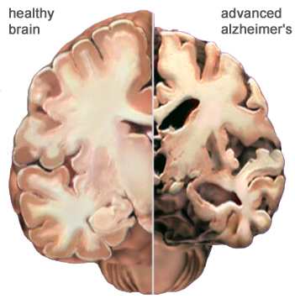
Late-onset Alzheimer’s Disease
Alzheimer’s disease is affecting over 35 million people worldwide.
Late-onset Alzheimer’s disease accounts for about 90% of total Alzheimer’s disease cases.
Notes:
This picture shows the damage of Alzheimer’s disease on the brain.

Slide 3
Alzheimer’s Disease Sequencing Project (ADSP)
Objective: Identify genomic variants that increase or decrease the risk of developing AD.
Until today, ADSP project has released the whole genome sequencing data for 584 people across 111 families.
AD diagnosis for 584 people across 111 families.
Notes:
Initiated by NIH, ADSP is the first large-scale whole-genome sequencing project on AD.
Each person was diagnosed with one of four AD status: no AD, possible, probable, definite. The pie graph shows 10% of them are definite AD, another 63% and 14% are probable and possible AD, and 14% as no AD.

Slide 4
Pipeline in a brief
Genotype
Phenotype
Extracting SNP calls from CS’ VCF
Code: /data/xwang/ADSP/SH/myVcf.sh
Phenotype & metadata processing
Code~/Dropbox/ADSP/R/mdata.R
AD status: 584 -> 578
Other dementia and unknown
Age: 578 -> 576 (Missing data)
Run Null models for predictor selection
Code~/Dropbox/ADSP/R/analysis1.R
Generate complete genotype data Code: /data/xwang/ADSP/R/vdata.R
MODELS: Linear, Hierarchical linear, Cumulative link
Code: /data/xwang/ADSP/R/analysis[123].R
~/Dropbox/ADSP/R/analysis[23].R

Slide 5
Samples: Age over AD status
Age generally increases with AD probability
L: Pooled ages. R: Age over AD status.
Notes:
The boxplot on the right shows the age distributions for people in each of the four AD categories. They are generally comparable, with a slight increase in the probable and definite categories.
Outliers: Q1 - 1.5 * IQR, Q3 + 1.5 * IQR

Slide 6
Samples: Sex over AD status
Female proportion increases with AD probability
L: Sample sex proportion.
R: Sex over AD status.

Slide 7
Samples: APOE over AD status
APOE ε3ε4 proportion increases with AD probability
APOE ε2 is rare and may protect against AD.
APOE ε3 is the most common allele and plays a neutral role.
APOE ε4 present in about 25 to 30% of population and in about 40 % of people with LOAD.

Slide 8
Samples: AD status in Families
AD status across families are not balanced
AD diagnosis for 584 people across 111 families.

Slide 9
Models
Linear model by coding (No, Possible, Probable, Definite) as (0, 0.25, 0.5, 1).
A cumulative model (CLM) is a model for an ordered categorical variable Y, that can fall in 1, 2, …, J categories.
Fixed and hierarchical model

Slide 10
Models: LM, CLM, LMM, CLMM
Sex1, Female, shows minor detrimental effect than Male
Caveat: Age shows little effect
Effects of APOE genotypes concord with the literature

Slide 11
SNP: summary statistics
4.18 –> 5.15 Million SNPs per sample (not includes the de novo, all prefixed with rs)
24 Million SNPs by pooling together all samples
8.3 out of 24 Million SNPs passed MAF > 0.05
8.24 out of 8.3 Million SNPs passed heterozygous (0/1) frequency (0/1) < 0.95
Notes:
With the whole-genome sequencing data from the 584 people, the first step of our work was to identify and quantify the genomic variants in each sample. We are currently focusing on SNP.

Slide 12
Permutations on linear models
Method:
Randomly pick 1M SNP
Run models on permuted SNP
Save maximal LRT value
Repeat 1-3 3200 times
Set threshold as top 0.95 maximal LRT

Slide 13
Peaks in log likelihood graph
Automatic peak detection

Slide 14
APOE in linear models
Model 1
Model 2
Model 3
Model 4

Slide 15
APOE in cumulative link models
Model 1
Model 2
Model 3
Model 4

Slide 16
Candidate loci identified by CLMM

Slide 17
Candidate loci identified by CLMM

Slide 18
Candidate loci identified by CLMM

Slide 19
Candidate loci identified by CLMM

Slide 20
To do list
Details on pipeline
Stick with cumulative logistic model 1 and model 3?
Automatic peak detection performance
Biology of the new loci
Pair scan and Cape
Bayesian inferences with ordered logistic model on chosen loci
Kinship matrix correction?

Slide 21
The Null model: choose covariates
Variance explained in proportion by each predictor

Slide 22
Mixed effects in LMM
The mixed effects based on family structure in HLM null model is not dramatic.

Slide 23
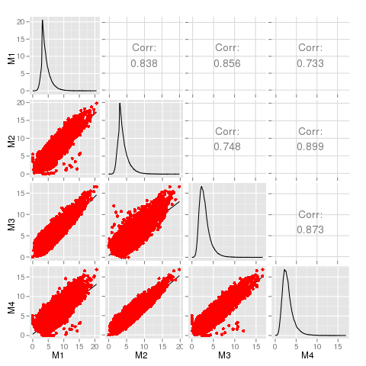
LRT distribution in linear models
L: Distribution and correlation of logLik in models.
Maximum logLik bigger than 3

Slide 24
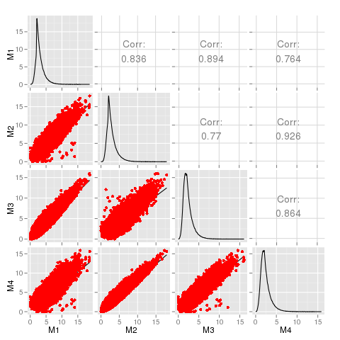
LRT distribution in CLM models
L: Distribution and correlation of logLik in models.
Maximum logLik bigger than 3

Slide 25
Blank

