Slide 1
A GWAS study to identify novel genomic variants for Late-onset Alzheimer’s Disease

Slide 2
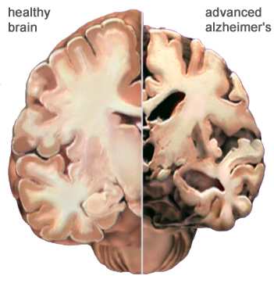
Alzheimer’s disease
Alzheimer’s disease (AD) affects over 35 million people worldwide.
Late-onset Alzheimer’s disease accounts for about 90% of total Alzheimer’s disease cases.
What are the risky and protective genomic mutations for AD?

Slide 3
Alzheimer’s Disease Sequencing Project (ADSP)
Objective: Identify genomic variants that increase or decrease the risk of developing AD.
ADSP project has released the whole genome sequencing data for 584 people across 111 families.
AD diagnosis for 584 people across 111 families.
Age, Sex, and APOE genotype data were collected
Notes:
Luckily, NIH has initiated the first large-scale whole-genome sequencing project on AD, ADSP.
Each person was diagnosed with one of four AD status: no AD, possible, probable, definite.

Slide 4
APOE e4 is the greatest genetic risk factor for LOAD
APOE makes apolipoprotein E which is critical in cholesterol/fat metabolism
There are at least three versions of the APOE gene (APOE e2/e3/e4) determined by two SNPs.
APOE e4 present in about 25 to 30% of population and in about 40 % of people with LOAD.
APOE genotype proportion in all samples (Left) and samples grouped by AD status (Right).
What are the effects of APOE genotypes and sex in a statistical model?
Notes:
Maintaining normal levels of cholesterol is essential for the prevention of disorders that affect the heart and blood vessels (cardiovascular diseases), including heart attack and stroke.

Slide 5
Generalized linear mixed model (GLMM)
AD status was modeled with an ordered categorical model
X are covariates, which include Age, Sex, Apoe2, Apoe4, and a specific variant in the additive models
X include an additional variant by Apoe4 or variant by Apoe2 term in the epistasis models
Genotype-based population structure was modeled by a mixed effect with covariance the kinship matrix
Chromosome-specific kinship relatedness was computed using variants of the other 21 autosomes
Model parameters were estimated with STAN (http://mc-stan.org/)

Slide 6
Females are more likely to develop LOAD
Point and bar are the first mode and 95% credible interval of covariant effect’s posterior distribution
Effects of APOE genotypes concord with the literature

Slide 7
GWAS scan identified many new risky and protective variants
To identify risky and protective genomic variants of LOAD, a generalized linear mixed model was run on 14 million genomic variants.
Graph shows the top 0.1% variants. Color represent risky (red) and protective (blue) effect. Size represents effect size.

Slide 8
Consequences of top variants (0.001 LOD quantile)
Variant consequences were predicted by Ensembl VEP.
Most top variants are intronic.
We identified 180 protein coding consequences from 69 variants.
What are the 69 variants?

Slide 9
69 top protein coding variants
Rare variants show bigger effects (both risky and protective), suggesting a process of nature selection.
Red: risky; Blue: protective. Size represents LOD value.

Slide 10
Risky missense variant works with APOE4
B^{-/-}
B^{-/+}
B^{+/+}
A^{-/-}/B^{-/-}
A^{-/-}/B^{-/+}
A^{-/-}/B^{+/+}
A^{-/+}/B^{-/-}
A^{-/+}/B^{-/+}
A^{-/+}/B^{+/+}
L: LOD score of variants in +/- 250 Kb range of rs191267549
R: Genotype of rs966384 (up) and APOE4/rs191267549 minor allele combination by AD status
Diseases associated with NANOS1 include spermatogenic failure and atherosclerosis (APOE4 is also related with atherosclerosis)
NANOS1-related pathway includes Disease and PEDF Induced Signaling. GO annotations include RNA binding and translation repressor activity
Mutant locus is an open region in neuron by ATAC sequencing

Slide 11
Protective missense variant works with APOE2
B^{-/-}
B^{-/+}
B^{+/+}
A^{-/-}/B^{-/-}
A^{-/-}/B^{-/+}
A^{-/-}/B^{+/+}
A^{-/+}/B^{-/-}
A^{-/+}/B^{-/+}
A^{-/+}/B^{+/+}
A^{+/+}/B^{-/+}
L: LOD score of variants variants in +/- 250 Kb range of rs966384
R: Genotype of rs966384 (up) and APOE2/rs966384 minor allele combination by AD status
LRG1 (Leucine-Rich Alpha-2-Glycoprotein 1) is a Protein Coding gene. Diseases associated with LRG1 include normal pressure hydrocephalus.

Slide 12
Acknowledgement
Pyewacket Foundation

Slide 13
MAP1S

Slide 14
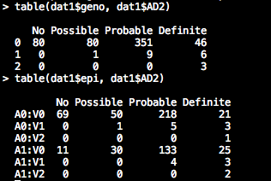
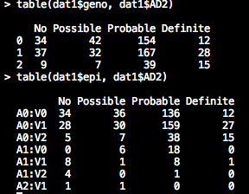
L: Nanos1 and Apoe4 genotype partition
R: Lrg1 and Apoe2 genotype partition
First table (upper) was genotype partition of the variant
Second table (lower) was genotype partition of the Apoe4/variant (Left) and Apoe2/variant (Right)

