Slide 1
Figure 1
A
B
C
D
E
F
Notes:
Figure 1. Summary statistics of the ADSP whole genome sequencing project participants. A. AD diagnosis for 576 individuals across 111 families. B. Age distributions of individuals in each AD status. C. APOE allele-type composition. D. APOE allele-type composition in each AD status. E. Sex composition. F. Sex composition in each AD status.

Slide 2
Figure 2
Notes:
Figure 2. IBS kinship relatedness of individual pairs. In and out mean in or out of the same family from the recorded pedigree.

Slide 3
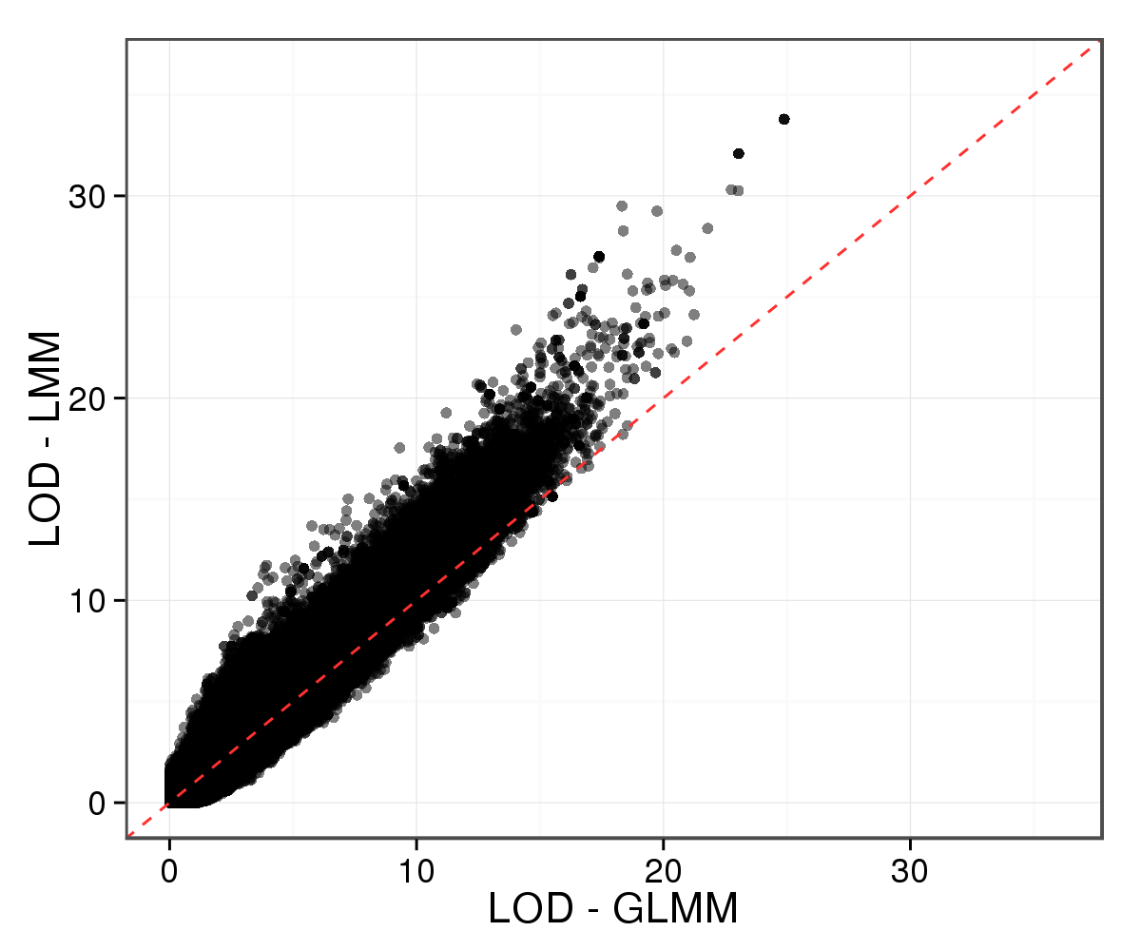
Figure 3
Notes:
Figure 3. Pairwise scatterplot of LOD by GLMM and LMM. GLMM: generalized linear mixed model. LMM: linear mixed model.

Slide 4
Figure 4
A
B
Notes:
Figure 4. Summary statistics of the ADSP variants. 12.6 million bi-allelic SNP (a) and 1.5 million bi-allelic INDEL (b), with MAF cutoff 0.01, were included in the GWAS.

Slide 5
Figure 5
Notes:
Figure 5. Estimation of model covariates by sampling. Points and error bars are the first mode and and 95% CI of posterior distributions for each covariate.

Slide 6
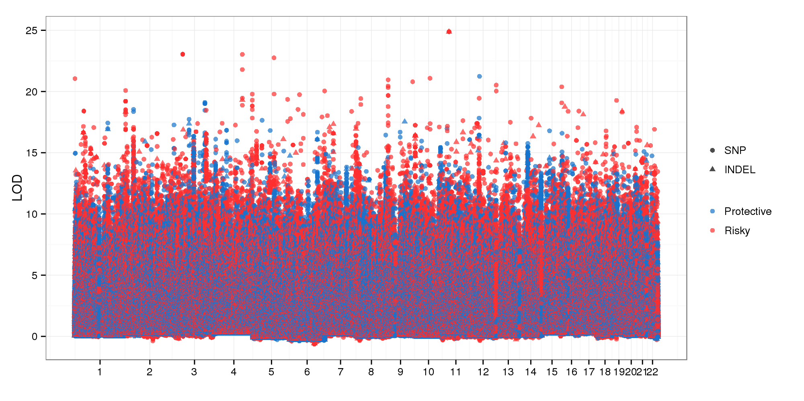
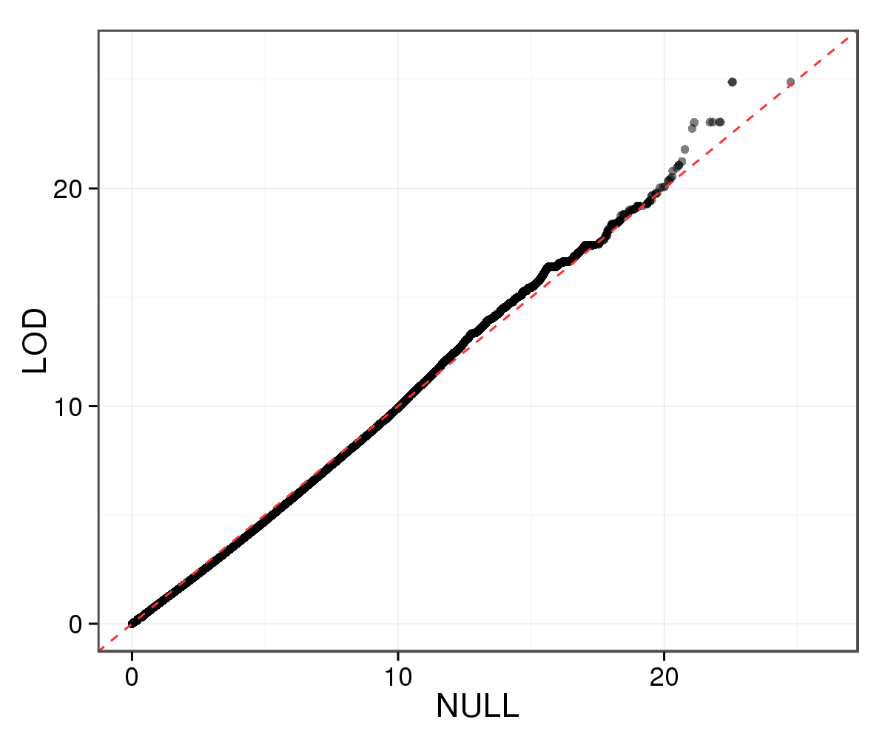
Figure 6
A
B
Notes:
Figure 6. (A) GWAS Manhattan. (B) QQ plot of GWAS LOD from true and randomized genotypes of each variants.

Slide 7
Figure 7
A
B
Notes:
Figure 7. (a) 244 variants with LOD value at least 15 by the additive model. (b) Effect sizes of variants surrounding the first peak by point estimation (x) and sampling (y). (c) WAIC and LOC profiles in the region.

Slide 8
Figure 7
C
Notes:
Figure 7. (a) 244 variants with LOD value at least 15 by the additive model. (b) Effect sizes of variants surrounding the first peak by point estimation (x) and sampling (y). (c) WAIC and LOC profiles in the region.

