Slide 1
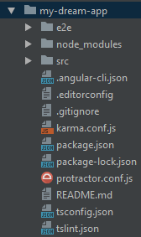
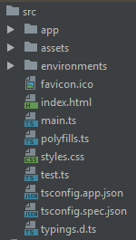
Working with project
End to end testing
Everything go here
Statistic info: images
Environment info
App will serve
this single page
For configuration
of your project
Default is fine

Slide 2



Slide 3
