Slide 1



ELASTIC: Edge Workload Forecasting based on Collaborative Cloud-Edge Deep Learning
Yanan Li¹, Haitao Yuan², Zhe Fu³, Xiao Ma¹,
Mengwei Xu¹, and Shangguang Wang¹
Notes:
Hello, everyone!
I’m Yanan Li from Beijing University of Posts and Telecommunications.
Today, I will introduce our work “ELASTIC: Edge Workload Forecasting based on Collaborative Cloud-Edge Deep Learning”.
This is a joint work with Nanyang Technological University and Tsinghua University.

Slide 2







Background-Edge is Gaining Momentum
In industry, many companies have launched edge computing services.
More and more web services are adopting edge computing due to the advantages of low latency and high bandwidth.
Notes:
Cloud gaming, video conferencing, live streaming

Slide 3
More limited and lower resource utilization
# of physical servers:
Centralized cloud: thousands or even millions;
Each edge site: tens or hundreds.
CPU utilization [1]:
Centralized cloud: 47% VMs less than 10%;
Edge platform: 74% VMs less than 10%.
[1] Xu, Mengwei, et al. "From cloud to edge: a first look at public edge platforms." IMC. 2021.
Notes:
However, the edge computing face the following challenges:
For example, the centralized cloud contains thousands or even millions of physical severs, while each edge site only contains tens or hundreds.
Moreover, 47% VMs of centralized cloud with CPU utilization less than 10%, while the number of edge platform is 74%.

Slide 4
For edge service providers (ESPs), how to
make the most of limited edge resources?
💡
Edge workload forecasting
Notes:
It’s natural for ESPs to want to know

Slide 5
Workload forecasting is the cornerstone
Usage:
Resource provisioning;
Request offload scheduling;
Adaptive bitrate (ABR) schemes.
Effect:
[NSDI’21] Reduce operating costs up to 65%;
[WWW’21] Improve user experience more than 30%.
[2] Singh, Rachee, et al. "Cost-effective cloud edge traffic engineering with cascara." NSDI. 2021.
[3] Ye, Fanghua, et al. "Outlier-resilient web service QoS prediction." WWW. 2021.
Notes:
It can be applied into
For example, it has the potential to reduce operating costs up to 65% and Improve user experience more than 30%.

Slide 6
Existing Forecasting Methods
“Edge-only” methods. Each edge site deploys their model separately and individually to only capture the correlation among VMs of same edge sites, namely intra-site correlations. Limitations: it does not (or poorly) consider the inter-site correlations.
“Cloud-only” methods. Each edge site transmit the whole workload data to the centralized cloud for centralized model training and inference. Limitations:
Huge data transmission overhead;
Additional time consumption of large models’ training and inferencing;

Slide 7
Existing Collaboration Methods
DNN model partition divides the giant model into different sub-models and deploys them on the cloud and the edge separately. Limitations: it is mainly applied to model inference and need an offline profiling phase for each edge site and cloud pair separately.
Federated learning is another type of collaboration paradigm to training DNN models on data distributed participants. Limitations: it requires all participants to train a common model, which cannot be directly applied to workload forecasting scenario, since each edge site generally has a different number of VMs.
Notes:
XXX and XXX
The former divides
The latter trains DNN models on data distributed participants.

Slide 8
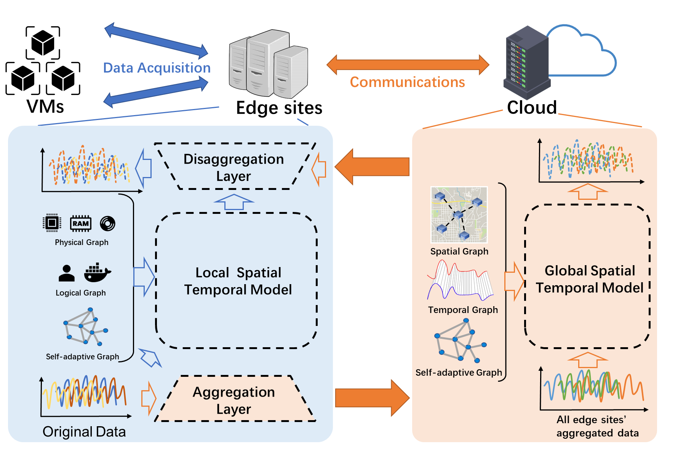
ELASTIC: A Collaborative Cloud-Edge Approach
It mainly consists of two stages:
The global stage performs coarse-grained spatial-temporal forecasting at the centralized cloud;
The local stage performs fine-grained spatial-temporal forecasting at each edge site.
The final forecasting results combine both the intra-site and inter-site correlations.

Slide 9
ELASTIC: A Collaborative Cloud-Edge Approach
It mainly consists of two stages:
The global stage performs coarse-grained spatial-temporal forecasting at the centralized cloud;
The local stage performs fine-grained spatial-temporal forecasting at each edge site.
The final forecasting results combine both the intra-site and inter-site correlations.

Slide 10
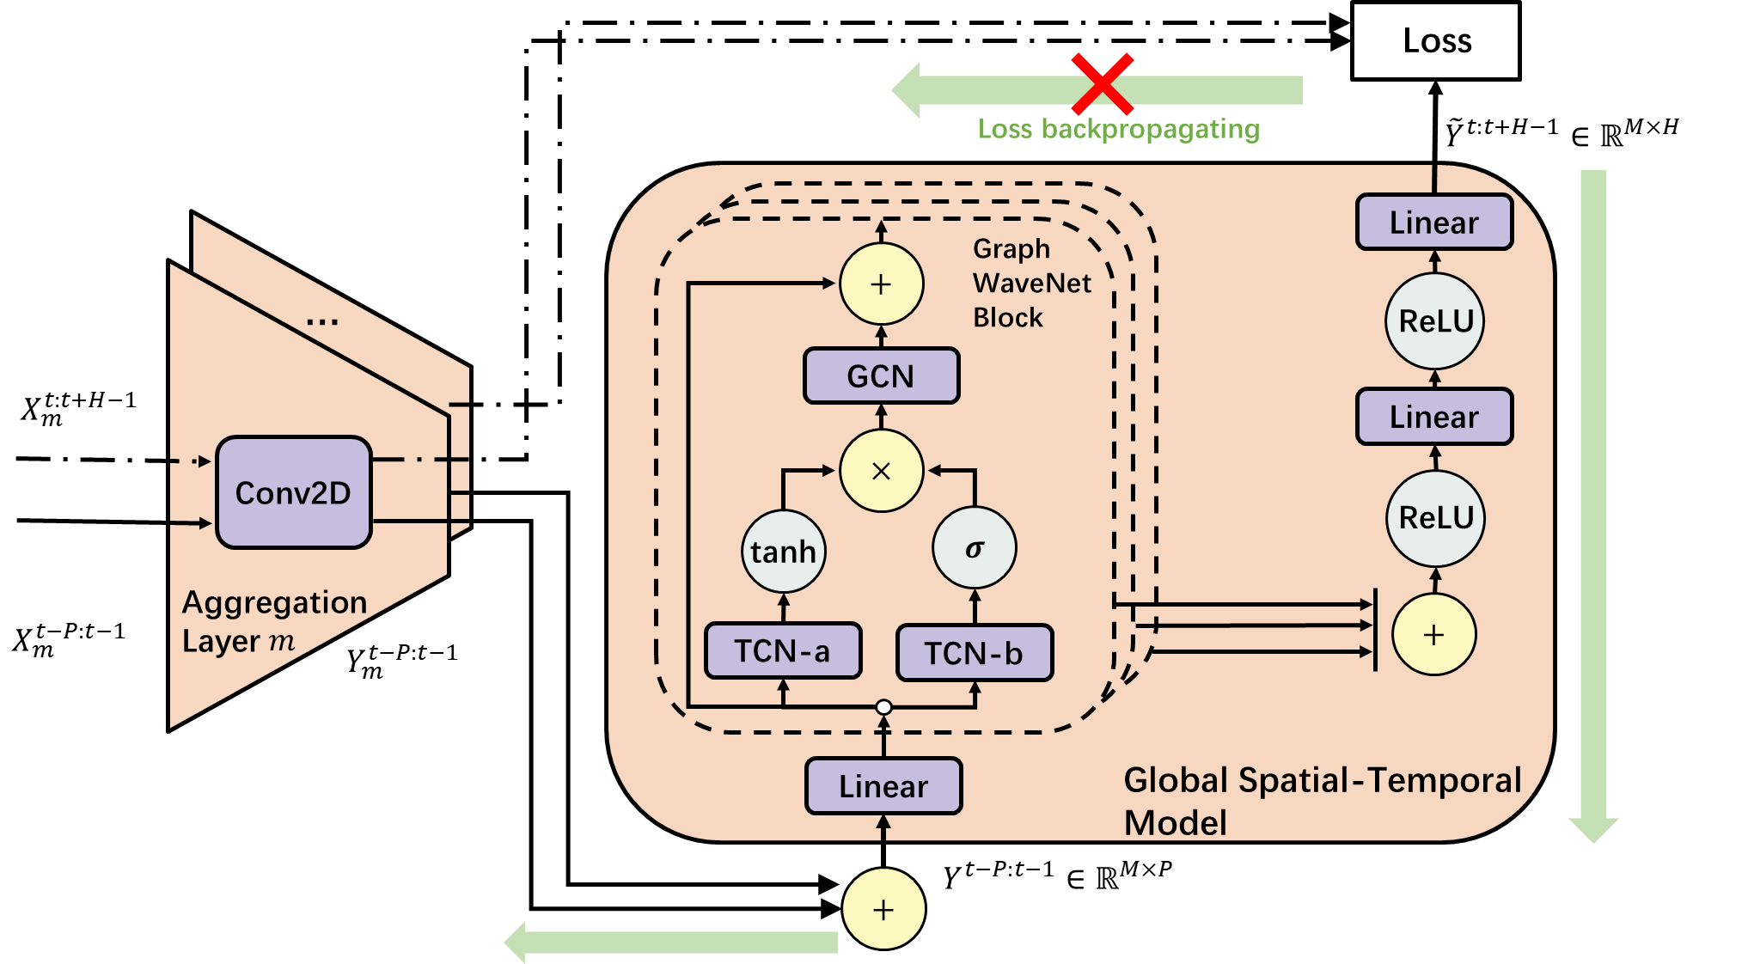
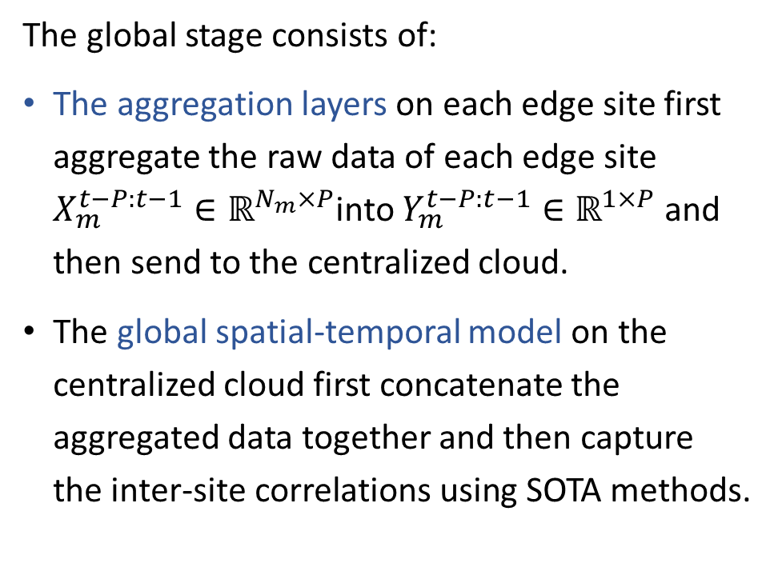
Global Stage
The global stage consists of:
The aggregation layers on each edge site first aggregate the raw data of each edge site $X_{m}^{t−P:t−1}∈ℝ^{N_{m}×P}$into $Y_{m}^{t−P:t−1}∈ℝ^{1×P}$ and then send to the centralized cloud.
The global spatial-temporal model on the centralized cloud first concatenate the aggregated data together and then capture the inter-site correlations using SOTA methods.

Slide 11
Global Stage
The global stage consists of:
The aggregation layers on each edge site first aggregate the raw data of each edge site $X_{m}^{t−P:t−1}∈ℝ^{N_{m}×P}$into $Y_{m}^{t−P:t−1}∈ℝ^{1×P}$ and then send to the centralized cloud.
The global spatial-temporal model on the centralized cloud first concatenate the aggregated data together and then capture the inter-site correlations using SOTA methods.
1. Decrease time consumption
2. Capture intra-site correlation
Notes:
Their functions are decreasing time consumption and capturing intra-site correlation respectively.

Slide 12
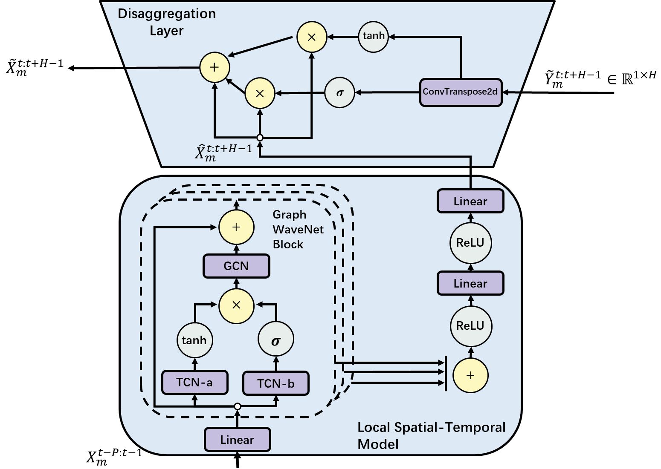
Local Stage
The local stage of each edge site consists of :
The local spatial-temporal model can utilize SOTA models to capture the intra-site correlations among VMs of same sites.
The disaggregation layer finally fuse the results of global and local stages in both linear and nonlinear manner.

Slide 13
Local Stage
The local stage of each edge site consists of :
The local spatial-temporal model can utilize SOTA models to capture the intra-site correlations among VMs of same sites.
The disaggregation layer finally fuse the results of global and local stages in both linear and nonlinear manner.
1. Capture inter-site correlation
2. Increase model accuracy by fusion
Notes:
Their functions are capturing inter-site correlation and increasing the model accuracy by fusing both inter-site and intra-site correlations respectively.

Slide 14
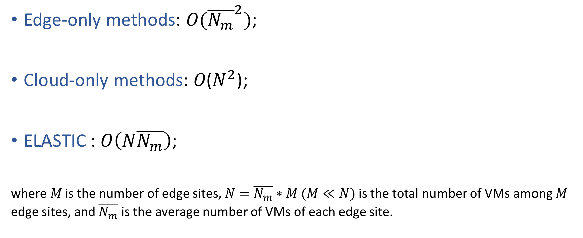
Complexity Analysis
Edge-only methods: $O({\overline{N_{m}}}^{2})$;
Cloud-only methods: 𝑂($N^{2}$);
ELASTIC : $O\left(N\overline{N_{m}}\right)$;
where 𝑀 is the number of edge sites, $N=\overline{N_{m}}∗M (M≪N)$ is the total number of VMs among 𝑀 edge sites, and $\overline{N_{m}}$ is the average number of VMs of each edge site.
ELASTIC is similar to edge-only methods and smaller than
cloud-only methods.
Notes:
We also analysis the time complexity of these three types of methods:
The results are that

Slide 15
Evaluation Setup
Datasets. Realistic workload (CPU and bandwidth) datasets collected from Alibaba ENS, one of the largest ESPs in China [5].
Network environments. To simulate the bandwidth between edge sites and cloud.
Slow: 4 Mbps
Medium: 16Mbps
Fast: 50 Mbps
Baselines.
Classical methods: ARIMA, Holt;
DNN-based methods: LSTM, GRU;
Spatial-temporal methods: STGCN, HGCN, GWNET.
[5] EdgeWorkloadsTraces. https://github.com/xumengwei/EdgeWorkloadsTraces
Notes:
The evaluation settings are as follows:
We utilize realistic workload datasets
To simulate the slow, median, and fast network conditions, we throttle the bandwidth between edge and cloud to 4, 16, and 50 Mbps, respectively.
The comparision baselines are classified into:
And all this methods are implemented in the cloud-only manner.

Slide 16
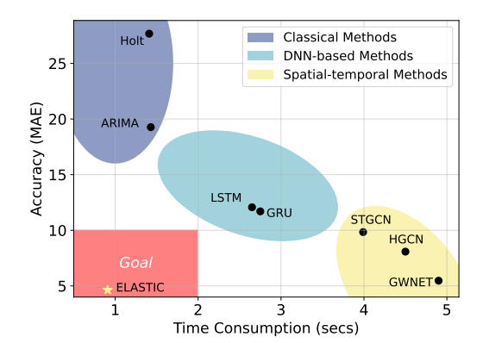
Comparison with SOTA Methods
ELASTIC can achieve better prediction accuracy while the time consumption is significantly reduced.
81.19%
81.43%
Notes:
Here we list three parts of our experimental results:
Firstly, ELASTIC can achieve better prediction accuracy while the time consumption is significantly reduced.

Slide 17
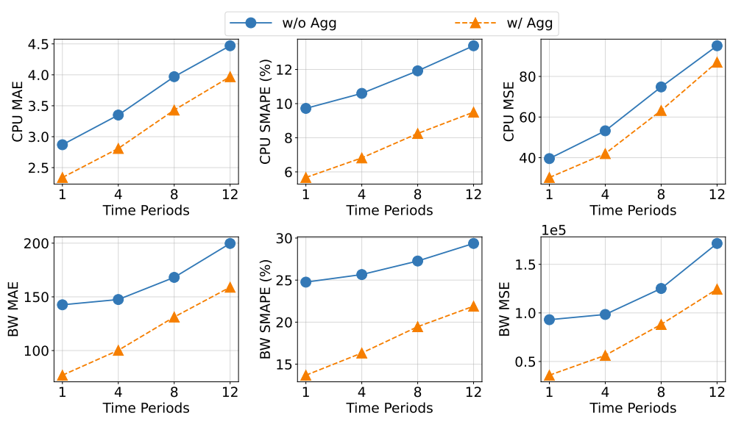
Ablation Studies of ELASTIC
CPU Datasets:
MAE have decreased 13.98%
SMAPE have decreased 18.82%
MSE have decreased 13.60%
BW Datasets:
MAE have decreased 37.64%
SMAPE have decreased 10.52%
MSE have decreased 55.23%
Ablation studies further confirm the effectiveness of different modules.

Slide 18
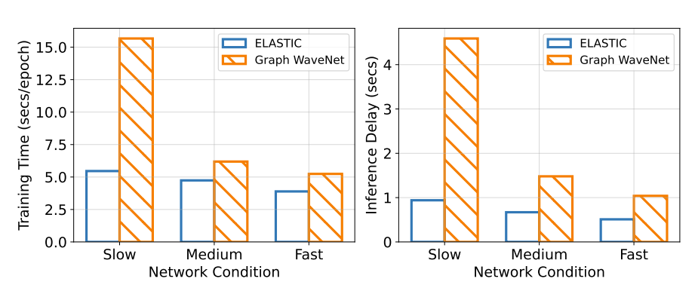
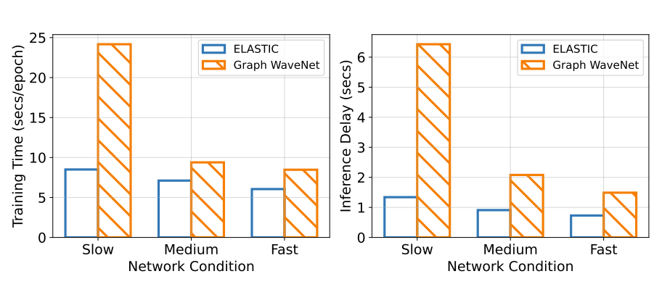
Time Consumption
CPU Datasets:
Training time have decreased 38.11%
Inference time have decreased 61.74%
BW Datasets:
Training time have decreased 39.23%
Inference time have decreased 62.14%.
Notes:
Finally, both training and inference time consumption are significantly reduced.

Slide 19
Our Contributions
This is the first study that leverages the collaborative cloud-edge paradigm for edge workload forecasting.
We propose ELASTIC, a novel two-stage framework capturing both intra-site and inter-site correlations, which not only increase prediction accuracy but also decrease time consumption.
Extensive evaluation utilizing the real-world datasets demonstrates the effectiveness of ELASTIC.
Notes:
In summary, our contributions are three-fold:

Slide 20
Thank You
Yanan Li
YaNanLi@bupt.edu.cn

