Slide 1
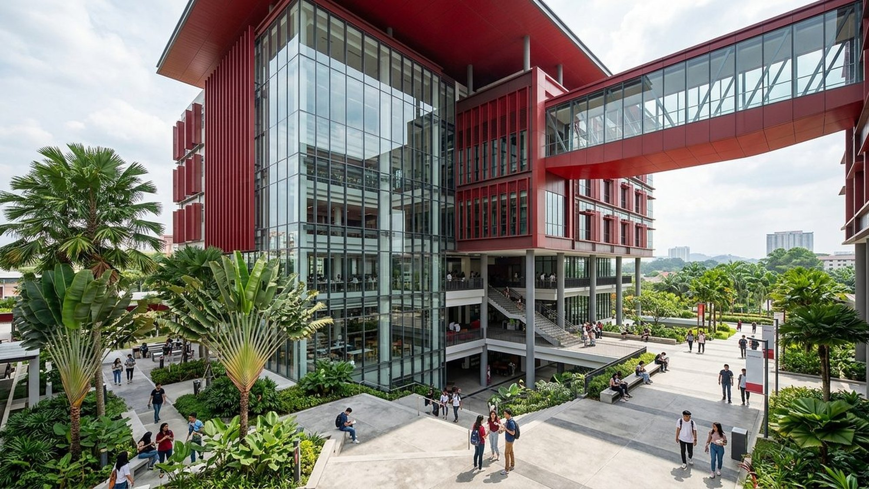
FIB 2074 | FINAL GROUP PROJECT
ALFA University College Management Plan
Shifting to 65% Direct Digital Enrolment and ALFA OneHub Paperless Operations
Members 1–7 | Lecturer: Dr. Paul | Slide 1

Slide 2

MEMBER 1 | SECTION 1: BUSINESS CONCEPT & SITUATION
100% Agent Reliance and Paper Slow ALFA Down
Verified ALFA Profile & Two Challenges
Verified Founding: Started 1998 as Alif Creative Academy; Nusantara Group (2017); UC status (2021).
Campus & Scale: USJ 1, Subang Jaya; motto 'A Leader For All'; 68 MQA courses; 120 staff (assumption).
Problem 1 (100% Agents): All 400 new students come via 12 master & 96 sub-agents taking 15% ($375/stu).
Problem 2 (Paper & MyClass): MyClass only shows PDF exam grades; 5–7 days chasing 3–4 paper ink stamps.
Source: ALFA Official Website (alfa.edu.my) & Times Higher Education (2024) | Slide 2

Slide 3
MEMBER 1 | SECTION 1: UNIFIED COMMISSION & BUDGET MODEL
65% Direct Intake Saves $97,500 Gross ($55,500 Net)
Commission Math (400 Students × $2,500)
Sub-Agent Rate (10%): $250/student × 400 students = $100,000/yr today.
Master Agent (5% Assump.): $125/student × 400 students = $50,000/yr today.
Total Commission Today: $375/stu (15%) = $150,000/yr (+$10K mktg = $160K).
65% Direct Plan Target: 260 direct stu save $97.5K gross ($55.5K net of $42K).
Source: Appendix A Unified Financial Model ($1,000,000 Gross First-Year Tuition) | Slide 3

Slide 4
MEMBER 1 | SECTION 2: APPLICATION OF MANAGEMENT THEORIES (LECTURE 2)
Classical, Behavioural & Contingency Theories Fix Both Issues
1. Classical Theory
Core Focus: Work structure, SOP standardisation & efficiency.
24-Hr Digital SOP: Upgrade MyClass to OneHub (<24h vs 5–7d paper).
Marketing Split: Divide 20 staff: 6 Video, 6 CRM, 4 Agent Audit.
2. Behavioural Theory
Core Focus: People, feelings, morale & fair motivation.
Restaurant B Style: Co-design OneHub screens with clerks & faculty.
$50 Direct Bonus: Pay $50/direct student ($13K/yr for 260 stu).
3. Contingency Theory
Core Focus: Adapt management approach to the situation.
Tailored Coaching: Autonomy for creators; buddy help for clerks.
Hybrid Channels: 65% direct online (260); 35% agents (140 stu).
Source: FIB 2074 Lecture 2 (Classical, Behavioural & Contingency Management Theories) | Slide 4

Slide 5

MEMBER 2 | SECTION 3: PLANNING THE BUSINESS (LECTURE 3)
SMART Objectives Target 65% Direct Online Intake
12-Month Goal & SMART Targets
Overall Goal: Shift ALFA to 65% direct digital intake & paperless OneHub.
SMART 1 (Financial): 0% → 65% direct (260 stu); save $97.5K gross / $55.5K net.
SMART 2 (Social Media): 5 Reels/wk; grow IG 2.1K → 20K; reply in <= 2 hours.
SMART 3 (ALFA OneHub): Launch OneHub by M6; student admin wait < 24 hours.
Source: FIB 2074 Lecture 3 (Robbins & Coulter 3-Step Framework & SMART Criteria) | Slide 5

Slide 6
MEMBER 2 | SECTION 3: STRATEGY, PLANS & CONTINGENCY (LECTURE 3)
Multi-Level Strategy, Backup Plan & $42,000 Budget Split
Types of Plans & Backup Rule
Timestamp Strategy: First Digital Timestamp blocks false agent claims.
Strategic & Tactical: 12-mo $42K shift; M3–M6 OneHub & studio campaigns.
Operational Plan: 5 Reels/wk, <=2h DM replies, <=24h ERP approvals.
Contingency Plan: If M6 direct < 30%, shift $3K to $100 Direct Rebate.
Source: Table 3 Action Plan ($42,000 Budget: $161.54/Direct Student; $236.25 Blended) | Slide 6

Slide 7
MEMBER 2 | SECTION 3: SIX-STEP ACTION PLAN & GANTT TIMELINE
Visual 12-Month Action Plan Timeline ($42,000 Budget)
Phase 1: Social Studio & 8 Ambassadors ($4.0K) [Marketing Dir.]
M1–M2
Phase 2: Agent Audit & Timestamp Rule ($1.5K) [VC & Finance]
M2–M4
Phase 3: Upgrade MyClass to OneHub ($9.5K) [Chief IT Mgr (12)]
M3–M6
Phase 4: Direct Ads ($12K) & Bonus ($13K) [Social & CRM Leads]
M4–M12
Phase 5: 120-Staff Training & Paperless ($2.0K) [Ops & HR Mgr]
M5–M8
Phase 6: Monthly Control & Variance Audits ($0) [VC & 4 Div. Heads]
M6–M12
Source: FIB 2074 Lecture 3 (Six Steps to Plan Effectively & 12-Month Gantt Schedule) | Slide 7

Slide 8
MEMBER 3 | SECTION 4: ORGANISING THE BUSINESS (LECTURE 4)
7-Step Organising Aligns 120 Staff & Clear Authority
Principles Applied Across 120 Staff
Exact 120 Headcount: 5 Top + 65 Academic + 20 Marketing + 12 IT + 18 Ops.
Match Authority: Marketing Dir. controls $12K ads & blocks false claims.
Smart Delegation: Leads approve reels/chats; Directors keep accountability.
Unity of Command: 6 Video Creators report solely to Social Media Lead.
Source: FIB 2074 Lecture 4 (7-Step Organising Process, Authority & Delegation) | Slide 8

Slide 9
MEMBER 3 | SECTION 4: VISUAL ORGANISATION CHART & SPAN OF CONTROL
Visual Organisation Chart (120 Staff) & Span of Control
TOP-LEVEL MANAGEMENT (5 Staff)
Chairman (Dr. Shaharuddin), Vice-Chancellor (Prof. Dr. Nurliza), Deputy VC & 2 Exec Assistants
1. Academic Affairs (65)
1 Academic Director
2. Digital Marketing (20)
1 Marketing Director
3. IT & OneHub ERP (12)
1 Chief IT Manager
4. Registry, Fin & HR (18)
1 Ops & HR Manager
8 Coordinators → 56 Lecturers
Wide Span: 7 per Coordinator
3 Leads → 6 Video, 6 CRM, 4 Audit
Narrow Span: 5–6 per Lead
2 Leads → 5 Dev, 4 Helpdesk
Narrow Span: 4–5 per Lead
3 Supv. → 5 Reg, 5 Fin, 4 HR
Narrow Span: 4–5 per Supv.
Centralised at Top: $2,500 Tuition, $42K Budget, MQA & 15% Agent Rules | Decentralised to Frontline: <=2h DM Replies & <=24h ERP Approvals
Source: FIB 2074 Lecture 4 (Hierarchy Levels, Span of Control & Centralisation Balance) | Slide 9

Slide 10
MEMBER 4 | SECTION 5: LEADING THE BUSINESS (LECTURE 5)
6-Step Leading & 5 Power Sources Turn Plans Into Action
6-Step Leading Process
1–2. Set & Share: Town hall 'Why' + clear 2h CRM / 24h ERP rules.
3–4. Guide & Motivate: Live iMac demos + $50 direct student bonus.
5–6. Support & Check: Daily IT floor-walks + 15-min Friday check-ins.
Formal Position Power
Legitimate Power: Mandate 100% paperless OneHub usage by M8.
Reward Power: $50/student bonus ($13K) & $400 team awards.
Coercive Power: Last resort if agents fake digital timestamps.
Personal Power (Trust)
Power vs. Influence: Power = capacity; Influence = behaviour change.
Expert Power: IT & Marketing leads teach ERP & reel skills.
Referent Power: Listen with empathy; model paperless habits.
Source: FIB 2074 Lecture 5 (Management vs. Leading, Power vs. Influence & French & Raven, 1959) | Slide 10

Slide 11

MEMBER 4 | SECTION 5: PRACTICAL WORKPLACE SCENARIO
Coaching Senior Clerks Clears 40-Student ERP Backlog
Month 6 Registry Resistance & Response
The Problem: Two 12-yr clerks fear ERP errors; 40 students wait 5 days.
1. Referent Power: Private coffee chat; reassure cloud backup protects files.
2. Expert Power: IT enables 10-file 'Sandbox Mode' & preview check.
3. Reward & Result: Tech buddy + town hall praise clears backlog in <24h.
Source: FIB 2074 Section 5.3 Workplace Leadership & Power Application | Slide 11

Slide 12
MEMBER 5 | SECTION 6: CONTROLLING BUSINESS PERFORMANCE
Five-Area Control Matrix Tracks Standards & Fixes Gaps
Financial, Operations & Quality Control
4-Step Control Loop: Set Standard → Measure → Compare → Fix (Textbook).
1. Financial Control: Comm. <=$52.5K/yr; direct cost <=$161.54 ($236.25 avg).
2. Operations Control: CRM reply <=2h; ERP reg/letters <=24h; -90% paper.
3. Quality Control: 5 Reels/wk; 20K IG followers; >=4.5/5.0 app score.
HR, Strategic & Control Types
Control Types: Feedforward, Concurrent, Feedback (Traffic-Light: Green ≥100%, Amber 90–99%, Red <90%).
4. HR Control: >=95% of 120 staff pass test; 100% QR attendance.
5. Strategic Control: Direct share: 0% → 20% → 40% → 55% → 65% (260 stu).
Corrective Action: Reassign queues, pause weak ads, or $100 Rebate.
Source: Section 6 & Robbins & Coulter (2021) Four-Step Control Process | Slide 12

Slide 13
MEMBER 5 | SECTION 6: QUARTERLY STRATEGIC CONTROL & FORMULAS
Direct Online Enrolment Rises from 0% to 65% in Year 1
Control Formulas & Checkpoints
Baseline Today: 0% direct (0 stu) / 100% agents (400 stu).
Month 6 Target: 40% direct (160 stu); <30% triggers $100 Rebate.
Month 12 Target: 65% direct (260 stu) / 35% agents (140 stu).
Variance & % Math: Variance = Actual − Target; % = (Actual÷Target)×100.
Source: ALFA OneHub CRM Quarterly Enrolment Source Projections (400 Annual Intake) | Slide 13

Slide 14
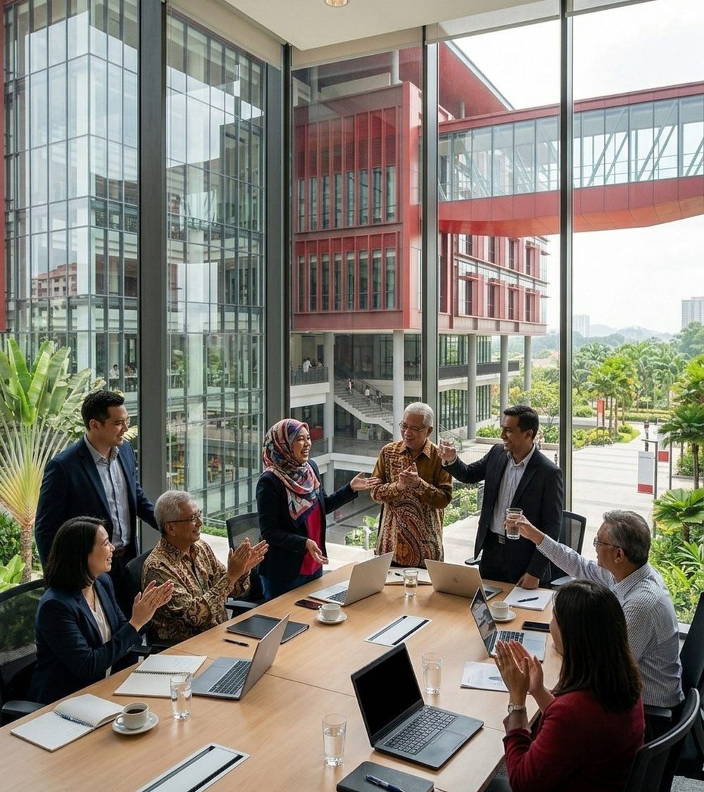
MEMBER 6 | SECTION 7: LEADERSHIP & COMMUNICATION
Participative Leadership & Two-Way Communication
Leadership Style & Communication
Participative Style: Involve 56 lecturers & 6 creators in OneHub & reel ideas.
Situational Coaching: Step-by-step ERP coaching for senior clerks (M5–M8).
Verbal Example: 15-min Monday 9 AM spoken stand-up with 16 mktg staff.
Non-Verbal Example: Eye-level, smiling coaching posture + green TV badge.
Source: FIB 2074 Lecture 5 & Robbins & Coulter (2021) Leadership Frameworks | Slide 14

Slide 15
MEMBER 6 | SECTION 7: EMPLOYEE MOTIVATION & EMPOWERMENT
Maslow, Herzberg, $50 Bonus & Empowerment Drive Effort
1. Safety & Hygiene
Textbook Basis: Maslow (1943) Safety & Herzberg (1968) Hygiene.
Zero Job Cuts: Guarantee 0 retrenchments across all 120 staff.
Workstation Aid: Fast PCs, laminated cheat sheets & IT floor help.
2. Extrinsic & Intrinsic
$50 Direct Bonus: 260 direct stu × $50 = $13,000/yr team pool.
$400 Team Award: ~RM 1,750 Paperless Efficiency Award for <24h ERP.
Public Recognition: Monthly 'ALFA Leader For All' town hall awards.
3. Empowerment
Video Creators: Publish campus reels without 7-day paper sign-off.
CRM Counselors: Approve standard tuition instalment plans on chat.
Registry Officers: Issue digital verification letters in 1 click.
Source: Lecture 5 & Textbook Motivation Theories (Maslow, 1943; Herzberg, 1968) | Slide 15

Slide 16
MEMBER 7 | SECTIONS 8 & 9: INTEGRATED POLC & RECOMMENDATIONS
Connected POLC Cycle Delivers $97.5K Gross / $55.5K Net Savings
POLC Loop & Top 3 Priorities
POLC Integration: Plan ($42K) → Organise (120) → Lead ($50) → Control (<24h).
Priority 1 (M1–M2): Launch Student Studio ($4K) for 5 weekly Reels/TikToks.
Priority 2 (M2–M4): Enforce First Timestamp Rule ($1.5K); cap agents at 35%.
Priority 3 (M3–M6): Upgrade MyClass to ALFA OneHub Cloud ($9.5K; <24h).
Source: Table 7 Turnaround Scorecard ($161.54/Direct Stu; $236.25 Blended; -90% Paper) | Slide 16

Slide 17
ALFA UNIVERSITY COLLEGE | A LEADER FOR ALL
Smart Management Turns Ambition Into Action.
Thank You & Questions?
FIB 2074 – Introduction to Management | Members 1–7 | Slide 17

