Slide 1
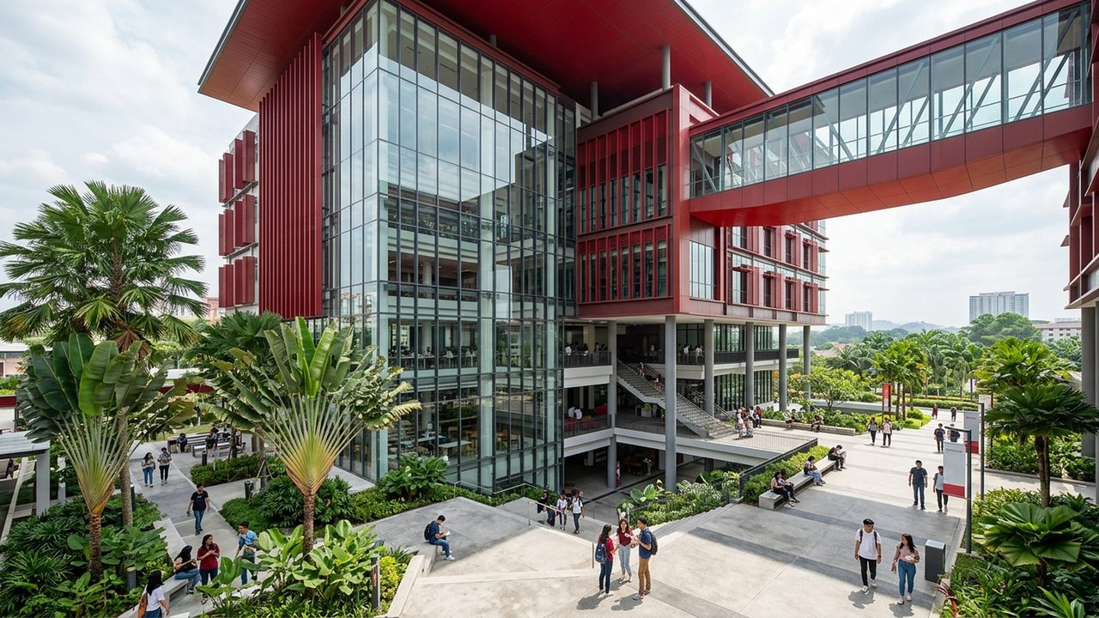
FIB 2074 | FINAL GROUP PROJECT
ALFA University College Management Plan
Solving Multi-Tier Agent Leakage and Paper Bureaucracy via POLC
7-Member Team | Lecturer: Dr. Paul | Slide 1

Slide 2

SPEAKER 1 | SECTION A: BUSINESS SITUATION
Agent Fees and Paper Slow ALFA Down
ALFA Profile & Operational Bottlenecks
Campus Profile: Subang Jaya campus, 68 MQA courses, 120 full-time staff.
Problem 1 (Agent Trap): 12 master agents hire ~96 sub-agents taking 25% of $2,500 tuition.
Dormant Social Media: Existing IG (2.1K), TikTok & YT accounts barely move.
Problem 2 (MyClass Limit): MyClass only shows PDF grades; 5–7 days for 3–4 paper stamps.
Source: ALFA Official Info (alfa.edu.my) & Student Team Model | Slide 2

Slide 3
SPEAKER 1 | SECTION A: UNIFIED BUDGET MODEL ($2,500 TUITION)
Cutting 10% Sub-Agents Saves $135,500 Net Annually
Per-Student Tuition Split ($2,500)
10% Sub-Agent Tier: $250 x 352 agent students wastes $88,000/yr.
15% Master Agent Tier: $375 x 352 = $132K ($220K total agent fees + $10K old ads).
Proposed Plan ($94.5K): $52.5K agents + $42K digital/OneHub saves $135.5K/yr net.
Source: Internal Financial Model Based on 400 Annual New Students ($1,000,000 Gross Tuition) | Slide 3

Slide 4
SPEAKER 2 | SECTION B: MANAGEMENT THEORIES (LECTURE 2)
Three Management Theories Guide Our Practical Solutions
1. Classical Theory
Main Focus: Work structure, standardisation, and efficiency.
24-Hr Digital SOP: Upgrade MyClass into OneHub (<24-hr ERP).
Marketing Split: Split 20 staff: 6 Video, 6 CRM, 4 Audit.
2. Behavioural Theory
Main Focus: People, morale, relationships, and motivation.
Involve 120 Staff: Co-design ERP screens so clerks feel supported.
$50 Direct Bonus: Reward staff for each direct online enrollment.
3. Contingency Theory
Main Focus: Adapt management approach to the exact situation.
Tailored Coaching: Freedom for young staff; buddy help for clerks.
Market Adaptation: Direct ads in SE/Central Asia; agents in China.
Source: FIB 2074 Lecture 2 (Classical, Behavioural & Contingency Approaches) | Slide 4

Slide 5

SPEAKER 3 | SECTION C: PLANNING THE BUSINESS (LECTURE 3)
SMART Plan Targets 65% Direct Intake
Robbins & Coulter 3-Step Plan
SMART Objective 1: Cut total cost from $230K ($575/stu) to $94.5K ($236/stu).
SMART Objective 2: Grow IG to 20K followers and reach 65% direct online intake.
SMART Objective 3: Upgrade MyClass to OneHub by M6; student wait <24 hrs.
Contingency Plan: Shift $3K ad funds to $100 Early-Bird Rebate if M6 < 30%.
Source: FIB 2074 Lecture 3 (Robbins & Coulter Framework, SMART Objectives & Contingency Plans) | Slide 5

Slide 6
SPEAKER 3 | SECTION C: ACTION PLAN & TIMELINE
Six-Phase Action Plan Connects Resources and Deadlines
Phase & Timeline | What Will Be Done (Action) | Who Is Responsible | Budget / Resource
M1–M2: Social Setup | Align IG/TikTok/YT; hire 8 student ambassadors | Marketing Director | $4,000 Studio & Gear
M2–M4: Agent Reform | Remove 10% sub-agent tier; cap 12 agents at 15% | VC & Finance Sup. | $1,500 Contract Update
M3–M6: ALFA OneHub | Upgrade MyClass into unified CRM, ERP & HRM | Chief IT Manager (12) | $9,500 Cloud Upgrade
M4–M12: Ads & Bonus | Meta/TikTok ads ($12K) + $50 direct bonus ($13K) | Social & CRM Leads | $25,000 Ads & Bonuses
M5–M8: Staff Rollout | Train 120 staff; 100% paperless by M8 ($42K Total) | Operations & HR Mgr | $2,000 Training & Awards
Source: FIB 2074 Lecture 3 (Six Steps to Plan Effectively) | Slide 6

Slide 7
SPEAKER 4 | SECTION D: ORGANISING THE BUSINESS (LECTURE 4)
Four Divisions Align Authority, Span of Control, and Speed
Division of 120 Staff
Top Level (5): Chairman & VC set strategy, budget, and 15% agent cap.
Academic (65): 1 Director, 8 Coordinators, 56 lecturers (1+8+56=65).
Marketing/IT/Ops (50): Marketing (20), IT OneHub (12), and Registry/HR (18).
Authority & Delegation
Match Authority: Marketing Head gets ad budget & blocks sub-agents.
Smart Delegation: CRM Leads approve quotes; Head keeps accountability.
Unity of Command: Creators report to one Lead, ending conflicts.
Span & Decentralisation
Wide Span (7): 8 Coordinators supervise 7 experienced lecturers each.
Narrow Span (4–6): Marketing, IT & Registry Leads coach digital teams.
Hybrid Decisions: Tuition centralised; 24-hr ERP approvals decentralised.
Source: FIB 2074 Lecture 4 (Organising Process, Authority, Span of Control & Centralisation) | Slide 7

Slide 8

SPEAKER 5 | SECTION E: LEADING THE BUSINESS (LECTURE 5)
Five Power Sources Guide Staff Change
Power, Influence & Workplace Case
Legitimate & Coercive: Mandate paperless OneHub usage and ban secret sub-agent splits.
Expert & Referent: IT/Marketing leads demonstrate tools patiently with respect.
Reward Power: $50/student direct enrollment bonus and monthly awards.
Registry Clerk Case: Use sandbox practice & buddy coaching to clear 40-file backlog.
Source: FIB 2074 Lecture 5 (Leading Process, Power vs. Influence & 5 Power Sources) | Slide 8

Slide 9
SPEAKER 6 | SECTION F: CONTROLLING BUSINESS PERFORMANCE
Five-Area Control System Tracks Standards and Fixes Gaps
Control Area | 1. What Is Monitored | 2. Target Standard | 3. Corrective Action if Below
Financial Control | Blended CAC & agent fees | <= $236.25/stu ($94.5K/yr) | Pause weak ads; audit agent invoices
Operations Control | CRM reply & student ERP speed | Reply <= 2h; Course/Exam <= 24h | Reassign files across Registry staff
Quality Control | Social engagement & student score | 5 Reels/wk; >= 4.5/5.0 survey | Shift to native-language student Q&As
HR Control | 120 staff OneHub usage & test | >= 95% pass by M8; QR attendance | Run 1-on-1 IT floor buddy coaching
Strategic Control | Direct vs. Agent intake share | >= 40% (M6) to >= 65% (M12) | Shift $3K to $100 Early-Bird Rebate
Source: FIB 2074 Section F (4-Step Control Loop Across 5 Management Control Areas) | Slide 9

Slide 10
SPEAKER 6 | SECTION F: QUARTERLY STRATEGIC CONTROL METRICS
Direct Digital Enrollment Rises from 12% to 65% in Year 1
Quarterly Control Checkpoints
Baseline Today: 88% agent dependency; only 12% direct online intake.
Month 6 Checkpoint: 40% direct digital intake after ALFA OneHub CRM launch.
Month 12 Target: 65% direct intake (260 stu), retaining $905.5K net (+$135.5K).
Source: ALFA OneHub CRM Quarterly Enrollment Source Tracking Projections | Slide 10

Slide 11
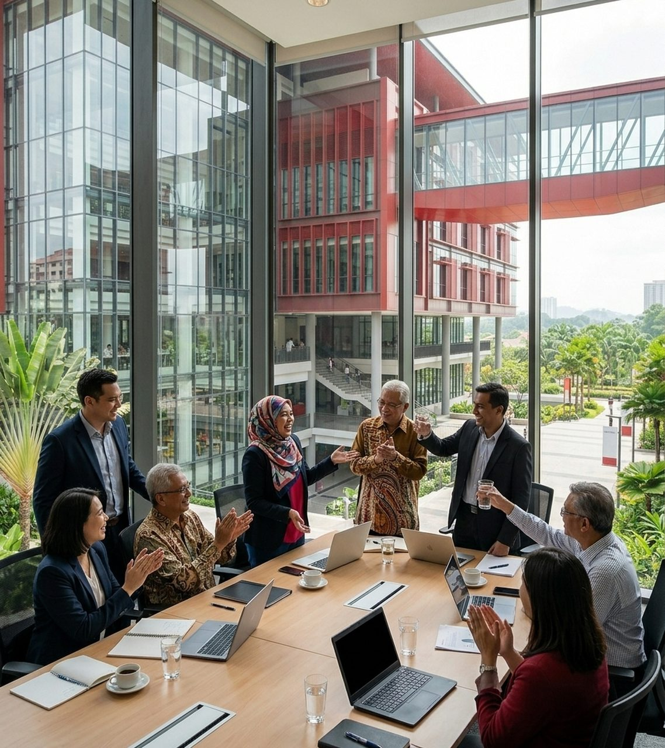
SPEAKER 7 | SECTIONS G & H: PEOPLE MANAGEMENT & RECOMMENDATIONS
People and POLC Drive $135.5K Savings
People Management & Top Actions
Leadership Style: Participative brainstorming for creators; coaching for ERP staff.
Communication: Monday verbal stand-ups + patient eye-level non-verbal coaching.
Motivation & Power: $50 direct bonus ($13K), $400 team award & 1-click ERP power.
Top 3 Priorities: Activate social studio, cap agents at 15%, upgrade MyClass.
Source: FIB 2074 Sections G & H (People Management & Integrated POLC Cycle) | Slide 11

Slide 12
ALFA UNIVERSITY COLLEGE | A LEADER FOR ALL
Smart Management Turns Ambition Into Action.
Thank You & Questions?
FIB 2074 – Introduction to Management | Group Presentation (Speakers 1–7) | Slide 12

